Slide 1
Balancing Efficiency and Flexibility
Cost of Abstractions in Embedded Systems Marcell Juhasz
Notes:
Hello Everyone! I am Marcell Juhasz. Welcome to my presentation about the cost of abstractions in embedded systems.

Slide 2
whoami
Marcell Juhasz
github.com/juhaszmarcell96
linkedin.com/in/juhaszmarcell
marcell.juhasz96@gmail.com
Zühlke Engineering (Austria) GmbH
Rivergate, Handelskai 92
1200, Vienna, Austria
wien@zuehlke.com
+43 1 205 11 6800

Slide 3



Motivation
C is dominant in the embedded world
direct interaction with hardware
flexible
robust
efficient
Common opinions:
C is as efficient as it gets
abstraction = less efficient software
C++ comes with inherent runtime overhead

Slide 4

Overview
Hardware Abstraction Layer
Template Metaprogramming
Concepts
Constant Expressions
Immediate Functions
Parameter Pack and Fold Expressions
Constexpr If Statements
Encapsulation
Inheritance
Polymorphism
+

Slide 5
Methodology
analysis of disassembled binary
arm-none-eabi 10.3.1
STM32F030CC
-Os
objdump
runtime performance (analytical)
source code
cross-compilation
binary
measurement of runtime performance
st-flash
compilation time
binary size
runtime performance (empirical)

Slide 6
Base Firmware
Absolute minimal embedded project:
Startup script:
Defines the vector table
Sets stack pointer
Copies data section from flash to RAM
Initializes uninitialized global and static variables to zero
Calls static constructors
Calls main()
Linker Script: specifies the memory layout
Main function:
Entry point of the firmware
Consists of a single, empty infinite loop
2092 bytes
text: 524 bytes
data: 0 bytes
bss: 1568 bytes

Slide 7
Inefficiencies in HAL
typedef struct {
uint32_t pin;
GPIO_Modes mode;
} GPIO_InitStruct;
void GPIO_Init(GPIO_InitStruct* conf) {
uint32_t temp;
/* check the values */
if (!IS_GPIO_PIN(conf->pin)) { return; }
if (!IS_GPIO_MODE(conf->mode)) { return; }
/* configure the GPIO based on the settings */
if (conf->mode == GPIO_MODE_OUTPUT) {
temp = OSPEEDR;
temp &= ~(OSPEEDR_MASK << (conf->pin * 2u));
temp |= (GPIO_SPEED_FREQ_LOW << (conf->pin * 2u));
OSPEEDR = temp;
/* ... */
}
/* ... */
}
Enums are basically integers with no value restrictions
Runtime branching based on input parameters
Runtime bitmask calculations
C++ support = extern “C”

Slide 8
Inefficiencies in HAL
<main>:
movs r3, #6
push {r0, r1, r2, lr}
str r3, [sp, #0]
mov r0, sp
subs r3, #5
str r3, [sp, #4]
bl 8000198 <GPIO_Init>
b.n 80001f4 <main+0x10>
int main (void) {
GPIO_InitStruct conf = { 0 };
conf.pin = GPIO_PIN_6;
conf.mode = GPIO_MODE_INPUT;
GPIO_Init(&conf) ;
while (1) { }
}
set up the pin value for GPIO_PIN_6 (value 6)

Slide 9
Inefficiencies in HAL
<main>:
movs r3, #6
push {r0, r1, r2, lr}
str r3, [sp, #0]
mov r0, sp
subs r3, #5
str r3, [sp, #4]
bl 8000198 <GPIO_Init>
b.n 80001f4 <main+0x10>
int main (void) {
GPIO_InitStruct conf = { 0 };
conf.pin = GPIO_PIN_6;
conf.mode = GPIO_MODE_INPUT;
GPIO_Init(&conf) ;
while (1) { }
}
prepare for calling a function by saving the current state

Slide 10
Inefficiencies in HAL
<main>:
movs r3, #6
push {r0, r1, r2, lr}
str r3, [sp, #0]
mov r0, sp
subs r3, #5
str r3, [sp, #4]
bl 8000198 <GPIO_Init>
b.n 80001f4 <main+0x10>
int main (void) {
GPIO_InitStruct conf = { 0 };
conf.pin = GPIO_PIN_6;
conf.mode = GPIO_MODE_INPUT;
GPIO_Init(&conf) ;
while (1) { }
}
store the pin value in the GPIO_InitStruct structure on the stack

Slide 11
Inefficiencies in HAL
<main>:
movs r3, #6
push {r0, r1, r2, lr}
str r3, [sp, #0]
mov r0, sp
subs r3, #5
str r3, [sp, #4]
bl 8000198 <GPIO_Init>
b.n 80001f4 <main+0x10>
int main (void) {
GPIO_InitStruct conf = { 0 };
conf.pin = GPIO_PIN_6;
conf.mode = GPIO_MODE_INPUT;
GPIO_Init(&conf) ;
while (1) { }
}
prepare to pass the address of the GPIO_InitStruct
structure to the GPIO_Init function

Slide 12
Inefficiencies in HAL
<main>:
movs r3, #6
push {r0, r1, r2, lr}
str r3, [sp, #0]
mov r0, sp
subs r3, #5
str r3, [sp, #4]
bl 8000198 <GPIO_Init>
b.n 80001f4 <main+0x10>
int main (void) {
GPIO_InitStruct conf = { 0 };
conf.pin = GPIO_PIN_6;
conf.mode = GPIO_MODE_INPUT;
GPIO_Init(&conf) ;
while (1) { }
}
set up the mode value for GPIO_MODE_INPUT (subtract 5 from 6 -> 1)

Slide 13
Inefficiencies in HAL
<main>:
movs r3, #6
push {r0, r1, r2, lr}
str r3, [sp, #0]
mov r0, sp
subs r3, #5
str r3, [sp, #4]
bl 8000198 <GPIO_Init>
b.n 80001f4 <main+0x10>
int main (void) {
GPIO_InitStruct conf = { 0 };
conf.pin = GPIO_PIN_6;
conf.mode = GPIO_MODE_INPUT;
GPIO_Init(&conf) ;
while (1) { }
}
store the mode value in the GPIO_InitStruct structure on the stack

Slide 14
Inefficiencies in HAL
<main>:
movs r3, #6
push {r0, r1, r2, lr}
str r3, [sp, #0]
mov r0, sp
subs r3, #5
str r3, [sp, #4]
bl 8000198 <GPIO_Init>
b.n 80001f4 <main+0x10>
int main (void) {
GPIO_InitStruct conf = { 0 };
conf.pin = GPIO_PIN_6;
conf.mode = GPIO_MODE_INPUT;
GPIO_Init(&conf) ;
while (1) { }
}
call the GPIO_Init function with the GPIO_InitStruct
structure as an argument

Slide 15
Inefficiencies in HAL
<main>:
movs r3, #6
push {r0, r1, r2, lr}
str r3, [sp, #0]
mov r0, sp
subs r3, #5
str r3, [sp, #4]
bl 8000198 <GPIO_Init>
b.n 80001f4 <main+0x10>
int main (void) {
GPIO_InitStruct conf = { 0 };
conf.pin = GPIO_PIN_6;
conf.mode = GPIO_MODE_INPUT;
GPIO_Init(&conf) ;
while (1) { }
}
create an infinite loop (branch to the same address)

Slide 16
Inefficiencies in HAL
typedef struct {
uint32_t pin;
GPIO_Modes mode;
} GPIO_InitStruct;
void GPIO_Init(GPIO_InitStruct* conf) {
uint32_t temp;
/* check the values */
if (!IS_GPIO_PIN(conf->pin)) { return; }
if (!IS_GPIO_MODE(conf->mode)) { return; }
/* configure the GPIO based on the settings */
if (conf->mode == GPIO_MODE_OUTPUT) {
temp = OSPEEDR;
temp &= ~(OSPEEDR_MASK << (conf->pin * 2u));
temp |= (GPIO_SPEED_FREQ_LOW << (conf->pin * 2u));
OSPEEDR = temp;
/* ... */
}
/* ... */
}
ldr r2, [r0, #0]
push {r4, r5, lr}
cmp r2, #15
bhi.n 80001da <GPIO_Init+0x42>
ldrb r3, [r0, #4]
cmp r3, #1
bhi.n 80001da <GPIO_Init+0x42>
bne.n 80001c4 <GPIO_Init+0x2c>
movs r4, #3
lsls r2, r2, #1
lsls r4, r2
ldr r5, [pc, #44]
ldr r1, [r5, #0]
bics r1, r4
movs r4, r3
str r1, [r5, #0]
if pin is greater than 15, branch to the end (invalid pin check)

Slide 17
Inefficiencies in HAL
typedef struct {
uint32_t pin;
GPIO_Modes mode;
} GPIO_InitStruct;
void GPIO_Init(GPIO_InitStruct* conf) {
uint32_t temp;
/* check the values */
if (!IS_GPIO_PIN(conf->pin)) { return; }
if (!IS_GPIO_MODE(conf->mode)) { return; }
/* configure the GPIO based on the settings */
if (conf->mode == GPIO_MODE_OUTPUT) {
temp = OSPEEDR;
temp &= ~(OSPEEDR_MASK << (conf->pin * 2u));
temp |= (GPIO_SPEED_FREQ_LOW << (conf->pin * 2u));
OSPEEDR = temp;
/* ... */
}
/* ... */
}
ldr r2, [r0, #0]
push {r4, r5, lr}
cmp r2, #15
bhi.n 80001da <GPIO_Init+0x42>
ldrb r3, [r0, #4]
cmp r3, #1
bhi.n 80001da <GPIO_Init+0x42>
bne.n 80001c4 <GPIO_Init+0x2c>
movs r4, #3
lsls r2, r2, #1
lsls r4, r2
ldr r5, [pc, #44]
ldr r1, [r5, #0]
bics r1, r4
movs r4, r3
str r1, [r5, #0]
if mode is greater than 1, branch to the end (invalid mode check)

Slide 18
Inefficiencies in HAL
typedef struct {
uint32_t pin;
GPIO_Modes mode;
} GPIO_InitStruct;
void GPIO_Init(GPIO_InitStruct* conf) {
uint32_t temp;
/* check the values */
if (!IS_GPIO_PIN(conf->pin)) { return; }
if (!IS_GPIO_MODE(conf->mode)) { return; }
/* configure the GPIO based on the settings */
if (conf->mode == GPIO_MODE_OUTPUT) {
temp = OSPEEDR;
temp &= ~(OSPEEDR_MASK << (conf->pin * 2u));
temp |= (GPIO_SPEED_FREQ_LOW << (conf->pin * 2u));
OSPEEDR = temp;
/* ... */
}
/* ... */
}
ldr r2, [r0, #0]
push {r4, r5, lr}
cmp r2, #15
bhi.n 80001da <GPIO_Init+0x42>
ldrb r3, [r0, #4]
cmp r3, #1
bhi.n 80001da <GPIO_Init+0x42>
bne.n 80001c4 <GPIO_Init+0x2c>
movs r4, #3
lsls r2, r2, #1
lsls r4, r2
ldr r5, [pc, #44]
ldr r1, [r5, #0]
bics r1, r4
movs r4, r3
str r1, [r5, #0]
if mode is not 1, branch to configure pin for input mode

Slide 19
Inefficiencies in HAL
typedef struct {
uint32_t pin;
GPIO_Modes mode;
} GPIO_InitStruct;
void GPIO_Init(GPIO_InitStruct* conf) {
uint32_t temp;
/* check the values */
if (!IS_GPIO_PIN(conf->pin)) { return; }
if (!IS_GPIO_MODE(conf->mode)) { return; }
/* configure the GPIO based on the settings */
if (conf->mode == GPIO_MODE_OUTPUT) {
temp = OSPEEDR;
temp &= ~(OSPEEDR_MASK << (conf->pin * 2u));
temp |= (GPIO_SPEED_FREQ_LOW << (conf->pin * 2u));
OSPEEDR = temp;
/* ... */
}
/* ... */
}
ldr r2, [r0, #0]
push {r4, r5, lr}
cmp r2, #15
bhi.n 80001da <GPIO_Init+0x42>
ldrb r3, [r0, #4]
cmp r3, #1
bhi.n 80001da <GPIO_Init+0x42>
bne.n 80001c4 <GPIO_Init+0x2c>
movs r4, #3
lsls r2, r2, #1
lsls r4, r2
ldr r5, [pc, #44]
ldr r1, [r5, #0]
bics r1, r4
movs r4, r3
str r1, [r5, #0]
prepare mask value for OSPEEDR (3)

Slide 20
Inefficiencies in HAL
typedef struct {
uint32_t pin;
GPIO_Modes mode;
} GPIO_InitStruct;
void GPIO_Init(GPIO_InitStruct* conf) {
uint32_t temp;
/* check the values */
if (!IS_GPIO_PIN(conf->pin)) { return; }
if (!IS_GPIO_MODE(conf->mode)) { return; }
/* configure the GPIO based on the settings */
if (conf->mode == GPIO_MODE_OUTPUT) {
temp = OSPEEDR;
temp &= ~(OSPEEDR_MASK << (conf->pin * 2u));
temp |= (GPIO_SPEED_FREQ_LOW << (conf->pin * 2u));
OSPEEDR = temp;
/* ... */
}
/* ... */
}
ldr r2, [r0, #0]
push {r4, r5, lr}
cmp r2, #15
bhi.n 80001da <GPIO_Init+0x42>
ldrb r3, [r0, #4]
cmp r3, #1
bhi.n 80001da <GPIO_Init+0x42>
bne.n 80001c4 <GPIO_Init+0x2c>
movs r4, #3
lsls r2, r2, #1
lsls r4, r2
ldr r5, [pc, #44]
ldr r1, [r5, #0]
bics r1, r4
movs r4, r3
str r1, [r5, #0]
shift pin value left by 1 bit (pin * 2)

Slide 21
Inefficiencies in HAL
typedef struct {
uint32_t pin;
GPIO_Modes mode;
} GPIO_InitStruct;
void GPIO_Init(GPIO_InitStruct* conf) {
uint32_t temp;
/* check the values */
if (!IS_GPIO_PIN(conf->pin)) { return; }
if (!IS_GPIO_MODE(conf->mode)) { return; }
/* configure the GPIO based on the settings */
if (conf->mode == GPIO_MODE_OUTPUT) {
temp = OSPEEDR;
temp &= ~(OSPEEDR_MASK << (conf->pin * 2u));
temp |= (GPIO_SPEED_FREQ_LOW << (conf->pin * 2u));
OSPEEDR = temp;
/* ... */
}
/* ... */
}
ldr r2, [r0, #0]
push {r4, r5, lr}
cmp r2, #15
bhi.n 80001da <GPIO_Init+0x42>
ldrb r3, [r0, #4]
cmp r3, #1
bhi.n 80001da <GPIO_Init+0x42>
bne.n 80001c4 <GPIO_Init+0x2c>
movs r4, #3
lsls r2, r2, #1
lsls r4, r2
ldr r5, [pc, #44]
ldr r1, [r5, #0]
bics r1, r4
movs r4, r3
str r1, [r5, #0]
shift mask value left by (pin * 2) positions

Slide 22
Inefficiencies in HAL
typedef struct {
uint32_t pin;
GPIO_Modes mode;
} GPIO_InitStruct;
void GPIO_Init(GPIO_InitStruct* conf) {
uint32_t temp;
/* check the values */
if (!IS_GPIO_PIN(conf->pin)) { return; }
if (!IS_GPIO_MODE(conf->mode)) { return; }
/* configure the GPIO based on the settings */
if (conf->mode == GPIO_MODE_OUTPUT) {
temp = OSPEEDR;
temp &= ~(OSPEEDR_MASK << (conf->pin * 2u));
temp |= (GPIO_SPEED_FREQ_LOW << (conf->pin * 2u));
OSPEEDR = temp;
/* ... */
}
/* ... */
}
ldr r2, [r0, #0]
push {r4, r5, lr}
cmp r2, #15
bhi.n 80001da <GPIO_Init+0x42>
ldrb r3, [r0, #4]
cmp r3, #1
bhi.n 80001da <GPIO_Init+0x42>
bne.n 80001c4 <GPIO_Init+0x2c>
movs r4, #3
lsls r2, r2, #1
lsls r4, r2
ldr r5, [pc, #44]
ldr r1, [r5, #0]
bics r1, r4
movs r4, r3
str r1, [r5, #0]
load address of OSPEEDR into r5

Slide 23
Inefficiencies in HAL
typedef struct {
uint32_t pin;
GPIO_Modes mode;
} GPIO_InitStruct;
void GPIO_Init(GPIO_InitStruct* conf) {
uint32_t temp;
/* check the values */
if (!IS_GPIO_PIN(conf->pin)) { return; }
if (!IS_GPIO_MODE(conf->mode)) { return; }
/* configure the GPIO based on the settings */
if (conf->mode == GPIO_MODE_OUTPUT) {
temp = OSPEEDR;
temp &= ~(OSPEEDR_MASK << (conf->pin * 2u));
temp |= (GPIO_SPEED_FREQ_LOW << (conf->pin * 2u));
OSPEEDR = temp;
/* ... */
}
/* ... */
}
ldr r2, [r0, #0]
push {r4, r5, lr}
cmp r2, #15
bhi.n 80001da <GPIO_Init+0x42>
ldrb r3, [r0, #4]
cmp r3, #1
bhi.n 80001da <GPIO_Init+0x42>
bne.n 80001c4 <GPIO_Init+0x2c>
movs r4, #3
lsls r2, r2, #1
lsls r4, r2
ldr r5, [pc, #44]
ldr r1, [r5, #0]
bics r1, r4
movs r4, r3
str r1, [r5, #0]
load current OSPEEDR value into r1

Slide 24
Inefficiencies in HAL
typedef struct {
uint32_t pin;
GPIO_Modes mode;
} GPIO_InitStruct;
void GPIO_Init(GPIO_InitStruct* conf) {
uint32_t temp;
/* check the values */
if (!IS_GPIO_PIN(conf->pin)) { return; }
if (!IS_GPIO_MODE(conf->mode)) { return; }
/* configure the GPIO based on the settings */
if (conf->mode == GPIO_MODE_OUTPUT) {
temp = OSPEEDR;
temp &= ~(OSPEEDR_MASK << (conf->pin * 2u));
temp |= (GPIO_SPEED_FREQ_LOW << (conf->pin * 2u));
OSPEEDR = temp;
/* ... */
}
/* ... */
}
ldr r2, [r0, #0]
push {r4, r5, lr}
cmp r2, #15
bhi.n 80001da <GPIO_Init+0x42>
ldrb r3, [r0, #4]
cmp r3, #1
bhi.n 80001da <GPIO_Init+0x42>
bne.n 80001c4 <GPIO_Init+0x2c>
movs r4, #3
lsls r2, r2, #1
lsls r4, r2
ldr r5, [pc, #44]
ldr r1, [r5, #0]
bics r1, r4
movs r4, r3
str r1, [r5, #0]
clear the two bits for the pin in OSPEEDR

Slide 25
Inefficiencies in HAL
typedef struct {
uint32_t pin;
GPIO_Modes mode;
} GPIO_InitStruct;
void GPIO_Init(GPIO_InitStruct* conf) {
uint32_t temp;
/* check the values */
if (!IS_GPIO_PIN(conf->pin)) { return; }
if (!IS_GPIO_MODE(conf->mode)) { return; }
/* configure the GPIO based on the settings */
if (conf->mode == GPIO_MODE_OUTPUT) {
temp = OSPEEDR;
temp &= ~(OSPEEDR_MASK << (conf->pin * 2u));
temp |= (GPIO_SPEED_FREQ_LOW << (conf->pin * 2u));
OSPEEDR = temp;
/* ... */
}
/* ... */
}
ldr r2, [r0, #0]
push {r4, r5, lr}
cmp r2, #15
bhi.n 80001da <GPIO_Init+0x42>
ldrb r3, [r0, #4]
cmp r3, #1
bhi.n 80001da <GPIO_Init+0x42>
bne.n 80001c4 <GPIO_Init+0x2c>
movs r4, #3
lsls r2, r2, #1
lsls r4, r2
ldr r5, [pc, #44]
ldr r1, [r5, #0]
bics r1, r4
movs r4, r3
str r1, [r5, #0]
GPIO_SPEED_FREQ_LOW is 0 -> optimized

Slide 26
Inefficiencies in HAL
typedef struct {
uint32_t pin;
GPIO_Modes mode;
} GPIO_InitStruct;
void GPIO_Init(GPIO_InitStruct* conf) {
uint32_t temp;
/* check the values */
if (!IS_GPIO_PIN(conf->pin)) { return; }
if (!IS_GPIO_MODE(conf->mode)) { return; }
/* configure the GPIO based on the settings */
if (conf->mode == GPIO_MODE_OUTPUT) {
temp = OSPEEDR;
temp &= ~(OSPEEDR_MASK << (conf->pin * 2u));
temp |= (GPIO_SPEED_FREQ_LOW << (conf->pin * 2u));
OSPEEDR = temp;
/* ... */
}
/* ... */
}
ldr r2, [r0, #0]
push {r4, r5, lr}
cmp r2, #15
bhi.n 80001da <GPIO_Init+0x42>
ldrb r3, [r0, #4]
cmp r3, #1
bhi.n 80001da <GPIO_Init+0x42>
bne.n 80001c4 <GPIO_Init+0x2c>
movs r4, #3
lsls r2, r2, #1
lsls r4, r2
ldr r5, [pc, #44]
ldr r1, [r5, #0]
bics r1, r4
movs r4, r3
str r1, [r5, #0]
store the modified OSPEEDR value back

Slide 27
Building Layers of Abstractions
Take the original C code, modify as little as possible, focusing only on the abstraction in question.
Compare the binary size, compilation time (generated code) and the runtime performance (analytically now, empirically probably only at the end).
C code

Slide 28
Building Layers of Abstractions
Take the original C code, modify as little as possible, focusing only on the abstraction in question.
Compare the binary size, compilation time (generated code) and the runtime performance (analytically now, empirically probably only at the end).
C code
C++ code

Slide 29
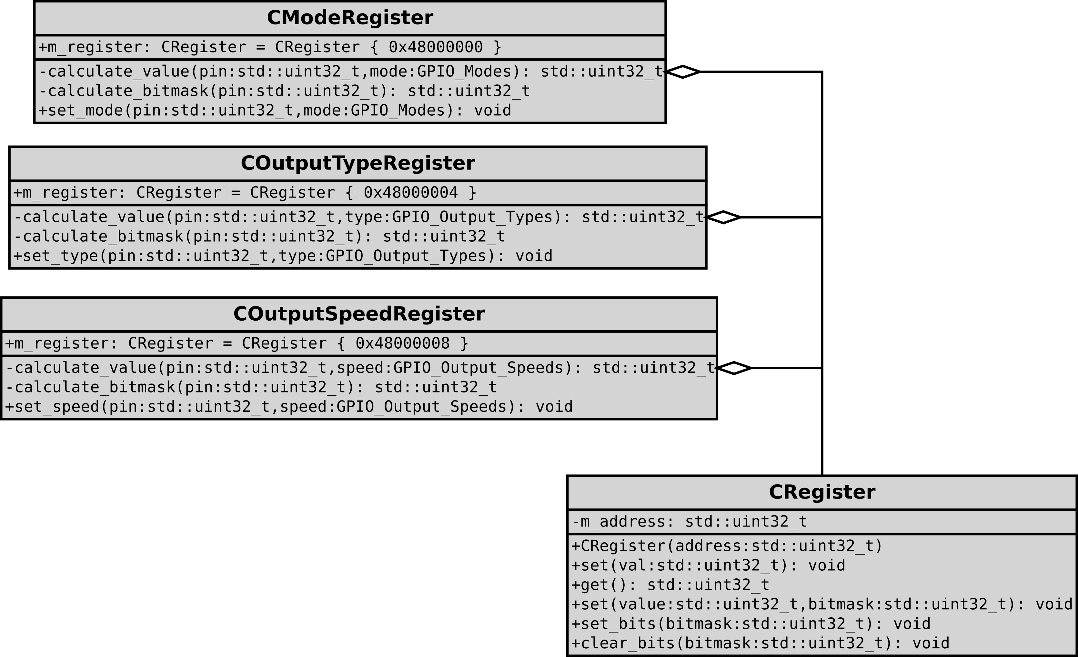
Encapsulation

Slide 30
Encapsulation

Slide 31
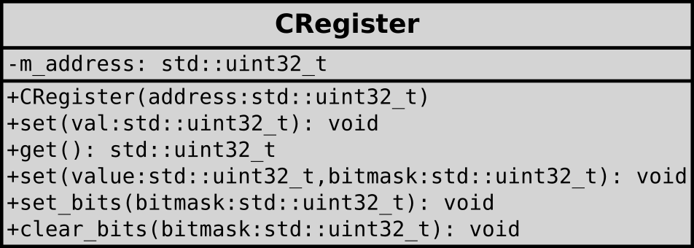
Encapsulation
(basic)
class CRegister {
private:
const std::uint32_t m_address;
public:
CRegister (std::uint32_t address) : m_address(address) { }
void set (std::uint32_t val) const {
*(reinterpret_cast<volatile std::uint32_t *>(m_address)) = val;
}
/* ... */
};

Slide 32
Encapsulation
(basic)
class CRegister {
private:
const std::uint32_t m_address;
public:
CRegister (std::uint32_t address) : m_address(address) { }
void set (std::uint32_t val) const {
*(reinterpret_cast<volatile std::uint32_t *>(m_address)) = val;
}
/* ... */
};

Slide 33
Encapsulation
(basic)
class CRegister {
private:
const std::uint32_t m_address;
public:
CRegister (std::uint32_t address) : m_address(address) { }
void set (std::uint32_t val) const {
*(reinterpret_cast<volatile std::uint32_t *>(m_address)) = val;
}
/* ... */
};

Slide 34
Encapsulation
(basic)
class CRegister {
private:
const std::uint32_t m_address;
public:
CRegister (std::uint32_t address) : m_address(address) { }
void set (std::uint32_t val) const {
*(reinterpret_cast<volatile std::uint32_t *>(m_address)) = val;
}
/* ... */
};

Slide 35
Encapsulation
(basic)
class CRegister {
private:
const std::uint32_t m_address;
public:
CRegister (std::uint32_t address) : m_address(address) { }
void set (std::uint32_t val) const {
*(reinterpret_cast<volatile std::uint32_t *>(m_address)) = val;
}
/* ... */
};
temp = OSPEEDR;
temp &= ~(OSPEEDR_MASK << (conf->pin * 2u));
temp |= (conf->speed << (conf->pin * 2u));
OSPEEDR = temp;

Slide 36
Encapsulation

Slide 37
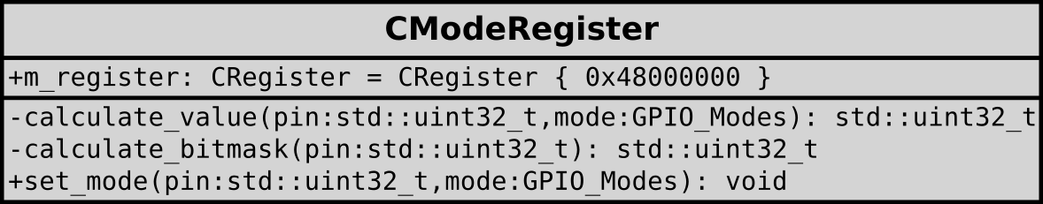
Encapsulation
(basic)
class CModeRegister {
private:
const CRegister m_register { 0x48000000 };
inline std::uint32_t calculate_value (std::uint32_t pin, GPIO_Modes mode) {
return (mode & GPIO_MODE) << (pin * 2);
}
inline std::uint32_t calculate_bitmask (std::uint32_t pin) {
return MODER_MASK << (pin * 2);
}
public:
inline void set_mode (std::uint32_t pin, GPIO_Modes mode) {
m_register.set(calculate_value(pin, mode), calculate_bitmask(pin));
}
};

Slide 38
Encapsulation
(basic)
class CModeRegister {
private:
const CRegister m_register { 0x48000000 };
inline std::uint32_t calculate_value (std::uint32_t pin, GPIO_Modes mode) {
return (mode & GPIO_MODE) << (pin * 2);
}
inline std::uint32_t calculate_bitmask (std::uint32_t pin) {
return MODER_MASK << (pin * 2);
}
public:
inline void set_mode (std::uint32_t pin, GPIO_Modes mode) {
m_register.set(calculate_value(pin, mode), calculate_bitmask(pin));
}
};

Slide 39
Encapsulation
(basic)
class CModeRegister {
private:
const CRegister m_register { 0x48000000 };
inline std::uint32_t calculate_value (std::uint32_t pin, GPIO_Modes mode) {
return (mode & GPIO_MODE) << (pin * 2);
}
inline std::uint32_t calculate_bitmask (std::uint32_t pin) {
return MODER_MASK << (pin * 2);
}
public:
inline void set_mode (std::uint32_t pin, GPIO_Modes mode) {
m_register.set(calculate_value(pin, mode), calculate_bitmask(pin));
}
};

Slide 40
Encapsulation
(basic)
class CModeRegister {
private:
const CRegister m_register { 0x48000000 };
inline std::uint32_t calculate_value (std::uint32_t pin, GPIO_Modes mode) {
return (mode & GPIO_MODE) << (pin * 2);
}
inline std::uint32_t calculate_bitmask (std::uint32_t pin) {
return MODER_MASK << (pin * 2);
}
public:
inline void set_mode (std::uint32_t pin, GPIO_Modes mode) {
m_register.set(calculate_value(pin, mode), calculate_bitmask(pin));
}
};

Slide 41
Encapsulation
(basic)
temp = OSPEEDR;
temp &= ~(OSPEEDR_MASK << (conf->pin * 2u));
temp |= (conf->speed << (conf->pin * 2u));
OSPEEDR = temp;
class CModeRegister {
private:
const CRegister m_register { 0x48000000 };
inline std::uint32_t calculate_value (std::uint32_t pin, GPIO_Modes mode) {
return (mode & GPIO_MODE) << (pin * 2);
}
inline std::uint32_t calculate_bitmask (std::uint32_t pin) {
return MODER_MASK << (pin * 2);
}
public:
inline void set_mode (std::uint32_t pin, GPIO_Modes mode) {
m_register.set(calculate_value(pin, mode), calculate_bitmask(pin));
}
};

Slide 42
Encapsulation
(basic)
void GPIO_Init(GPIO_InitStruct* conf) {
/* ... */
if (conf->mode == GPIO_MODE_OUTPUT) {
temp = OSPEEDR;
temp &= ~(OSPEEDR_MASK << (conf->pin * 2u));
temp |= (conf->speed << (conf->pin * 2u));
OSPEEDR = temp;
temp = OTYPER;
temp &= ~(OTYPER_MASK << conf->pin);
temp |= (((conf->type & GPIO_OUTPUT_TYPE) >> 4u)
<< conf->pin);
OTYPER = temp;
}
temp = MODER;
temp &= ~(MODER_MASK << (conf->pin * 2u));
temp |= ((conf->mode & GPIO_MODE) << (conf->pin * 2u));
MODER = temp;
/* ... */
}
void GPIO_Init(GPIO_InitStruct* conf) {
/* ... */
if (conf->mode == GPIO_MODE_OUTPUT) {
COutputSpeedRegister ospeedr {};
ospeedr.set_speed(conf->pin, conf->speed);
COutputTypeRegister otyper {};
otyper.set_type(conf->pin, conf->type);
}
CModeRegister moder {};
moder.set_mode(conf->pin, conf->mode);
/* ... */
}

Slide 43

Encapsulation
(basic)
Compiles to the same binary.
TODO : compilation time?

Slide 44
Encapsulation
(static)
void GPIO_Init(GPIO_InitStruct* conf) {
/* check the values */
if (!IS_GPIO_PIN(conf->pin)) { return; }
if (!IS_GPIO_MODE(conf->mode)) { return; }
/* configure the GPIO based on the settings */
if (conf->mode == GPIO_MODE_OUTPUT) {
COutputSpeedRegister::set_speed(conf->pin, conf->speed);
COutputTypeRegister::set_type(conf->pin, conf->type);
}
CModeRegister::set_mode(conf->pin, conf->mode);
/* ... */
}

Slide 45
Encapsulation
(static)
class CModeRegister {
private:
static inline const CRegister m_register { 0x48000000 };
static inline std::uint32_t calculate_value (std::uint32_t pin, GPIO_Modes mode) {
return (mode & GPIO_MODE) << (pin * 2);
}
static inline std::uint32_t calculate_bitmask (std::uint32_t pin) {
return MODER_MASK << (pin * 2);
}
public:
static inline void set_mode (std::uint32_t pin, GPIO_Modes mode) {
m_register.set(calculate_value(pin, mode), calculate_bitmask(pin));
}
};

Slide 46
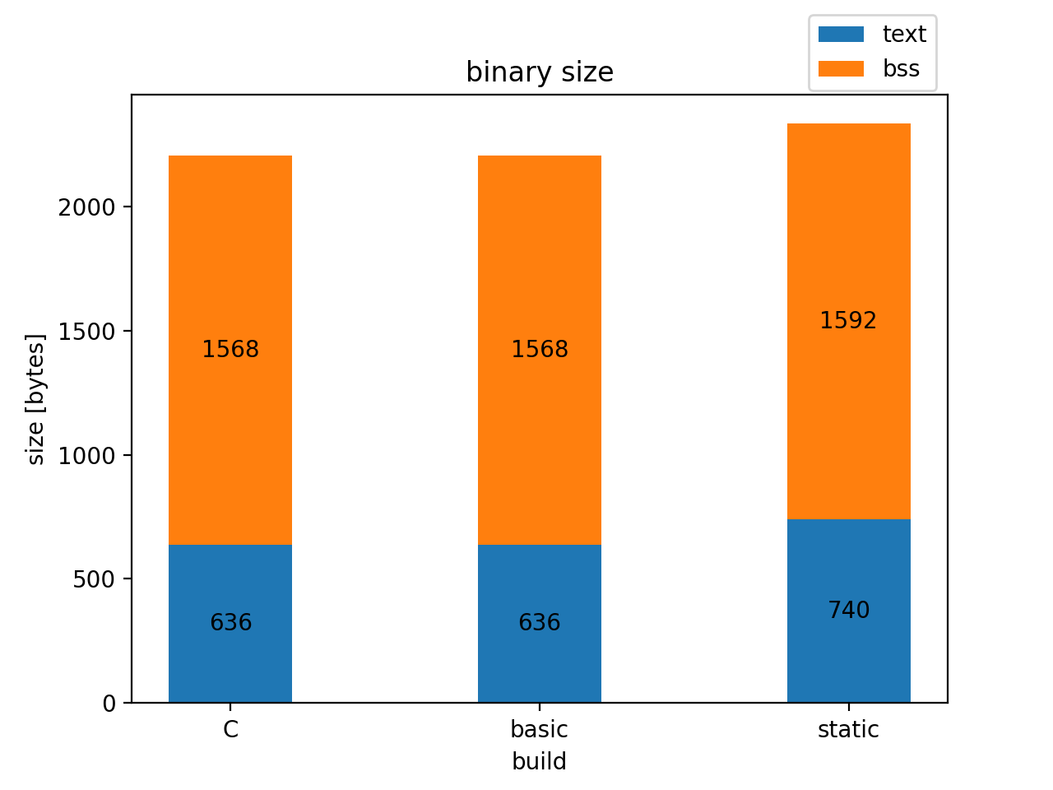
Encapsulation
(static)
Binary size increase… why?

Slide 47
Encapsulation
(static)
_GLOBAL__sub_I__Z9GPIO_InitP15GPIO_InitStruct
Objects with static storage duration need to be initialized before the main function starts executing.
This function initializes the static CRegister objects and loads the values used in the static member functions of the register classes.
Does not affect runtime performance, as it executes before the main function, but it increases binary size.

Slide 48
Encapsulation
(static & template)
template <std::uint32_t address>
class CRegister {
public:
void set (std::uint32_t val) const {
*(reinterpret_cast<volatile std::uint32_t *>(address)) = val;
}
/* ... */
};

Slide 49
Encapsulation
(static & template)
class CModeRegister {
private:
static inline const CRegister m_register { 0x48000000 };
/* ... */
};
class CModeRegister {
private:
static inline const CRegister<0x48000000> m_register { };
/* ... */
};

Slide 50
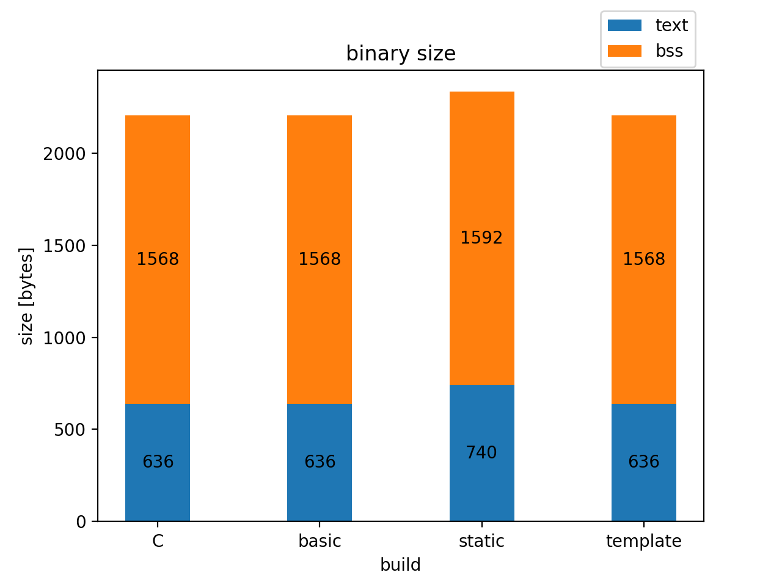
Encapsulation
(static & template)
Binary size is back to the original.
Each CRegister instance is fully defined at compile time.
No global state that needs to be explicitly initialized before main.
Compiler can better optimize the code at compile time.

Slide 51
Inheritance
class COutputSpeedRegister : public CRegister<0x48000008> {
private:
static inline std::uint32_t calculate_value (std::uint32_t pin, GPIO_Output_Speeds speed) {
return speed << (pin * 2);
}
static inline std::uint32_t calculate_bitmask (std::uint32_t pin) {
return OSPEEDR_MASK << (pin * 2);
}
public:
static inline void set_speed (std::uint32_t pin, GPIO_Output_Speeds speed) {
set(calculate_value(pin, speed), calculate_bitmask(pin));
}
};

Slide 52
Inheritance
Compiles to the same binary.

Slide 53
Moving Higher
Microcontroller
Peripheral

Slide 54
Moving Higher
Microcontroller
Peripheral
STM32
External Peripheral Interface
ESP32
HAL
PIC32

Slide 55
Moving Higher
Microcontroller
Peripheral
External Peripheral Interface
STM32
ESP32
HAL
PIC32

Slide 56
Moving Higher
Microcontroller
Peripheral
Dynamic Polymorphism
External Peripheral Interface
STM32
interfaces
ESP32
HAL
PIC32
realizations

Slide 57
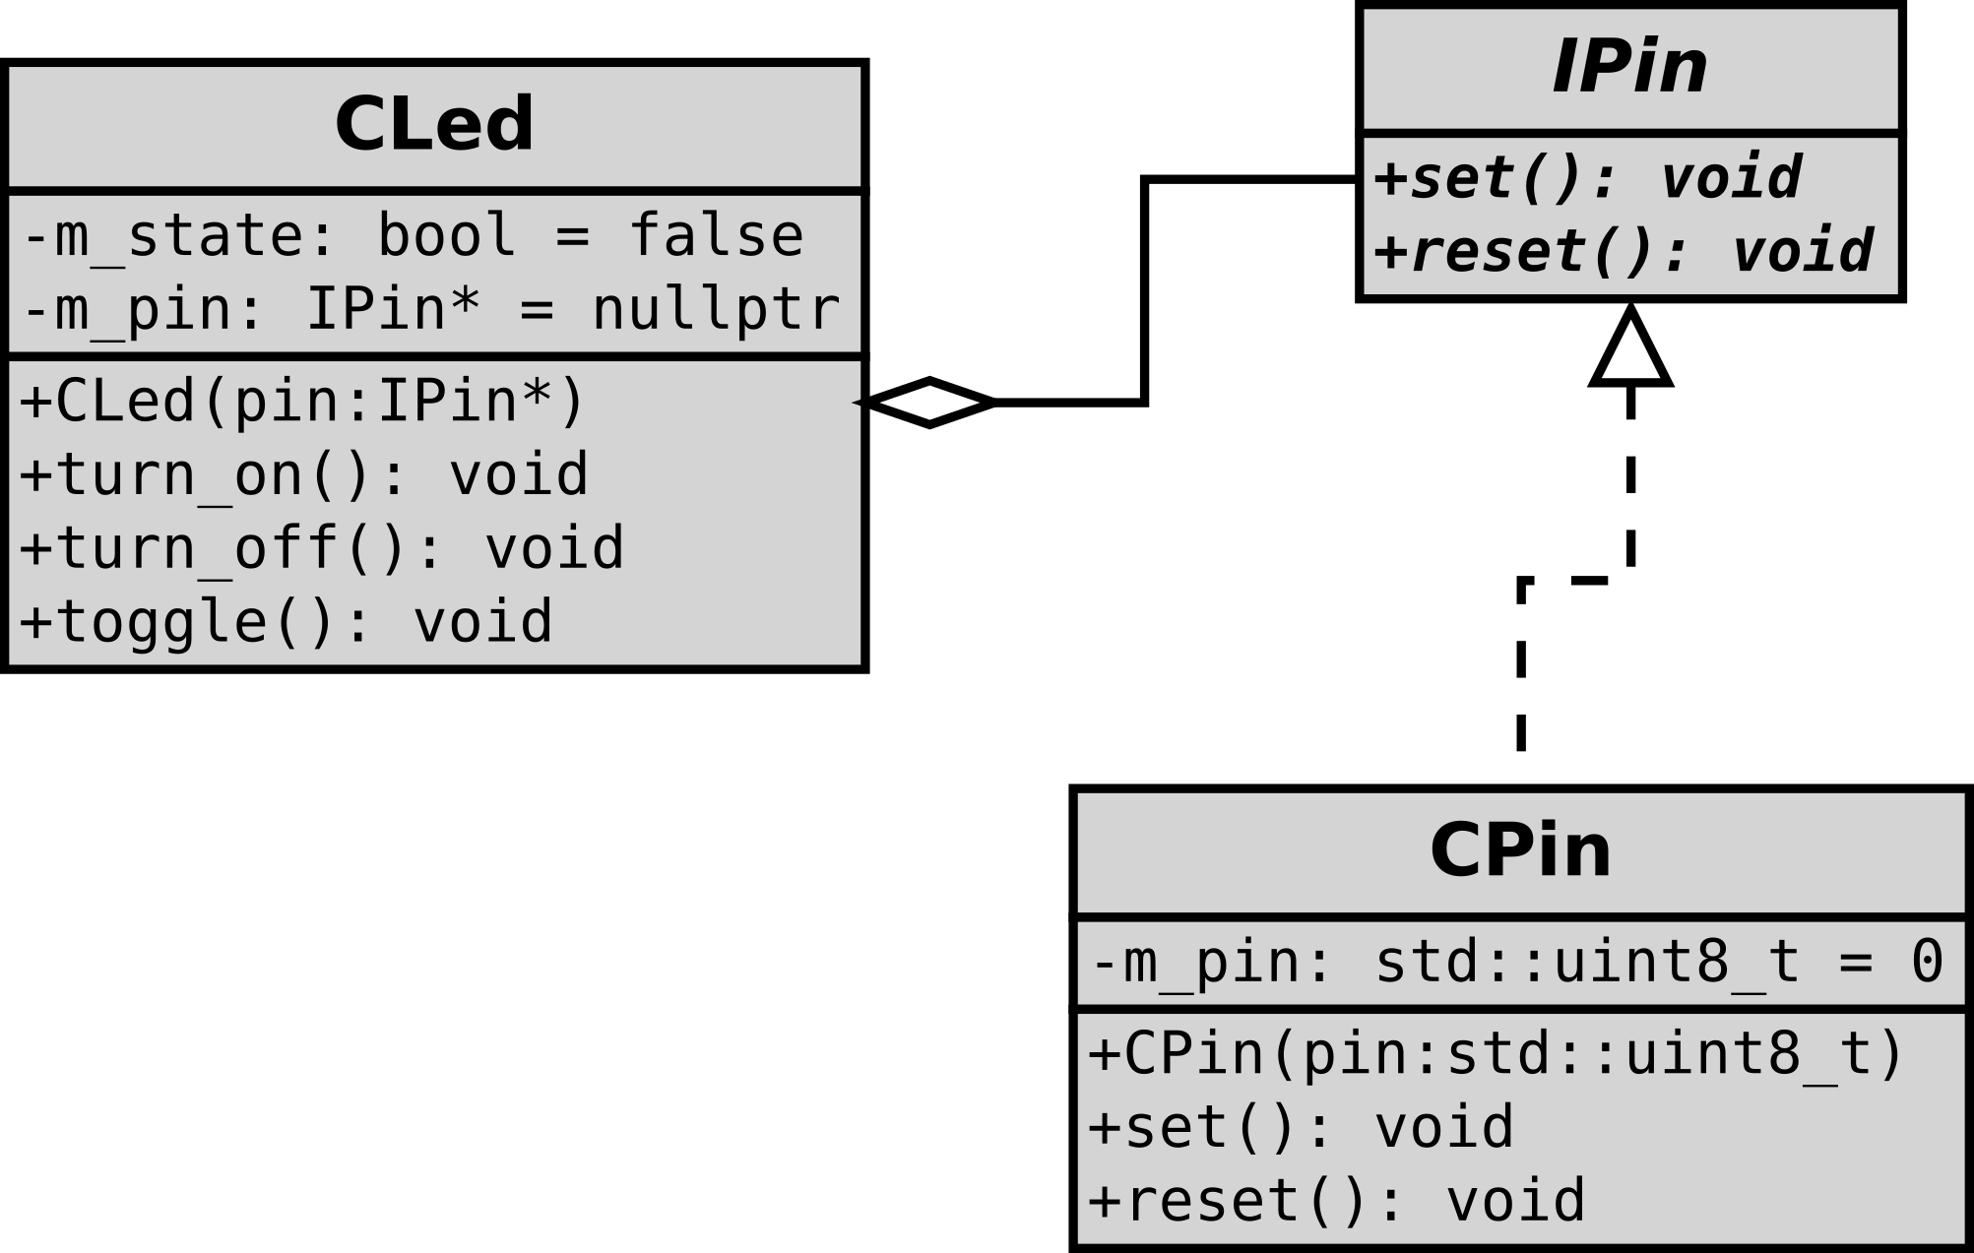
Dynamic Polymorphism
class IPin {
public:
virtual void set () = 0;
virtual void reset () = 0;
};

Slide 58
Dynamic Polymorphism
class CLed {
private:
bool m_state { false };
IPin* m_pin { nullptr };
public:
CLed () = delete;
CLed (IPin* pin) : m_pin(pin) {
m_pin->reset();
}
/* ... */
};

Slide 59
Dynamic Polymorphism
class CPin : public IPin {
private:
std::uint8_t m_pin { 0 };
public:
CPin () = delete;
CPin (std::uint8_t pin) : m_pin(pin) {}
void set () override {
CBitSetResetRegister::set_pin(m_pin);
}
void reset () override {
CBitSetResetRegister::reset_pin(m_pin);
}
};

Slide 60
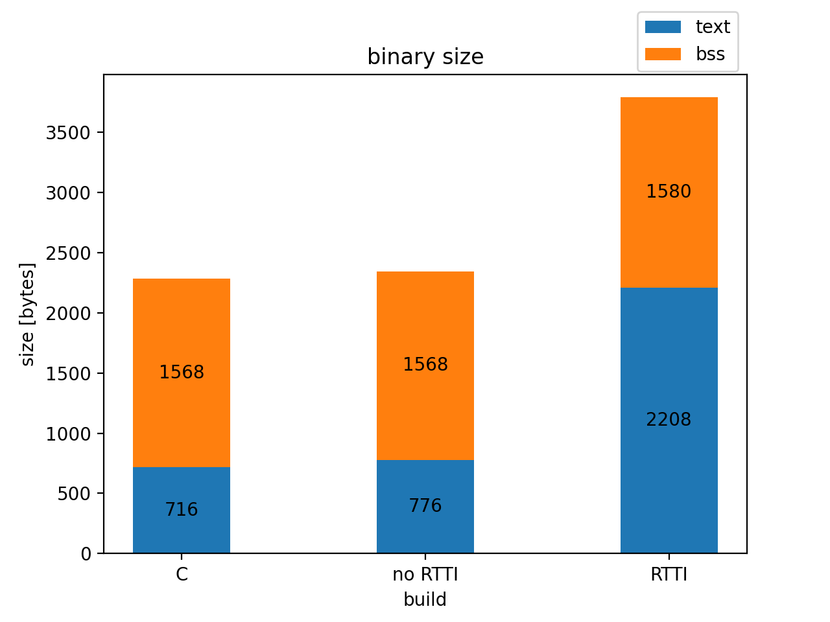
Dynamic Polymorphism

Slide 61
Dynamic Polymorphism
To RTTI, or not to RTTI...
Run-Time Type Information
_type_info sections in the binary
Necessary for:
typeid
dynamic_cast

Slide 62
Dynamic Polymorphism
CPin pin { GPIO_PIN_6 };
CLed led { &pin };
while (true) {
led.toggle();
delay(1000);
}
For statically allocated objects, the compiler can often determine the type at compile-time.
-> no virtual function calls (de-virtualization)

Slide 63
Dynamic Polymorphism
without de-virtualization
080001b0 <_ZN4CPin3setEv>: ...
08000198 <_ZN4CPin5resetEv>: ...

Slide 64
Dynamic Polymorphism
without de-virtualization
080001b0 <_ZN4CPin3setEv>: ...
08000198 <_ZN4CPin5resetEv>: ...
CLed vtable
0x08000258 : 0x080001b1
0x0800025c : 0x08000199

Slide 65
Dynamic Polymorphism
without de-virtualization
080001b0 <_ZN4CPin3setEv>: ...
08000198 <_ZN4CPin5resetEv>: ...
<main>:
push {r0, r1, r2, lr}
ldr r3, [pc, #28] ; (80001e4 <main+0x20>)
mov r2, sp
str r3, [sp, #0]
movs r3, #6
strb r3, [r2, #4]
ldr r3, [sp, #0]
mov r0, sp
ldr r3, [r3, #0]
blx r3
ldr r3, [sp, #0]
mov r0, sp
ldr r3, [r3, #4]
blx r3
b.n 80001d0 <main+0xc>
Nop ; (mov r8, r8)
.word 0x08000258
CLed vtable
0x08000258 : 0x080001b1
0x0800025c : 0x08000199

Slide 66
Dynamic Polymorphism
without de-virtualization
080001b0 <_ZN4CPin3setEv>: ...
08000198 <_ZN4CPin5resetEv>: ...
<main>:
push {r0, r1, r2, lr}
ldr r3, [pc, #28] ; (80001e4 <main+0x20>)
mov r2, sp
str r3, [sp, #0]
movs r3, #6
strb r3, [r2, #4]
ldr r3, [sp, #0]
mov r0, sp
ldr r3, [r3, #0]
blx r3
ldr r3, [sp, #0]
mov r0, sp
ldr r3, [r3, #4]
blx r3
b.n 80001d0 <main+0xc>
Nop ; (mov r8, r8)
.word 0x08000258
CLed vtable
0x08000258 : 0x080001b1
0x0800025c : 0x08000199
Load the vtable address in r3.

Slide 67
Dynamic Polymorphism
without de-virtualization
080001b0 <_ZN4CPin3setEv>: ...
08000198 <_ZN4CPin5resetEv>: ...
<main>:
push {r0, r1, r2, lr}
ldr r3, [pc, #28] ; (80001e4 <main+0x20>)
mov r2, sp
str r3, [sp, #0]
movs r3, #6
strb r3, [r2, #4]
ldr r3, [sp, #0]
mov r0, sp
ldr r3, [r3, #0]
blx r3
ldr r3, [sp, #0]
mov r0, sp
ldr r3, [r3, #4]
blx r3
b.n 80001d0 <main+0xc>
Nop ; (mov r8, r8)
.word 0x08000258
CLed vtable
0x08000258 : 0x080001b1
0x0800025c : 0x08000199
Load the address of the reset method from the vtable into r3.

Slide 68
Dynamic Polymorphism
without de-virtualization
080001b0 <_ZN4CPin3setEv>: ...
08000198 <_ZN4CPin5resetEv>: ...
<main>:
push {r0, r1, r2, lr}
ldr r3, [pc, #28] ; (80001e4 <main+0x20>)
mov r2, sp
str r3, [sp, #0]
movs r3, #6
strb r3, [r2, #4]
ldr r3, [sp, #0]
mov r0, sp
ldr r3, [r3, #0]
blx r3
ldr r3, [sp, #0]
mov r0, sp
ldr r3, [r3, #4]
blx r3
b.n 80001d0 <main+0xc>
Nop ; (mov r8, r8)
.word 0x08000258
CLed vtable
0x08000258 : 0x080001b1
0x0800025c : 0x08000199
Call the reset method via the address in r3.

Slide 69
Dynamic Polymorphism
without de-virtualization
080001b0 <_ZN4CPin3setEv>: ...
08000198 <_ZN4CPin5resetEv>: ...
<main>:
push {r0, r1, r2, lr}
ldr r3, [pc, #28] ; (80001e4 <main+0x20>)
mov r2, sp
str r3, [sp, #0]
movs r3, #6
strb r3, [r2, #4]
ldr r3, [sp, #0]
mov r0, sp
ldr r3, [r3, #0]
blx r3
ldr r3, [sp, #0]
mov r0, sp
ldr r3, [r3, #4]
blx r3
b.n 80001d0 <main+0xc>
Nop ; (mov r8, r8)
.word 0x08000258
CLed vtable
0x08000258 : 0x080001b1
0x0800025c : 0x08000199
Load the address of the set method from the vtable into r3.

Slide 70
Dynamic Polymorphism
without de-virtualization
080001b0 <_ZN4CPin3setEv>: ...
08000198 <_ZN4CPin5resetEv>: ...
<main>:
push {r0, r1, r2, lr}
ldr r3, [pc, #28] ; (80001e4 <main+0x20>)
mov r2, sp
str r3, [sp, #0]
movs r3, #6
strb r3, [r2, #4]
ldr r3, [sp, #0]
mov r0, sp
ldr r3, [r3, #0]
blx r3
ldr r3, [sp, #0]
mov r0, sp
ldr r3, [r3, #4]
blx r3
b.n 80001d0 <main+0xc>
Nop ; (mov r8, r8)
.word 0x08000258
CLed vtable
0x08000258 : 0x080001b1
0x0800025c : 0x08000199
Call the set method via the address in r3.

Slide 71
Recap
Microcontroller
Peripheral
External Peripheral Interface
STM32
ESP32
HAL
PIC32

Slide 72
Static Polymorphism
Microcontroller
Peripheral
Static Polymorphism
External Peripheral Interface
STM32
Interfaces using concepts
ESP32
HAL
PIC32
Implementations that satisfy the requirements

Slide 73
Static Polymorphism
template <typename T>
concept IPin = requires (T pin) {
{ pin.set() } -> std::same_as<void>;
{ pin.reset() } -> std::same_as<void>;
};

Slide 74
Static Polymorphism
template <IPin TPin>
class CLed {
private:
bool m_state { false };
TPin* m_pin { nullptr };
public:
CLed () = delete;
CLed (TPin* pin) : m_pin(pin) {
m_pin->reset();
}
/* ... */
};

Slide 75
Static Polymorphism
class CPin {
private:
std::uint8_t m_pin { 0 };
public:
CPin () = delete;
CPin (std::uint8_t pin) : m_pin(pin) {}
void set () override {
CBitSetResetRegister::set_pin(m_pin);
}
void reset () override {
CBitSetResetRegister::reset_pin(m_pin);
}
};
static_assert(IPin<CPin>); // optional

Slide 76
Static Polymorphism
Compiles to the same binary.

Slide 77
Inefficiencies in HAL
Runtime bitmask calculations
Runtime branching
Function calls
Runtime input validation

Slide 78

Inefficiencies in HAL
Runtime bitmask calculations
Runtime branching
Function calls
Runtime input validation

Slide 79
Notes
This is about the “special” cases where the hardware is known, which is common for embedded systems.
I did not replace the HAL given by the manufacturer, I extended it.
The same techniques can be used in any other application as well, if the circumstances allow it.
These are no guidelines or rules.

Slide 80
Enumerations
enum class modes : std::uint32_t {
input = 0b00,
output = 0b01,
alt_func = 0b10,
analog = 0b11
};
Enumerations
Not plain integers anymore
No implicit conversions between enum values and integral types
Explicit static_cast required
Harder to misuse accidentally
enum class ports : std::uint8_t {
port_f,
port_d,
port_c,
port_b,
port_a
};

Slide 81
Concepts
template <modes mode>
concept is_valid_mode = (
(mode == modes::input) ||
(mode == modes::output) ||
(mode == modes::alt_func) ||
(mode == modes::analog)
);
template <pins pin>
concept is_valid_pin = (
is_valid_low_pin<pin> || is_valid_high_pin<pin>
);
template <pins... pin>
concept are_valid_pins = (is_valid_pin<pin> && ...);

Slide 82
Immediate Functions
template <modes mode, pins... pin>
requires (are_valid_pins<pin ...> && is_valid_mode<mode>)
consteval std::uint32_t moder_value () {
return (... | (static_cast<std::uint32_t>(mode) <<
(static_cast<std::uint32_t>(pin) * 2)));
}
template <pins... pin>
requires (are_valid_pins<pin ...>)
consteval std::uint32_t moder_bitmask () {
return (... | (GPIO_MODER_MODER0 <<
(static_cast<std::uint32_t>(pin) * 2)));
}

Slide 83
Compile-time Branching

Slide 84
Measurement

