Slide 1

Regular Expressions
Ganna Androsova
07.01.2015

Slide 2
What is a regular expression?
A regular expression (regex) is simply a way of describing text.
When do we use it?
For testing if a string has a specific character, word, or phrase
Examples:
“Are there any letter characters in my string?”
“Do I have word ‘identifier’ in my data?”
/^(.+?):\/\/([^\/]+)\/(?:(.*?)(?:\?(.*))?|)$/s

Slide 3

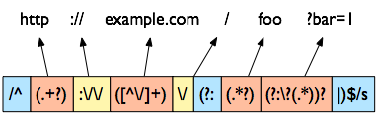
What is a regular expression?
/^(.+?):\/\/([^\/]+)\/(?:(.*?)(?:\?(.*))?|)$/s

Slide 4
Objectives
To learn reading of the regular expressions (regexes)
To write your own regexes

Slide 5
/red/
m{red}

Slide 6
Exercise
my $string = ‘red riding hood’;
if ($string =~ /red/) {
print “$string has ‘red’ in it!’;
}

Slide 7
Explanation
If you want to look for the pattern -> use the bind operator
if ($string =~ /red/) {die}
looks for ‘red’ in $string
The bind operator is in no way similar to the ‘=‘
= is assignment,
== is equality,
=~ is bind.

Slide 8
/red/
barred
redis
tired
caught red handed
red, purple, and blue shirt

Slide 9
Match a word boundary.
To match word boundary place \b at the start and the end of the word.
/\bred\b/
barred
redis
tired
caught red handed
red, purple, and blue shirt

Slide 10
Match the beginning of the line.
To match word boundary place \b at the start and the end of the word.
/^red\b/
barred
redis
tired
caught red handed
red, purple, and blue shirt

Slide 11
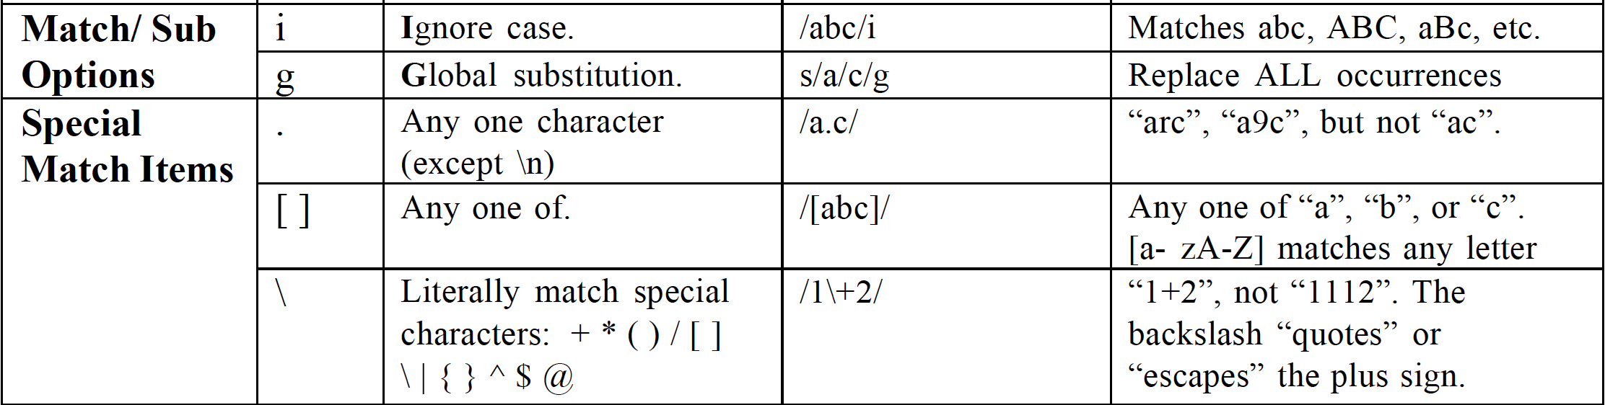
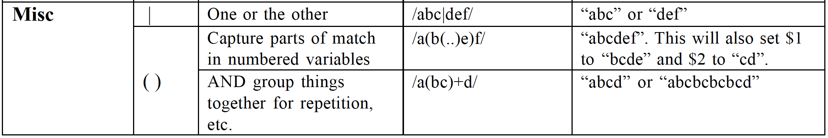
Metacharacters
Exclude something from search pattern: [^ ]
[abc] – match “a”, “b” or “c”
[^abc] – match something except “a”, “b” or “c”

Slide 12
Grouping
You can group elements together with parentheses
/cat+/ matches cat, catt, cattt
/(cat)+/ matches cat, catcat, catcatcat

Slide 13
Alternation
You can specify patterns which match either one thing or another.
/cat|dog/ matches either ‘cat’ or ‘dog’
/ca(t|d)og/ matches either ‘catog’ or ‘cadog’

Slide 14
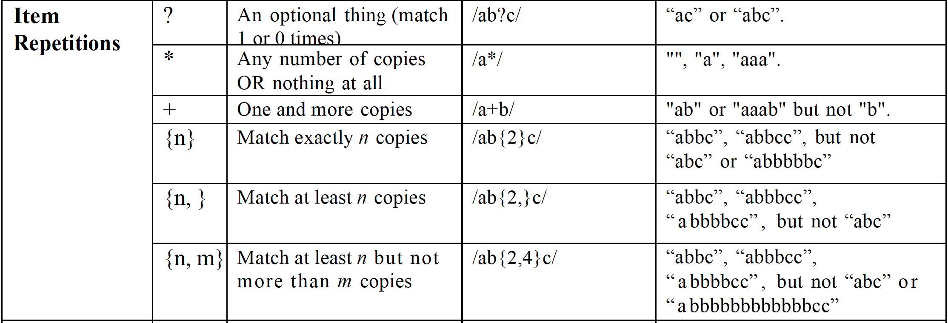
Quantifiers

Slide 15
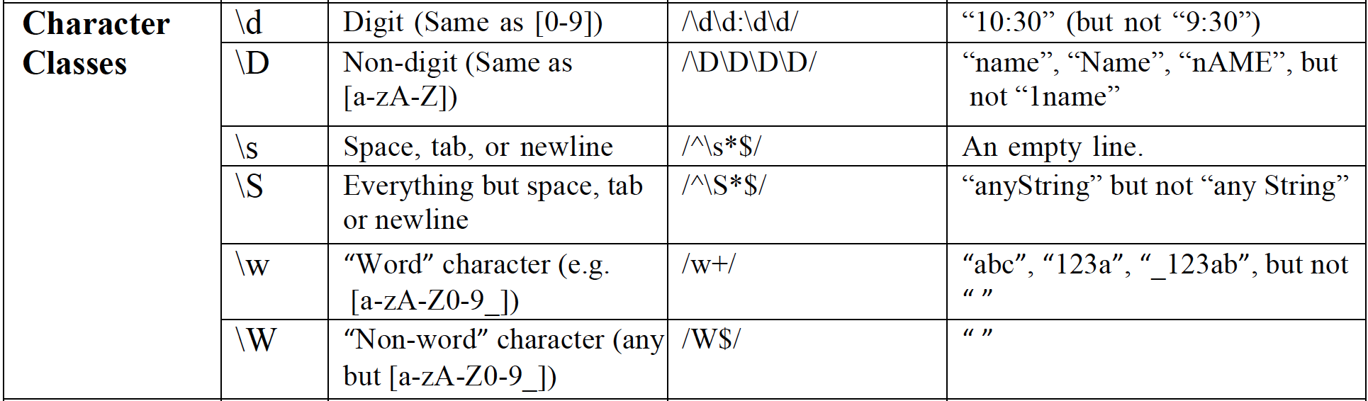
Character Classes

Slide 16
Precedence
Just like with mathematical operations, regular expressions have an order of precedence
Highest : Parentheses and grouping
Next : Repetition (+,*, {4})
Next : Sequence (/abc/)
Lowest : Alternation ( | )

Slide 17
Get a site adress out of an HTML Document
<html> <head> <title>Example.com</title>
</head>
<body>Hello world!</body>
</html>
What we will need:
( ) To capture and return the title.
. To match any character (except newline).
* To match zero or more times.
\ To escape what would normally not be a literal character.

Slide 18
/<title>/
<html> <head> <title>Example.com</title>
</head>
<body>Hello world!</body>
</html>

Slide 19
/<title>./
<html> <head> <title>Example.com</title>
</head>
<body>Hello world!</body>
</html>

Slide 20
/<title>.*/
<html> <head> <title>Example.com</title>
</head>
<body>Hello world!</body>
</html>

Slide 21
/<title>(.*)/
<html> <head> <title>Example.com</title>
</head>
<body>Hello world!</body>
</html>

Slide 22
/<title>(.*)<\/title>/
<html> <head> <title>Example.com</title>
</head>
<body>Hello world!</body>
</html>

Slide 23
m{<title>(.*)<\/title>}
<html> <head> <title>Example.com</title>
</head>
<body>Hello world!</body>
</html>

Slide 24
Result
#!usr/bin/perl
my $html = “<html>\t<head>\n<title>Example.com</title>\n</head>\n<body>Hello world!</body>\n</html>”;
$html =~ m{<title>(.*)<\/title>};
print “The title is $1\n”;

Slide 25
Variable interpolation
You can put variables into your pattern.
my $string = ‘cat’;
/$string/ matches ‘cat’
/$string+/ matches ‘cat’, ‘catcat’, etc.
/\d{2}$string+/ matches ‘12cat’, ‘24catcat’, etc.

Slide 26
Remembering Stuff
Being able to match patterns is good, but limited.
We want to be able to keep portions of the regular expression for later.
Example: $string = ‘phone: 353-7236’
We want to keep the phone number only
Just figuring out that the string contains a phone number is insufficient, we need to keep the number as well.

Slide 27
Memory Parentheses (pattern memory)
Since we almost always want to keep portions of the string we have matched, there is a mechanism built into perl.
Anything in parentheses within the regular expression is kept in memory.
‘phone: 353-7236’ =~ /phone: (.+)$/;
Perl knows we want to keep everything that matches ‘.+’ in the above pattern

Slide 28
Getting at pattern memory
Perl stores the matches in a series of default variables. The first parentheses set goes into $1, second into $2, etc.
This is why we can’t name variables ${digit}
Memory variables are created only in the amounts needed. If you have three sets of parentheses, you have ($1, $2, $3).
Memory variables are only valid in the current scope

Slide 29
An example of pattern memory
my $string = ‘phone: 353-7236’;
if ($string =~ /^phone: (\d{3}-\d{4})$/){
$phone_number = $1;
}
You can assign pattern memory directly to your own variable names:
my ($phone) = $value =~ /^phone: (.+)$/;
Read from right to left. Bind (apply) this pattern to the value in $value, and assign the results to the list on the left
my ($front,$back) = /^phone: (\d{3})-(\d{4})/;
Bind this pattern to $_ (!!!) and assign the results to the list on the left

Slide 30
Exercise 1
Make regular expression pattern that matches:
Strings containing only a's or b's.
Strings that do not contain white space.
Strings with exactly one word regardless of white space.
Strings that end with the same character they start with.
Like 1. but the number of a's should be even.
Any string.
No string, not even the empty string.

Slide 31
Resulting program
#!/usr/local/bin/perl
# 1. Strings containing only a's and b's.
my $string1 = “ababb”;
if ($string1 =~ /^[ab]*$/){
print “string 1 – success\n”;
}
# 2. Strings that do not contain white space or tab or new line.
my $string2 = “fhrntp4_#05”;
if ($string2 =~ /^\S*$/){
print “string 2 – success\n”;
}
# 3. Strings with exactly one word regardless of white space.
my $string3 = “red ”;
if ($string3 =~ /^\s*\w+\s*$/){
print “string 3 – success\n”;
}
# 4. Strings that end with the same character they start with.
my $string4 = “There was a caT”;
if ($string4 =~ /^(.)/){
my $search = $1;
if ($string4 =~ /$search$/){
print "string 4 – success\n";
print "$search\n";
}else{
print "false\n";
}
}
# 5. Strings containing only a's and b’s, but the number of a's should be even.
my $string5 = “ababbbbaba”;
if ($string5 =~ /^(b*ab*ab*)*$/){
print “string 5 – success\n”;
}
# 6. Any string
my $string6 = “ This is #any string!”;
if ($string6 =~ /.*/){
print “string 6 – success\n”;
}
# 7. No string, not even the empty string.
my $string7 = “”;
if ($string7 =~ /[^\w\W]/){
print “string 7 – success\n”;
}

Slide 32
Function split
split is a very useful function
Takes a string and splits it into an array
You choose what character (or characters) to split on
split (/pattern/, string)
where pattern is what to split on and string is what to split
the split function returns a list

Slide 33
Function split
my @array = split (/\s/,$string); or
my @array = split (“\s”, $string); or
my @array = split “\s”; or
my @array = split;
Examples:
split (/\s/, ‘a few words’);
returns a list containing (‘a’, ‘few’, ‘words’)
split (/x/, ‘ABxCXxDDxxEFGx’);
returns (‘AB’, ‘CX’, ‘DD’, ‘’, ‘EFG’)
Note that the character you split on is ‘destroyed’ - it doesn’t appear in your list

Slide 34
Function join (anti-split)
join : takes an array as its argument, and returns a string.
join (“pattern”, list);
Example: $string = join (‘;’, @array);
if array contained (‘foo’, 15, ‘bar’)...
$string = ‘foo;15;bar’
Whatever the ‘pattern’ is will the the string in between the array elements.

Slide 35
Substitute Function
Substitution operator
s/pattern/substitution/options
my $string = "abc123def";
$string =~ s/123/456/
Result: "abc456def”
$string =~ s/123//
Result: "abcdef”
$string =~ s/(\d+)/[$1]/
Result: "abc[123]def“
Use of backreference!

Slide 36
Translate Function
translate or transliterate
tr/characterlist1/characterlist2/;
substitutes characters in the first list with characters in the second list
$string =~ tr/a/A/; # changes every ‘a’ to an ‘A’
No need for the g modifier when using tr.

Slide 37
The grep function
The grep function searches for patterns in an array. The syntax for Perl’s grep is: grep(/pattern/, @list);
For example, to find all the elements with the pattern “day” in the array: @days = (“week-end”, “Monday”, “Tuesday”);
you would issue the command: @result = grep (/day/, @days); which will populate the array @result with the matching elements (@result will contain “Monday” and “Tuesday”).

Slide 38
How grep works
The Perl grep works by proceeding through an array, one element at a time, and assigning the element to the default variable $_. The pattern to be found is then compared against $_.
If the pattern is found in $_, the expression is true and the element is returned by grep.
If the pattern is not found, the element is not returned by grep.

Slide 39
Exercise 2
For each of the strings (a)–(e), choose which of the patterns
(1–10) it matches.
/[a-z]/
/\W+/
/\W$/
/^\w+$/
/^[^\w+]$/
/\d/
/﻿(.+)\s*\d/
/﻿\(.+\)\\s*\d/
/\DOS/
/DOS\\/
the brown fox
(b) The Sea!
(c) (.+)\s*\1
(d) 00100
(e) C:\DOS\PATH\NAME

Slide 40
Exercise 2 - Solution
#!usr/bin/perl
use strict;
#Un-comment any line you would like to test
my $string = 'the brown fox';
#$string = 'The Sea!';
#$string = '(.+)\s*1\n';
#$string = '00100';
#$string = 'C:\DOS\PATH\NAME';
print "found 1, " if ($string =~ /[a-z]/);
print "found 2, " if ($string =~ /\W+/);
print "found 3, " if($string =~ /\W$/);
print "found 4, " if($string =~ /^\w+$/);
print "found 5, " if($string =~ /^[^\w+]$/);
print "found 6, " if($string =~ /\d/);
print "found 7, " if($string =~ /(.+)\s*\d/);
print "found 8, " if($string =~ /\(.+\)\\s*\d/);
print "found 9, " if($string =~ /\DOS/);
print "found 10, " if($string =~ /DOS\\/);

Slide 41
Exercise 3
Make a hash of below amino acids, where keys are their codons and values are respective molecular weights.
Gly: GGU => 57.05
Leu: CUU => 113.16
Thr: ACC => 101.11
Met: AUG => 131.19
Trp: UGG => 186.21
Lys: AAA => 128.17
Print out the weight of tryptophan.
Print out a list of all of the amino acids sorted by their molecular weights (heaviest to lightest).
Find the molecular weight of peptide with the sequence “MKTLLTLGLL”.

Slide 42
Exercise 3 - Solution
#!usr/bin/perl
use strict;
my %AA = (GGU => 57.05,
CUU => 113.16,
ACC => 101.11,
AUG => 131.19,
UGG => 186.21,
AAA => 128.17);
print $AA{"UGG"};
foreach (sort { $AA{$b} <=> $AA{$a} } keys%AA){
print "$_\n";
}
#sequence of MKTLLTLGLL
print $AA{'AUG'}+$AA{'AAA'}+$AA{'ACC'}+$AA{'CUU'}+$AA{'CUU'}+$AA{'ACC'}+$AA{'CUU'}+$AA{'GGU'}+$AA{'CUU'}+$AA{'CUU'};

Slide 43
Exercise 4
Part 1 Do a search and replace of 'dog' to 'cat', 'cat' to `mouse', and 'mouse' to 'dog' in:
Do dogs eat cats, or does your cat eat a mouse?
Part 2
Part 1 results in the word 'mouses', which is not very good English! Modify your solution to also replace 'cats' with 'mice' .
Hint: We need to distinguish 'cat' from 'cats' .

Slide 44
Exercise 4 - Solution
Part 1
In this case, you cannot do three search-and-replace actions in sequence. However, a single search-and-replace that replaces from a hash will do:
my $work = 'Do dogs eat cats, or does your cat eat a mouse?';
my $text = $work;
my %reps = (dog => 'cat', mouse => 'dog', cat => 'mouse');
my $pattern = join ('|', keys %reps);
$work =~ s/($pattern)/$reps{$1}/g;
print "Original: $text\nResult: $work\n";
The output is shown below:
Original: Do dogs eat cats, or does your cat eat a mouse?
Result: Do cats eat mouses, or does your mouse eat a dog?

Slide 45
Exercise 4 - Solution
Part 2
We need to add the new translation pair, cats => mice, to the hash, but the problem is that we might find 'cat' in 'cats'.
We need to sort the words in the pattern by length, in descending order, which ensures 'cats' is searched for before 'cat'.
%reps = (dog => 'cat', mouse => 'dog', cat => 'mouse', cats => 'mice');
$pattern = join ('|', sort{length($b) <=> length($a)} keys %reps);
$work =~ s/($pattern)/$reps{$1}/g;
print "Original: $text\nResult: $work\n";
The output is now:
Original: Do dogs eat cats, or does your cat eat a mouse?
Result: Do cats eat mice, or does your mouse eat a dog?
It might be easier to indicate the word boundaries, using \b, but that would not work with 'dog' and 'dogs'.

Slide 46
Acknowledgements
NPL Course (2006) “Perl Basics. Perl Tutorial”
Simon Andrews (2007) Course Exercises – v1.1 “Learning to Program With Perl”

