Slide 1
From the shell to Perl
Ganna Androsova
Roland Krause
06.01.2015

Slide 2
What is Perl and why to learn it?
PERL stands for Practical Extraction and Report Language
Easy to learn,
Quick to write a code,
A “glue” language. Ideal for connecting things together, such as a GUI to a number cruncher, or a database to a web server.
Cross-platform usage (Windows, Mac, UNIX),
Open Source – lots of code already available,
Additional programming language for your CV

Slide 3
Objectives of the course
To understand advantages/disadvantages
To write a basic Perl program
To learn Perl variables, functions and syntax
To familiarize with operators in Perl
To familiarize with loop structures
To work on common errors

Slide 4
Objectives of the course
To understand advantages/disadvantages
To write a basic Perl program
To learn Perl variables, functions and syntax
To familiarize with operators in Perl
To familiarize with loop structures
To work on common errors

Slide 5
UNIX shell vs. Perl
Writing portable shell scripts is hard as they rely on external commands;
Perl overcomes portability problems by executing internal functions and modules
Shell scripts tend to be fragile due to changes of the command output format
Shell unexercised code contains more syntax errors as script is not compiled at loading
Perl catches syntax errors at compile time
Shell scripts tend to be slow if they have to create new processes to run external commands
Shell scripts tend to be insecure.
Running an external command in a global environment is less secure than calling an internal function (as in Perl).
Shell has fewer reusable libraries available
Perl has great amount of supported CPAN libraries
Adapted from http://www.perlmonks.org/?node_id=668481

Slide 6
In defense of UNIX shell
Cases when it is better to write scripts in UNIX shell:
If the script must run in a Unix environment in which Perl is not available.
If you "know" the script will always remain very simple and short, less than around 20 lines of code.
If process startup time is significant. Note that shell has a lower startup cost than Perl.
If you're sure the script will "never" need to be ported to Windows.
Adapted from http://www.perlmonks.org/?node_id=668481

Slide 7
Objectives of the course
To understand advantages/disadvantages
To write a basic Perl program
To learn Perl variables, functions and syntax
To familiarize with operators in Perl
To familiarize with loop structures
To work on common errors

Slide 8
Getting Started
1. Check if Perl is installed:
Run command line (Start -> Run -> type: cmd -> Ok)
-> type: perl –v -> should appear a message:
if not installed appears a message:
For Windows: install from
http://www.activestate.com/Products/ActivePerl
Installed on Linux, Mac computers by default

Slide 9
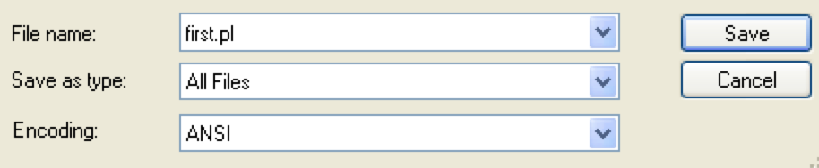
Write your first Perl program
Open Notepad (Start -> All Programs -> Accessories -> Notepad)
Type the first line:
#!/usr/bin/perl
Type next line:
print “My program is working\n”;
Save the file as “first.pl”
(Save as… -> Desktop -> Create new folder called “perl” -> go to this folder
-> in File name field type: first.pl -> in Save as type field choose “All Files”
-> Save)
Any PERL program should start with this line
Important: commands should end with semicolon ‘;’

Slide 10

Run your first Perl program
In command line type:
cd Desktop\perl
-> press “Enter”
Type:
perl first.pl
-> press “Enter”
If you got a message like below
Congratulations! You wrote your first program!
changes the current directory to folder “perl”
stands for “current directory”

Slide 11
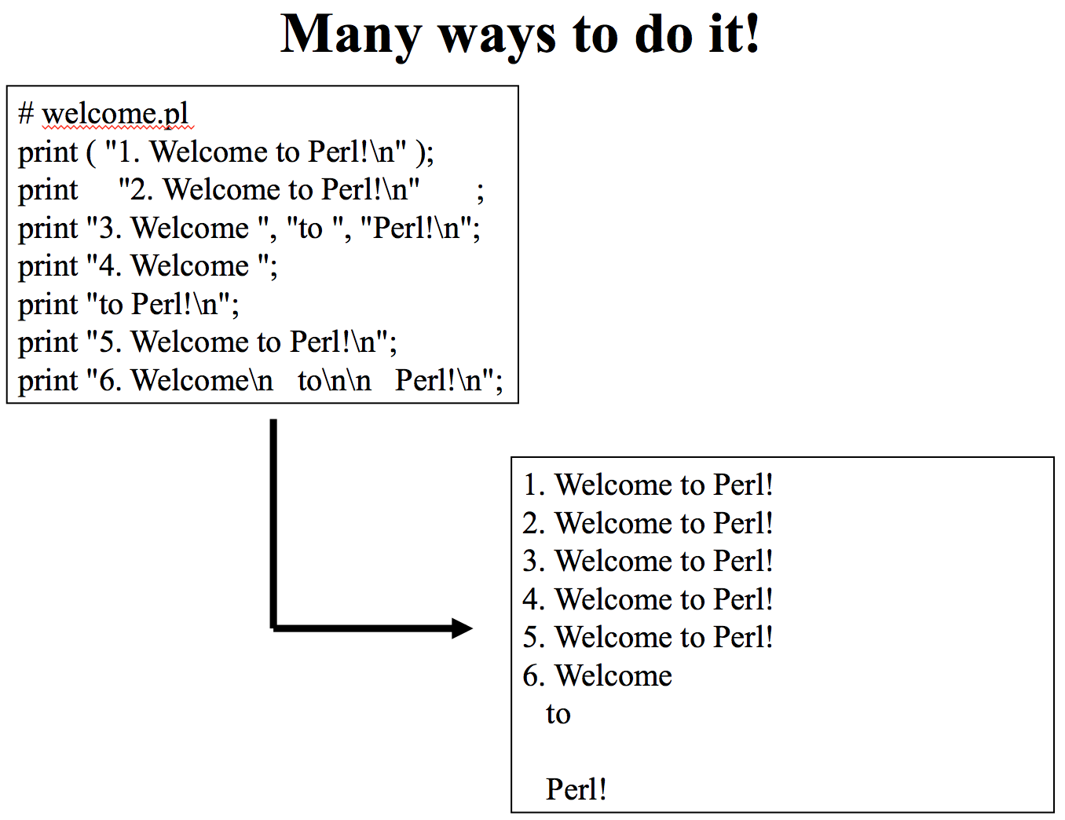
Explanation
Type the first line:
#!/usr/bin/perl
Type next line:
print “My program is working\n”;
Save the file as “first.pl”
is an executive line for any Perl script
makes a new line
print - is a function that print to the screen everything contained inside double quotes (“”)
.pl – is extension of the Perl programs

Slide 12
Objectives of the course
To understand advantages/disadvantages
To write a basic Perl program
To learn Perl syntax, variables and functions
To familiarize with operators in Perl
To familiarize with loop structures
To work on common errors

Slide 13
Basic Syntax
Each PERL program file should start with
#!/usr/bin/perl
To track syntax errors include in your script
use strict;
Commands should end with semicolon ‘;’
Each new variable (scalar, array, hash) should be declared with my
Comments should start with ‘#’
Perl is case sensitive!
print is not the same as Print
$bio is not the same as $Bio

Slide 14
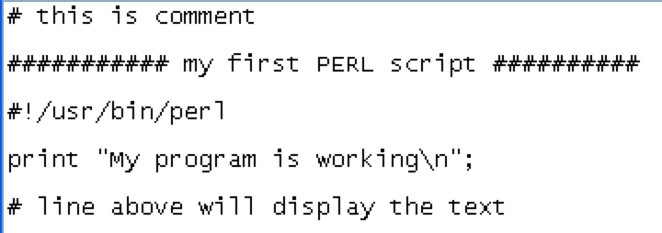
Comments
Any text after ‘#’sign doesn’t do anything
You can add a comments in any part of your script
For example:
when your script runs – comments are not shown
Note: this is not a comment because it has exclamation mark ‘#!’

Slide 15
Scalars
Scalar:
is a single value (can be a text or number)
$e_value = 1e-4;
#any number is quotation is recognized as number not a string
$string = "has spaces and $vars and \n";
$species = ‘’;
Has following rules:
must start with a dollar sign ($),
must not start with a number,
must not contain any space,
may contain any letter (upper or lower case), any number, or‘_’ character,
value is assigned with '=’
value can change during a program
$species = “Jenny”;
$species = “Bob”; # new value substituted the old one

Slide 16
Scalar Names
These are valid names:
$variable
$this_is_a_place_for_my_stuff
$Xvf34_B
These are invalid names:
$2
$another place for my stuff
$push-pull
$%percent

Slide 17
Exercise
#!/usr/bin/perl
use strict;
# create a numeric scalar
my $number = 3;
print “$number\n”;
#create a text scalar
my $text = “This is text”;
print “$text\n”;
# assign value of $text scalar to $number
$number = $text;
print “$number\n”;

Slide 18
The $_ variable
The $_ variable is used by Perl as a default variable.
You can use it in place of variable names in your scripts: $_=“This is a test”; print;
This will print the default variable $_ and display the string.
Don’t save important information in this this variable as it frequently changes its value (and information will be lost).

Slide 19
Perl Functions
Perl functions are identified by their unique names (print, chop, close, etc)
Usage of print function:
print ""; # legal, prints nothing, not even \n
print("Hi", "There"); # prints HiThere
print(Hi); # illegal (calls the function Hi)
print(1+1, 2+2, "\n"); # prints 24 and a new line

Slide 20
Perl Functions
Perl functions are identified by their unique names (print, chomp, chop, close, etc)
Usage of chomp function:
my $string1 = "I am String";
my $retval = chomp( $string1 );// Chomps the last whitespace
print " Chomp String is : $string1\n";
print "Characters Removed : $retval\n";
$string1 = "I am String \n";
$retval = chomp( $string1 ); // Chomps the last whitespace
print " Chomp String is : $string1\n";
print "Characters Removed : $retval\n";

Slide 21
Perl Functions
Perl functions are identified by their unique names (print, chomp, chop, close, etc)
Usage of chop function:
my $string1 = "I am String";
my $retval = chop( $string1 );// Chops the last character
print " Chomp String is : $string1\n";
print "Characters Removed : $retval\n”;

Slide 22
Quoting Strings
Use single quotes to avoid interpolation:
Everything will be interpreted literally
my $example = 5;
print ‘$example’; #prints $example
Use double quotes to interpolate
my $example = 5;
print “$example”; #prints 5
When printing, use escapes (backslash) to print special characters:
print “She said \”Nortel cost \$$cost \@ $time\”.”
Output: She said “Nortel cost $0.01 @ 10:00”.
Special chars are $, @, %, &, \, ”
Another quoting mechanism: qq() and q()
print qq(She said “Nortel cost \$$cost \@ $time”.);
print q(My email is bhecker@acm.org. Please send me $);
Useful for strings full of quotes.

Slide 23
Array
Array name should start with '@’ followed by letter.
Array is an ordered list with several elements
my @array = (1, 2, 3, ‘Jenny’, 6);
Element of array can be addressed by its index (position)
Indexing starts from 0: (‘index 0’, ‘index 1’, ‘index 2’), thus element 1 has
index=0, element 2 has index=1, etc.
print @array; #prints 123Jenny6
print @array[3,4]; # prints a range of values: Jenny6
print $array[0]; #prints specific value: 1
print $array[2], “ ”, $array[3]; #3 Jenny
$array[5] = “Simon”; # adds a new element to array at position 5
To get a size of array use ‘$#’ (gives the last index of array)
$size = $#array + 1; #adding 1 as indexing starts at 0
$size = @array; # same thing
scalar(@array); #same as previous expression

Slide 24
Array Operations
push(@ARRAY, ‘value’);
add the element (‘value’) to the end of the @ARRAY
pop(@ARRAY);
remove and return the last element of @ARRAY
unshift(@ARRAY, ‘value’);
add the the element (‘value’) to the front of @ARRAY
shift(@ARRAY);
remove and return the first element of @ARRAY
scalar(@ARRAY);
return the number of elements in the @ARRAY

Slide 25
Array Exercise
#!/usr/bin/perl
use strict;
# Address an element in the list
@stringInstruments = ("violin","viola","cello","bass");
$biggestInstrument = $stringInstruments[3];
print("The biggest instrument: ", $biggestInstrument);
# Join elements at positions 0, 1, 2 and 4 into a white space delimited string
@brass = ("trumpet","horn","trombone","euphonium","tuba");
print("orchestral brass: ", join(" ",@brass[0,1,2,4]), "\n");
#Sort the list
@unsorted_num = ('3','5','2','1','4');
@sorted_num = sort(@unsorted_num);
print("Numbers (Sorted, 1-5): ”, @sorted_num, "\n");
#Add a few more numbers @numbers_10 = @sorted_num; push(@numbers_10, ('6','7','8','9','10')); print("Numbers (1-10): ”, @numbers_10, "\n"); # Remove the last print("Numbers (1-9): ”, pop(@numbers_10), "\n"); # Remove the first print("Numbers (2-9): ”, shift(@numbers_10), "\n"); # Combine two ops print("Count elements (2-9): ”, $#@numbers_10; # scalar( @numbers_10 ), "\n"); print("What's left (numbers 2-9): ”, @numbers_10, "\n");

Slide 26
Associative Arrays - Hashes
Hash name starts with ‘%’
Hash contains Key-Value pairs
my %hash = (“Country”, “Luxembourg”, “Faculty”, “FSTC”, “Program”, “MISB”);
To improve readability hash is usually written as:
my %hash = (“Country”, “Luxembourg”,
“Faculty”, “FSTC”,
“Program”, “MISB”);
where Country, Faculty, Program are KEYS,
and Luxembourg, FSTC, MISB are respective associated VALUES
Perl allows the use of the => operator, which Perl interprets to mean a double-quoted string and a comma.
my %hash = (Country => Luxembourg,
Faculty => FSTC,
Program => MISB);

Slide 27
Associative Arrays - Hashes
When you have a pair like this: Country => Luxembourg
the left side of the pair is called the hash key, and the right side is the value.
You can use the key to find associated value to it
my %hash = (name => John,
age => 23);
print $hash{name}; #will print John
All hash keys must be unique. If you have more than one hash key the same, the newer entries will overwrite the older ones in the list.
Values do not have to be unique.
Adding a key-value pair to hash:
$hash{‘city’} = (‘Luxembourg’); #hash received one more pair

Slide 28
Hash Operations
keys(%HASH)
return a list of all the keys in the %HASH
values(%HASH)
return a list of all the values in the %HASH
each(%HASH)
iterates through the key-value pairs of the %HASH
delete($HASH{KEY})
removes the key-value pair associated with {KEY} from the HASH

Slide 29
Hash Exercise
#!/usr/bin/perl
use strict;
my %player = “”;
$player{"clarinet"} = "Susan Bartlett";
$player{"basson"} = "Andrew Vandesteeg";
$player{"flute"} = "Heidi Lawson";
$player{"oboe"} = "Jeanine Hassel";
@woodwinds = keys(%player);
@woodwindPlayers = values(%player);
# Who plays the oboe?
print("Oboe: ", $player{'oboe'}, "\n");
$playerCount = scalar(@woodwindPlayers);
while (($instrument, $name) = each(%player)) {
print( "$name plays the $instrument\n" );
}

Slide 30
Same Name, Different Variables
The same name can be reused for scalars, arrays, hashes, subroutine names, file handles, etc..
Each of the following refer to a completely different thing:
$a $A @a %a
scalar
hash
another scalar
array

Slide 31
Objectives of the course
To understand advantages/disadvantages
To write a basic Perl program
To learn Perl syntax, variables and functions
To familiarize with operators in Perl
To familiarize with loop structures
To work on common errors

Slide 32
Operators
. acts on strings only,
! on both strings and numbers,
the rest on numbers only.
$string1 = "potato";
$string2 = "head";
$number = 2;
$newstring = $string1 . $string2; #"potatohead"
$newerstring = $string1 x 2; #"potatopotato"
$string1 .= $string2; #"potatohead”
$number += 3; #5

Slide 33
Increment/Decrement
++ is “magical”. It adds +1 to indicated number or string
if value is purely numeric, works as expected
if string value, or ever used as string, magic happens
‘99’++ ➔ ‘100’
‘a9’++ ➔ ‘b0’
‘Az’++ ➔ ‘Ba’
‘zz’++ ➔ ‘aaa’
-- has the same concept but it decreases a value by 1.

Slide 34
Comparison Operators
Less Than or Equal
Greater Than or Equal
FALSE
TRUE
Do not confuse ‘=‘ with ‘==‘ !
<=> is really only useful when using the ‘sort’ function
print 3 < 5; # 3 is indeed less than 5, resulting in Boolean true denoted
# by 1. Result of printing will 1.
print 3 == 5; # 3 is not equal to 5, resulting in Boolean false.
# Since it is a false statement nothing will be printed out

Slide 35
String Comparison Operators
Sorting an array string-wise:
@sorted = sort {$a cmp $b} @array;
Sorting an array in reverse order:
@sorted = sort {$b cmp $a} @array; #swapping $a and $b changes the sort order
Sorting an array numerically:
@sorted_num = sort {$a <=> $b} @array;

Slide 36
Sort Comparison Operators
Sorting follows a rule:
[current index]
-1 if left is less then right
0 if left equals right
+1 if left is greater than right
$x <=> $y; # denotes numeric sorting
$s cmp $t; #denotes string-wise sorting
Adapted from http://sc.tamu.edu/shortcourses/SC-perl/

Slide 37
What is Truth?
Something is FALSE if:
a) it evaluates to zero
b) it evaluates to ‘’ (empty string)
c) it evaluates to an empty list (@array = “”)
d) the value is undefined (ie. uninitialized variable)
Everything else is TRUE
Statements can also be TRUE or FALSE, and this is generally logical
a) 1 == 2 - false
b) 1 !=2 - true
c) ‘dog’ eq ‘cat’ - false
d) (1+56) <= (2 * 100) – true
e) (1-1) – false! - evaluates to zero
f) ‘0.0’ - true! Tricky.
g) ‘0.0’ + 0 - false! Even trickier.

Slide 38
Logical Operators
Operator | Description
||, or | logical or
&&, and | logical and
!, not | logical not
These operators are often used for conditions: if (($num1 < 10) && ($num1 > 5))
Perl also allows the use of the words “and” and “or”: if ($num1 < 10 and $num1 > 5)
Perl allows the negation NOT operator to be specified either as “!” or as the word “not”: if (($x < 5) && !($x > 0)) #will always return FALSE #if ($x < 5 and not $x > 3) # TRUE for 0,1,2
Boolean conditions are always evaluated left to right.

Slide 39
Precedence
Operator order of precedence applies according to standard rules; parentheses group operations
Highest : Parentheses and grouping
Next: logical operators '&&', '||', and '!' operators.
Next: logical operators 'and', 'or', 'not', and 'xor' operators

Slide 40
Objectives of the course
To understand advantages/disadvantages
To write a basic Perl program
To learn Perl syntax, variables and functions
To familiarize with operators in Perl
To familiarize with loop structures
To work on common errors

Slide 41
Perl Control Statements
Conditionals:
if/elsif/else
unless ( inverse of “if” )
Construction:
if (something){ do something }
elsif (something else) { do something }
else { do the default thing }
The block of code associated with the first true condition is executed.

Slide 42
Example of if/elsif/else usage
#!/usr/bin/perl
my $value = 4;
if ($value > 100){
print “This number is big\n”;
}elsif($value <10){
print “This value is small\n”;
}else{
print “Value is between 10 and 100”;
}

Slide 43
Example of unless usage
#!/usr/bin/perl
my $value = 0;
unless($value != 0){
$value += 1;
}
print “value is $value\n”;

Slide 44
Perl Control Statements
Loops:
for ( current variable; condition; next variable) { do something }
Example:
for ($i=0; $i<10; $i++) {
print “i is $i\n”;
}
foreach () { do something }
while() { do something }
until() { do something }
Jumping:
next/last/redo/goto

Slide 45
Example of foreach usage
#!/usr/bin/perl
use strict;
my @list = ('pkc','pkd’,'mapk32’,'efgr');
my $count = 1;
my $item;
foreach $item (@list){
print "Element number $count is $item\n";
$count++;
}

Slide 46
Example of while usage
my $num1=6;
while ($num1 < 12){ print $num1; $num1++;
}
This loop will print the values of $num1 starting at 6 and going through to 11. The loop fails when $num1 is incremented to 12.

Slide 47
Functions (subroutines)
Functions are blocks of codes that are given names so that you can use them as needed.
For instance, if your program has a function that calculates the area of a circle the following line of code might be used to call it:
$areaOfFirstCircle = areaOfCircle(5);
print("$areaOfFirstCircle\n");
sub areaOfCircle {
$radius = $_[0];
return(3.1415 * ($radius ** 2));
}
Calling a function means that Perl stops executing the current series of program lines. Program flow jumps into the program code inside the function. When the function is finished, Perl jumps back to the point at which the function call was made. Program execution continues from that point onward.
A function definition is very simple. It consists of:
sub functionName {
}

Slide 48
Functions (subroutines)
Parameters are values passed to the function. In previous example, the function call was areaOfCircle(5).
There was only one parameter, the number 5. Even though there is only one parameter, Perl creates a parameter array for the function to use.
Inside the areaOfCircle() function, the parameter array is named @_. All parameters specified during the function call are stored in the @_ array so that the function can retrieve them. Our small function did this with the line:
$radius = $_[0];
This line of code assigns the first element of the @_ array to the $radius scalar.

Slide 49
Exercise
Pass lists to subroutines and print them
#!/usr/bin/perl
my $a = 10;
my @b = (1, 2, 3, 4);
# Function call with list parameter
PrintList($a, @b);
# Function definition
sub PrintList{
my @list = @_;
print "Given list is @list\n";
}

Slide 50
Objectives of the course
To understand advantages/disadvantages
To write a basic Perl program
To learn Perl syntax, variables and functions
To familiarize with operators in Perl
To familiarize with loop structures
To work on common errors

Slide 51
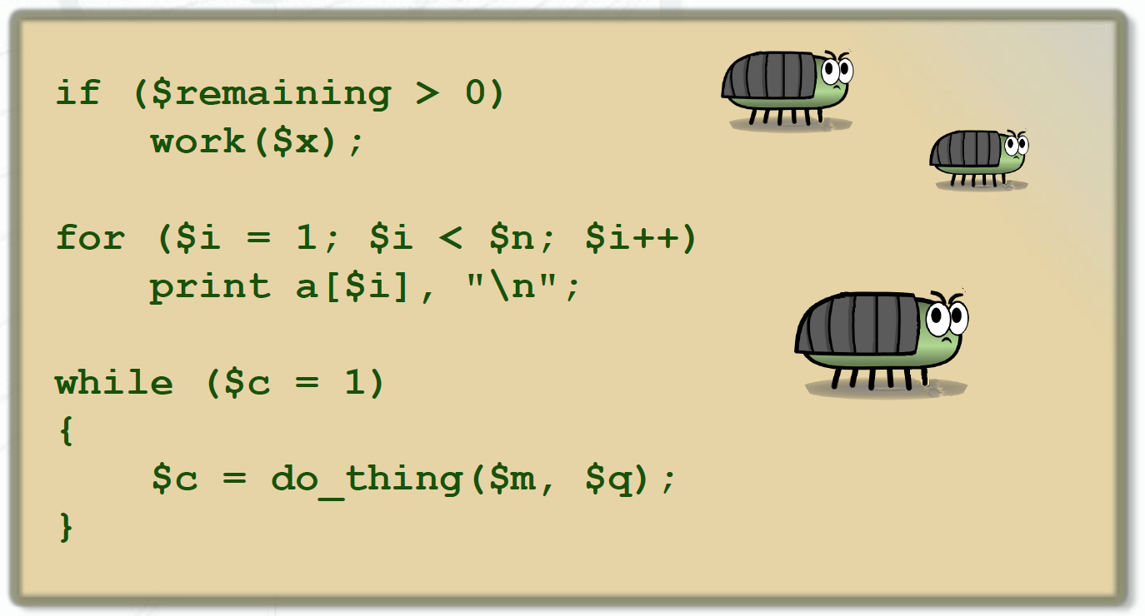
Find Common Errors
Adapted from http://sc.tamu.edu/shortcourses/SC-perl/

Slide 52
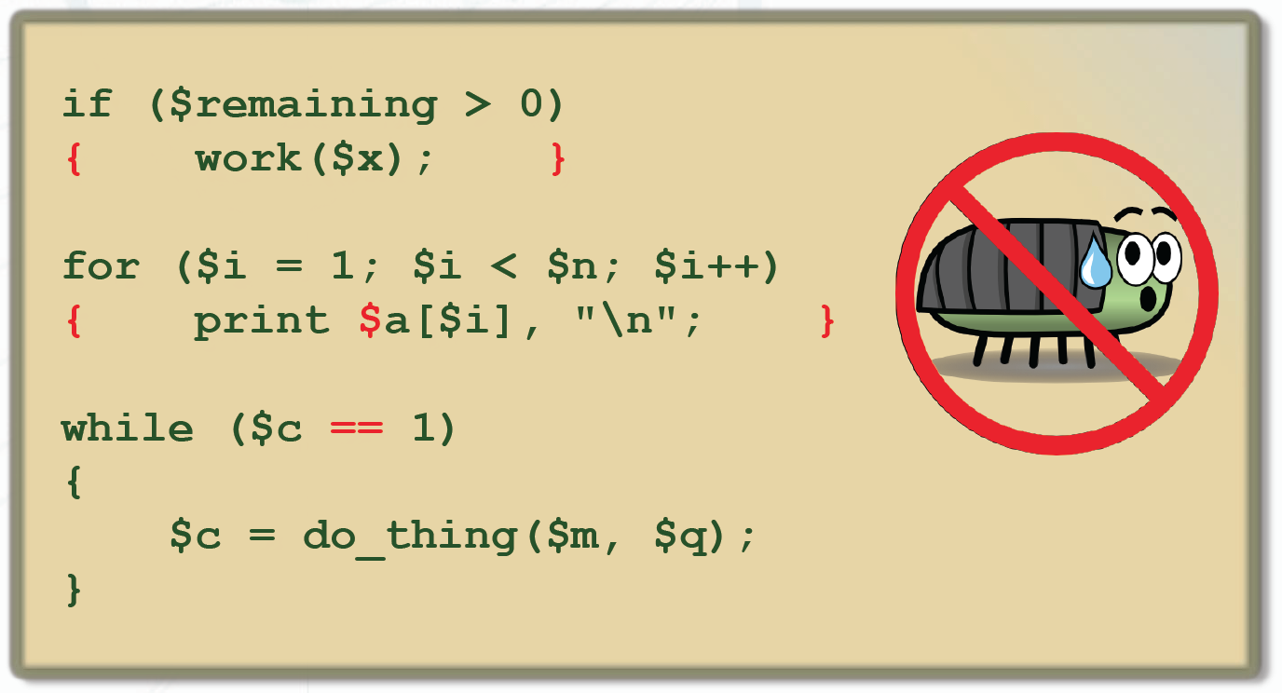
Fixing Errors
Adapted from http://sc.tamu.edu/shortcourses/SC-perl/

Slide 53
How do I get help?
Run command line (Start -> Run -> type: cmd -> Ok)
-> type:
perldoc perl (general info, TOC)
perldoc perlop (operators like +, *)
perldoc perlfunc (functions like chomp: > 200!)
perldoc perlretut (regular expressions: /ABC/)
perldoc perlreref (regular expression reference)
perldoc -f chomp (what does chomp function do?)
perldoc Getopt::Long (learn about a Perl module)
Type q to quit when viewing help pages,
Hit the space bar for next page

Slide 54
Acknowledgements
Amir Karger “Perl in a Day. Peeking Inside the Oyster. Biology-Flavored Perl Overview” rc.hms.harvard.edu/training
Keith Jackson “Introduction to Perl” (Spring 2013) http://sc.tamu.edu/shortcourses/SC-perl/

