Slide 1
Wiktionary Matcher

Slide 2

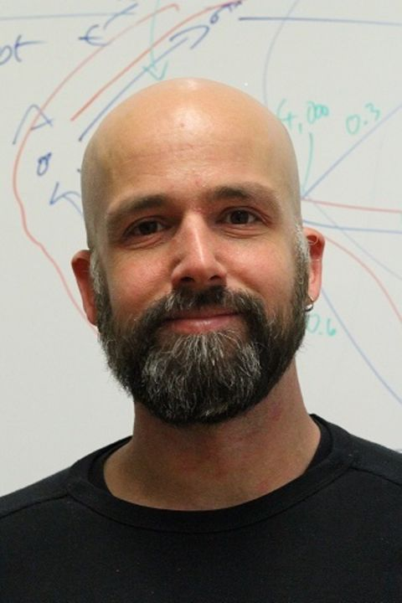
Joint Work
Jan Portisch Data and Web Science Group, University of Mannheim / SAP SE jan@informatik.uni-mannheim.de
Heiko Paulheim Data and Web Science Group, University of Mannheim heiko@informatik.uni-mannheim.de

Slide 3


General Background Knowledge
WordNet
Wiktionary
heavily used for OM
proprietary license
small
monolingual
slow vocabulary growth
rarely used for OM
public domain
large
multilingual
continuous vocabulary growth
[2]
[1]
[1] https://wordnet.princeton.edu/
[2] https://upload.wikimedia.org/wikipedia/commons/thumb/0/05/WiktionaryEn_-_DP_Derivative.svg/1200px-WiktionaryEn_-_DP_Derivative.svg.png

Slide 4
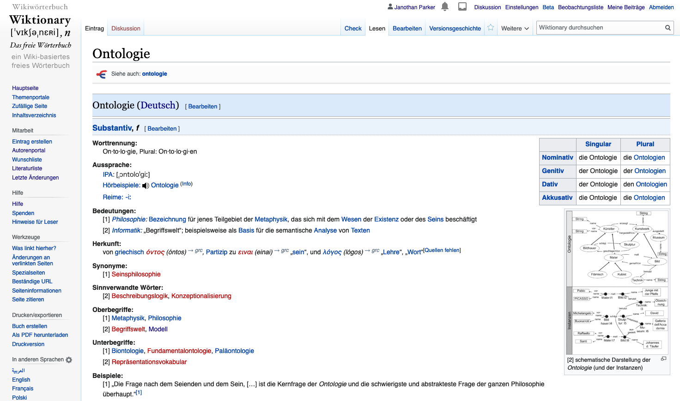
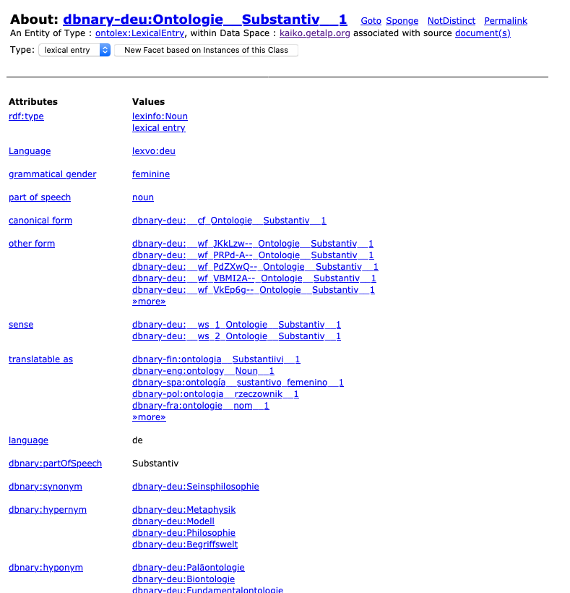
Wiktionary and DBnary

Slide 5
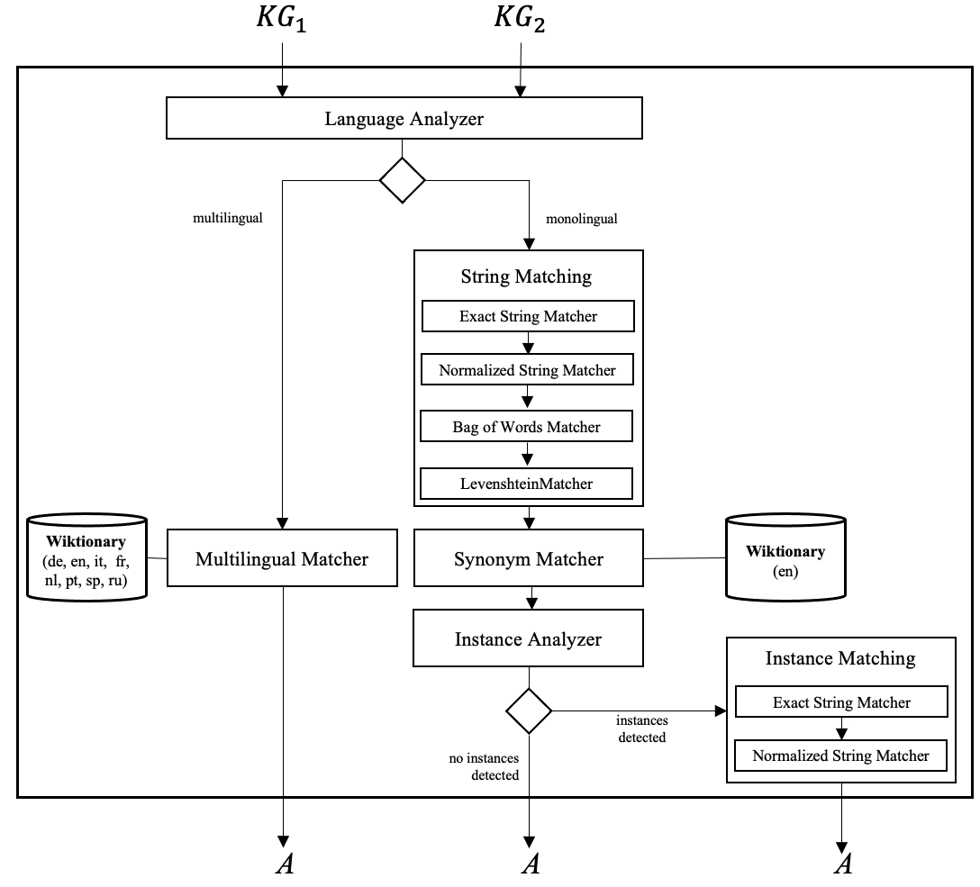
Wiktionary Matcher

Slide 6
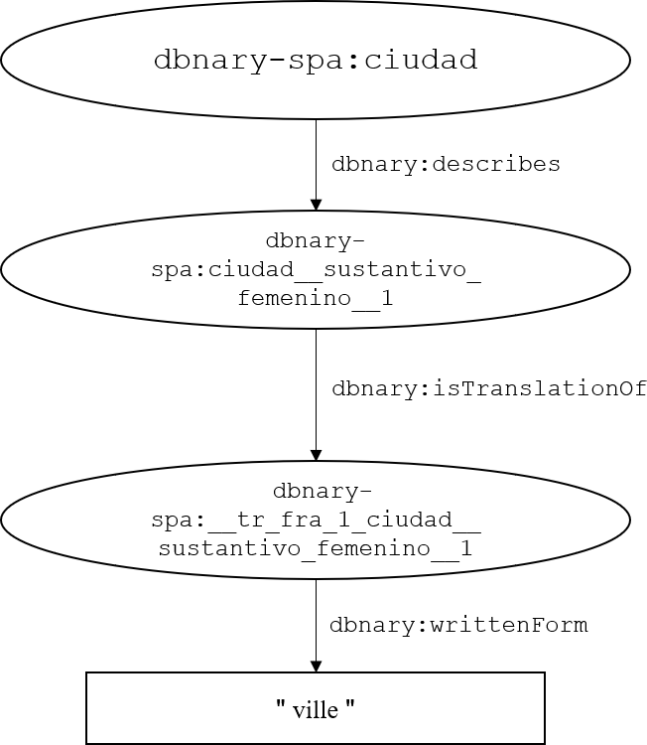
Multilingual Capabilities Direct Wiktionary Translations

Slide 7
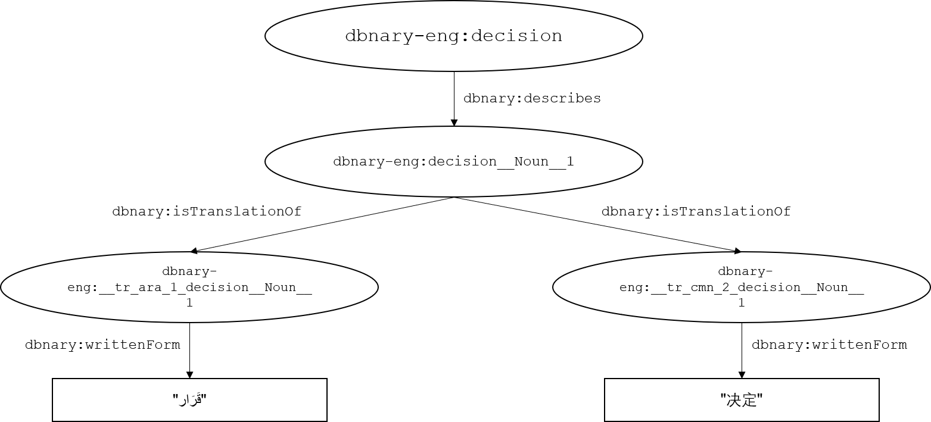
Multilingual Capabilities Indirect Wiktionary Translations

Slide 8
System Improvements
Wiktionary initially participated in the OAEI 2019.
For the 2020 campaign, the system has been refactored and improved:
Updated DBnary graphs that are used.
String matching pipeline improved.
Improvements of the instance matching module.
Refactoring to latest MELT version.
Code available via GitHub: https://github.com/janothan/WiktionaryMatcher

Slide 9
OAEI 2020 Performance
Participation in:
Anatomy (5th, F₁ = 0.842)
Conference (4th on rar2-M3, F₁ = 0.58)
Knowledge Graph (1st , F₁ = 0.87)
LargeBio (4th, F₁ = 0.913 on FMA-NCI small)
Multifram (numbers not yet publicly available)
Competitive performance, improvements on all tracks compared to 2019 version of the system.
Note that no specific knowledge source from the bio domain was used.

Slide 10
How the System Could be Improved
Include more strategies than just the label such as structure or reasoning-based approaches.
Exploit more Wiktionary relations (note that not all are extracted by DBnary).
Include more sources of background knowledge such as specific biomedical knowledge bases.

Slide 11

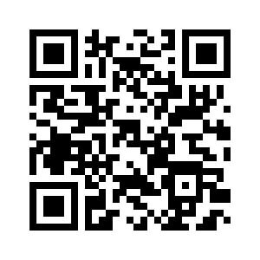
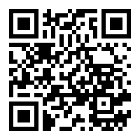
Thank you!
Jan Portisch Data and Web Science Group, University of Mannheim jan@informatik.uni-mannheim.de
Heiko Paulheim Data and Web Science Group, University of Mannheim heiko@informatik.uni-mannheim.de
GitHub

