Slide 1
React.js – a modern UI framework + other web development “goodies”
Jakub Nowak

Slide 2
What is in the box
React.js
Concepts behind framework
“Hello World” and “Todo List” app
Under the hood
Webpack and React hot loader
Esma 6 new features
Imports/exports
Classes
Await/async
Isomorphic apps – holy grail of web development

Slide 3
React
Yet another JS library for building user interfaces
Developed by Facebook
V in MVC – no assumptions about the rest of your technology stack
Used in (no facebook?):
https://libscore.com/#React

Slide 4
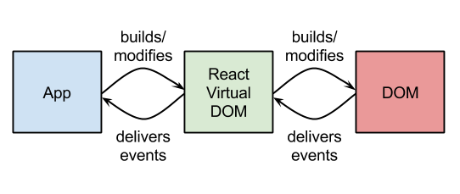
React architecture
Virtual DOM
JAVASCRIPT IS FAST. DOM IS SLOW.
UI Apps contains less then 1000 elements

Slide 5

React architecture
Reusable components (with special XML-like syntax: JSX) e.g:
Support for native HTML elements:
JSX is optional (maps directly to .js code), whole compilation can be done in fly
Support for namespaced elements

Slide 6
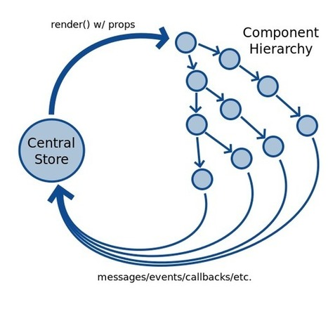
React architecture
One way, reactive data flow
Each component have its own:
Pros
State
Any change in any of this triggers recursive render()
Higher picture: one way unified dataflow (Flux architecture):
https://facebook.github.io/flux/docs/overview.html
http://www.banderson.me/2014/11/01/react-series-intro/

Slide 7
Getting started
https://github.com/janowak/react_presentation
Hello world
Timer
“Todo” app

Slide 8
React diff algorithm
Problem:
“Generating the minimum number of operations to transform one tree into another”
The state of arts algorithms have a complexity in the order of O(n³) where n is the number of nodes in the tree.
React algorithm is optimal O(n) algorithm using heuristics

Slide 9
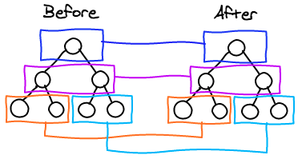
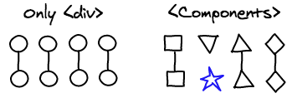

React diff algorithm
React only tries to reconcile trees level by level
Two components of the same class will generate similar trees and two components of different classes will generate different trees.
It is possible to provide a unique key for elements that is stable across different renders.

Slide 10
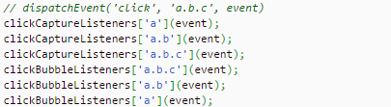
React diff algorithm
Event Delegation
Attaching event listeners to DOM nodes is painfully slow
A single event listener is attached to the root of the document

Slide 11
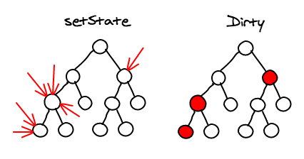
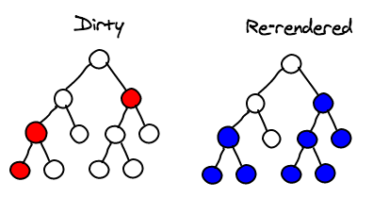
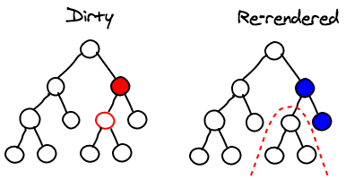
React diff algorithm
Batching
Sub-tree Rendering
Selective Sub-tree Rendering boolean shouldComponentUpdate (object nextProps, object nextState)
https://medium.com/@joshuawcomeau/efficient-nested-react-components-dd9347e9b3f3

Slide 12
Webpack
Webpack

