Slide 1
CrossMind
Split inference for sensitive data
• The problem
Large organizations need central AI models, but cannot export sensitive text to them. Today they either ban AI or accept full-text risk.
• The buyer
Hospital-group IT, clinic compliance, enterprise AI leads: anyone blocking raw data export to a central model.
• Across domains
Healthcare, finance, logistics, legal, industrial. For this hackathon: clinic to hospital.
AI BEAVERS Founder Hackathon | House of AI Hamburg | June 6, 2026
DEMO - Research prototype only. Not medical advice, diagnosis, or treatment.

Slide 2
How it works: two models, one connection
• Clinic runs Qwen 2.5 locally
Encodes patient text into a numeric vector. The original words never leave the clinic.
• Hospital runs Llama 3.1 remotely
Receives only numbers (vectors), not your sentence, not your words, not your document.
• Linear alignment connects them
A trained matrix translates Qwen's internal representation into Llama's space (Gorbett & Jana, 2025).
• Trained on medical Q&A pairs
The alignment is optimized for clinical domain accuracy.
Clinic (Qwen) encodes text into vector --> alignment matrix translates it --> obfuscated via passphrase --> Hospital (Llama) generates from vector --> token back
DEMO - Research prototype only. Not medical advice, diagnosis, or treatment.

Slide 3
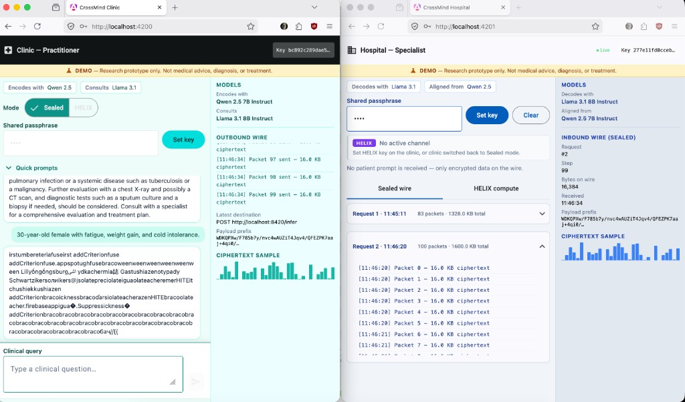
Privacy Layer 1: Sealed (wire obfuscation)
• Vector-by-vector transmission
Each hidden state travels individually. This adds a structural privacy layer: no full document crosses the wire.
• Shared passphrase rotates each vector
Before sending, the clinic rotates the vector using a shared secret. The specialist only ever sees rotated numbers.
• Wrong passphrase = garbled nonsense
Without the matching key, intercepted data is meaningless. See screenshot: mismatched keys produce noise.
• Protects against passive eavesdroppers
Anyone tapping the network link gets rotated vectors they cannot reverse.
Mismatched passphrase: clinic and hospital have different keys.
Output is garbled. Data stays protected on the wire.
DEMO - Research prototype only. Not medical advice, diagnosis, or treatment.

Slide 4
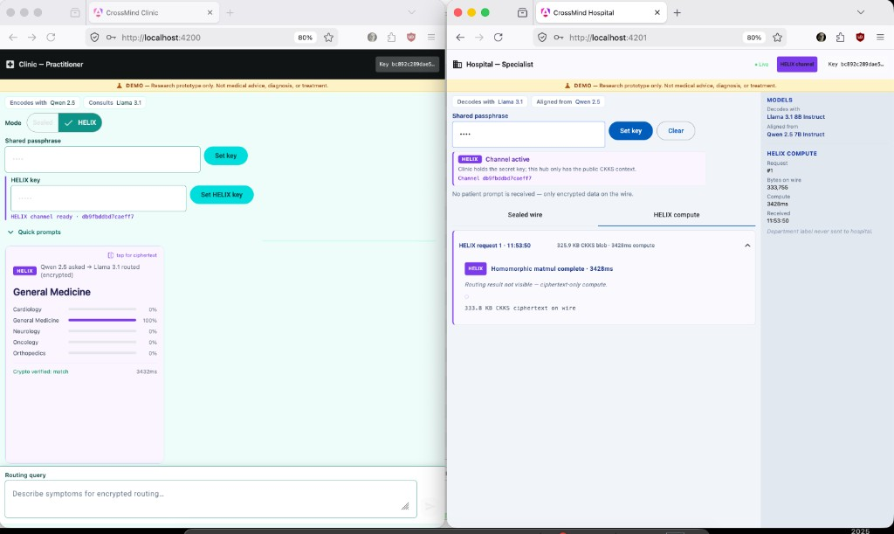
Privacy Layer 2: HELIX (homomorphic encryption)
• CKKS homomorphic encryption
The hospital computes on ciphertext. It never sees the plaintext vector at any point.
• Department routing (5 classes)
Cardiology, Neurology, Oncology, Orthopedics, General Medicine.
• Hospital never sees the department label
Only the clinic can decrypt the routing result. The hospital is truly blind.
• ~3.4 seconds per routing request
Homomorphic operations are computationally expensive. Full-vocab generation (128k tokens) is not feasible yet. But a 5-class routing head is practical today.
HELIX routing: crypto verified, department decrypted only by clinic.
DEMO - Research prototype only. Not medical advice, diagnosis, or treatment.

Slide 5
What our privacy layers do and what they don't
What it DOES
• Prompt text stays on the local machine
• Wire tap sees only rotated/encrypted vectors
• HELIX: hospital computes without seeing plaintext
• Department label decrypted only by clinic
• Data minimization: no full-text export needed
What it does NOT (yet)
• Full encrypted generation (too expensive to compute at vocab scale today)
• Sealed generation still requires hospital-side decrypt per token
• HIPAA/GDPR compliance certification
• Guarantee hospital learns nothing from vectors alone
• Clinical-grade diagnosis or medical advice
DEMO - Research prototype only. Not medical advice, diagnosis, or treatment.

Slide 6
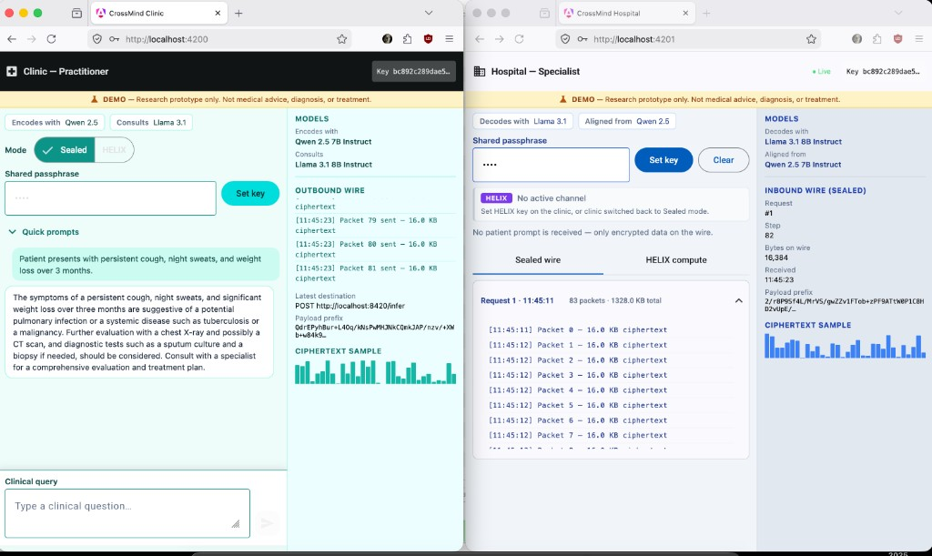
Live demo: Clinic and Hospital connected
Working end-to-end: Clinic encodes locally (alignment cosine ~0.83) | Hospital routes via HELIX (~83% accuracy, ~3.4s) | Sealed generation streams in real-time
Sealed mode: vectors streaming, passphrase matched
HELIX mode: encrypted routing, department decrypted by clinic only
DEMO - Research prototype only. Not medical advice, diagnosis, or treatment.

Slide 7
What is to come
• Upload documents (PDF, TXT)
Send encrypted document vectors for specialist analysis without exposing content.
• Upload images and reports
Medical imaging, lab reports: encoded locally, routed or analyzed remotely via encrypted vectors.
• Multi-modal encrypted routing
Same HELIX pattern extended to richer inputs for better clinical results.
• Domain-agnostic infrastructure
Finance, logistics, legal, industrial: wherever sensitive data needs central AI without full-text export.
Thank you
Reference: Gorbett, T., & Jana, S. (2025). Characterizing Linear Alignment Across Language Models. arXiv:2603.18908
AI BEAVERS Founder Hackathon | House of AI Hamburg | June 6, 2026
DEMO - Research prototype only. Not medical advice, diagnosis, or treatment.

