Slide 1
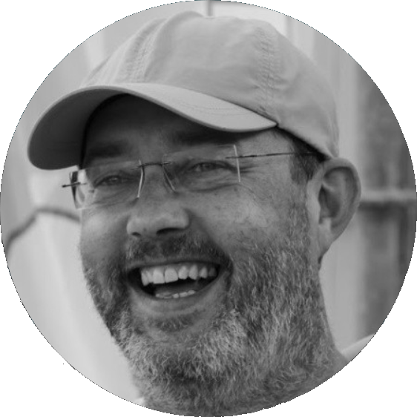

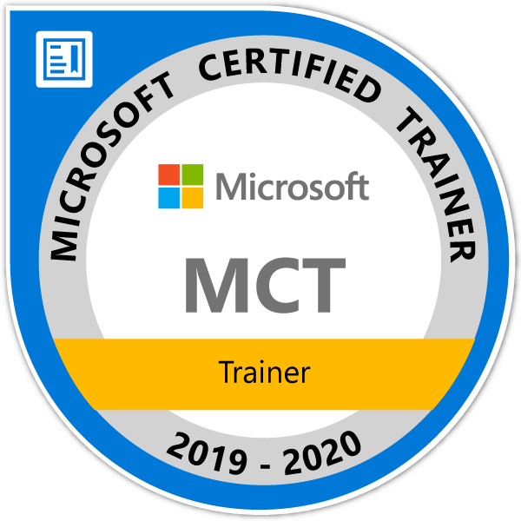
Jan Remko Yntema
Working for ilionx since 2014
SQL Server since 1999
Microsoft Data Warehouse Consultant since 2008
www.linkedin.com/in/jryntema
Microsoft Certified Trainer since 2008

Slide 2
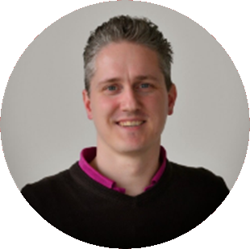



Joost van Rossum
Working for ilionx since 2010
Microsoft Data Warehouse Consultant since 2005
microsoft-ssis.blogspot.com
microsoft-bitools.blogspot.com
@SSISJoost
www.linkedin.com/in/joostvanrossum
Data Platform MVP since 2014

Slide 3

Analytics in a day workshop Wifi
Wifi eventcode: msevent771tz
Slides: https://github.com/janremko/airlift

Slide 4
Analytics in a day workshop Lab guidance
Register Azure environment for the two labs
Lab 1: Analytics in a Day - Building a Modern Data Warehouse 2 hours Lab 2: Analytics in a Day - Deep Dive on Azure Synapse Analytics 1 hour 30 minutes
Link to Register: http://bit.ly/32EGkI9
Activation Codes: ACTIVATE5959

Slide 5
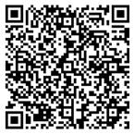
Analytics in a day workshop Evaluation
https://aka.ms/EvaluatieDiscoverworkshops

