Slide 1

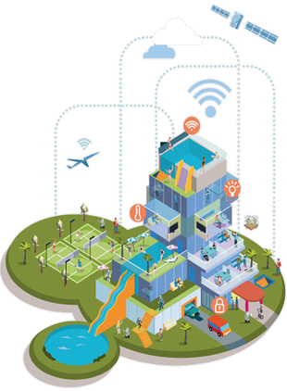


Gesture-Controlled Smart Glove
(VR / Robotics Interface)
부산대학교 정보의생명공학대학
정보컴퓨터공학부
Adventure Design

Slide 2
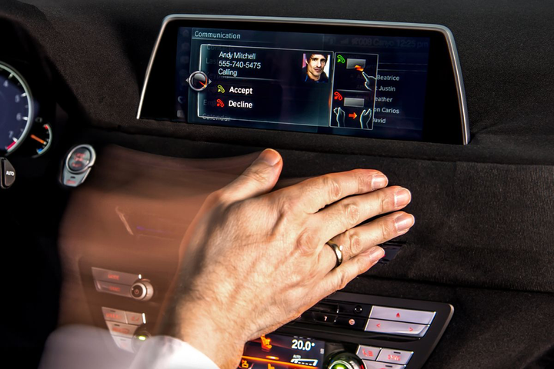
Background and necessity
With the rise of VR, AR, and robotic systems, there is growing demand for natural and intuitive control beyond keyboards and joysticks.
Traditional controllers limit hand movement and lack realism.
A gesture-controlled glove allows users to interact with virtual or robotic systems using natural hand gestures.
This can improve accessibility, immersion, and remote control precision.
‹#›

Slide 3
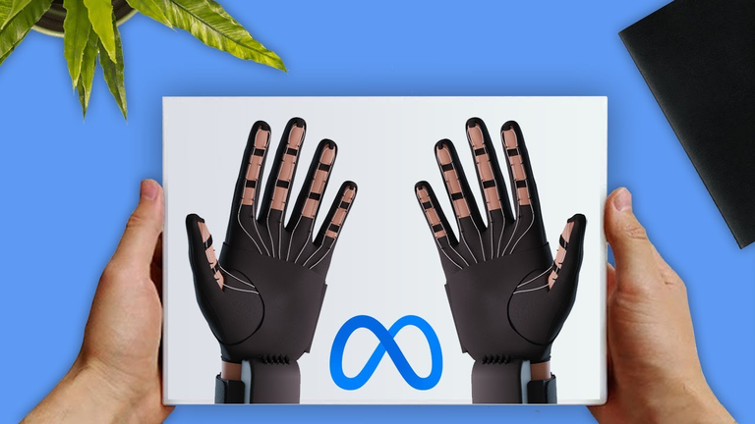
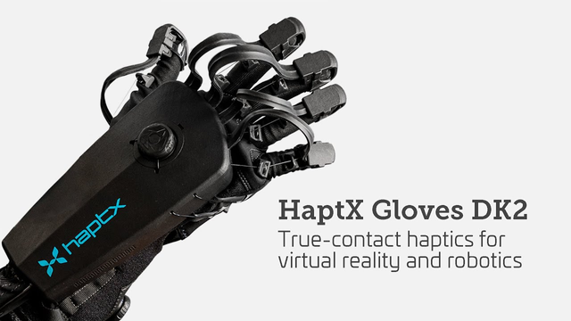
Current status and limitations of related system(services)
Commercial gesture gloves (e.g., Meta Quest, HaptX) are expensive and proprietary.
Limited flexibility for educational or low-cost research purposes.
Often lack real-time feedback or wireless control in open-source systems.
Because this technology is still relatively new and evolving, many features are not yet fully learned or optimized, requiring further development for better accessibility and usability.
Therefore, there is a need for an affordable Arduino-based prototype that provides basic hand-gesture recognition and wireless output while remaining open for improvement and experimentation.
‹#›

Slide 4
Goals and features of the proposed system
Goal:
Design and implement an Arduino-based smart glove that recognizes finger and hand movements to control devices or simulate virtual interactions.
Features:
Detect finger bending using flex sensors.
Capture hand orientation using accelerometer & gyroscope (MPU-6050).
Transmit gesture data wirelessly using Bluetooth (HC-05).
Control a robotic arm or VR cursor in real time.
Display current mode/status via LED indicators.
‹#›

Slide 5
System description and methodology
System Overview:
Input Sensors → Arduino Mega 2560 → Wireless Transmission → Receiver System / PC Interface
Block Diagram:
Flex Sensors + MPU-6050 → Arduino → HC-05 Bluetooth → VR Controller
Operation Scenario:
User wears glove and performs gestures.
Arduino reads flex and motion sensor values.
Data transmitted wirelessly to receiver.
Receiver interprets gestures to control robotic servos or VR environment.
Software Implementation:
Analog readings for flex sensors (A0–A4).
I²C communication for MPU-6050 (SDA, SCL).
Serial communication for Bluetooth module.
Gesture mapping via threshold logic.
Example Gestures:
Fist → “Stop”
Open palm → “Start”
Index forward → “Move”
Tilt right/left → “Turn”
‹#›

Slide 6
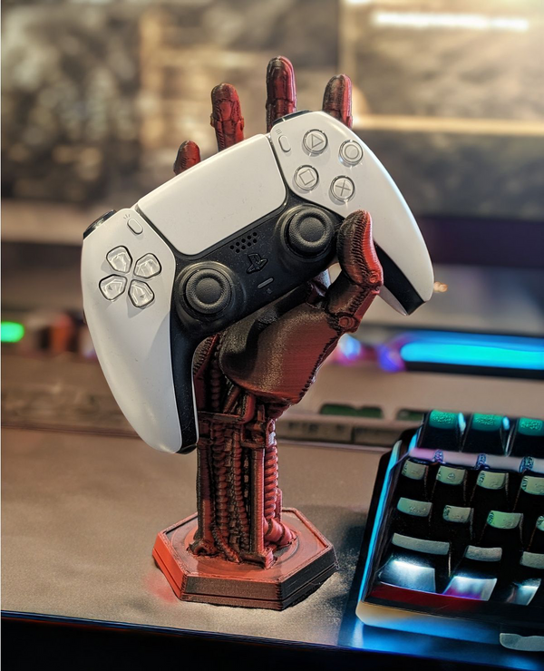
Application plans and future development directions
VR Integration: Use glove as an open-source VR controller.
Robotics: Control robotic arms for industrial training or prosthetic design.
Gaming and Simulation: Replace physical joysticks in 3D environments.
Future improvements: add haptic feedback, Wi-Fi control, and machine-learning gesture recognition.
‹#›

Slide 7
List of required equipment
Arduino Mega 2560 1EA
Flex Sensor 2.2" 5EA (https://www.devicemart.co.kr/goods/view?no=12737236) (32500won)
MPU-6050 Gyro + Accelerometer 1EA
Bluetooth Module HC-05 1EA (https://www.coupang.com/vp/products/7897730697?itemId=24320032273&vendorItemId=91072872309&q=bluetooth+serial+port+module+hc-06+szh-ek010&searchId=c045a3ba998350&sourceType=search&itemsCount=36&searchRank=1&rank=1&traceId=mhj4b06q) (3500won)
LED Indicator 3EA
Resistors, Jumper Wires, Breadboard
Servo Motor (for robotic control demo) 1EA
Glove (cotton or sports type) 1EA
Budget: Within ₩100,000 limit
‹#›

