Slide 1

Smart device efficiency
Author: Maciej Broda
Date: March 2025

Slide 2

Goal of presentation
Present trends in FitBit smart device data to implement most relevant marketing strategy in Bellabeat’s product.

Slide 3

Analyze introdution
Analyze include data from FitBit company about usage of one of they smart device. Data were measured in 2016 within one month. We will focus on the most crucial part in smart device industry – calories.

Slide 4
Calories
The main purpose of buying smartwatches is to measure various physical activity metrics, but ultimately it all comes down to burning, maintaining, or gaining calories, which can help us achieve our ideal silhouette.
That's why I measured the correlation between the time spent in light, moderate, and intense activities and the calories burned during each activity.

Slide 5
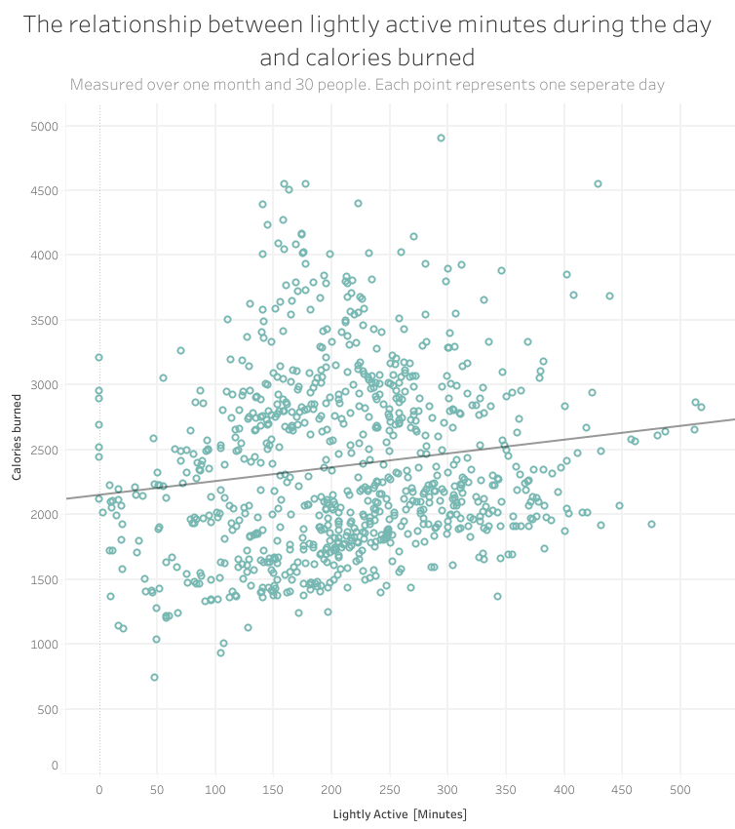
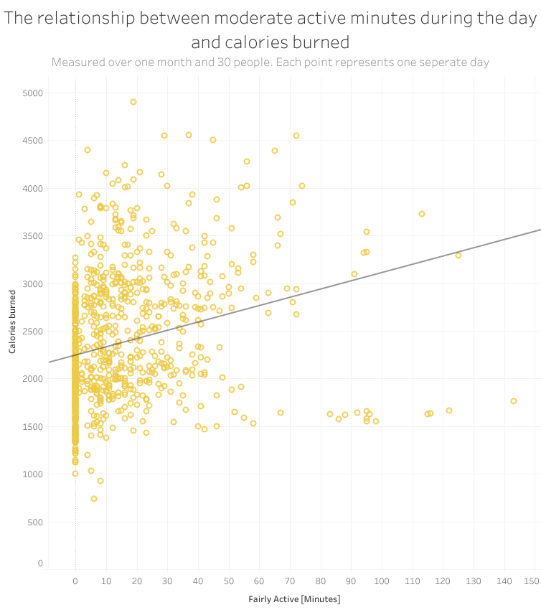
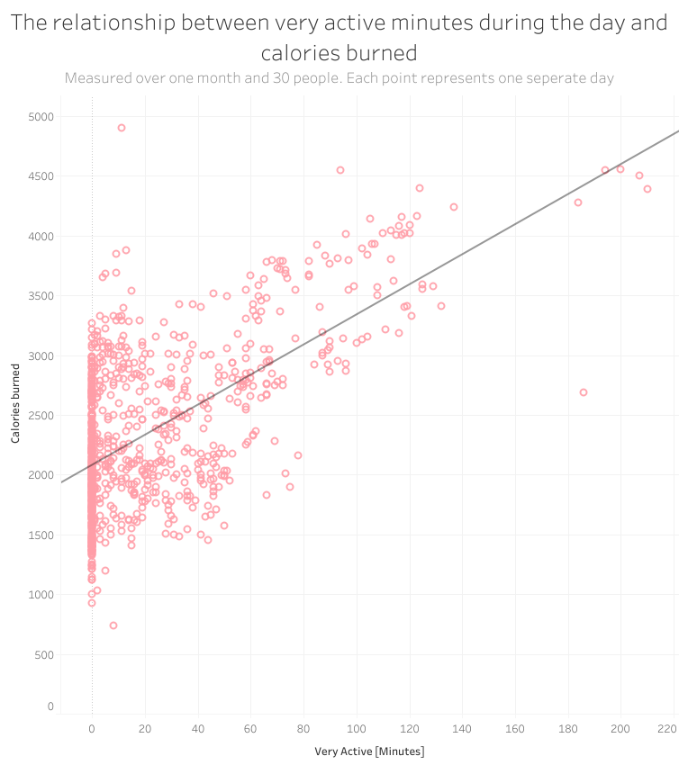
Scatter plots depict correlation between each activity type and calories burned.

Slide 6
Very high activity The most effective way to lose calories
Based on the scatter plots, very high intensity is closest to the trend line, which means that the correlation is the most significant. Therefore, Bellabeats should focus on this area if they want to improve client satisfaction and self-fulfillment, ultimately enhancing client trust and happiness.

Slide 7
Insights
Introducing an application on the smartwatch that guides the user towards very high intensity exercises. This application should strongly encourage our users to engage in high-intensity workouts such as HIIT, cardio, dynamic cycling, and similar activities.
Introducing as many options as possible for tracking one's activity during high-intensity workouts.
Raising user awareness through gentle pop-up messages that appear periodically in the app, explaining why following the path outlined by the app can lead to the best possible results.

Slide 8

Time for questions

