Slide 1
Designing the Digital Future: The Information Systems Group
At the Intersection of Data, Business, and Technology
Information Systems (IS) Group | Department of IE & IS

Slide 2
We Engineer Intelligent Enterprises ⚙️
The Information Systems (IS) group focuses on the design, implementation, and management of information technology to solve complex business and societal challenges. Our approach is:
Data-Driven: Leveraging data science and AI to optimize performance and enable smart decision-making.
Process-Oriented: Using business process management as a foundation for digital transformation.
Human-Centered: Ensuring technology works effectively for the people and organizations it serves.

Slide 3
Pushing the Boundaries of Digital Innovation 📈
Our research is clustered around key areas shaping the future of business.
Business Process Intelligence: World-leading research in process mining to discover, monitor, and improve real-life operational processes based on event data.
AI in Business: Developing and applying AI and machine learning models to enhance decision-making, from supply chain logistics to customer relationship management.
Digital Platforms & Ecosystems: Analyzing the design, governance, and strategy of digital platforms that are transforming entire industries.

Slide 4
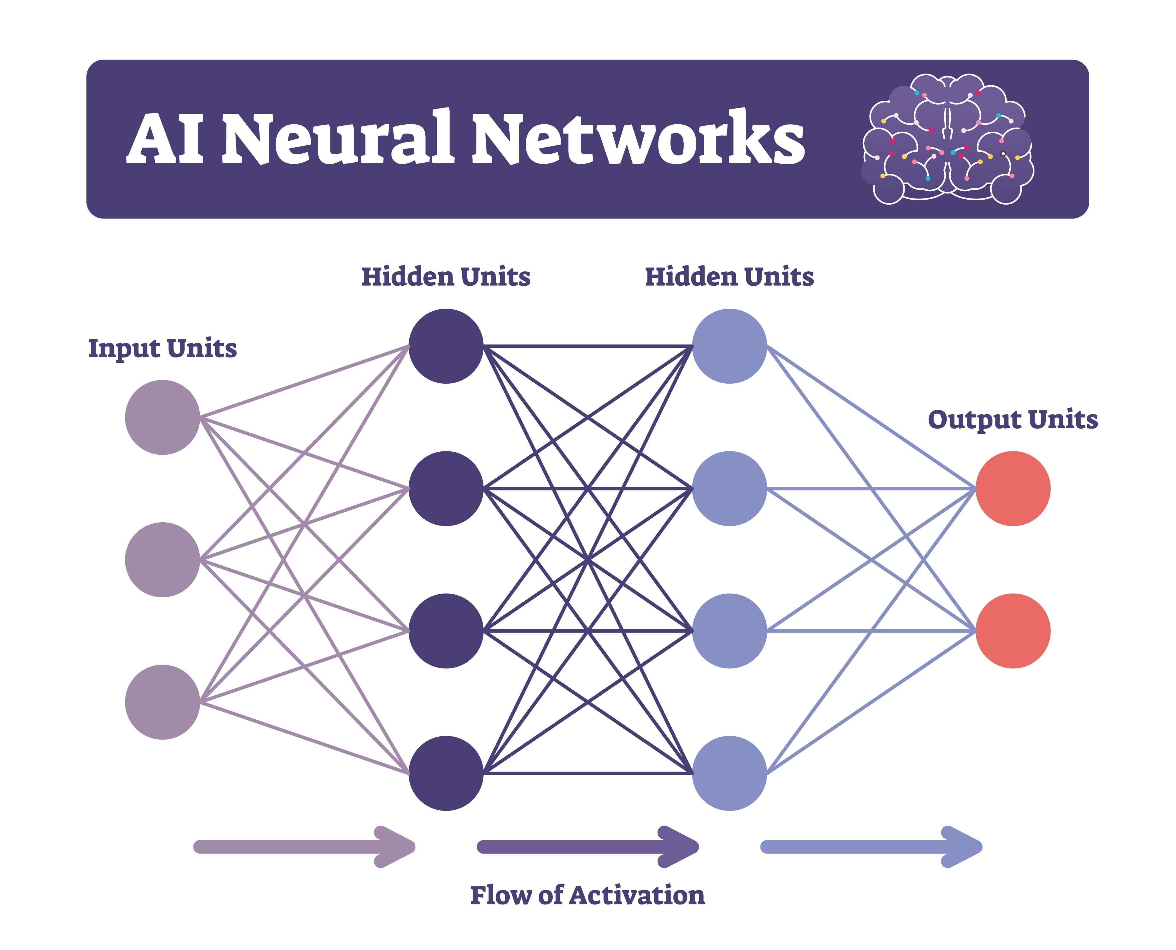
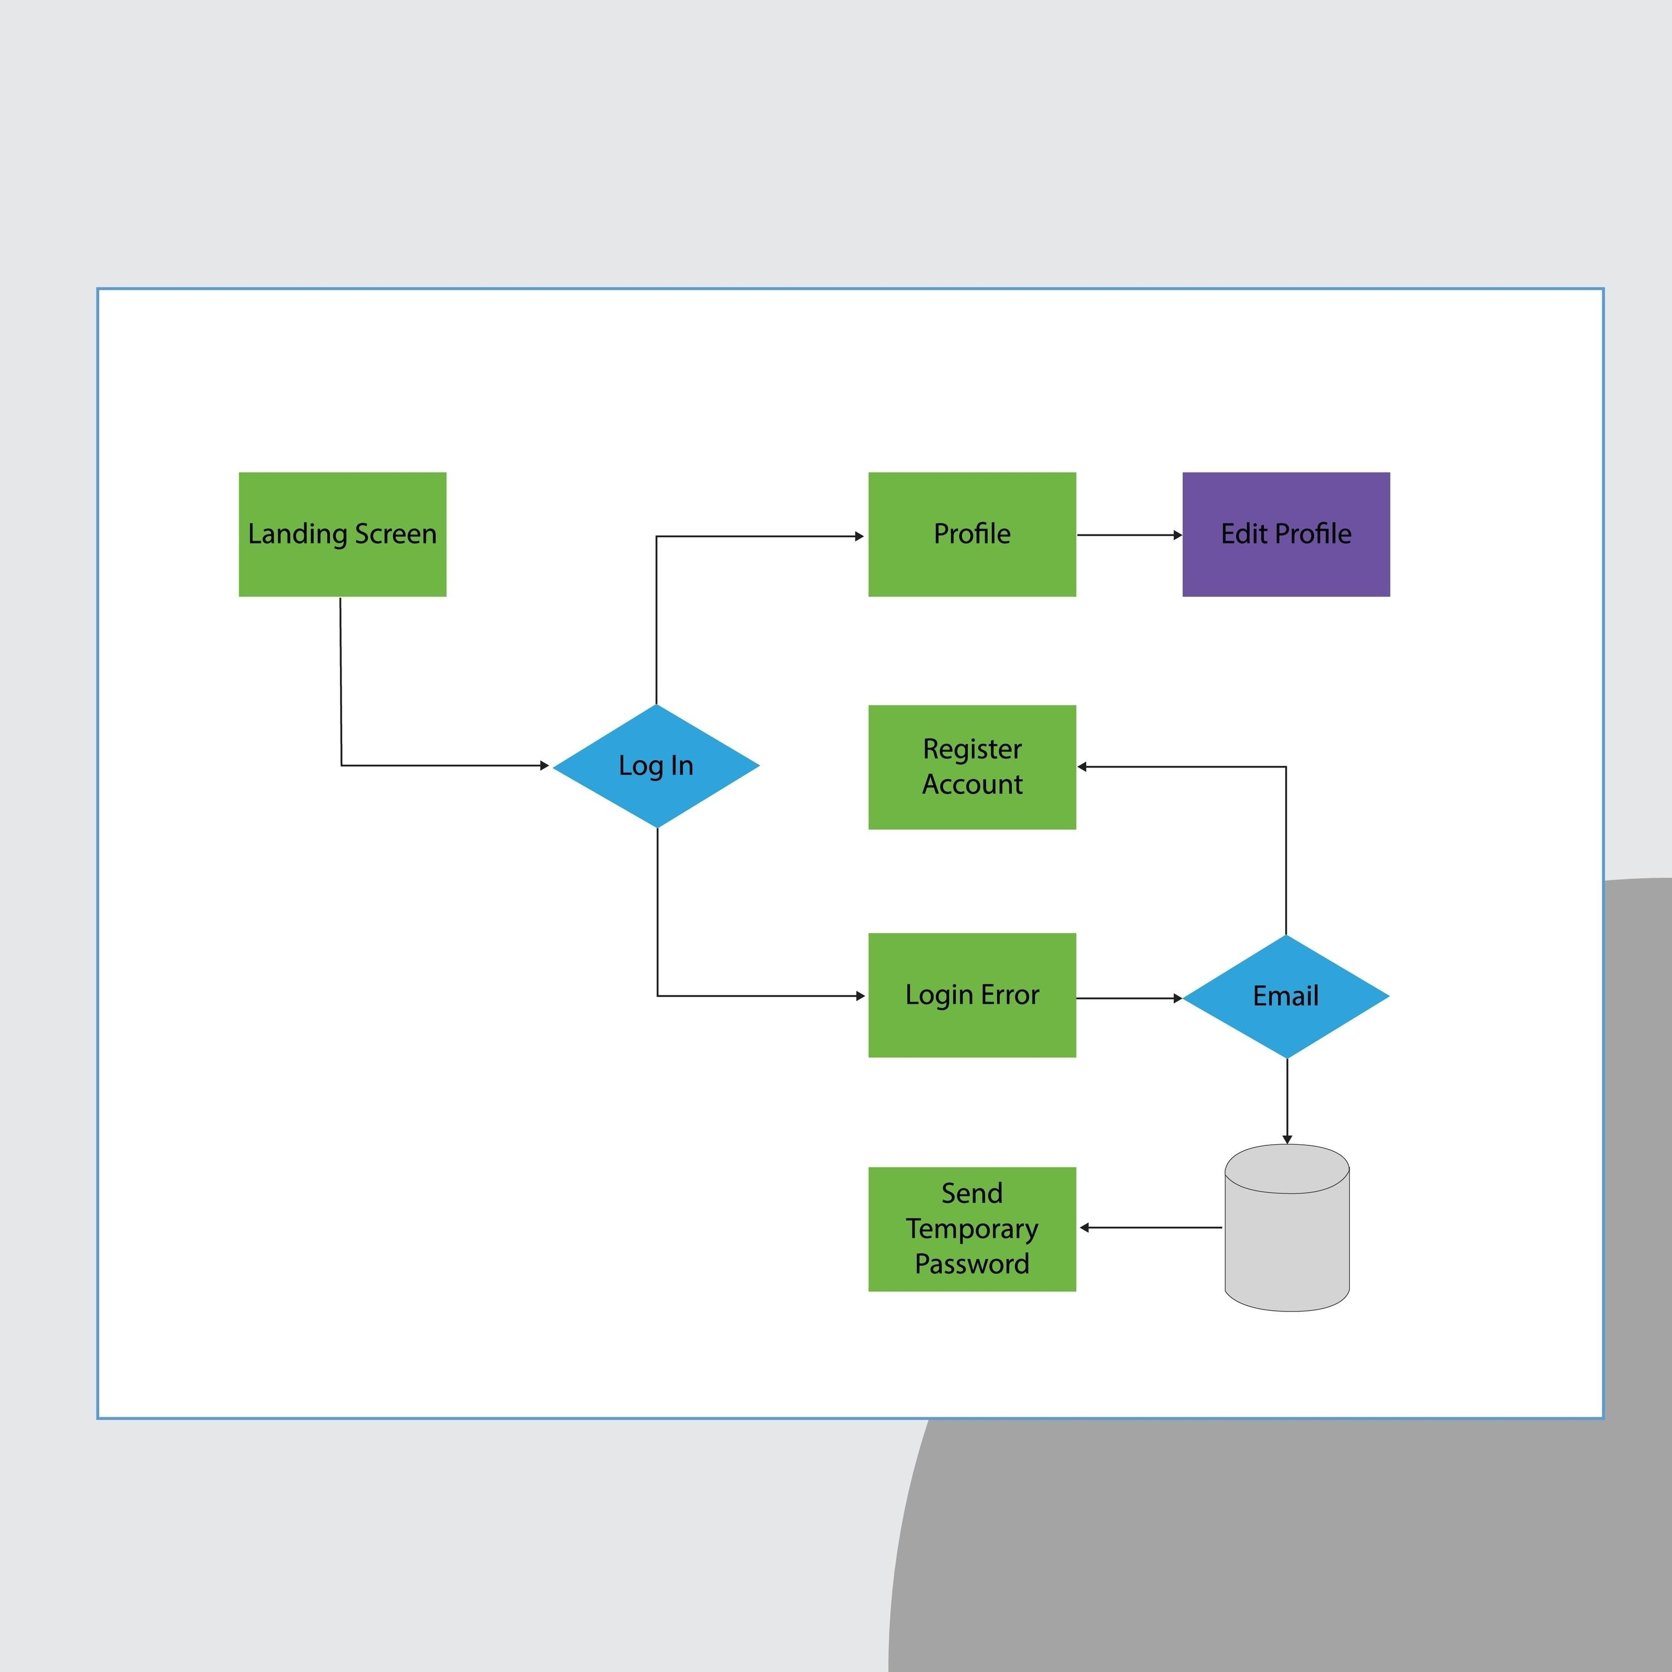

Slide 5
From Classroom Theory to Real-World Impact 🧑‍🎓
We educate the next generation of engineers who can lead digital innovation. Our students learn to analyze business needs and translate them into robust IT solutions.
Master's Track: Core of the Business Information Systems track within the M.Sc. in Operations Management & Logistics.
Project-Based Learning: Students work in teams on real-world cases provided by our industry partners, designing and prototyping actual information systems.
Essential Skills: Graduates are equipped with expertise in data analytics, IT architecture, and business process modeling.

Slide 6
A Sandbox for Business Innovation 🏭
The 'Nazareth' Logistics Lab provides a unique, realistic environment for testing IS concepts. This model warehouse allows students and researchers to experiment with:
Warehouse Management Systems (WMS).
Automated guided vehicles (AGVs) and order-picking technologies.
Real-time data collection and process optimization.

Slide 7
Let's Build the Future Together
The TU/e Information Systems group combines rigorous academic research with practical application, training leaders who can navigate and shape the digital world.
Call to Action for Partners & Students:
Industry: Partner with us on a research project or provide a case for our students.
Students: Specialize in Business Information Systems and learn to solve the challenges of tomorrow.
Contact/Info:
Link to the TU/e Information Systems group homepage.

