Slide 1
The new Hilti Warehouse Management Service
Version 2.0
December 2023
Notes:
https://www.hilti.de/content/hilti/E3/DE/de/support/support/lagermanagement.html

Slide 2
Agenda
Idea
Version 2.0 of Warehouse Management
Changes compared to Version 1
Outlook

Slide 3
Idea
Offering an Efficient Warehouse Organization to focus on core business activities while also saving time and money
Our Goal: Taking charge of customers’ warehouse, ensuring it becomes a strategic asset for the business operations.
Optimal organization to provide transparency and improve productivity
Addressing common challenges of warehouse management
Maintaining optimal stock levels and ensuring readiness for upcoming projects.
Initiative based on idea by Jahangir
More Details: See „Warehouse Management Documentation“

Slide 4
Version 2.0 of Warehouse Management
Warehouse Analysis
Warehouse Planning
Warehouse Maintenance
Warehouse Analysis | Warehouse Planning | Warehouse Maintenance
Conducting a joint analysis to determine the specific product range and optimize inventory levels for each item. | Defining minimum and maximum stock levels for consumables in collaboration. | Establishing a regular visit schedule for optimal warehouse maintenance and inventory management.
Customizing stock levels through a collaborative warehouse analysis, considering individual product requirements and prices. | Generating purchase lists for the Hilti Online Account based on agreed-upon levels. | The Hilti Sales Representative takes care of the warehouse on agreed-upon days, conducting stock checks, and placing orders if necessary.
 | Creating a clear structure through product labeling with detailed information, including product name, packaging unit, Hilti item number, product image, and barcode. | Ensuring ongoing support as the dedicated Hilti Sales Representative is available at all times for additional assistance.

Slide 5
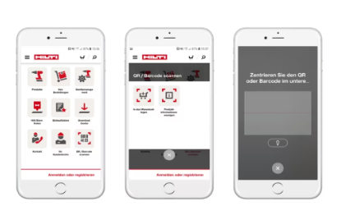
New Hilti Mobile App
The customer can conveniently scan and reorder labeled Hilti products using the Hilti Mobile App.
Barcodes on shelf labels or QR codes on Hilti packaging can be utilized by the customer for quick and easy reordering.
Download will be for Free:
The app is available for free download on the App Store.
It is also available for free on Google Play.

Slide 6
Available prefabricated shelving sets
Basic
2x Red Upright Frame (H x D: 2278mm x 500mm)
5x Galvanized Shelves (W: 995mm/ max. Load 200 kg)
5x Label Holders (1 per Shelf)
10x Vertical Dividers for Shelf Segmentation
1x Side Perforated Plate including
10x Perforated Plate Hooks
Comfort
Better than Basic
Premium
Better than Comfort

Slide 7


Changes compared to Version 1
New function „Hilti Mobile App“ included
Adding the option to use the HILTI Warehouse Management Service for already existing shelving system

Slide 8
Outlook
Version 3.0 with new features
Using RFID to automatically scan articles that are brought into or removed from the warehouse
Frank will prepare an assessment of the potential of AI for warehouse services

