Slide 1
Wideband-Delphi Software Estimation
Mohamed Omer
Jan Schulte
Universidad Politécnica de Madrid
13/05/2008

Slide 2
Table of Content
Introduction
Wideband-Delphi
Entry critera
Steps
Delphi
Usage statistics
Best practices
Further steps
Summary
Bibliography

Slide 3
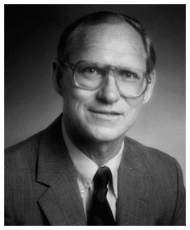
History
Introduction
History
Wideband Delphi Estimation
Developed by Barry W. Boehm in 1981
Refinement of the RAND Delphi Estimation Technique (1940s)

Slide 4
Wideband Delphi Estimation
Introduction
History
Wideband Delphi Estimation
Expert Estimation
Several experts
Each with equal voice
Works because team members correct each other
One expert does not fully understand system
Explicit estimation of efforts
Not LOC
More interaction than with standard Delphi

Slide 5
Prerequisites for Wideband-Delphi
Wideband Delphi
Prerequisites
Process steps
Step 1
Step 2
Step 3
Step 4
Step 5
Step 6
Vision and Scope document
Agreed by all stakeholders
If not available:
Enough supporting documentation to understand work product
Kickoff meeting and estimation session have been scheduled

Slide 6
Process Steps
Wideband Delphi
Prerequisites
Process steps
Step 1
Step 2
Step 3
Step 4
Step 5
Step 6
Choosing the team
Kickoff meeting
Individual preparation
Estimation session
Assembling tasks
Reviewing results

Slide 7
Step 1: Choosing the team
Wideband Delphi
Prerequisites
Process steps
Step 1
Step 2
Step 3
Step 4
Step 5
Step 6
Project manager chooses team
3-7 members
Representatives of involved engineering groups
Should know
Organizational needs
Previous projects
Project manager should not be moderator
Stakeholders should also be involved

Slide 8
Step 2: Kickoff meeting
Wideband Delphi
Prerequisites
Process steps
Step 1
Step 2
Step 3
Step 4
Step 5
Step 6
Prepare team for estimation session
Each member is given the vision and scope document beforehand
Moderator explains Delphi to new members
Product discussion and assumption brainstorming
Creation of major task list (workbench breakdown structure)

Slide 9
Step 3: Individual preparation
Wideband Delphi
Prerequisites
Process steps
Step 1
Step 2
Step 3
Step 4
Step 5
Step 6
Moderator distributes task list and assumptions
Team members independently create the preparation results
Estimate and assumption for each task
Estimation in effort, not calendar time (e.g. Person-Days)
Any additional task that should be made
Delays
Don‘t include project overhead (e.g. Vacation, meetings, etc.)

Slide 10
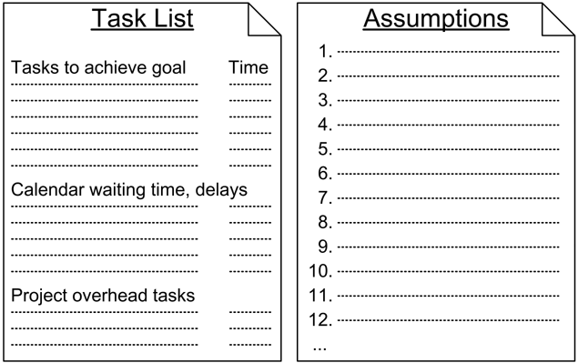
Step 3: Individual preparation
Wideband Delphi
Prerequisites
Process steps
Step 1
Step 2
Step 3
Step 4
Step 5
Step 6
Prerequisites

Slide 11
Step 4: Estimation session
Wideband Delphi
Prerequisites
Process steps
Step 1
Step 2
Step 3
Step 4
Step 5
Step 6
Brief discussion about additional tasks
Each member fills out estimation form
Steps
Moderator collects form and plots total on the whiteboard
Each estimator reads out clarifications
Discovered assumptions, changed tasks & questions are raised
Specific estimations are NOT discussed
Team discusses & resolves issues
Each member modifies his list
Revision of estimates using Delta
New total calculated
Repitition

Slide 12
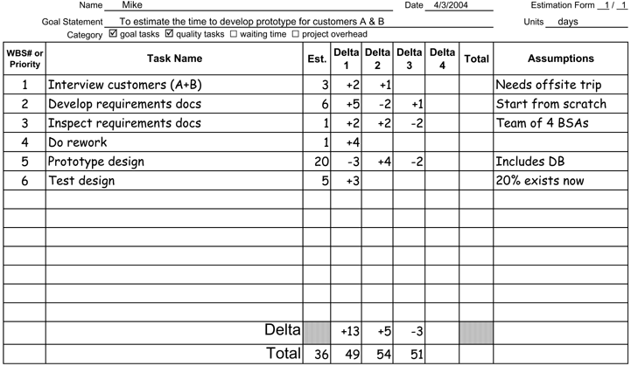
Step 4: Estimation session
Wideband Delphi
Prerequisites
Process steps
Step 1
Step 2
Step 3
Step 4
Step 5
Step 6

Slide 13
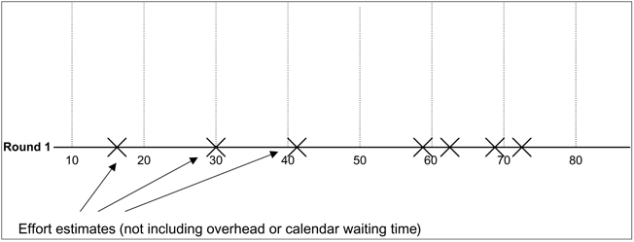
Step 4: Estimation session
Wideband Delphi
Prerequisites
Process steps
Step 1
Step 2
Step 3
Step 4
Step 5
Step 6

Slide 14
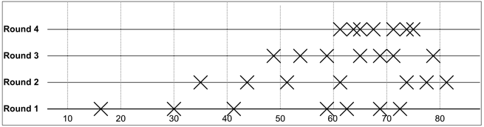
Step 4: Estimation session
Wideband Delphi
Prerequisites
Process steps
Step 1
Step 2
Step 3
Step 4
Step 5
Step 6

Slide 15
Step 5: Assembling tasks
Wideband Delphi
Prerequisites
Process steps
Step 1
Step 2
Step 3
Step 4
Step 5
Step 6
Project manager & moderator gather final task list
Remove redundancies
Resolve remaining differences
Estimation should include best-case and worst-case scenarios
Remove highest & lowest estimates
Create final assumption
Final decision by project manager

Slide 16
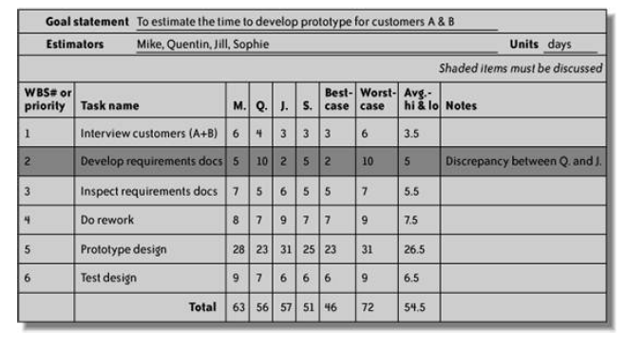
Step 5: Assembling tasks
Wideband Delphi
Prerequisites
Process steps
Step 1
Step 2
Step 3
Step 4
Step 5
Step 6

Slide 17
Step 6: Reviewing results
Wideband Delphi
Prerequisites
Process steps
Step 1
Step 2
Step 3
Step 4
Step 5
Step 6
Final team meeting to review results
Determine wether the range is acceptable
Decide if tasks need to be broken down
Agree on new estimation session

Slide 18
Delphi
Delphi
Developed in the 1940s by the RAND corporation
Estimation completely independent
No team discussion
Anonymous expert interactions through several iterations
Supervised by moderator
Finishes when an agreed-on majority position is attained
Notes:
Delphi is the predecessor of wideband delphi technique. It was developed in 1940s by the RAND corporation. This technique does not involve face to face discussions between the team members, but anonymous expert interaction through several iterations,
supervised by a moderator until an agreed-on majority position is attained.
The main difference between this technique and the wideband is that there is no group discussions in the delphi technique.

Slide 19
Primary techniques in industry
Usage statistics
Techniques in industry
Comparison
Dominant strategy for estimating software development effort
In the studies that were made:
Estimation strategy categories and definitions not the same in the different studies
Strong evidence that expert based estimation most frequently used
No paper indicating model-based estimation as the most frequently used
Notes:
Published surveys on estimation practice suggest that expert estimation is the dominant strategy when estimating software development effort. In fact, we were not able to find any study reporting that most estimates were based on formal estimation models. The estimation strategy categories and definitions are probably not the same in the different studies, but there is nevertheless strong evidence to
support the claim that expert estimation is more frequently applied than model-based estimation.

Slide 20
Primary techniques in industry
Usage statistics
Techniques in industry
Comparison
Notes:
For example, the study of software development estimation practice at Jet Propulsion Laboratory reported in Hihn and Habib- Agahi (1991a) found that 83% of the estimators used expert based estimation whereas 7% ‘‘models’’. The investigation of Dutch companies described in Heemstra and Kusters (1991) conclude that 62% based the estimates on ‘‘intuition and experience’’ and only 16% on ‘‘formalized estimation models’’

Slide 21
Comparison with estimation models
Usage statistics
Techniques in industry
Comparison
Design of Studies | Results and limitations
Experimental comparison of the estimation accuracy of 14 project leaders with that of estimation models (BYL and Estimacs) on 1 finished software project. | The project leaders’ estimates were, on average, more accurate than the estimation models. Limitations: (1) The experimental setting. (2) The estimation models were not calibrated to the organization.
Experimental comparison of the estimation accuracy of five software professionals with that of estimation models (function points and COCOMO) on 10 finished software projects. | The software professionals had the most and least accurate estimates, and were, on average, more accurate than the models. Limitation: (1) The experimental setting. (2) The project information was tailored to the estimation models, e.g., no requirement specification was available, and (3) The estimation models were not calibrated to the organization.
Experimental comparison of the estimation accuracy of 1 expert with that of estimation models (case-based reasoning model based on previous estimation strategy of the expert, function points, and COCOMO) on five finished software projects. | Expert’s estimates - the most accurate , but not much better than the case-based reasoning estimation model. The algorithmic estimation models (COCOMO and function points) were the least accurate. Limitations: (1) The experimental setting. (2) The algorithmic estimation models were not calibrated to the organization. (3) Only one expert

Slide 22
Comparison with estimation models
Usage statistics
Techniques in industry
Comparison
Experimental comparison of the estimation accuracy of experts (activity-based estimates) with that of estimation models (Doty, COCOMO, function point, and Putnam SLIM) on 1 finished project. | The expert estimates were the most accurate. Limitations: (1) The experimental setting. (2) The estimation models were not calibrated to the organization. (3) Only one project was estimated.
Observations of 145 maintenance tasks in a software development organization. Comparison of expert estimates with estimates based on the average of two estimation methods, e.g., the average of an expert estimates and a formal model-based estimate. The actual projects estimates were also compared with the estimates from estimation models (variants of a regression + function point-based model) based on the observed maintenance tasks | There was no difference in estimation accuracy between the average-combined and the purely expert based estimates. The expert estimates were more accurate than the model-based estimates. Limitations: (1) The relationship is not necessarily causal, e.g., the project combining estimation methods may be more complex than the other projects. (2) The expert estimates could impact the actual effort, the formal models could not.
Out of 15 conducted studies
5 - in favor expert based
5 - in favor model based
5 - found no difference

Slide 23
Reduce situational and human biases
Best practices
Evaluate estimation accuracy, but avoid high evaluation pressure
Avoid conflicting estimation goals
Ask the estimators to justify and criticize their estimates
Avoid irrelevant and unreliable estimation information.
Use documented data from previous development tasks.
Notes:
In this section I present and discuss 5 expert estimation principles that have improvement of expert estimation as goal.

Slide 24
Evaluate estimation accuracy
Best practices
B.P. 1
B.P. 2
B.P. 3
B.P. 4
B.P. 5
A high motivation for accuracy results in low estimation accuracy.
when people feel personally responsible
perceive that the estimation task is very important
receive monetary rewards for accurate estimates

Slide 25
Avoid conflicting estimation goals
Best practices
B.P. 1
B.P. 2
B.P. 3
B.P. 4
B.P. 5
the conflicts between ‘‘bid’’,‘‘planned effort’’ and ‘‘most likely effort’’
Bid should, optimally, be low enough to get the job and high enough to maximize profit
Planned effort should enable a successful project and motivate to efficient work
the estimate of the most likely effort should represent the most realistic use of effort
The conflict between ‘‘wishful thinking’’ and ‘‘realism’’
over-optimism when predicting own performance
Notes:
The results from many human judgment studies indicate that people get over-optimistic when predicting own performance, i.e., they have problems separating ‘‘wish’’ and ‘‘realism’’.
There are other, obviously unfortunate, variants of the conflict between ‘‘wishful thinking’’ and ‘‘realism’’, e.g., the ‘‘software estimation game’’ described in Thomsett (1996)
Boss: Hi, Mary. How long do you think it will take
to add some customer enquiry screens to the Aardvark
System?
Mary: Gee . . . I guess about six weeks or so.
Boss: WHAAT?!!!! That long?!!! You’re joking, right?
Mary: Oh! Sorry. It could be done perhaps in four
weeks . . .
This type of situation both puts an unfortunate pressure
on the estimator and leads to conflicting goals, i.e., a
conflict between ‘‘be realistic’’ and ‘‘please the manager’’.

Slide 26
Justify and criticize their estimates
Best practices
B.P. 1
B.P. 2
B.P. 3
B.P. 4
B.P. 5
Expert estimation of effort is frequently a ‘‘constructive’’ process
‘‘Confirming theories on how to complete the project’’, rather than ‘‘reject incorrect hypotheses and assumptions’’

Slide 27
Avoid irrelevant and unreliable estimation information
Best practices
B.P. 1
B.P. 2
B.P. 3
B.P. 4
B.P. 5
Whitecotton et al. (1998) , People, as good as models, to provide financial forecasts when presented with the same highly relevant information, but less accurate when irrelevant information is included
Ettenson et al. (1987) , Domain experts (financial auditing) were better than novices to focus on the most relevant information, i.e., the experts applied less information compared with the novices

Slide 28
Use documented data from previous development tasks
Best practices
B.P. 1
B.P. 2
B.P. 3
B.P. 4
B.P. 5
Expert estimators have the opportunity to apply a more analytic estimation strategy
Lederer and Prasad (1992), Software project cost overruns were associated with lack of documented data from previous tasks, i.e., high reliance on ‘‘personal memory’’
Notes:
Use of documented data means that that the expert estimators have the opportunity to apply a more analytic estimation strategy and consequently, be less prone to human and situational biases
This are not the only best practices available. There are some other practices that support the expert’s estimation process like using estimation checklist which can help not to forget important activities and also Combining estimates from different sources which ofcourse is far more accurate than using individual estimates.

Slide 29
Projection
Further steps
Estimation done either after the project scope and vision or requirements
Estimation of the implementation effort
Projection of the remaining effort
Notes:
in industry you also start estimation from the requirements doc and just do it for the implementation, and from that you project the whole project --> more accurate since you spend more time on the estimation of the implementation and calculate (project) the rest from old project values

Slide 30
Additional surcharges
Further steps
Additional project overhead efforts will be added on the estimation :
Team meetings
Travel time
Vacations
Risk surcharges
Acquaintance

Slide 31
Summary
Summary
One of the more common problems in the software/systems industry is the inaccurate estimation of product development schedules
The Wideband Delphi technique is a team-based process for deriving comprehensive estimates for solution development, deployment and maintenance work.
can be used to estimate any kind of project, e.g., new feature set, legacy modification, maintenance release, solution deployment, or improvement project.

Slide 32
Bibliography
Bibliography
J. Greene, A. Stellman: Applied Software Project Management, O‘Reilly 2005
D. Galorath, M. Evans: Software Sizing, Estimation, and Risk Management, Auerbach Publications 2006
M. Jørgensen: A review of studies on expert estimation of software development effort, Journal of System and Software 2004

Slide 33

Do you have any questions ?

