Slide 1
Digital Portfolio
STUDENT NAME: JANSIRANI.B
REGISTER NO AND NMID: 20124U09013, astvu20120124u09013
DEPARTMENT: BCA
COLLEGE: COLLEGE/ UNIVERSITY: ARIGNAR ANNA GOVT ARTS COLLEGE THIRUVALLUVAR UNIVERSITY

Slide 2
STUDENT- DIGITAL PORTFOLIO

Slide 3


AGENDA
Problem Statement
Project Overview
End Users
Tools and Technologies
Portfolio design and Layout
Features and Functionality
Results and Screenshots
Conclusion
Github Link
3/21/2024 Annual Review

Slide 4

PROBLEM STATEMENT
The Student Digital Portfolio Program is designed to provide learners with a structured and creative platform to document, showcase, and reflect on their academic progress, personal growth, and co-curricular achievements.
Document Learning – Record coursework, projects, assessments, and learning experiences in a digital format.
Showcase Skills – Highlight academic achievements, extracurricular involvement, creative works, and digital competencies.
Promote Self-Reflection – Encourage students to assess their strengths, areas for growth, and personal goals.
Foster Digital Literacy – Develop skills in organizing content, using online tools responsibly, and creating a professional digital presence.
5. Prepare for Future Opportunities – Provide a shareable portfolio that can support applications for higher education, scholarships, internships, or employment.

Slide 5

PROJECT OVERVIEW
Brief summary of the project
What my portfolio contains(About me, projects, skills, contact)
Main Idea: skills and project

Slide 6

WHO ARE THE END USERS?
Student –semester projects,Resumes
Job seekers-To share with the interviewer
Freelancers-To show to their clients
Professionals-To show their achievement and experience

Slide 7

TOOLS AND TECHNIQUES
HTML: Structure (pages, sections)
CSS: styling (colour, layout)
JAVASCRIPT: Interactivity(navigation menu, animation,form validation
CODE EDITOR:CODEPEN and hosting platform (GitHub pages)

Slide 8
POTFOLIO DESIGN AND LAYOUT
Sections included :
Home /About me :
Digital portfolio
Jansirani B
Hello, I’m Jansirani B
A passionate student learning web development
[View My work]
About Me
Profile photo
I am a student enthusiastic about technology and design.I love building interactive ,user-friendly web applications and exploring new tools In the tech world.
Projects:
My projects
Project 1
A simple responsive website.
Project 2
JavaScript-based quiz app.
Project 3
Personal Blog with CMS.
8

Slide 9
Skills:
Using HTML ,CSS, JavaScript.
Handling errors quickly.
Contact :
Contact me
[Your Name]
[Your Email]
[Your message]
[Send]

Slide 10
FEATURES AND FUNCTIONALITY
Navigation bar smooth scrolling
Project showcase with images/details
Interactive elements (hover effects, animation ).
Contact form (with velidation).
Responsive design for all devices.

Slide 11

RESULTS AND SCREENSHOTS
Screenshots with result:
Before vs after
( Plain html-> With CSS and JavaScript )
3/21/2024 Annual Review
11

Slide 12
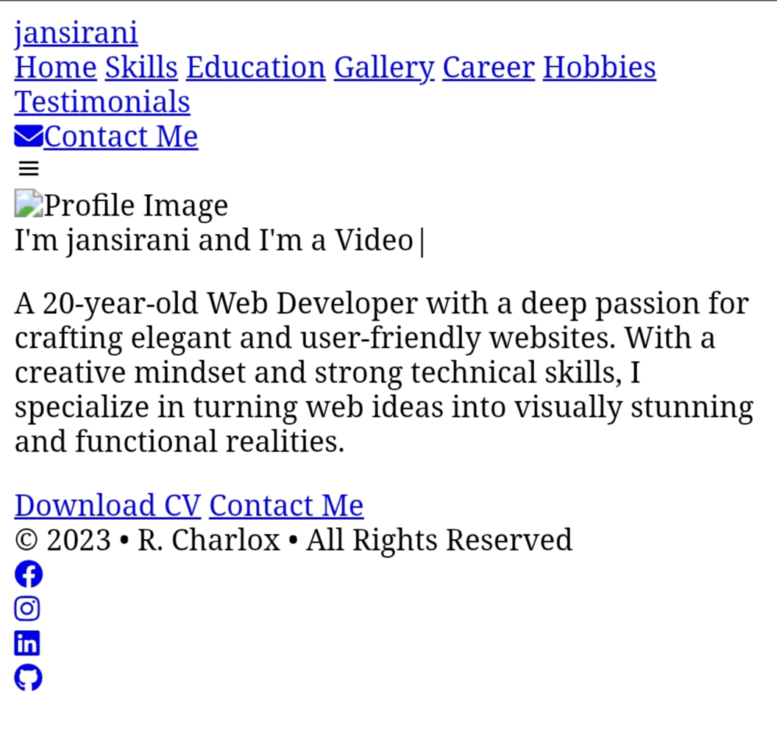
Before:

Slide 13
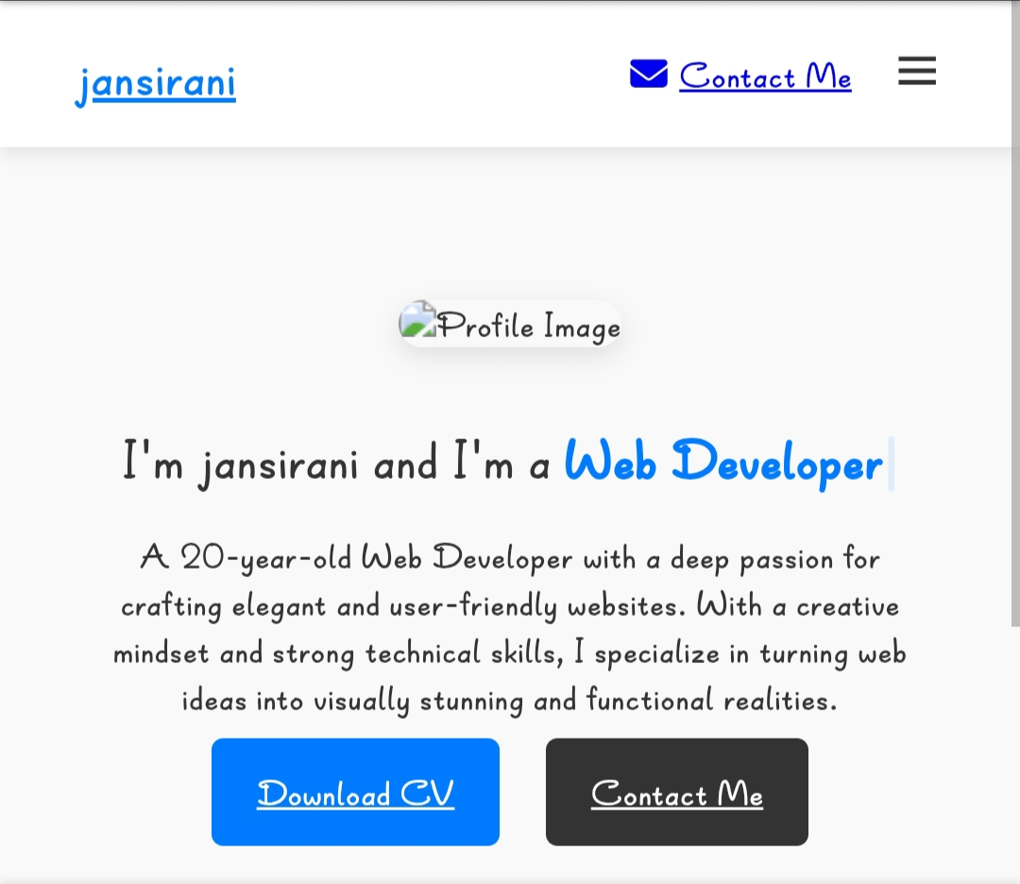
After:

Slide 14
CONCLUSION
A student digital portfolio conclusion should summarize growth, reflect on the learning process, and look toward the future, acknowledging both challenges and triumphs
14

