Slide 1



Tipping in a cellular automaton modelling forest-fire feedback in tropical forest
Bert Wuyts & Jan Sieber
University of Exeter
PNAS 120 (45), e2211853120, 2023
e-mail: b.wuyts@ex.ac.uk
twitter: @b3wu8
Notes:
Good afternoon and thanks for having me here.
I will talk today about [...].
The focus of my talk is more on the results than on the method so hence the different title than in the program.
This is based on work during my postdoc in Exeter with JS.

Slide 2
OUTLINE
Stochastic cellular automaton of forest and fire
Slow and fast processes
Analysis: steady states & dynamics
  => emergent structure-dynamics relations

Slide 3
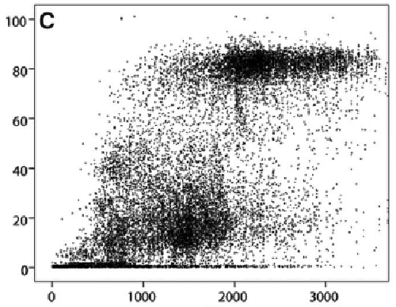
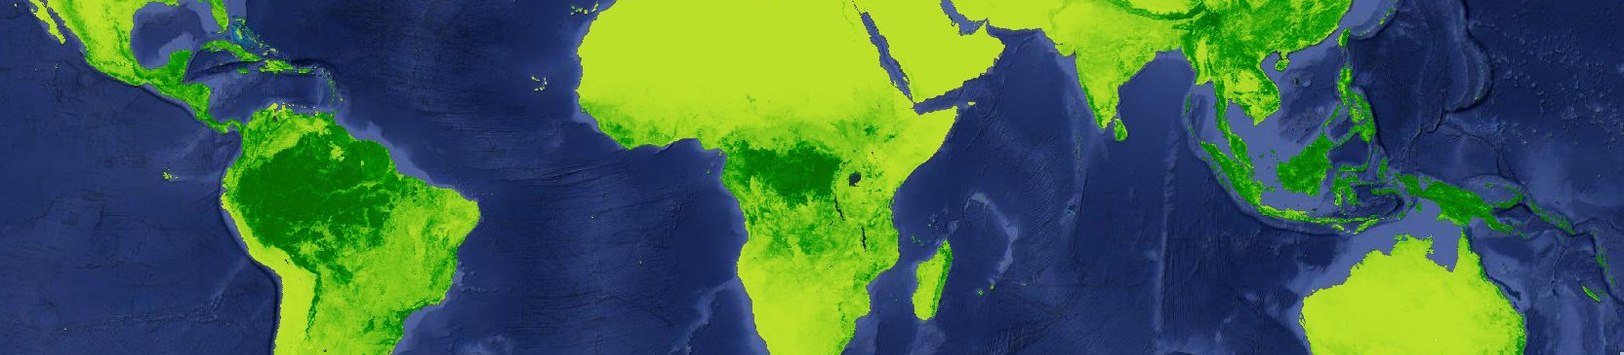
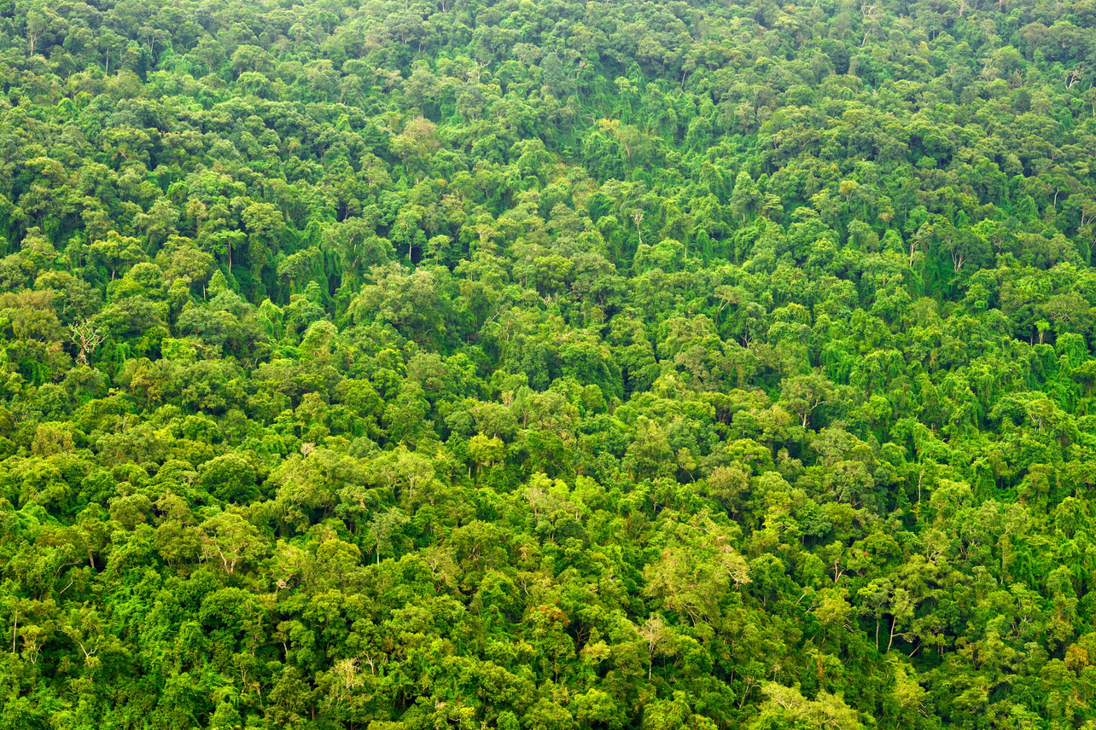
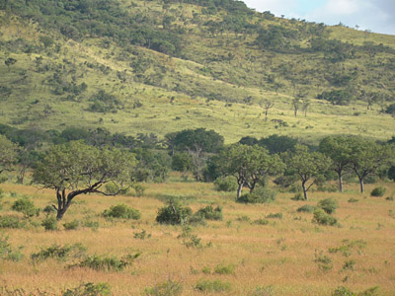
Tropical tree cover bimodality
MODIS VCF data
Tree cover (%)
Mean annual rainfall (mm)
Hirota et al., 2011
Staver et al., 2011
Notes:
Here you see a map of global TC.

Slide 4
Stochastic cellular automaton:
fire and forest dynamics

Slide 5
CA FOREST AND FIRE
Square Lattice (each cell ~ 30m x 30m)
Empirical facts:
  fire ignites and spreads in grassland
  trees block fires but get damaged
  fast fire spread (hours-days)
  slow tree spread (years-decades)
4 Species: Tree, Grass, Burning, Ash
Staver et al., 2011; 2012
Dufresne et al., 2018
Notes:
[...]

Slide 6
CA FOREST AND FIRE
Cellular automaton:
  species: {G, T, B, A}
  reactions:
G
G
G
G
T
G
G
G
T
T
G
G
T
T
T
G
Dufresne et al., 2018
Wuyts & Sieber, 2023
Notes:
[...]

Slide 7
CA FOREST AND FIRE
Cellular automaton:
  species: {G, T, B, A}
  reactions:
G
G
G
G
T
G
G
G
T
T
G
G
T
T
T
G
Dufresne et al., 2018
Wuyts & Sieber, 2023
Notes:
[...]

Slide 8
CA FOREST AND FIRE
Cellular automaton:
  species: {G, T, B, A}
  reactions:
G
G
G
G
T
T
G
G
T
T
G
G
T
T
T
G
Dufresne et al., 2018
Wuyts & Sieber, 2023
Notes:
[...]

Slide 9
CA FOREST AND FIRE
Cellular automaton:
  species: {G, T, B, A}
  reactions:
G
G
G
G
T
T
G
G
T
T
G
G
T
T
T
G
Dufresne et al., 2018
Wuyts & Sieber, 2023
Notes:
[...]

Slide 10
CA FOREST AND FIRE
Cellular automaton:
  species: {G, T, B, A}
  reactions:
G
G
G
G
T
T
G
G
T
T
G
G
G
T
T
G
Dufresne et al., 2018
Wuyts & Sieber, 2023
Notes:
[...]

Slide 11
CA FOREST AND FIRE
Cellular automaton:
  species: {G, T, B, A}
  reactions:
G
G
G
G
T
T
G
G
T
T
G
G
G
T
T
G
Dufresne et al., 2018
Wuyts & Sieber, 2023
Notes:
[...]

Slide 12
CA FOREST AND FIRE
Cellular automaton:
  species: {G, T, B, A}
  reactions:
G
G
G
G
T
T
G
T
T
T
G
G
G
T
T
G
Dufresne et al., 2018
Wuyts & Sieber, 2023
Notes:
[...]

Slide 13
CA FOREST AND FIRE
Cellular automaton:
  species: {G, T, B, A}
  reactions:
G
G
G
G
T
T
G
T
T
T
G
G
G
T
T
G
Dufresne et al., 2018
Wuyts & Sieber, 2023
Notes:
[...]

Slide 14
CA FOREST AND FIRE
Cellular automaton:
  species: {G, T, B, A}
  reactions:
B
G
G
G
T
T
G
T
T
T
G
G
G
T
T
G
Dufresne et al., 2018
Wuyts & Sieber, 2023
Notes:
[...]

Slide 15
CA FOREST AND FIRE
Cellular automaton:
  species: {G, T, B, A}
  reactions:
B
G
G
G
T
T
G
T
T
T
G
G
G
T
T
G
Dufresne et al., 2018
Wuyts & Sieber, 2023
Notes:
[...]

Slide 16
CA FOREST AND FIRE
Cellular automaton:
  species: {G, T, B, A}
  reactions:
B
B
G
G
T
T
G
T
T
T
G
G
G
T
T
G
Dufresne et al., 2018
Wuyts & Sieber, 2023
Notes:
[...]

Slide 17
CA FOREST AND FIRE
Cellular automaton:
  species: {G, T, B, A}
  reactions:
B
B
B
B
T
T
B
T
T
T
B
B
G
T
T
G
Dufresne et al., 2018
Wuyts & Sieber, 2023
Notes:
[...]

Slide 18
CA FOREST AND FIRE
Cellular automaton:
  species: {G, T, B, A}
  reactions:
B
B
B
B
T
T
B
T
T
T
B
B
G
T
T
G
Dufresne et al., 2018
Wuyts & Sieber, 2023
Notes:
[...]

Slide 19
CA FOREST AND FIRE
Cellular automaton:
  species: {G, T, B, A}
  reactions:
B
B
B
B
B
T
B
T
T
T
B
B
G
T
T
G
Dufresne et al., 2018
Wuyts & Sieber, 2023
Notes:
[...]

Slide 20
CA FOREST AND FIRE
Cellular automaton:
  species: {G, T, B, A}
  reactions:
B
B
B
B
B
T
B
T
T
T
B
B
G
T
T
G
Dufresne et al., 2018
Wuyts & Sieber, 2023
Notes:
[...]

Slide 21
CA FOREST AND FIRE
Cellular automaton:
  species: {G, T, B, A}
  reactions:
A
B
B
B
B
T
B
T
T
T
B
B
G
T
T
G
Dufresne et al., 2018
Wuyts & Sieber, 2023
Notes:
[...]

Slide 22
CA FOREST AND FIRE
Cellular automaton:
  species: {G, T, B, A}
  reactions:
A
A
A
A
A
T
A
T
T
T
A
A
G
T
T
G
Dufresne et al., 2018
Wuyts & Sieber, 2023
Notes:
[...]

Slide 23
CA FOREST AND FIRE
Cellular automaton:
  species: {G, T, B, A}
  reactions:
A
A
A
A
A
T
A
T
T
T
A
A
G
T
T
G
Dufresne et al., 2018
Wuyts & Sieber, 2023
Notes:
[...]

Slide 24
CA FOREST AND FIRE
Cellular automaton:
  species: {G, T, B, A}
  reactions:
G
A
A
A
A
T
A
T
T
T
A
A
G
T
T
G
Dufresne et al., 2018
Wuyts & Sieber, 2023
Notes:
[...]

Slide 25
CA FOREST AND FIRE
Cellular automaton:
  species: {G, T, B, A}
  reactions:
G
G
G
G
G
T
G
T
T
T
G
G
G
T
T
G
Dufresne et al., 2018
Wuyts & Sieber, 2023
Notes:
[...]

Slide 26
CA FOREST AND FIRE
trees
grass
fast fire spread (<hours)
medium
grass regrowth (months)
slow tree
dynamics
(decades)
ash
fire
Dufresne et al., 2018
Wuyts & Sieber, 2023
Notes:
[...]

Slide 27
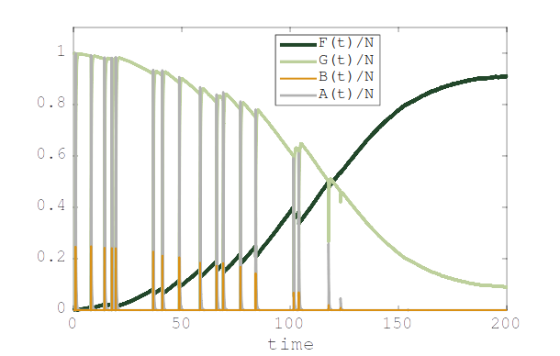
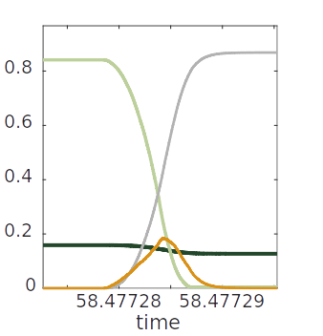
CA FOREST AND FIRE
trees
grass
ash
fire
video
Dufresne et al., 2018
Wuyts & Sieber, 2023
Notes:
[...]

Slide 28
Analysis of the forest & fire automaton
steady states,
dynamics
and
structure-dynamics relations

Slide 29
CA FOREST AND FIRE
Fire spreading probability
B
T
B
A
B
T
B
G
B
A
B
G
Dufresne et al., 2018
Wuyts & Sieber, 2023
Notes:
[...]

Slide 30
MACROSCOPIC QUANTITIES
Steady states and dynamics
=> first define macroscopic quantities:
- frequency of T or G cells: [T], [G] (FOREST/GRASS AREA)
- frequency of TG pairs: [TG] (FOREST PERIMETER)
normalised by N:
e.g.:
G
G
G
G
[T] = 3/16
[G] = 13/16
[TG] = 8/16
G
T
G
G
G
T
T
G
NOTE:
mean field assumes
[TG] = 4 [T][G]
but:
[TG] = 0.5 < 4 [T][G] = 0.61
G
G
G
G
Notes:
[...]

Slide 31
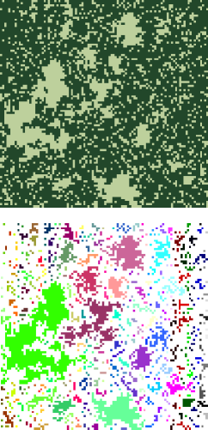
SLOW-FAST DYNAMICS
Fast dynamics
For each grass patch, fires ignite and spread through entire patch to bounding forest:
forest exposure to fire damage:
Slow dynamics
fire-induced loss:
forest spread and spontaneous conversion:
# fires per time
in cluster j
loss per fire
in cluster j
Wuyts & Sieber, 2023
Notes:
[...]

Slide 32
BALANCE ON SLOW TIMESCALE
Overall
rate of change
forest perimeter
for spread
“grassland-weighted
forest perimeter”
for loss
undetermined
Wuyts & Sieber, 2023
Notes:
[...]

Slide 33
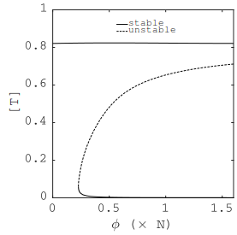
STEADY STATES VIA FEEDBACK CONTROL
conventional simulation
Wuyts & Sieber, 2023
Notes:
[...]

Slide 34
STEADY STATES VIA FEEDBACK CONTROL
video (T0 = 40%)
simulation with feedback control
Wuyts & Sieber, 2023
Notes:
[...]

Slide 35
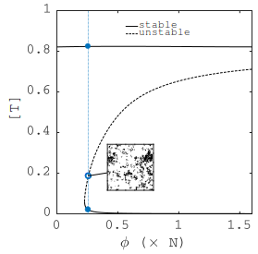
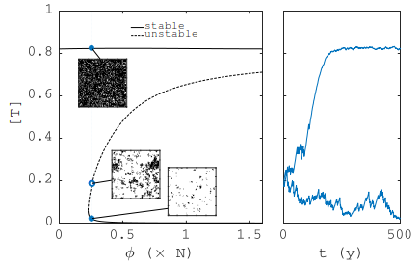
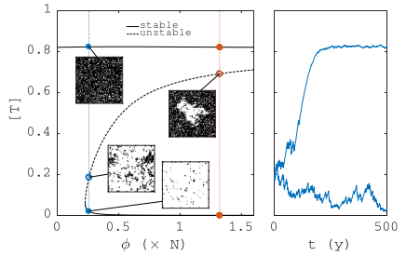

STEADY STATES & BISTABILITY
trees
grass
ash
fire
Wuyts & Sieber, 2023
Notes:
[...]

Slide 36
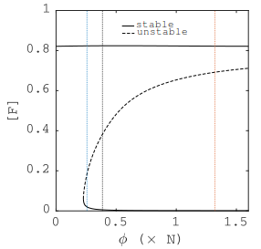
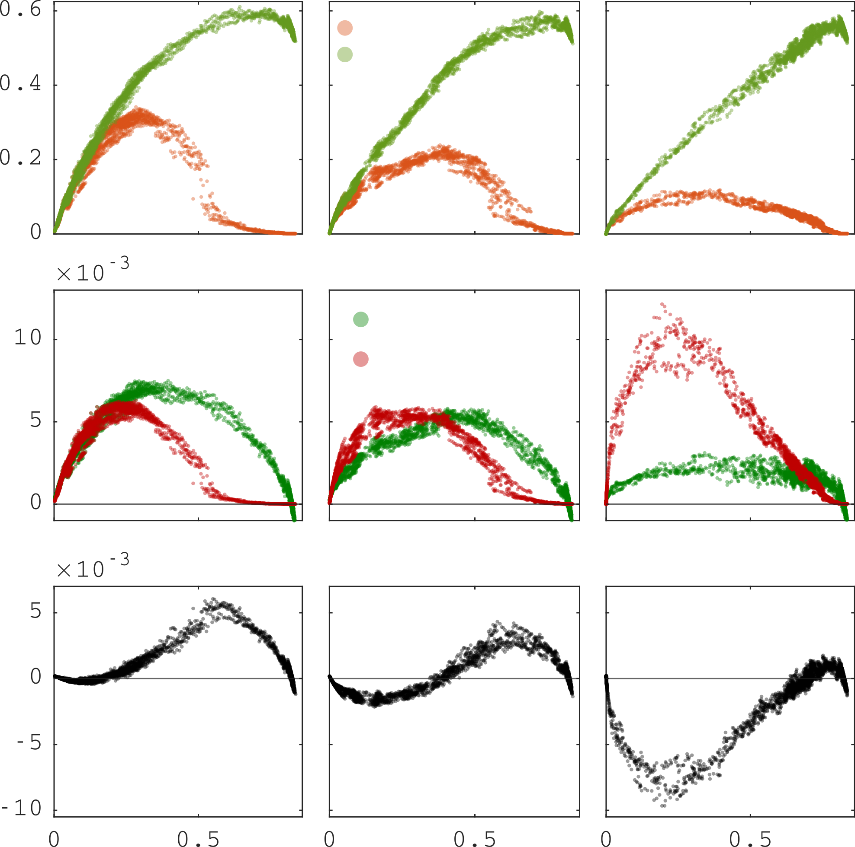
CLOSURE
gain
loss
R.H.S. of emerging scalar ODE
Wuyts & Sieber, 2023
Notes:
[...]

Slide 37
STRUCTURE-DYNAMICS RELATIONS
linear terms
(independent of spatial structure)
nonlinear terms
(emerge from interactions
at forest perimeter)
perimeter-area relation
weighted perimeter-area relation
Can be calculated from spatial data
=> test where fire feedbacks are strong enough to cause bistability
Wuyts & Sieber, 2023
Notes:
[...]

Slide 38
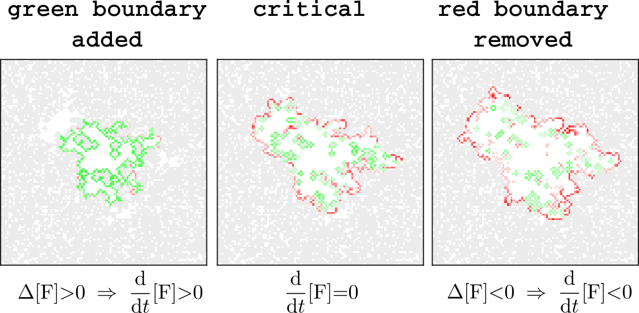
EARLY-WARNING SIGNS
Hole of critical size in the forest
Wuyts & Sieber, 2023
Notes:
[...]

Slide 39
CONCLUSIONS
Hypothesis of tropical tree cover bistability relies on bimodality in observations, but alternative explanations exist
=> more specific indicators are required
Processes on extremely different timescales
=> slow-fast analysis gives forest balance equation
Spreading processes occur near the forest perimeter
=> structure-dynamics relations emerge
=> test where fire-vegetation feedbacks cause bistability
Explore saddle landscapes
Explore Ash blocking fire spread for frequent fires

