Slide 1
NON-REVIT APPLICATIONS
RHINO - GRASSHOPPER
Form Generation
Export Tool Gadgets
C# CODE
Complex Problems
Custom Functions
OTHER - POTENTIAL
AutoCAD
ArchiCAD
Primary Use
Secondary Workflow
C# DLL LIBRARY
UTILITY TOOLS FOR READING / WRITING .CSV FILE
.CSV – Text File
PSEUDO-LANGUAGE
Primary Use
Sample Data and
Secondary Workflow
MODEL BUILDER - REVIT API ADD-IN
CONCEPTUAL MASS EDITOR
REVIT MODEL EDITOR

Slide 2
RHINO GRASSHOPPER
Form Generation
Export Tool Gadgets
C# MODEL BUILDER TOOL
Complex Development
Excel Export Library
PROCESS
To be Defined
OTHER
AutoCAD
Generative Components
EXCEL
PSEUDO-LANGUAGE
Primary Use of the Tool
Future Workflow
Sample Data
REVIT API ADD-IN
MODEL BUILDER
VASARI
REVIT

Slide 3
RHINO GRASSHOPPER
Form Generation
Export Tool Gadgets
C# MODEL BUILDER TOOL
Complex Development
Custom Functions
OTHER ACTIVE
Procesing
Cinema 4D
OTHER POTENTIAL
AutoCAD
Generative Components
C# DLL LIBRARY
UTILITY TOOLS FOR WRITING TO EXCEL
EXCEL
PSEUDO-LANGUAGE
Primary Use of the Tool
Future Workflow
Sample Data
REVIT API ADD-IN
MODEL BUILDER
VASARI
REVIT

Slide 4
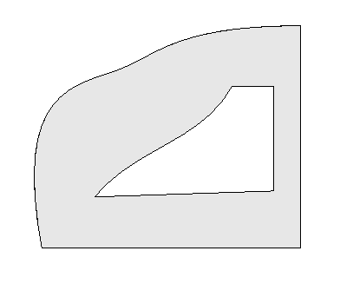
OUTER LOOP
LINE
NURBS SPLINE
LINE
INNER LOOP
LINE
LINE
LINE
NURBS SPLINE

Slide 5
NON-REVIT APPLICATIONS
RHINO - GRASSHOPPER
Form Generation
Export Tool Gadgets
C# CODE
Complex Problems
Custom Functions
OTHER - POTENTIAL
AutoCAD
ArchiCAD
Primary Use
Future Workflow
C# DLL LIBRARY
UTILITY TOOLS FOR READING / WRITING .CSV FILE
.CSV – Text File
PSEUDO-LANGUAGE
Primary Use
Sample Data and
Future Workflow
MODEL BUILDER - REVIT API ADD-IN
VASARI
REVIT

