Slide 1

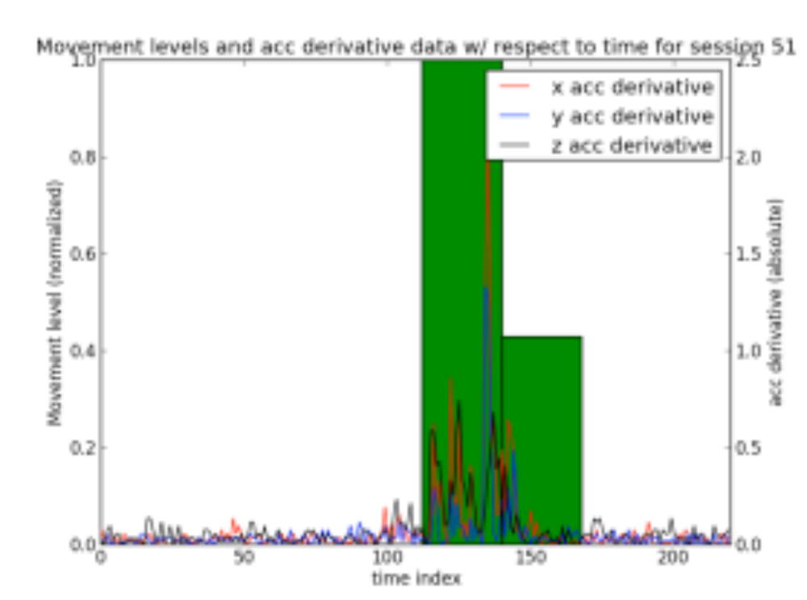
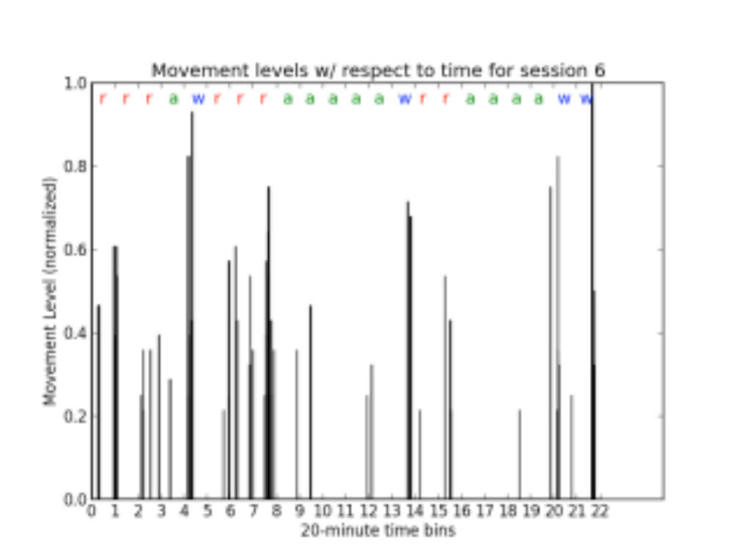
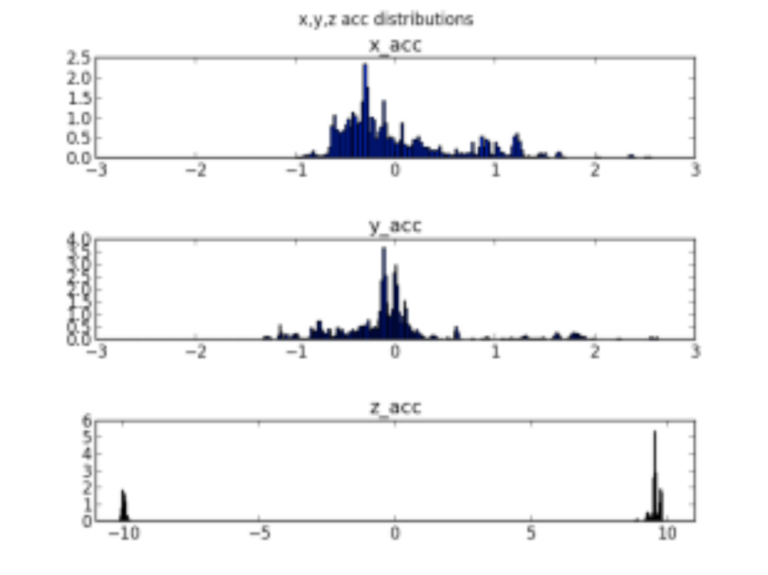
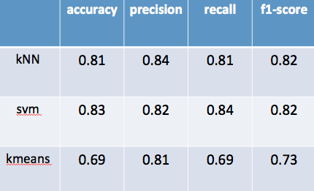
Do we dream or do we have a nightmare?
Josh Antonson
ECE 18-755 M4 Poster Session May 5, 2015
1. Introduction
2. Problem description
Sleep is fundamental
  Four stages of sleep
    1, 2, 3, and REM
    characterized by different properties such as brain wave form, body movement, etc.
    sleep cycles through these stages
  Pattern of sleep
    each full cycle through the stages lasts on average 90 minutes
    when we sleep and how we sleep is largely affected by daily behavior and environmental conditions
    the more consistent our routine, the better we sleep
    each person has unique sleep patterns
Analyze a user’s sleep / wake patterns
  Android Application
    collect accelerometer data during the sleep duration
    data is stored in cloud server
    aggregate user data over a period of time (1 week)
  Analyze sleep behavior
    precise modeling of aggregated user data
    use collected data to display patterns of sleep
    optimize to demonstrate saving in one metric of interest (accuracy vs. performance)
3. Approach
4. Results
Details
  Data collection
    android application records five acc readings (x, y, z) per second
    each user records five sessions where they lay still in different positions (on back, on stomach, on left side, on right side, empty bed)
    training set of users label each 20 minute time window as “restless”, “asleep”, or “woke up”
  Identify movements
    establish acc derivative threshold values [-b1, +b1] for each user’s no movement sessions
    acc reading outside threshold is considered a movement
    count number of movements within each two second window
  Classify sleep
    train classifier using aggregated user data to recognize labels for each 20 minute time window
    update classifier using individualized user behavior information
    display time-based graph of user sleep with generated labels and key metrics
Plots
Summary
  Accurately classifies user’s sleep
    5 users with a total of 31 nights of acc data
    classifier learns user’s sleep patterns
    app provides predictions about their sleep patterns
classification results

