Slide 1
Do we dream or do we have a nightmare?
Most current sleep apps measure sleep movement and attempt to wake user up at best time or help the user fall asleep
This ignores the underlying reasons why one is not sleeping well
No current app attempts to relate sleep pattern to their daily behavior
Sleep is majorly impacted by many different factors… Why is there not an app that tracks these factors too?
Notes:
- What is the problem that you are trying to solve?
- What are the main objectives?

Slide 2
Approach
Android application collects daily behavior information and records accelerometer data during sleep, which syncs with server running in Google App Engine.
Analyze the accelerometer data to determine movement during sleep and the different sleep phases
Analyze relationships between user’s daily behavior, sleep conditions, and sleep/wake patterns to determine positive/negative influences
Notes:
Explain the main steps of your approach and emphasize what is novel.
- Comment on main assumptions; use small examples to illustrate the main ideas, as appropriate.

Slide 3
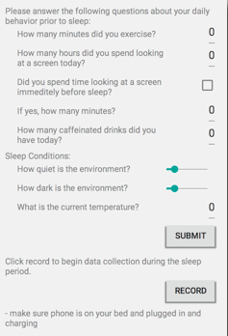
Sample entry for data recorded during sleep:
“sensor_type” = “accelerometer”
“time” = 1424693685510
“x_acc” = [0.2745819, 0.23535156, 0.2647705, 0.2647705, 0.22555542, 0.24516296, 0.24516296, 0.21574402, 0.24516296, 0.21574402, … ]
“y_acc” = [0.06864929, 0.039215088, 0.009796143, -0.019607544, 0.05883789, 0.04902649, 0.088256836, 0.029418945, 0.05883789, 0.039230347, …]
“z_acc” = [9.728195, 9.855682, 9.76741, 9.87529, 9.855682, 9.728195, 9.777222, 9.757614, 9.806656, 9.83606, … ]

Slide 4
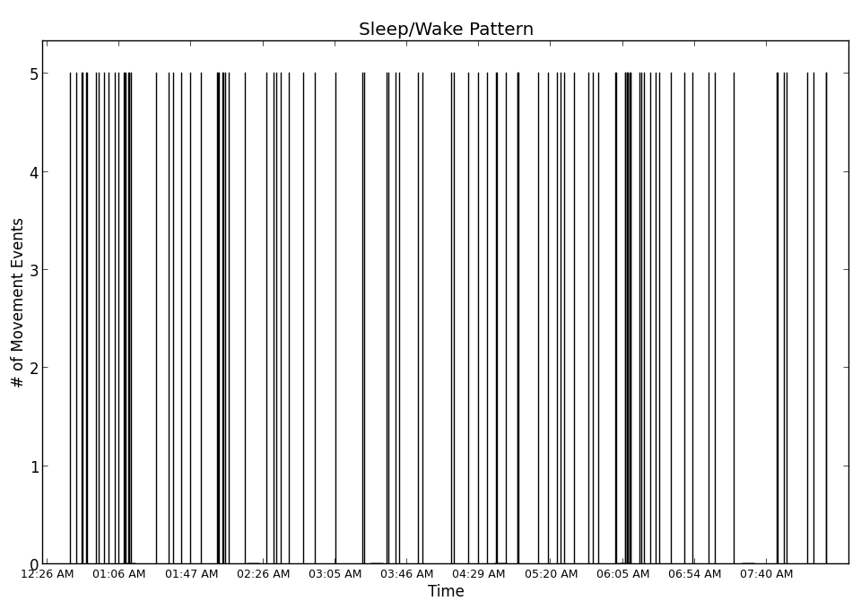
Preliminary Results
Notes:
Present preliminary results (e.g., plots, tables, simulation traces, etc.). Do they make sense?
Comment on challenges, anticipated difficulties, and possible solutions.
Robust algorithm to detect sleep movement from accelerometer data
Isolating key factors from many different factor data collected
Finding relationship between daily behavior factors and sleep pattern
Efficient data collection during sleep (rate of collection and sync with server)

Slide 5
Conclusion and short-term plans
(1) Figure out best algorithm to determine sleep movement/wake patterns (potentially training a classifier to detect outliers)
(2) Allow multiple concurrent users to use app
(2) Collect data from multiple users (5-10) over a period of 1-2 weeks
(3) Begin to explore relationship data between factors and sleep patterns
Notes:
What are your plans for Milestone 2?
- What are the next tasks/timeline?

