Slide 1
Do we dream?
Josh Antonson

Slide 2
Overview
Android app which measures accelerometer data during sleep and stores in database
Analyze sleep data to make decisions regarding the sleep/wake patterns
For m2, focused on identifying movement during sleep

Slide 3
Approach (2-3 slides)
1. Record training accelerometer data for user
2. Extract movement events during sleep
3. Classify sleep according to movement events

Slide 4

Step 1: Training
Place phone in 6 different locations
Record user in 5 positions:
Lying on left side
Lying on right side
Lying on back
Lying on stomach
Empty bed
Establish baseline values [-b1, + b2] for acc data

Slide 5
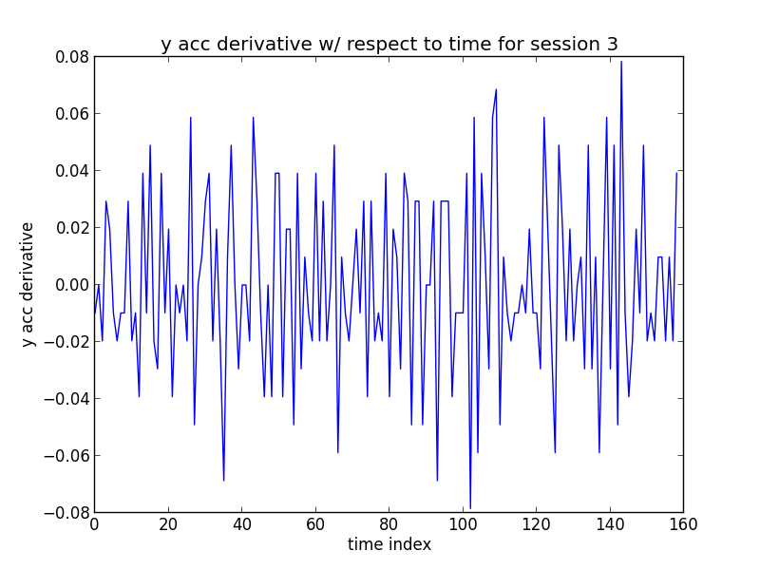

Slide 6
Step 2: Extracting Movement Events
Record all time steps where acc value exceeds [-b1, +b2] threshold = movement event
For each 2 second window count number of movement events and normalize
Remove windows where movement event level < 0.20

Slide 7
Step 2: Classifying sleep
Cluster movement windows
Highlight areas of restlessness vs. being asleep
Detect when user wakes up
Compare to user generated labels

Slide 8
Relevant results
Successfully detect noticeable movements such as rolling over, sitting up, getting out of bed, etc.
Avoids detecting subtle movements that do not affect sleep
Detect periods of restlessness and and when user wakes up

Slide 9
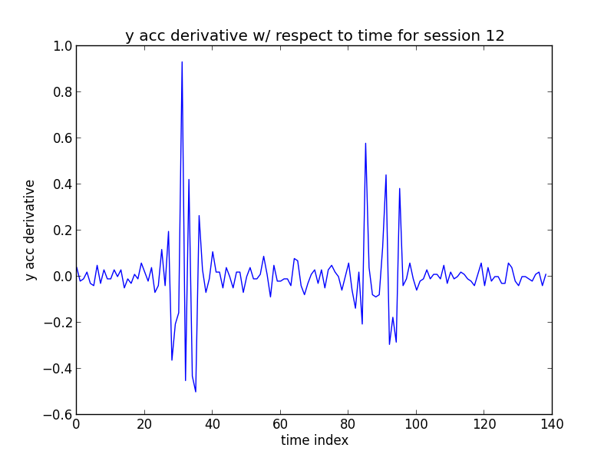

Slide 10
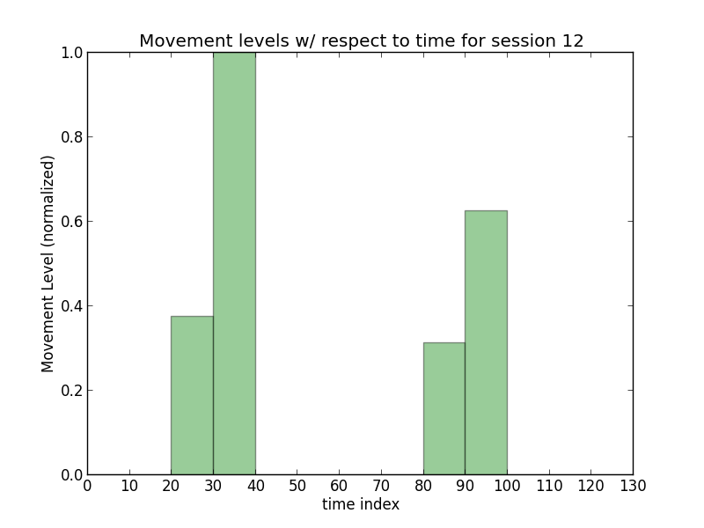

Slide 11
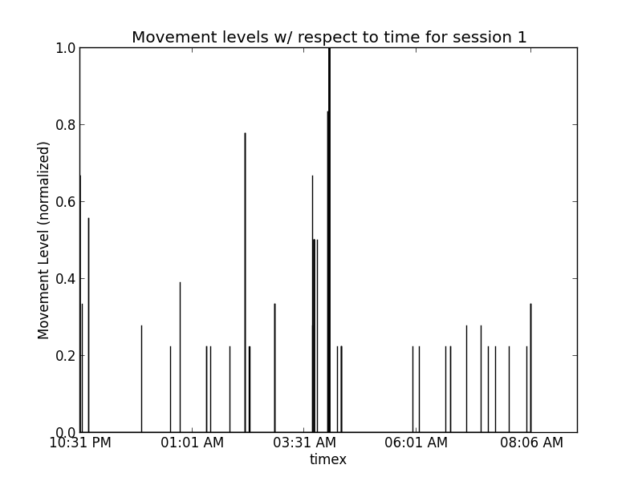
I woke up at 3:40am

Slide 12
Summary and short-term plans
Detects movement events during sleep and identifies restlessness vs. sound sleep and when user wakes
For M3,
Label sleep stages during sleep using movement event data
Detect different movements during sleep (rolling over vs. sitting up vs. getting out of bed, etc.)
Compare results to Fitbit and other sleep apps

