Slide 1



VS-Lite
Jan Tumajer
Charles University, Prague
Czech Republic
tumajerj@natur.cuni.cz

Slide 2
VS-Lite
Low-complexity non-linear sink-oriented process-based/empirical model of tree-ring formation
Suzan Tolwinski-Ward et al. : https://github.com/suztolwinskiward
Tolwinski-Ward, S.E., Evans, M.N., Hughes, M.K., Anchukaitis, K.J., 2011. An efficient forward model of the climate controls on interannual variation in tree-ring width. Clim. Dyn. 36, 2419–2439. https://doi.org/10.1007/s00382-010-0945-5

Slide 3
What are key assumptions of climate-growth correlations?
Linearity
Problem for extrapolation
Independence
No interaction between explanatory climate variables
Nonstationarity
Nonsignificant shifting of climate-growth response over time
r
p-value
Tree-ring width [mm]
r
p-value
0
5
10
Temperature [°C]

Slide 4

Linear or non-linear response in ecology?
Tree-ring width [mm]
Tree-ring width [mm]
Tree-ring width [mm]
Environmental variable
Environmental variable
Environmental variable
Temperature
CO2 concetration (greenhouse)
N concentration in soil

Slide 5
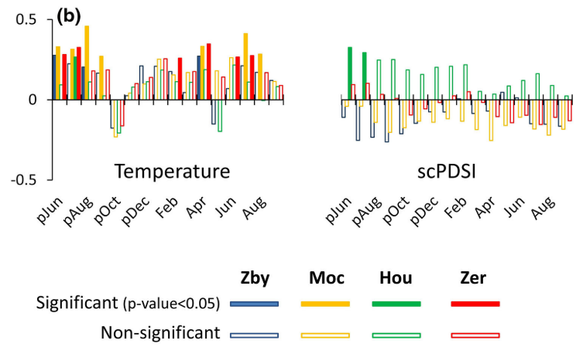
Which climatic variable drives tree growth in Each moment?
Species with autocorrelation
Early growing season
Rather cold than dry environment
… but climate-growth correlations can not answer following questions:
How trees grew during 1976 extreme year?
What shapes the growth in May?
Was the climatic response stable over the calibration period?
Wilmking, M et al. 2020. Global assessment of relationships between climate and tree growth. Glob. Chang. Biol. 26, 3212–3220. https://doi.org/10.1111/gcb.15057
…
(Tumajer and Treml 2017: Trees-Structure and Function)

Slide 6
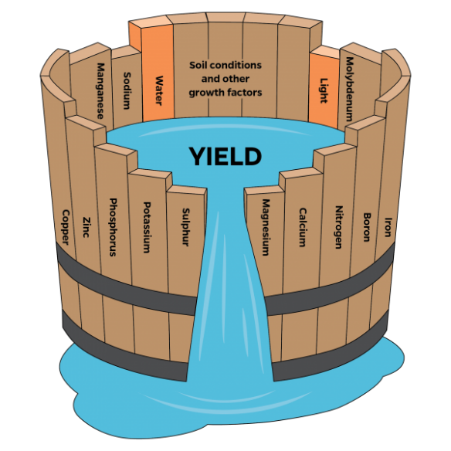
How moisture and temperature interact?
… but climate-growth correlations can not answer following questions:
How growth responds to the interaction of multiple climatic factors?
(Tumajer and Treml 2017: Trees-Structure and Function)

Slide 7
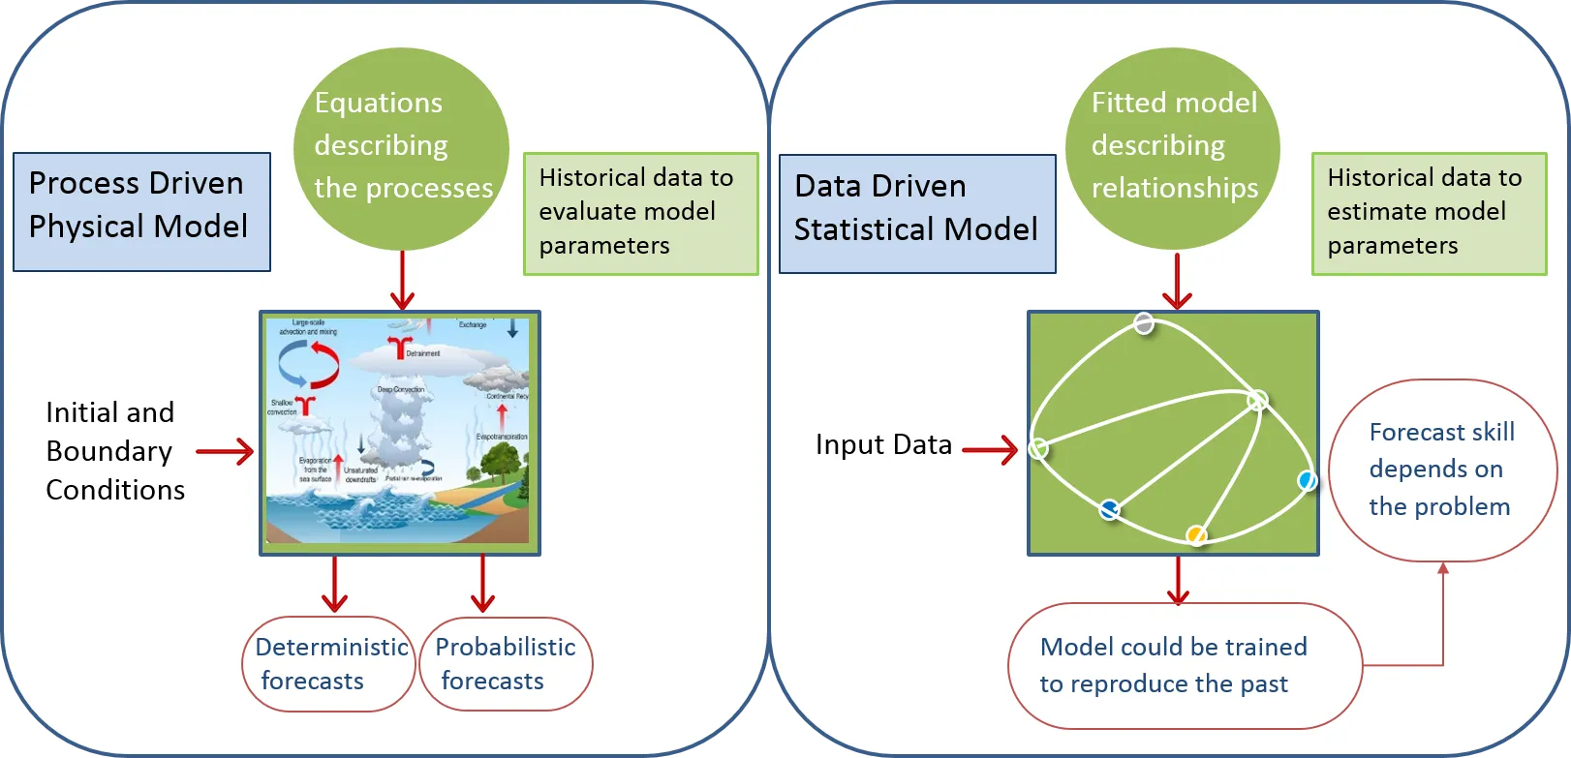
Statistical/empirical/process-based models

Slide 8
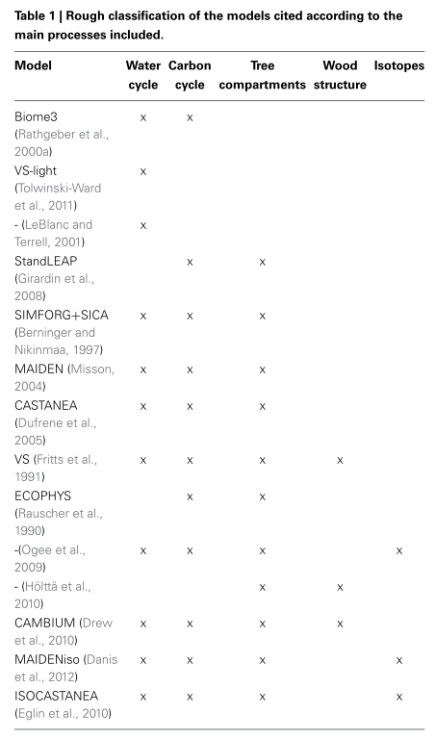
Process-based models of wood formation
= sets of numerical equations that implement current state of knowledge about mechanisms of environmental control on tree-ring formation
Xylogenesis, phenology
QWA
Physiology (usually photosynthesis)
Isotopes, …
Hormones, …
Eckes-Shephard et al. (2022): Frontiers in Plant Science
Guiot et al. (2014): Frontiers in Ecology and Evolution
Sink models
Source models

Slide 9
VS-Lite
Low-complexity …
Considers only climatic limitation of the growth (temperature, soil moisture)
Works with monthly resolution
+ Can be applied almost everywhere (you only need montly temperature, precipitation and site chronology)
- Less detailed outputs of simulations compared to other models
… non-linear …
Climate-growth response functions are non-linear
... sink-oriented …
Considers direct effects of climate on cambium, ignores everything related to photosynthesis
… process-based/empirical model of wood formation

Slide 10
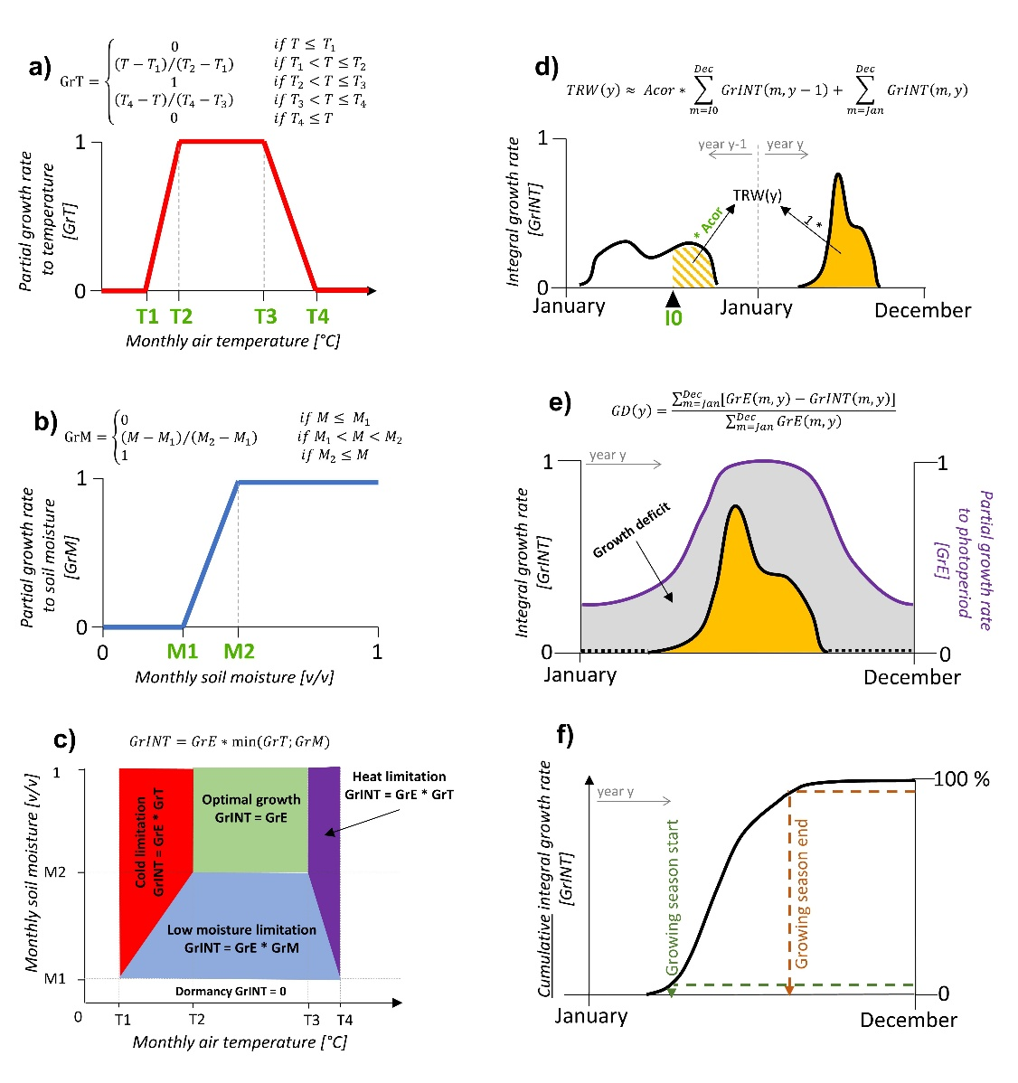
VS-Lite – workflow
Simulating tree-ring width
Calculating monthly
growth rates
Seasonal growth phenology
Monthly climatic limitation

Slide 11
VS-Lite – workflow (1)
Calculating environmental variables that (according to the model) affect tree growth
Mean monthly air temperature T[°C]
Provided by the user as an input
Mean monthly volumetric soil moisture M[v/v]
Provided by the user as an input OR …
… calculated from temperature and precipitation (input) by inbuild soil moisture model (Huang, J., et al. 1996)
Mean monthly daylength E[h]
Calculated automatically from site latitude

Slide 12
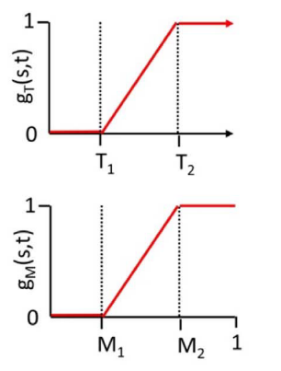
VS-Lite – workflow (2)
Converting environmental variables into monthly partial growth rates
= relative variable describing the capacity of a tree to form wood under given temperature OR soil moisture OR daylength
0 = no growth, dormancy; 1 = optimum, full capacity to growth
Partial growth rate to temperature (GrT) and partial growth rate to soil moisture (GrM)
Determined from climatic variables by means of non-linear response functions
GrT
GrM

Slide 13
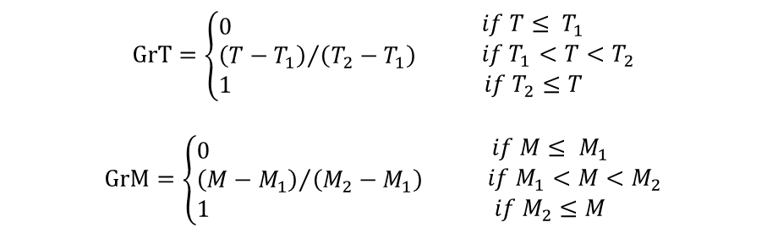
VS-Lite – workflow (3)
Converting environmental variables into monthly partial growth rates
= relative variable describing the capacity of a tree to form wood under given temperature OR soil moisture OR daylength
0 = no growth, dormancy; 1 = optimum, full capacity to growth
T₁, T₂, M₁ and M₂ are usually calibrated
$$GrT=\left\{\begin{aligned}&0 \\ &{\left(T−T_{1}\right)}/{\left(T_{2}−T_{1}\right)} \\ &1\end{aligned}\right. \begin{matrix}if T≤ T_{1} \\ if T_{1}<T<T_{2} \\ if T_{2}≤T\end{matrix}$$
$$GrM=\left\{\begin{aligned}&0 \\ &{\left(M−M_{1}\right)}/{\left(M_{2}−M_{1}\right)} \\ &1\end{aligned}\right. \begin{matrix}if M≤ M_{1} \\ if M_{1}<M<M_{2} \\ if M_{2}≤M\end{matrix}$$

Slide 14
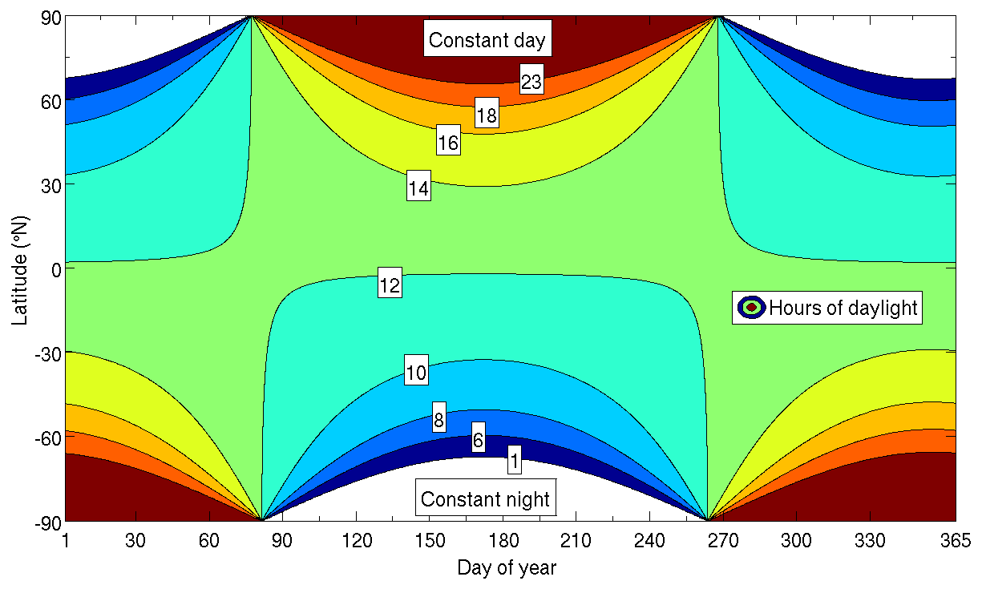
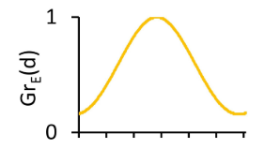
VS-Lite – workflow (4)
Converting environmental variables into monthly partial growth rates
Partial growth rate to daylength (GrE)
GrE(d) = daylength of day d / daylength of summer solstice
Calculated automatically
GrE(d)

Slide 15
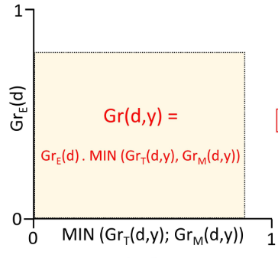
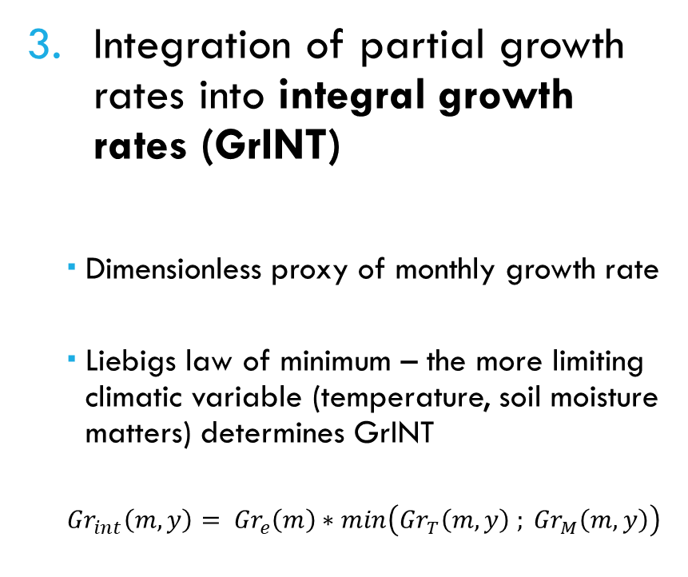
VS-Lite – workflow (5)
Integration of partial growth rates into integral growth rates (GrINT)
Dimensionless proxy of monthly growth rate
Liebigs law of minimum – the more limiting climatic variable (temperature, soil moisture matters) determines GrINT
$${Gr}_{int}\left(m,y\right)= {Gr}_{e}\left(m\right)∗min\left({Gr}_{T}\left(m,y\right) ; {Gr}_{M}\left(m,y\right)\right)$$
GrE(m)
min(GrT(m,y); GrM(m,y))

Slide 16

VS-Lite – workflow (6)
Identification of dominant climatic limiting factor of growth for each month
GrINT follows lower of GrT and GrM
0 < GrT < GrM … temperature-limited
0 < GrM < GrT … moisture-limited
GrT = GrM = 1 … optimal growth
GrINT = 0 … dormancy
1
Temperature-limited
Optimal
M₂
Moisture-limited
M₁
Dormancy
0
T₁
T₂

Slide 17
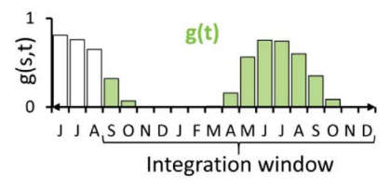
VS-Lite – workflow (7)
Calculating simulated annual tree-ring width chronology
≈ sum of GrINT during the given year + (optionally) part of GrINT from the previous year * (optionally) weight
GrINT

Slide 18
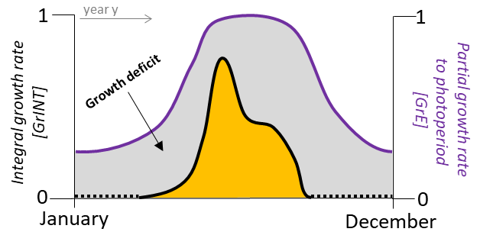
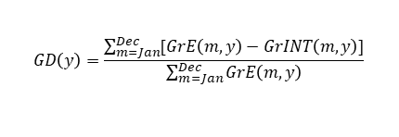
VS-Lite – workflow (8)
6. Calculating growth deficit (GD)
Difference between integral growth rate and partial growth rate to photoperiod
Proportion of possible growth that was lost due to climatic limitation
e)
$$GD\left(y\right)=\frac{\sum_{m=Jan}^{Dec}{[GrE\left(m,y\right)−GrINT\left(m,y\right)]}}{\sum_{m=Jan}^{Dec}{GrE\left(m,y\right)}}$$
1
year y
1
Growth deficit
Integral growth rate
[GrINT]
Partial growth rate
to photoperiod
[GrE]
0
0
January
December

Slide 19
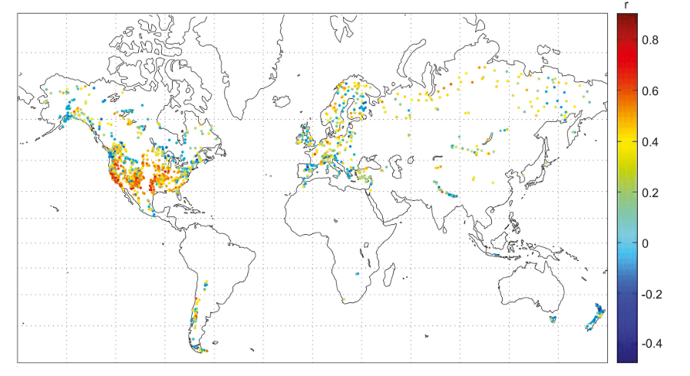
Global application of the VS-Lite
Breitenmoser et al (2014): Climate of the Past

Slide 20
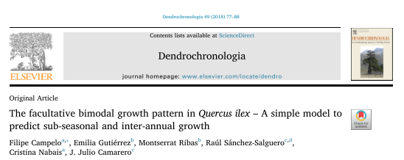
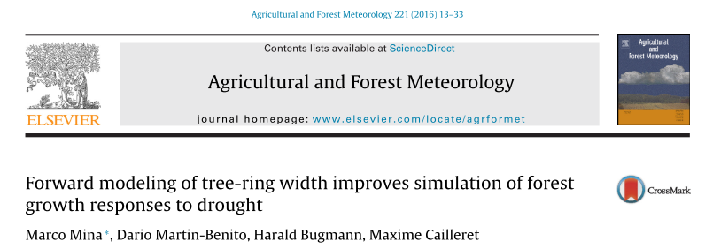
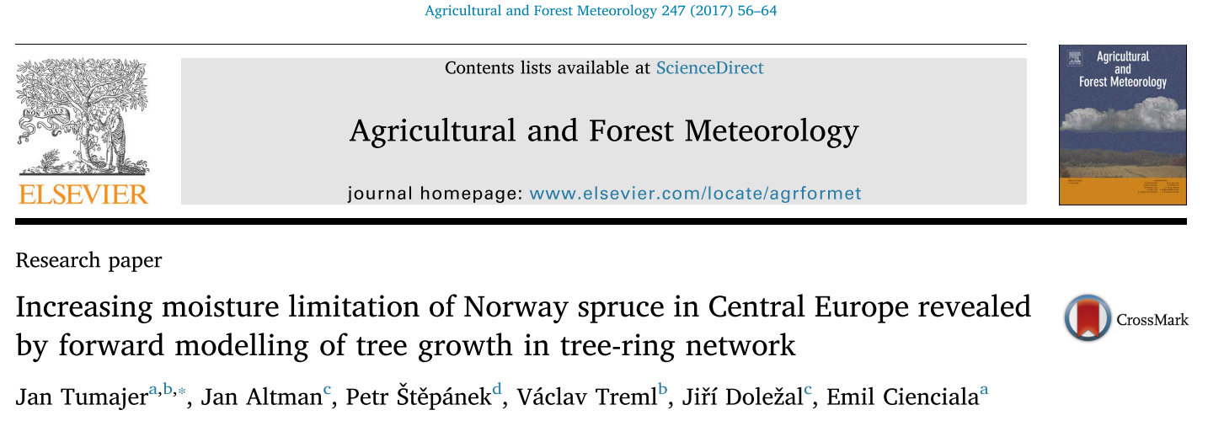
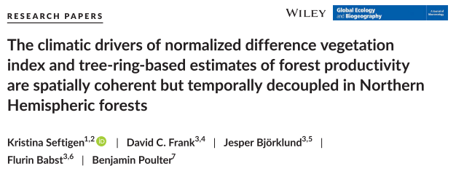


Model development

Slide 21
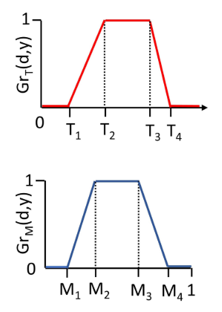

Model Modifications (1)
More complexity in response functions
Declining partial growth rates for too high temperatures and too high soil moisture
New parameters T₃, T₄, M₃, M₄
New types of limitation
Low temperature – High temperature
Drought – Soil water oversaturation (wetlands!!!)
$${Gr}_{T}=\left\{\begin{aligned}& 0 \\ &{\left(T−T_{1}\right)}/{\left(T_{2}−T_{1}\right)} \\ &\begin{matrix}1 \\ {\left(T_{4}−T\right)}/{\left(T_{4}−T_{3}\right)} \\ 0\end{matrix}\end{aligned}\right. \begin{matrix}if T≤ T_{1} \\ if T_{1}<T≤T_{2} \\ \begin{matrix}if T_{2}<T≤T_{3} \\ if T_{3}<T≤T_{4} \\ if T_{4}≤T \end{matrix}\end{matrix}$$

Slide 22
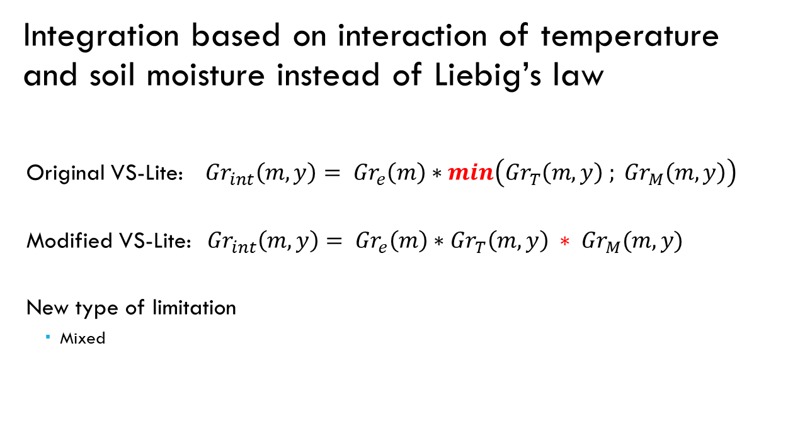
Model Modifications (2)
Integration based on interaction of temperature and soil moisture instead of Liebig’s law
Original VS-Lite: ${Gr}_{int}\left(m,y\right)= {Gr}_{e}\left(m\right)∗min\left({Gr}_{T}\left(m,y\right) ; {Gr}_{M}\left(m,y\right)\right)$
Modified VS-Lite:${Gr}_{int}\left(m,y\right)= {Gr}_{e}\left(m\right)∗{Gr}_{T}\left(m,y\right) ∗ {Gr}_{M}(m,y)$
New type of limitation
Mixed

Slide 23
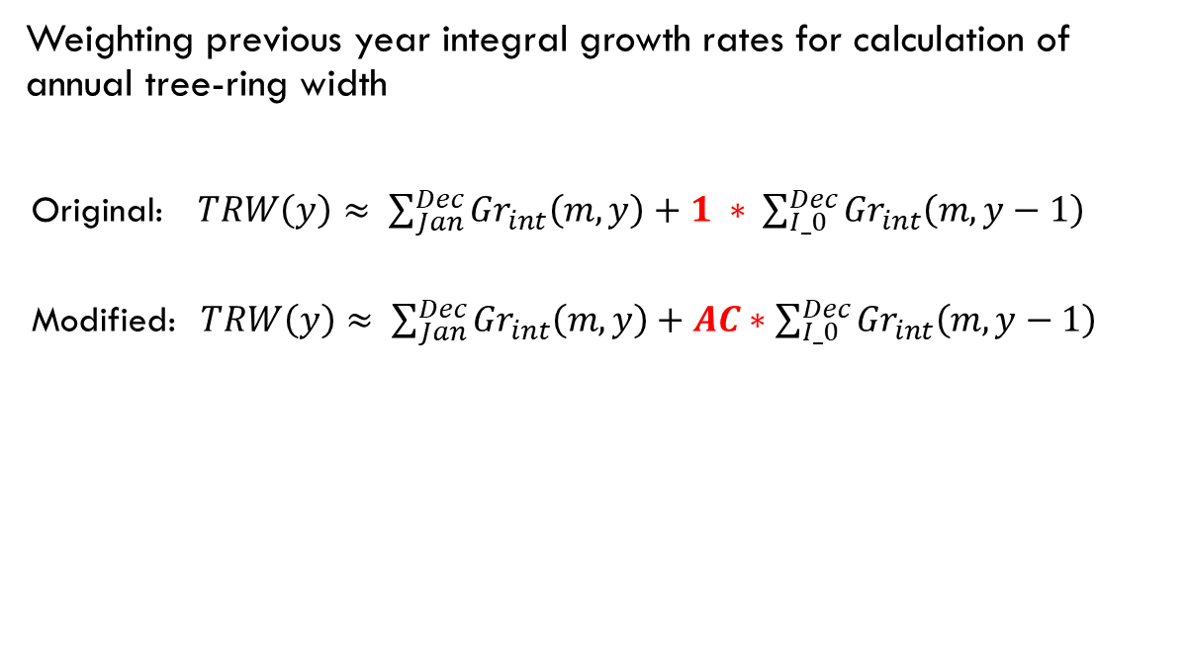
Model Modifications (3)
Weighting previous year integral growth rates for calculation of annual tree-ring width
Original: $TRW\left(y\right)≈ \sum_{Jan}^{Dec}{{Gr}_{int}\left(m,y\right)}+1 ∗ \sum_{I_0}^{Dec}{{Gr}_{int}\left(m,y−1\right)}$
Modified:$TRW\left(y\right)≈ \sum_{Jan}^{Dec}{{Gr}_{int}\left(m,y\right)}+AC∗\sum_{I_0}^{Dec}{{Gr}_{int}\left(m,y−1\right)}$

Slide 24
Model Modifications (4)
Original GrINT definition
Modified GrINT definition
1
1
Limitation:
Cold
Warm
Dry
Wet
Mixed
Optimal growth
M₄
M₄
M₃
M₃
Liebig’s law (minimum)
M₂
M₂
M₁
M₁
0
T₁
T₂
T₃
T₄
0
T₁
T₂
T₃
T₄
1
1
M₄
M₄
M₃
M₃
Interaction (multiplication)
M₂
M₂
M₁
M₁
0
T₁
T₂
T₃
T₄
0
T₁
T₂
T₃
T₄

Slide 25
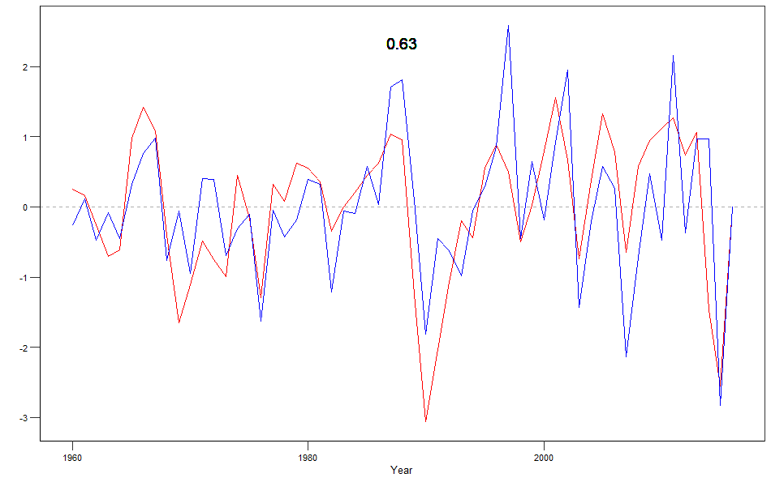
Results presentation (1)
Simulated and observed chronologies

Slide 26
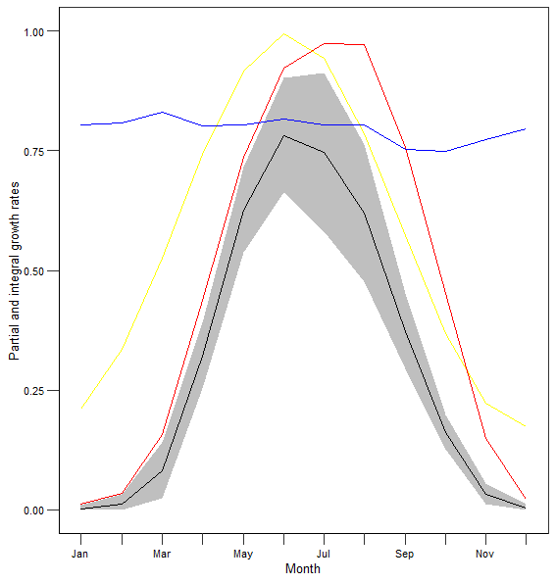
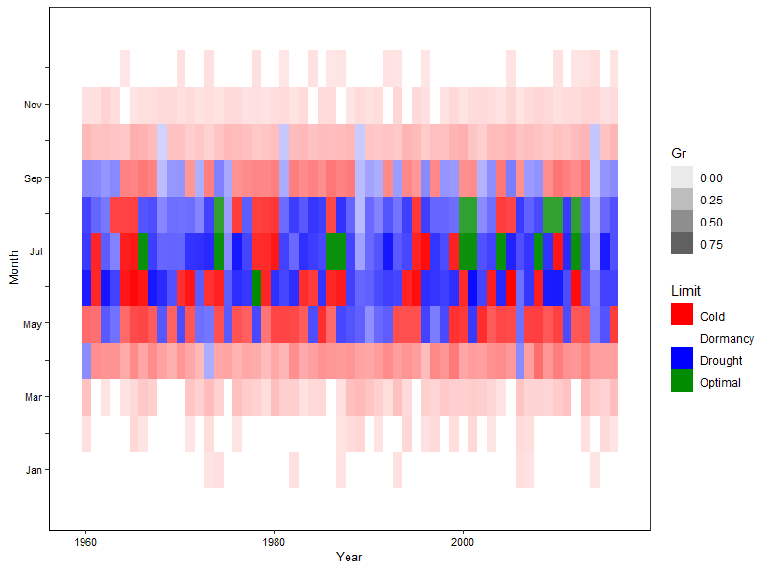
Results presentation (2)
Intra-annual variation of partial and integral growth rates

Slide 27
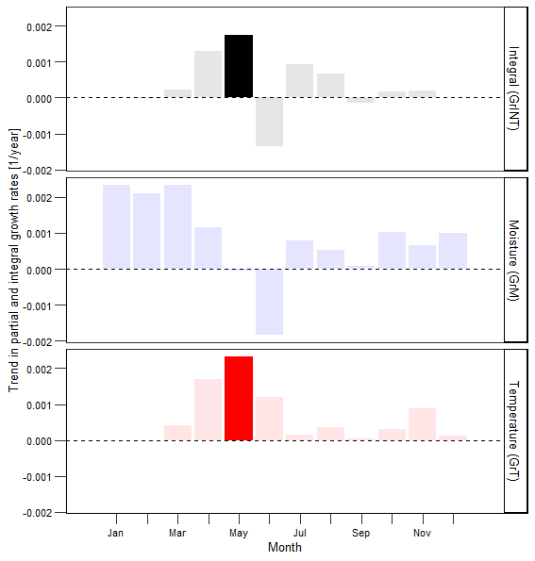
Results presentation (3)
Temporal changes of partial and integral growth rates

Slide 28
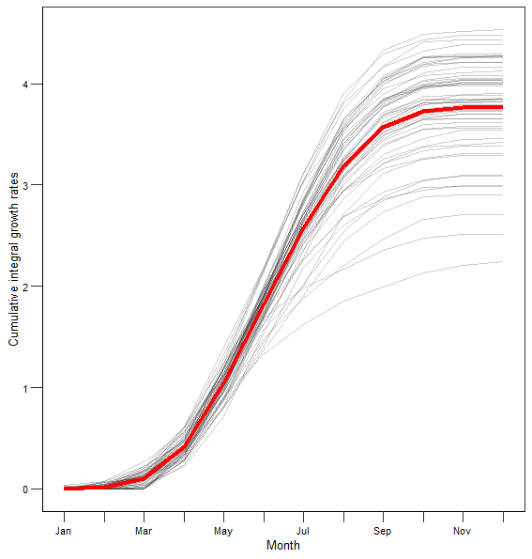
Results presentation (5)
Phenology

Slide 29
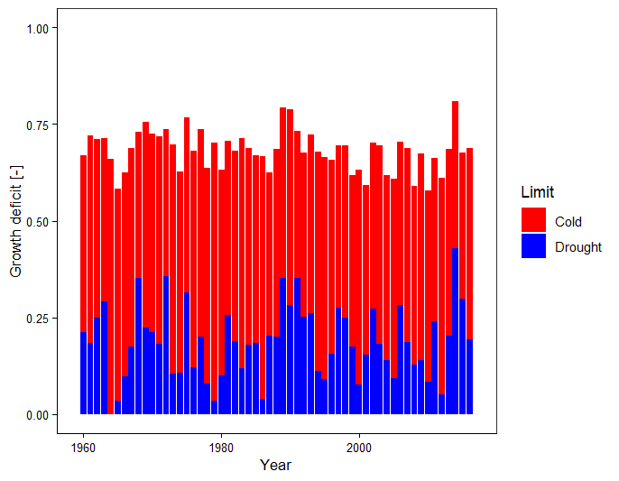
Results presentation (6)
Growth deficits

Slide 30
Vaganov-Shashkin, TRACH, VS-Lite
TRACH (Fritts et al. 1991)
Original ancestor
Vaganov-Shashkin model (Vaganov et al. 2006)
Daily resolved model
Three serialy-linked modules
Environmental module – calculation of GrINT
Xylogenesis module – conversion of GrINT into daily cell numbers inside cambial zone and dynamics of their radial growth and division (Anchukaitis et al. 2021: Dendrochronologia; Tumajer et al. 2021: Frontiers in Plant Science)
QWA module – calculating LA and CWT for each developing tracheid each day (Popkova et al. 2023: Dendrochronologia)
VS-Lite (Tolwinski-Ward et al. 2011)
Adopting solely environmental module of the Vaganov-Shashkin model to work with monthly data

Slide 31
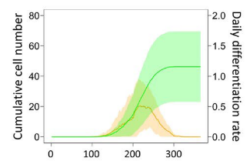
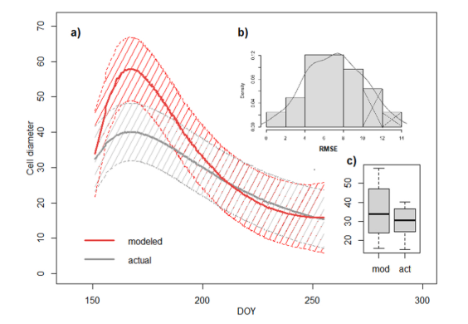
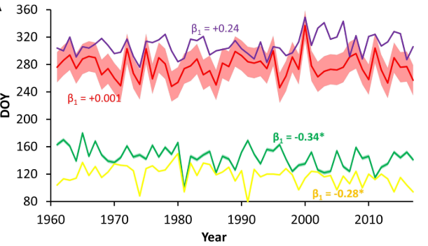
VS-Lite model limitations compared to Vaganov-Shashkin
Monthly resolution of results
Only “relative” intra-annual growth dynamics
GrINT is relative number
Lack of module that would convert GrINT into “real-life” units (cell numbers, mm of tree-ring) for each month
Lack of QWA module
Simplified equations for determining cambial phenology dates

Slide 32
VS-Lite model limitations compared to Vaganov-Shashkin
My personal subjective (!) experience:
Aim is to understand intra-annual and inter-annual climate growth limitation – VS-Lite is equally (sometimes even more) efficient compared to Vaganov-Shashkin
Aim is to simulate phenology and growth kinetics – Vaganov-Shashkin is better option
Aim is to simulate QWA – Vaganov-Shashkin is the only option
Both models well capture between site differences, but between species/cohorts/etc. differences inside single stand might be a problem

Slide 33
Thank you for your attention
tumajerj@natur.cuni.cz
web.natur.cuni.cz/physgeo/dendro/
www.github.com/jantumajer

