Slide 1
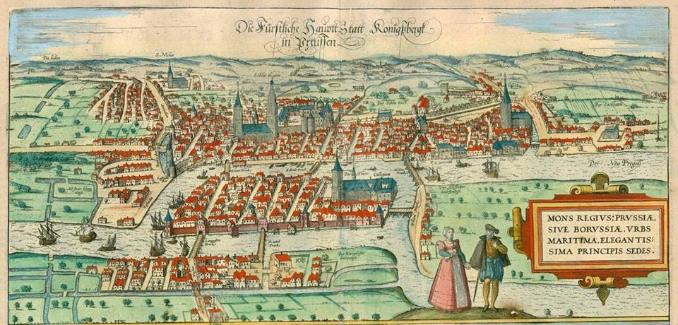

Ranking of Graphs
Presented by Janith Perera
Supervised by Prof. Zsolt Tuza

Slide 2
Introduction
Ranking Graphs is a NP-hard problem.
A vertex ranking of a graph G = (V, E) is a vertex t-ranking if for any two vertices of the same rank every path between them contains a vertex with higher rank.
Used to model the parallel assembly of a product from its components.

Slide 3
Brief History
Katchalski, McCuaig and Seager introduced "ordered coloring"
Known as a similar to minimum height of an elimination tree, by Pothen
Iyer, Ratcliff and Vijayan used it, concentrating on, line graphs of trees
All these different directions of researches happened in 1988

Slide 4
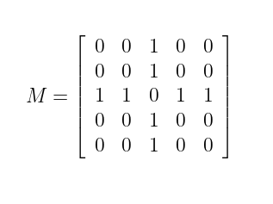
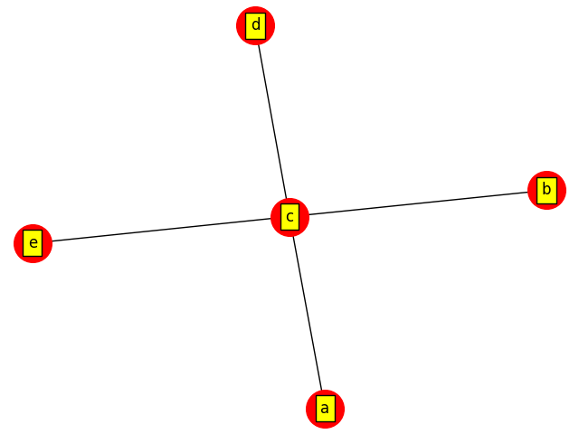
Graph Simulation 1
Adjacency Matrix

Slide 5
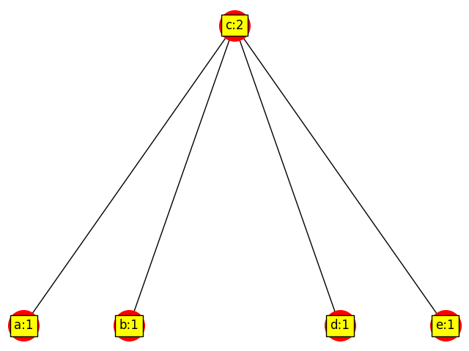
Graph Simulation 2

Slide 6
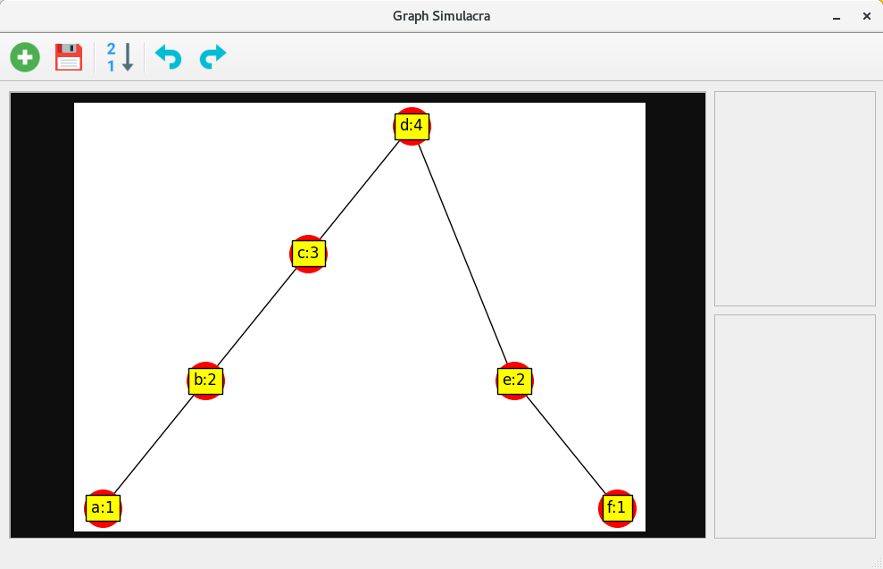
Graph Simulation 3
Add
Save
Rank
Label:Rank

Slide 7
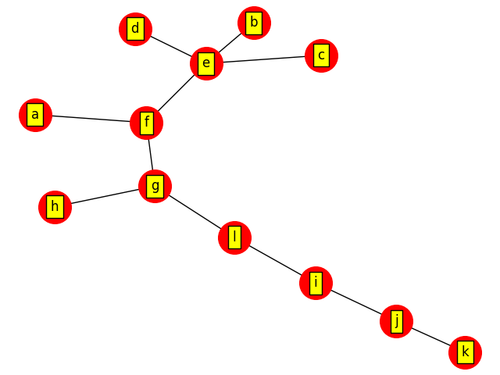
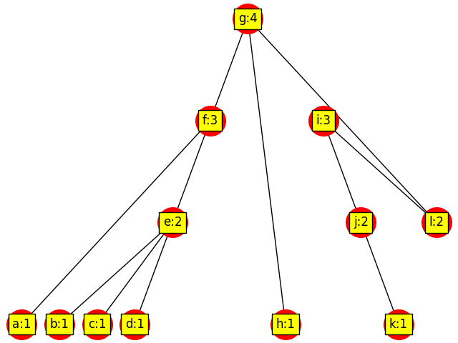
Graph Simulation Example

Slide 8
Ranking Algorithm
Get degree of vertices
Find leaves (degree = 1)
Rank leaves as 1 and set other vertices as 2
[Iteration of non-leaves]
Get neighbors of each vertex
  If all ranks are minor, then continue
  If neighbors are equal ranks, increase self rank +1
  If both equal and minor ranks exist, then increase equal rank neighbor +1
  If superior and equal ranks exist, increase self rank +1

Slide 9
Software Platform
Programmed in Python3+
Uses Qt5 Interface
Numpy Mathematical structures
NetworkX Mathematical Graphs
Matplotlib Visualization
Cookie cutter Python packaging

Slide 10
Next Step
Improve the ranking algorithm (focus on other shapes than trees).
Integrate user input into the main program.
Test option to see a preview of the graph in user input interface.
Detailed display on each vertex.

Slide 11
Thank You!

