Slide 1
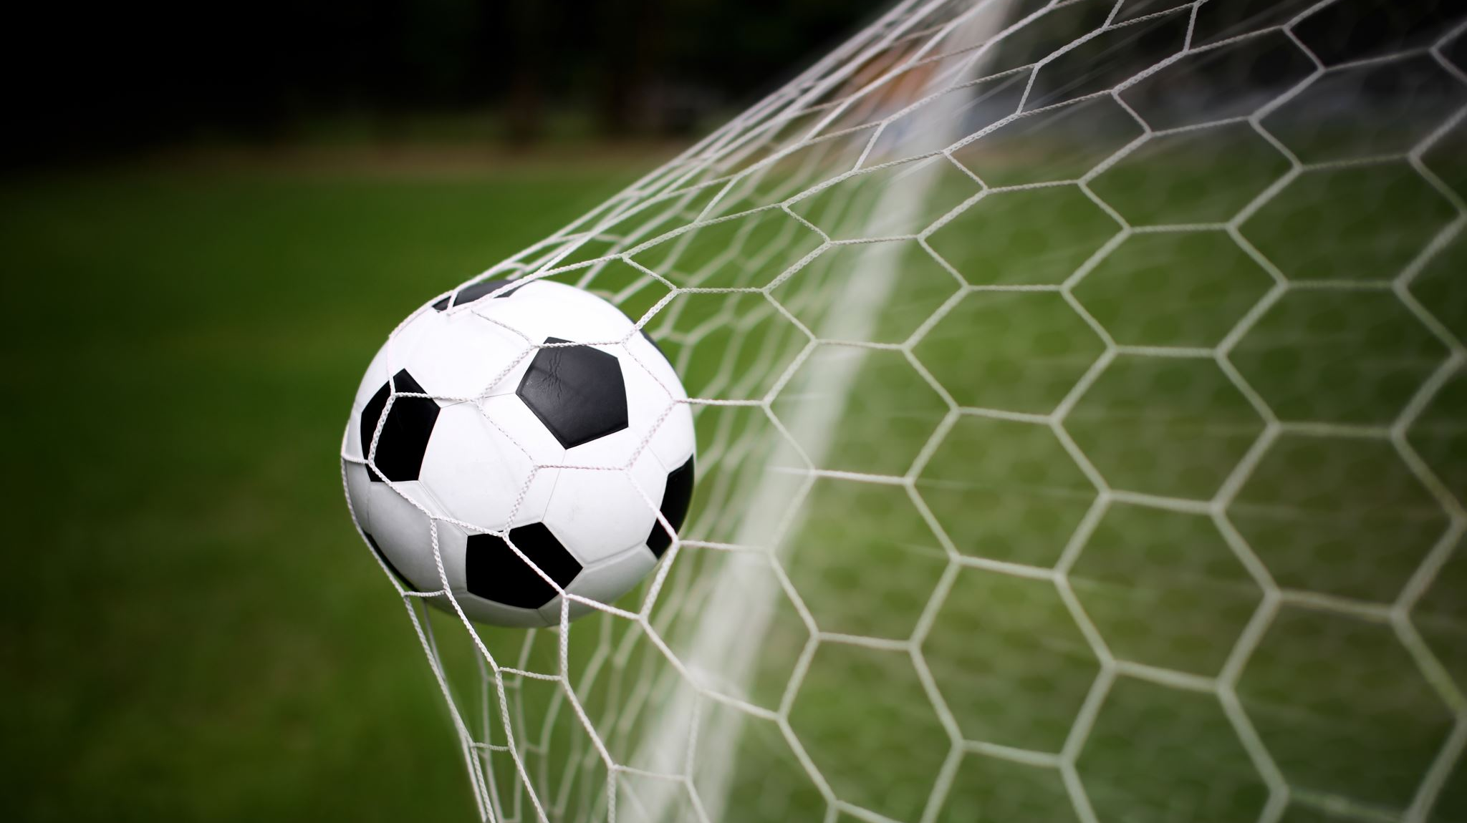

Case-Study: FIFA-MONEY BALL
Giuliana Miranda | Laura Jantz
28.10.2023

Slide 2

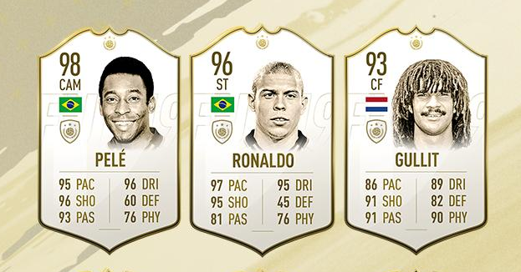
The Challenge
Get the 3 best Players for our driving team
Budget 100 M

Slide 3
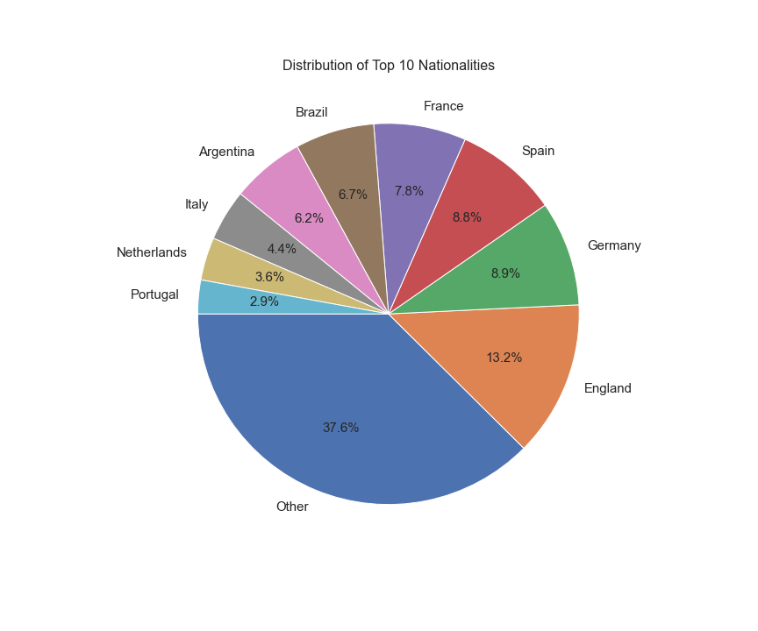
Information Base
13.700 Players 897 Clubs 160 Nationalities Players Ability from 38 to 93 Player Values from 1 K to 90 M

Slide 4
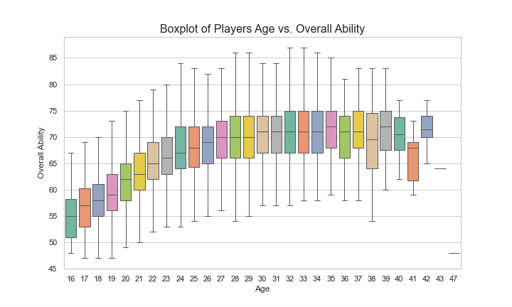
Information Base
13.700 Players 897 Clubs 160 Nationalities Players Ability from 38 to 93 Player Values from 1 K to 90 M

Slide 5
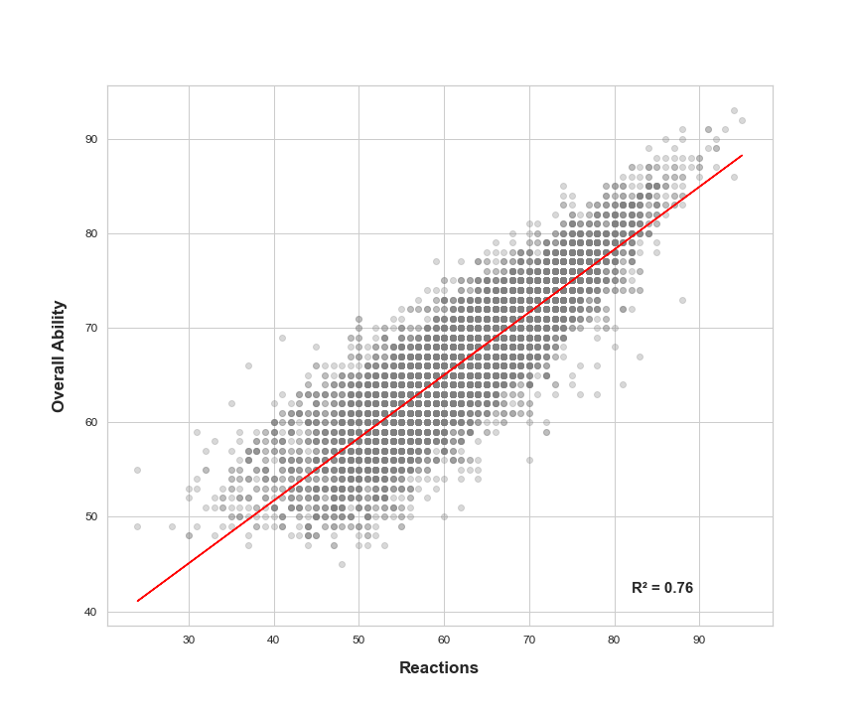
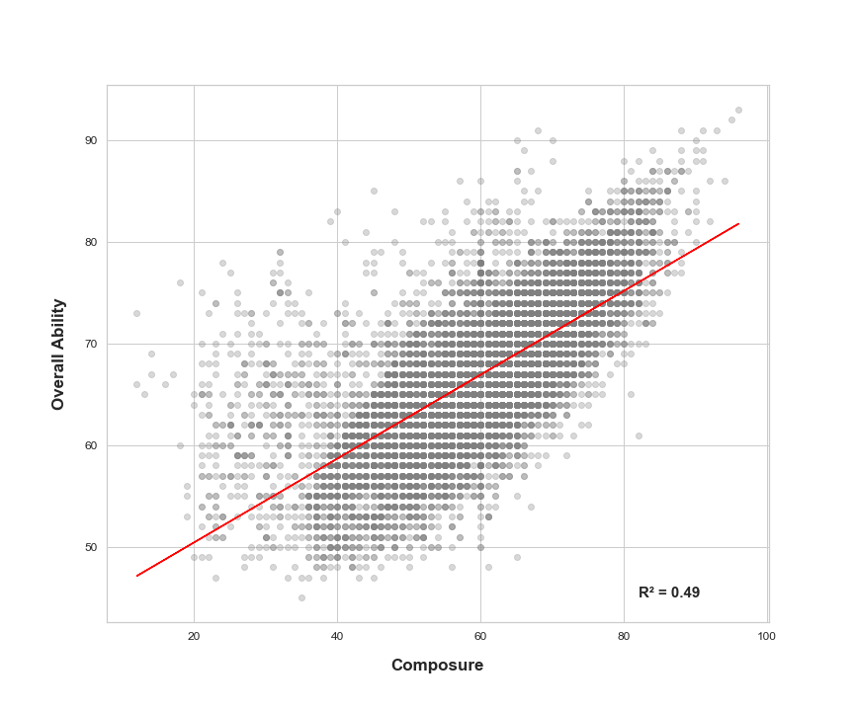
Information Base

Slide 6
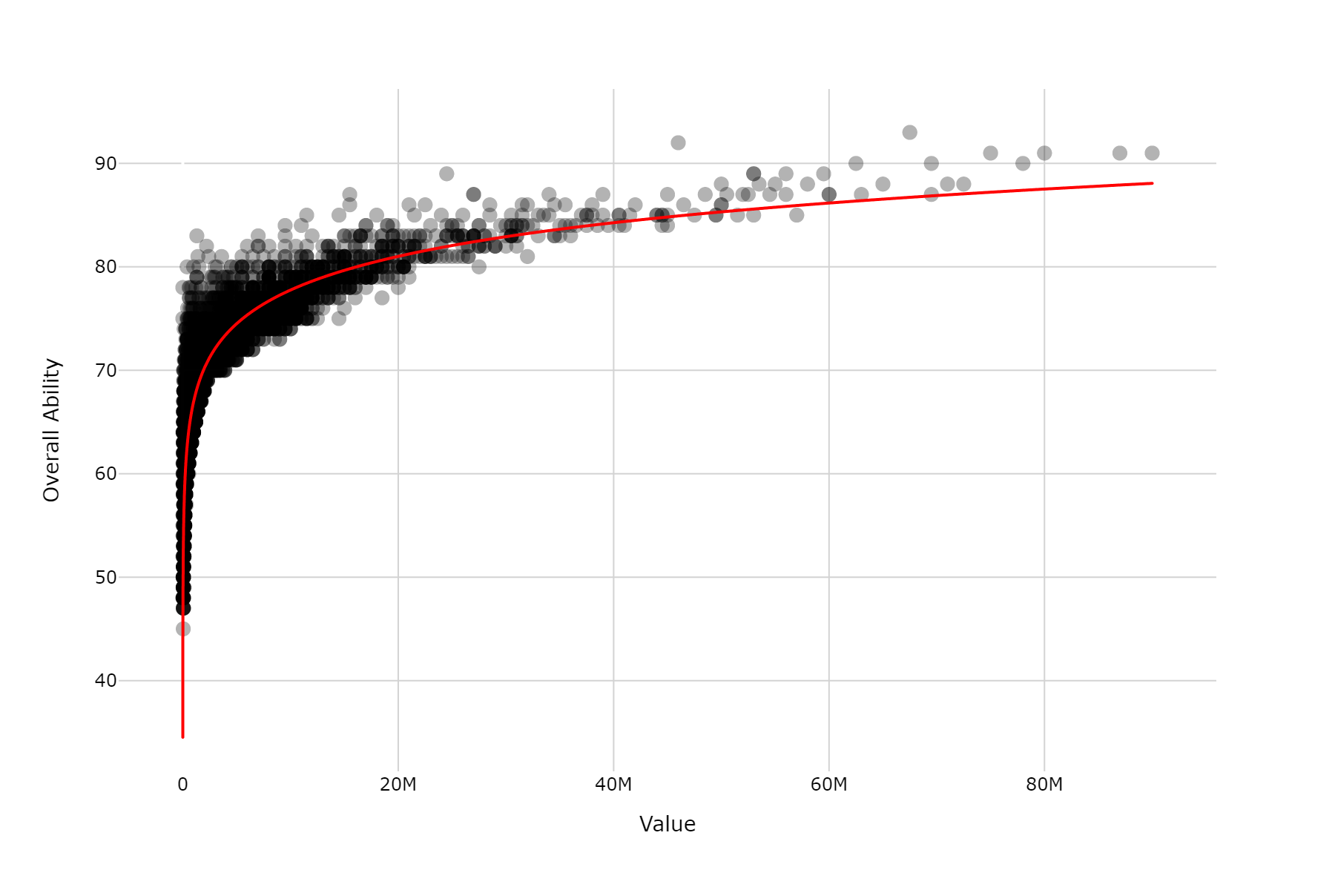
Information Base

Slide 7
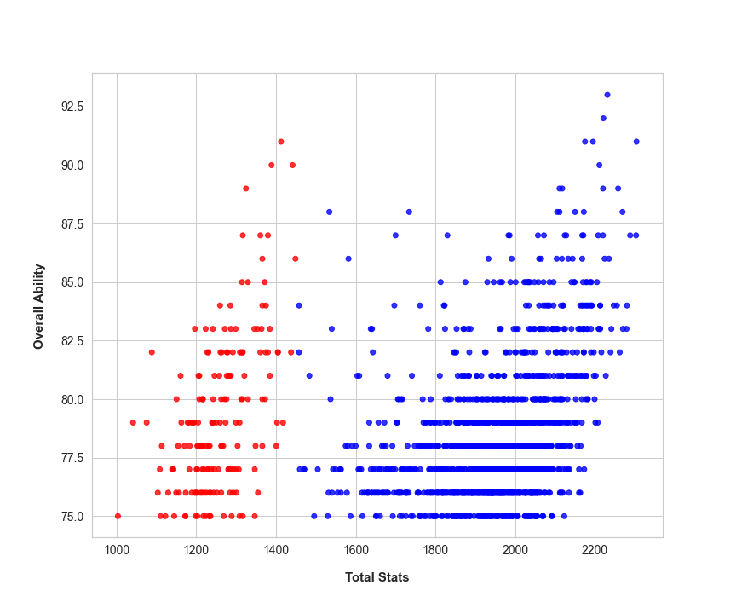
Information Base

Slide 8
The Result
 | Player | Ova | Value | Age
1 | M. Neuer | 89 | 29.0 M € | 34
2 | V. van Dijk | 87 | 75.5 M € | 28
3 | S. Mané | 87 | 78.0 M € | 28
4 | L. Suárez | 86 | 31.5 M € | 33
5 | S. Handanovič | 86 | 16.0 M € | 35
6 | P. Lahm | 86 | 29.6 M € | 32
7 | L. Modrić | 85 | 24.5 M € | 34
8 | F. de Jong | 85 | 50.5 M € | 23
9 | N. Kanté | 85 | 51.0 M € | 29
10 | M. Hummels | 85 | 33.0 M € | 31
Number of variables | 29
R² | 0.71
MSE | 1.64
MAE | 1.28

Slide 9
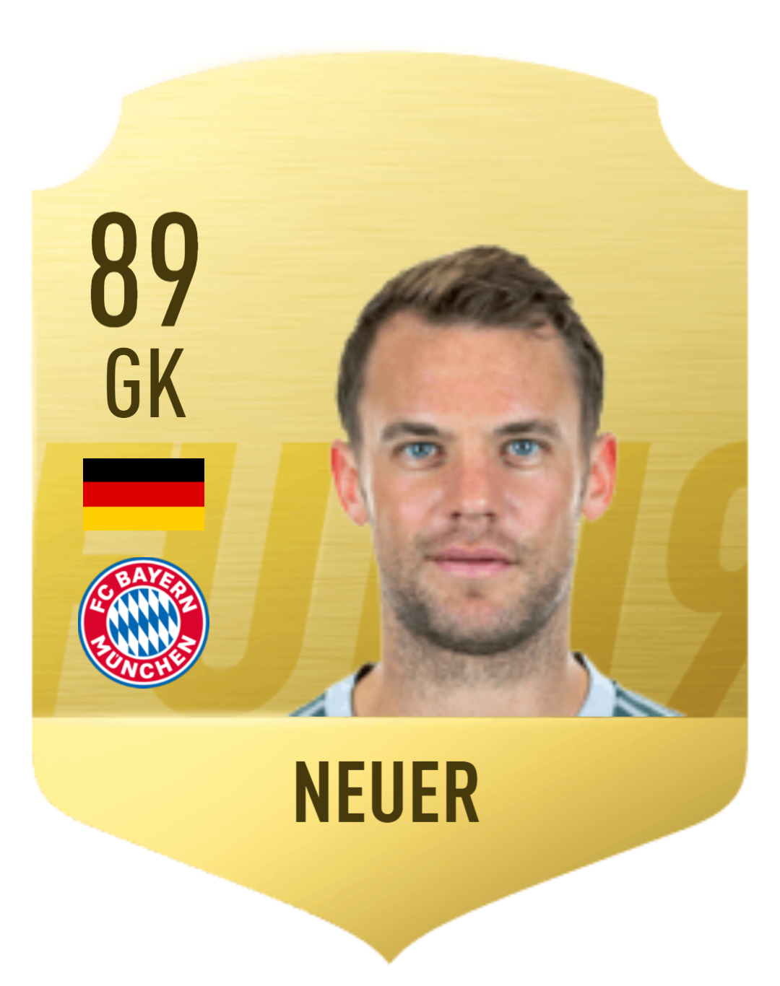
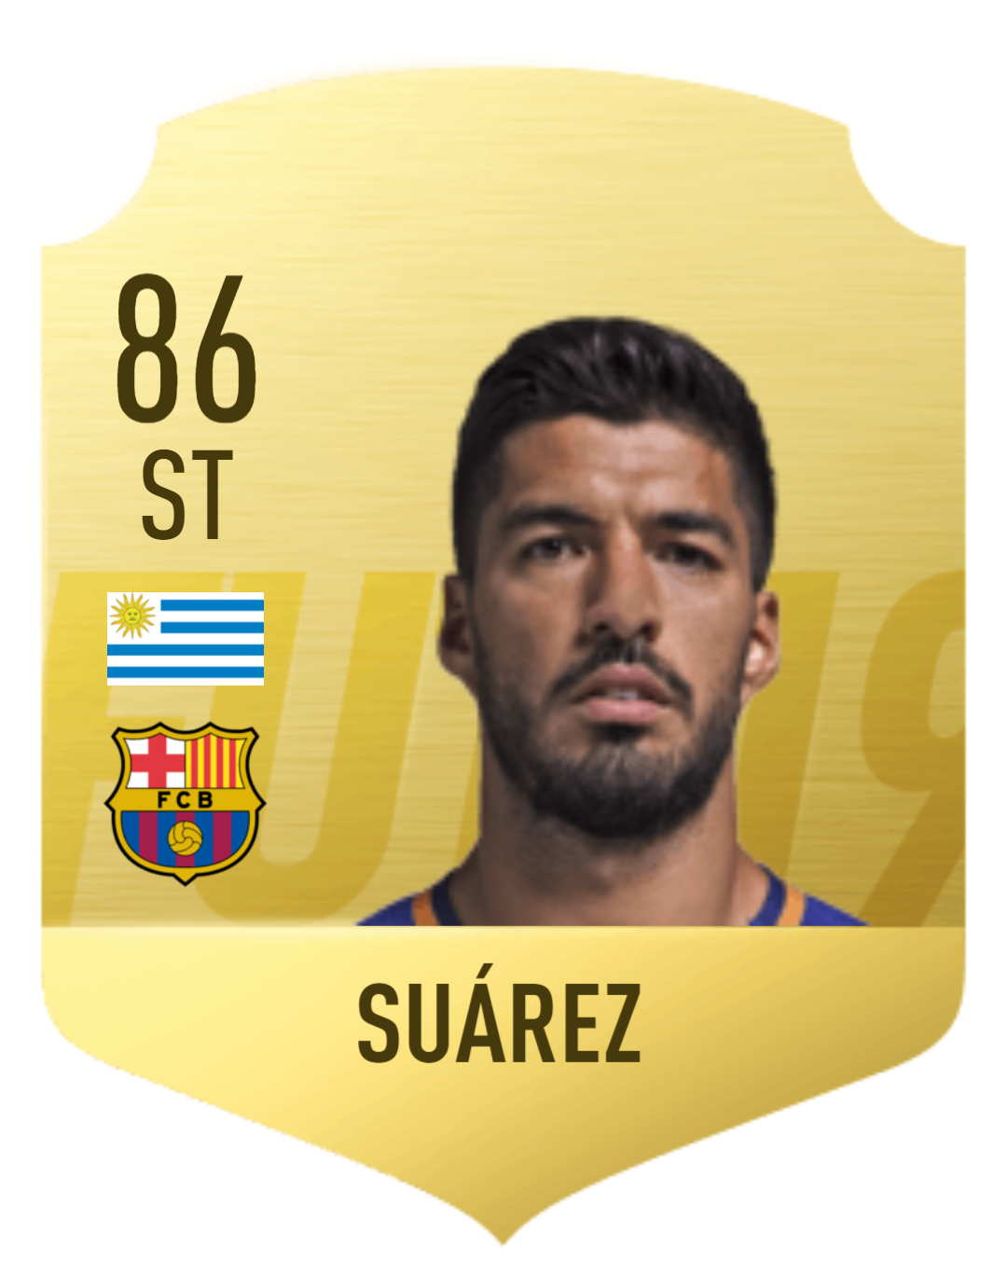
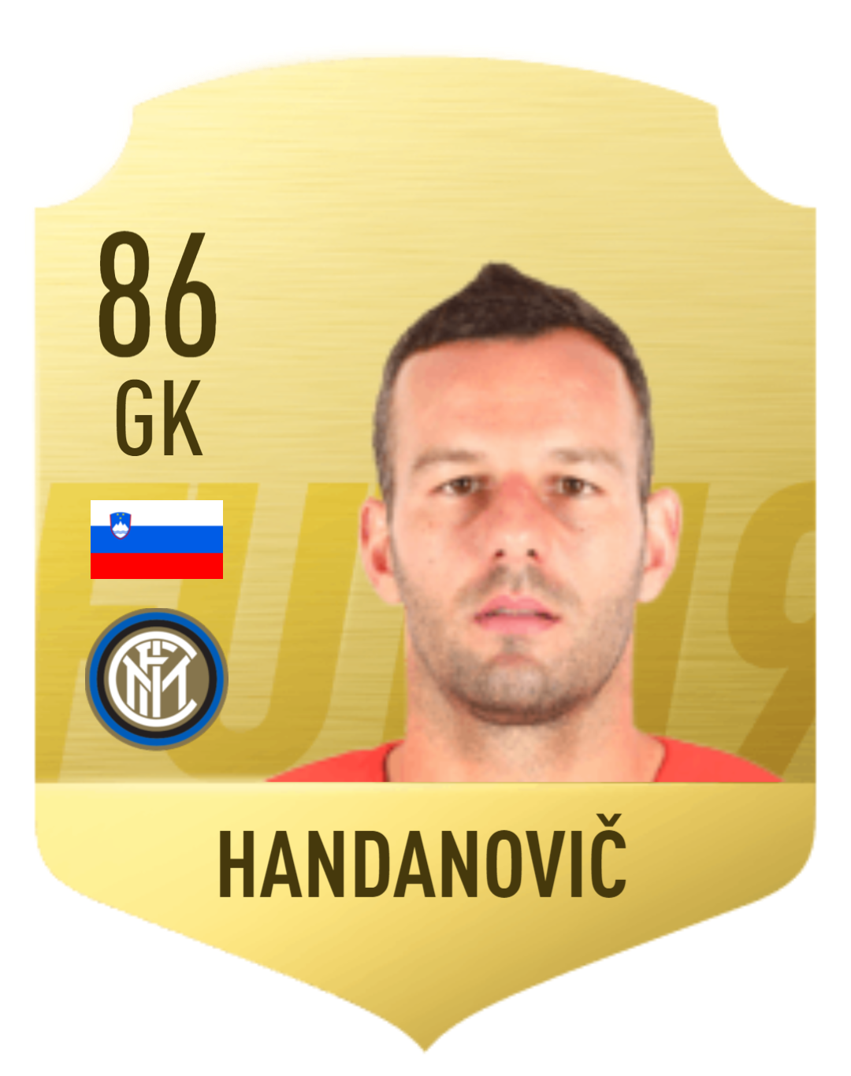
The Chosen
29.0 M
1
31.5 M
16.0 M
2
3
Rest budget: 23.5 M

