Slide 1

System Sequence Diagrams
Based on Craig Larman, Chapter 10
and Anuradha Dharani’s notes

Slide 2
Dynamic behaviors
Class diagrams represent static relationships. Why?
What about modeling dynamic behavior?
Interaction diagrams model how groups of object
collaborate to perform some behavior
  Typically captures the behavior of a single use case
Use Case: Order Entry
1) An Order Entry window sends a “prepare” message to an Order
2) The Order sends “prepare” to each Order Line on the Order
3) Each Order Line checks the given Stock Item
4) Remove appropriate quantity of Stock Item from stock
5) Create a deliver item
Alternative: Insufficient Stock
3a) if Stock Item falls below reorder level
  then Stock Item requests reorder

Slide 3
Sequence diagrams
Vertical line is called an object’s lifeline
  Represents an object’s life during interaction
Object deletion denoted by X, ending a lifeline
  Horizontal arrow is a message between two objects
Order of messages sequences top to bottom
Messages labeled with message name
  Optionally arguments and control information
Control information may express conditions:
  such as [hasStock], or iteration
Returns (dashed lines) are optional
  Use them to add clarity

Slide 4
A time for systems analysis
”To every thing there is a season, and a time to every purpose under heaven.” Ecclesiastes 3:1
What UP phase are your projects in?
What have you determined about your projects?
Preliminary requirements analysis determines a vision and scope, use cases, risks and estimates
I.e., is there a project worthy of pursuing?
Next comes systems analysis:
  Clarifies input and output System events and which Objects trigger them
  Generates System Sequence Diagrams from Use Cases
Why does this activity make sense now?

Slide 5
System Sequence Diagram (SSD)
For a use case scenario, an SSD shows:
The System (as a black box)
The external actors that interact with System
The System events that the actors generate
SSD shows operations of the System in response to events, in temporal order
Develop SSDs for the main success scenario of a selected use case, then frequent and salient alternative scenarios
:System

Slide 6
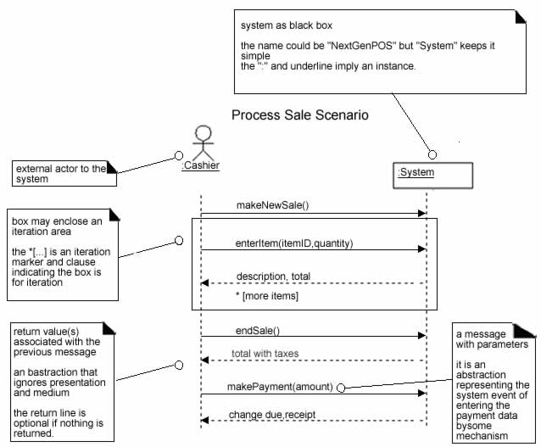
SSD for Process Sale scenario
(Larman, page 175)

Slide 7
From Use Case to
Sequence System Diagram
How to construct an SSD from a use case:
Draw System as black box on right side
For each actor that directly operates on
the System, draw a stick figure and a lifeline.
For each System events that each actor generates in use case, draw a message.
Optionally, include use case text to left of diagram.

Slide 8
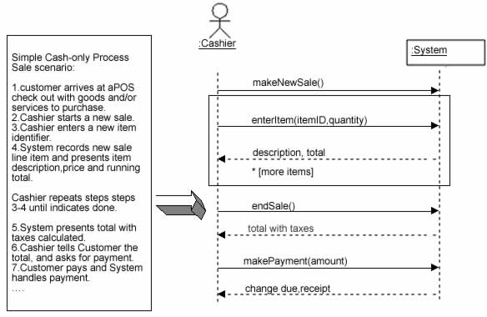
Example: use cases to SSD

Slide 9
Identifying the right Actor
In the process Sale example, does the customer interact directly with the POS system?
Who does?
Cashier interacts with the system directly
Cashier is the generator of the system events
Why is this an important observation?

Slide 10
Naming System events & operations
System events and associated system operations should be expressed at the level of intent
Rather than physical input medium or UI widget
Start operation names with verb (from use case)
Which is better, scanBarCode or enterItem?

Slide 11
SSDs and the Glossary in parallel
Why is updating the glossary important when developing the SSD?
New terms used in SSDs may need explanation, especially if they are not derived from use cases
A glossary is less formal, easier to maintain and more intuitive to discuss with external parties such as customers

Slide 12
SSDs within the Unified Process
Create System Sequence Diagrams during Elaboration in order to:
Identify System events and major operations
Write System operation contracts (Contracts describe detailed system behavior)
Support better estimates
Remember, there is a season for everything:
it is not necessary to create SSDs for all scenarios of all use cases, at least not at the same time

Slide 13
Concurrency in Sequence Diagrams
Concurrent processes:
  UML 1: asynchronous messages as horizontal lines with half arrow heads
  UML 2 makes this distinction by not filling an arrowhead
  Fowler prefers older notation.
  Why? Which do you prefer?
After setting up Transaction Coordinator,
invoke concurrent Transaction Checkers
  If a check fails, kill all Transaction Checker processes
Note use of comments in margin
  When is this a good idea?

Slide 14
Collaboration diagrams
Objects are rectangular icons
  e.g., Order Entry Window, Order, etc.
Messages are arrows between icons
  e.g., prepare()
Numbers on messages indicate sequence
  Also spatial layout helps show flow
Which do you prefer: sequence or collaboration diagrams?
Fowler now admits he doesn’t use collaboration diagrams
  Interaction diagrams show flow clearly,
  but are awkward when modeling alternatives
UML notation for control logic has changed in UML 2
but Fowler isn’t impressed

