Slide 1
Reproducible science:
A bioinformatic service perspective January Weiner

Slide 2
Three stories
Predicting tuberculosis (TB) onset in patients
Operating an RNA-Seq pipeline at the CUBI
How not to do gene set enrichments

Slide 3
Core principles
Reproducibility: the analysis should be reproducible with minimal effort (always a compromise!); also here: good science practices
Accountability: we should be able to trace back every result to its underlying data (e.g.: gene set enrichment to differential expression of individual genes) with minimal effort; also here: user empowerment

Slide 4
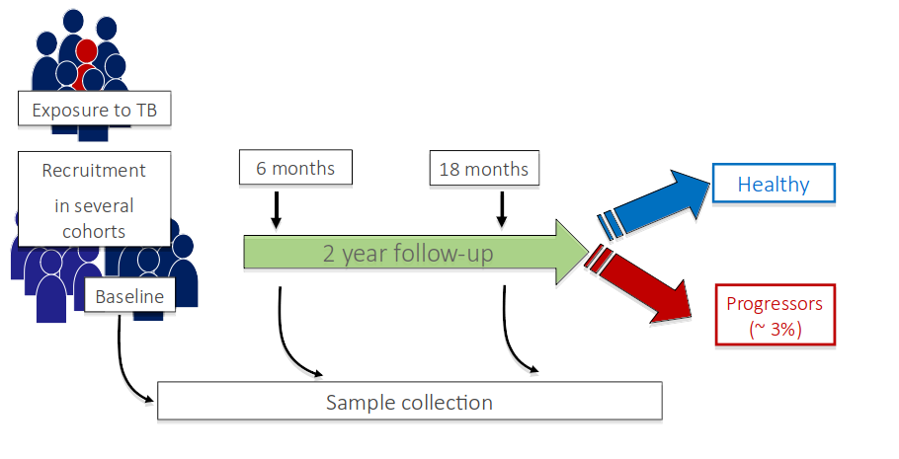
Predicting the onset of TB

Slide 5
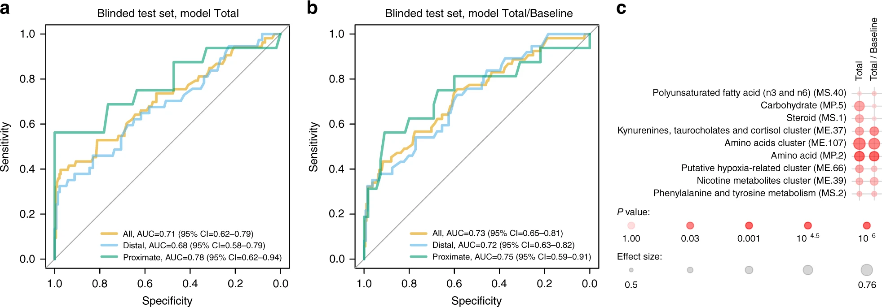
Predicting the onset of TB

Slide 6
Predicting the onset of TB
Key papers:
Weiner 3rd J, Maertzdorf J, Sutherland JS, Duffy FJ, Thompson E, Suliman S, McEwen G, Thiel B, Parida SK, Zyla J, Hanekom WA. Metabolite changes in blood predict the onset of tuberculosis. Nature Communications. 2018 Dec 6;9(1):5208.
Suliman S, Thompson EG, Sutherland J, Weiner 3rd J, Ota MO, Shankar S, Penn-Nicholson A, Thiel B, Erasmus M, Maertzdorf J, Duffy FJ. Four-gene pan-African blood signature predicts progression to tuberculosis. American Journal of Respiratory and Critical Care Medicine. 2018 May 1;197(9):1198-208.
Duffy FJ, Weiner 3rd J, Hansen S, Tabb DL, Suliman S, Thompson E, Maertzdorf J, Shankar S, Tromp G, Parida S, Dover D. Immunometabolic signatures predict risk of progression to active tuberculosis and disease outcome. Frontiers in Immunology. 2019 Mar 22;10:527.

Slide 7
Implementing the core principles:
Introduced blinded predictions for the validation set
All data published

Slide 8
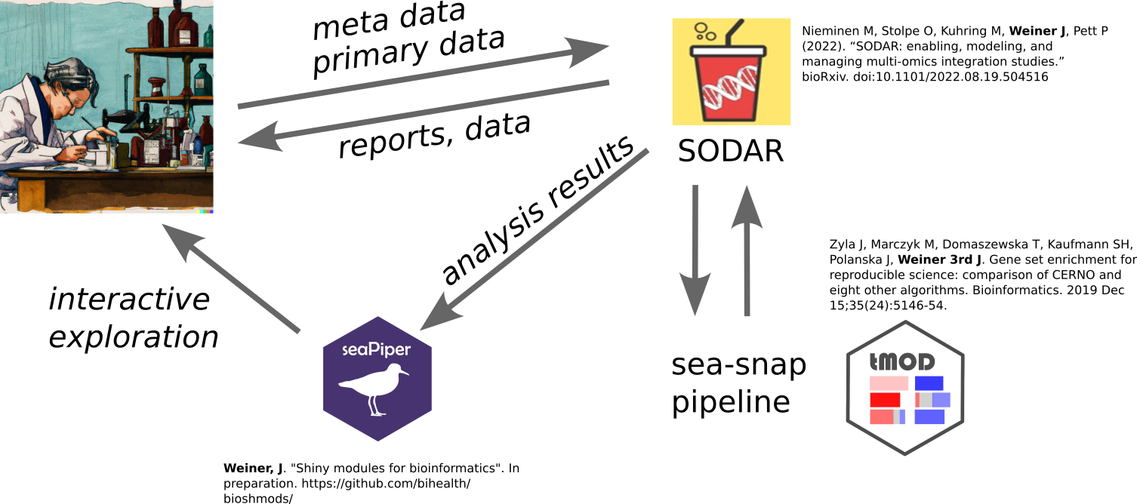
Running an RNA-Seq pipeline at CUBI

Slide 9
Running an RNA-Seq pipeline at CUBI

Slide 10
Implementing the core principles:
Reproducibility:
keeping track of all analyses
–,,– software versions
software environments preserved with conda
data and meta-data stored in SODAR “forever”
Accountability ensured by providing custom interactive interfaces read only mode! Not for making the analyses
Interpretability
frequent updates and discussions
incorporating research hypotheses in the pipeline

Slide 11
How not to do gene set enrichments
two groups of patients: G1 and G2
two conditions: COVID vs controls
do the two groups react differently to COVID?

Slide 12
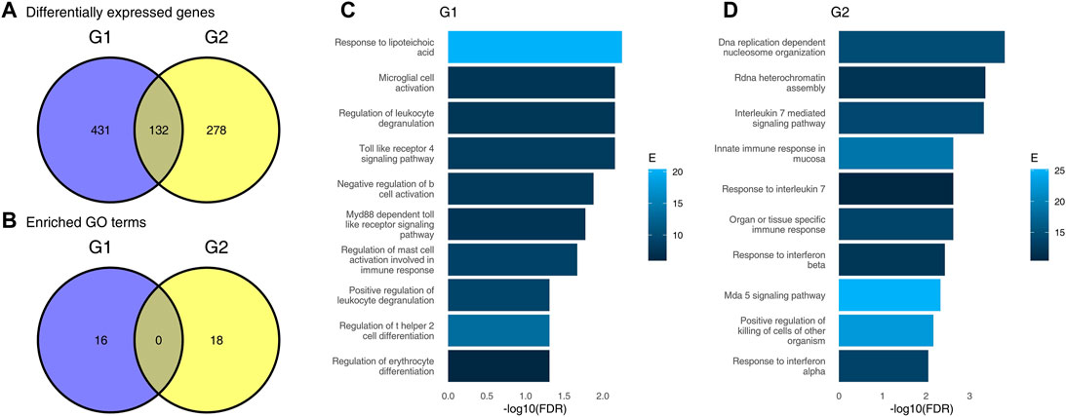
How not to do gene set enrichments

Slide 13
Weiner J, Obermayer B, Beule D. Venn diagrams may indicate erroneous statistical reasoning in transcriptomics. Frontiers in Genetics. 2022 Apr 14;13:818683.

Slide 14
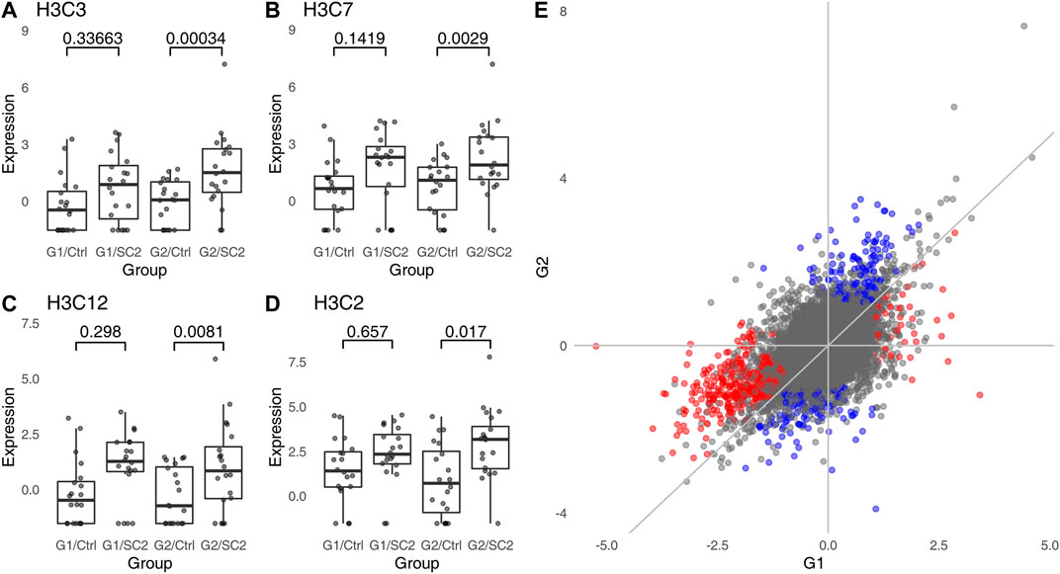
How not to do gene set enrichments

Slide 15
How not to do gene set enrichments
25% of papers on transcriptomics with a Venn diagram fall for this fallacy
correct interpretation: interactions, disco score (Domaszewska et al. and Weiner, 2017)
paper sources as rmarkdown available from github

Slide 16
Thank you
Personal github: https://github.com/january3/
CUBI github: https://github.com/bihealth/
Scholar profile: http://tiny.cc/y8o3vz

