Slide 1
POWER BI PL-300 · CAPSTONE PROJECT
Customer Subscription & Churn Analysis
What drives churn at NovaStream, and what to do about it
Learner's name: January Sambrook
Date: 20 August 2026
Newto Training
Notes:
Opening line: 'NovaStream knows customers are leaving. This is who, why, and what I'd do first.' Set expectation: five raw tables in, one costed recommendation out. Keep this slide to 20 seconds.

Slide 2
2
Project Brief
A subscription business losing one customer in four, and the five questions that find out why.
THE SITUATION
NovaStream is a subscription business whose leadership can see subscribers cancelling but cannot see why. They handed over a raw export of the customer base: five related tables, 2,030 rows, uncleaned. This analysis takes that export from raw files to a ranked set of actions: who is leaving, what separates them from the customers who stay, and where the business should intervene first.
OBJECTIVES
Prepare
Fix the quality issues across five raw tables so the numbers can be trusted.
Model
Build a star schema plus a Date table so every visual answers one question.
Analyse
Separate what genuinely drives churn from what only looks like it does.
Communicate
Turn the finding into actions a non-technical exec can sign off.
KEY QUESTIONS TESTED
1. What is the overall churn rate, and how many customers does it represent?
2. Does contract type (monthly vs annual) relate to churn?
3. Do auto-renew, plan tier or price relate to churn?
4. Do engagement signals such as usage, login recency, tenure and support tickets separate leavers from stayers?
5. Which factors matter most, and which only look like they matter?
Power BI PL-300 · Capstone Project
2 / 12
Notes:
Frame it as a business problem, not a data problem. The five questions are the promise of the deck; slide 10 answers them one by one, in the same order. If you're short on time, read questions 1, 2 and 5 only.

Slide 3
3
Dataset Overview
Five related tables, 2,000 customers after cleaning, and why the data fits the question.
2,000
5
23.9%
2019 to 2024
Customers after cleaning
Related tables
Overall churn rate
Signup window (Jan 19 to Nov 24)
File | Role | Rows (raw → clean) | What it holds
Subscriptions.csv | Fact | 2,030 → 2,000 | One row per customer: contract, plan, price, tenure, usage, logins, tickets, plus the Churned target.
Customers.csv | Dimension | 2,005 → 2,000 | Customer name, date of birth, gender. Source of the derived Age field.
Plans.csv | Dimension | 3 | Basic / Standard / Premium and their base monthly price.
Regions.csv | Dimension | 4 | North / South / East / West, all United Kingdom.
PaymentMethods.csv | Dimension | 4 | Credit Card, Bank Transfer, PayPal, Direct Debit and their type.
Source: a synthetic teaching dataset supplied with the PL-300 capstone. It is not real customer data: the method and the modelling are real, the effect sizes are illustrative.
Why it fits the question: the churn outcome sits on the same row as both the commercial terms (contract, plan, price) and the behavioural signals (usage, login recency, tenure, tickets), so the two can be compared directly.
Power BI PL-300 · Capstone Project
3 / 12
Notes:
Say out loud that the data is synthetic; the brief asks for it and it protects your credibility. The 2,030 → 2,000 is your first hint that cleaning mattered; don't explain it here, it's the next two slides.

Slide 4
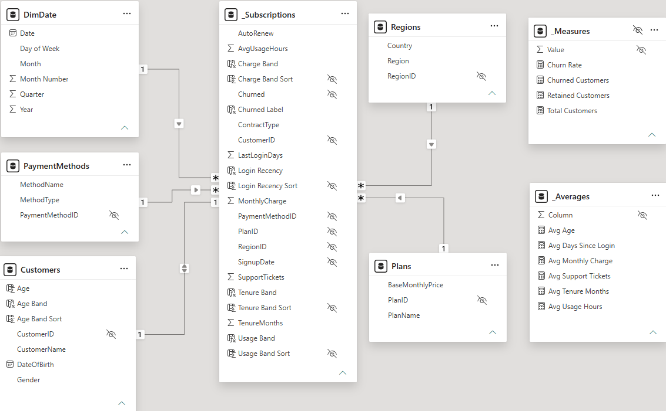
4
Dataset Structure
One fact table, four dimensions, and a Date table built in DAX.
MODEL VIEW FROM THE .PBIX
KEY VARIABLES
TARGET
Churned (Yes / No, categorical)
CATEGORICAL
ContractType, AutoRenew, PlanName, Region, MethodName, Gender
NUMERICAL
MonthlyCharge, TenureMonths, AvgUsageHours, LastLoginDays, SupportTickets, Age
DATE
SignupDate related to DimDate[Date]
KEYS
CustomerID (text), PlanID, RegionID, PaymentMethodID (whole number)
Four one-to-many relationships, single-direction, plus a one-to-one to Customers. DimDate is marked as the date table.
Power BI PL-300 · Capstone Project
4 / 12
Notes:
Point at the fact table in the middle and say it once: 'Subscriptions is the fact, everything else filters it, and DimDate lets me slice by signup cohort.' The screenshot is the evidence the marker asked for last time, so let it be seen rather than talked over. If asked about the double arrow on Customers: that relationship is one-to-one, and Power BI makes one-to-one bidirectional automatically.

Slide 5
5
Identified Problems in the Dataset
Six defects in the raw files, and what each one would have cost.
35
260
9
5
Duplicate rows
Missing values
Orphan foreign keys
Impossible outliers
# | Issue | Where it sits | Scale | Why it would break the analysis
1 | Duplicate customers | Subscriptions and Customers | 30 + 5 rows | A repeated key makes the relationship ambiguous and double-counts churned customers.
2 | Missing values | AvgUsageHours 70, LastLoginDays 40, RegionID 40, PaymentMethodID 50, DateOfBirth 60 | 260 cells | Blanks are dropped silently from averages and fall into an unlabelled bar on every slicer.
3 | Orphan foreign keys | PlanID = 9 (5 rows), RegionID = 7 (4 rows) | 9 rows | Keys point at dimension rows that do not exist, so they vanish into a blank once modelled.
4 | Impossible outliers | TenureMonths = 999 (3), MonthlyCharge = 9999 (2) | 5 rows | Five rows drag mean tenure from 20.1 to 21.6 months and mean charge from £31.19 to £41.01.
5 | Wrong data type | MonthlyCharge values carrying a "$" | 60 values | One stray character forces the whole column to text, so no sums, no averages, no bands.
6 | Inconsistent categories | ContractType (5 spellings), AutoRenew (4), Churned (5), Gender (5) | n/a | Churned read as-is gives 22.8%; the true rate is 23.9%. Every chart splits into additional categories.
Power BI PL-300 · Capstone Project
5 / 12
Notes:
This is the slide that shows you looked before you leapt. The line to land: 'Read straight out of the box, this dataset reports a churn rate of 22.8%. The real answer is 23.9%, and every one of these six issues moves a number.' Have the 999-month tenure ready as the memorable example.

Slide 6
6
Data Cleaning Process
Six steps, each with a reason. 2,030 rows in, 2,000 out, no customer dropped for one bad cell.
Step | What I did | Why, and what the alternative would have cost
1 De-duplicate | Removed 30 exact duplicate rows from Subscriptions and 5 from Customers. CustomerID is now unique in both tables. | A duplicated dimension key makes the relationship ambiguous; left in, the same churned customer is counted twice.
2 Standardise categories | Mapped M / monthly → Monthly, Yearly → Annual; Y / N / 0 → Yes / No; M / F / female → Male / Female. | One value per category, so a bar chart shows two bars rather than five, and the churn measure counts every churner.
3 Fix data types | Stripped "$" from MonthlyCharge → decimal. Set SignupDate and DateOfBirth to date using UK locale (dd/mm/yyyy). | Text columns cannot aggregate or band. The wrong locale silently swaps day and month for the first 12 days of each month.
4 Treat outliers | TenureMonths = 999 and MonthlyCharge = 9999 set to blank. The five rows were kept. | These are impossible, not merely extreme. The rest of each row is still valid churn evidence, so deleting the row throws away good data.
5 Handle blanks | Left AvgUsageHours (70), LastLoginDays (40) and DateOfBirth (60) blank and excluded them from averages. No imputation. | Mean-imputing would pull every group toward the middle and shrink exactly the gaps being tested. Blank is honest; the mean is a guess wearing a number.
6 Resolve orphan keys | Routed PlanID 9, RegionID 7 and the blank Region / Payment keys to an explicit "Unknown" member. | Keeps 99 rows visible and labelled in the totals instead of dropping them into an unexplained blank bar.
Before → after: Subscriptions 2,030 → 2,000 rows (−1.5%) · Customers 2,005 → 2,000 rows · Columns 13 → 19 in the fact table (six derived fields added). No customer was dropped for a bad value in a single column.
Power BI PL-300 · Capstone Project
6 / 12
Notes:
Examiners reward the justification column more than the action column, so read one of them out in full, ideally step 5. The headline to say: 'I lost 30 rows, all of them exact duplicates. Nothing was dropped for being inconvenient.'

Slide 7
7
Data Transformation & Modelling
Five relationships, a Date table, six derived fields and three measures.
MODEL
Four one-to-many relationships, single-direction, each dimension filtering the fact: Plans[PlanID], Regions[RegionID], PaymentMethods[PaymentMethodID] and DimDate[Date] to Subscriptions[SignupDate].
Customers[CustomerID] is one-to-one, because this dataset holds exactly one subscription per customer. Power BI makes one-to-one relationships bidirectional automatically. Kept as a separate dimension so the model still holds if a customer later takes more than one subscription.
DimDate built in DAX with CALENDAR over 01/01/2019 to 31/12/2024, marked as the date table, with Year, Quarter, Month Number and Month Name columns for correct sorting.
NEW FIELDS CREATED
Age
DATEDIFF from DateOfBirth to today, in years
Tenure Band
Under 6 / 6-11 / 12-23 / 24-35 / 36+ months
Usage Band
Under 10 / 10-30 / 30+ hours a month, plus Unknown
Login Recency
Active / Recent / Inactive / Dormant, by days since last login
Charge Band
Under £20 / £20-39.99 / £40-59.99 / £60+
Age Band
18-24 / 25-34 / 35-44 / 45-54 / 55-64 / 65+
MEASURES
Total Customers = DISTINCTCOUNT ( Subscriptions )
Churned Customers = CALCULATE ( [Total Customers], Subscriptions[Churned] = "Yes" )
Churn Rate = DIVIDE ( [Churned Customers], [Total Customers] )
Why this shape: banding turns continuous behaviour into bars an executive can read at a glance, and a single Churn Rate measure means every visual in the report answers the same question the same way.
Power BI PL-300 · Capstone Project
7 / 12
Notes:
If you get one technical question in the whole presentation it will be here. Be ready to say why DIVIDE rather than '/' (it returns blank instead of an error on a zero denominator), and why the bands are set where they are (roughly even group sizes, and the login cut points match where the churn curve bends).

Slide 8
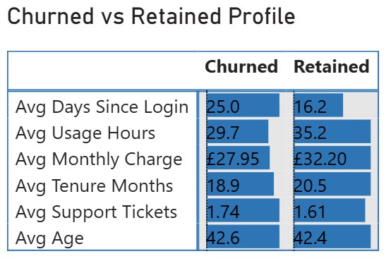
8
Exploratory Data Analysis (EDA)
Churned and retained customers compared, measure by measure.
23.9%
478
1,522
2,000
Overall churn rate
Customers churned
Customers retained
Customers analysed
WHAT THE GAPS SAY
FROM THE REPORT
Measure | Gap | Reading
Days since last login | +8.8 days | Largest separation of any measure
Average usage hours | −5.5 hrs | Second largest
Monthly charge | −£4.25 | Churners pay less, not more
Tenure (months) | −1.6 | Mild
Support tickets | +0.13 | Negligible
Age (years) | +0.2 | No separation at all
Read: no single measure separates the two groups on its own. The real signal sits in the group rates on the next slide, where login recency runs from 17.1% among active customers to 75.0% among dormant ones.
Power BI PL-300 · Capstone Project
8 / 12
Notes:
Numbers before pictures, deliberately. The one line that matters: 'Churned customers had last logged in 25 days ago on average; retained customers 16. That eight-day gap is the largest separation in the dataset.' The table on the left is the reading; the screenshot on the right is where the numbers came from. Do not read either out row by row.

Slide 9
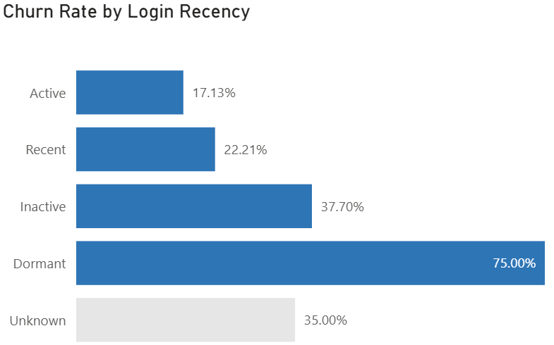
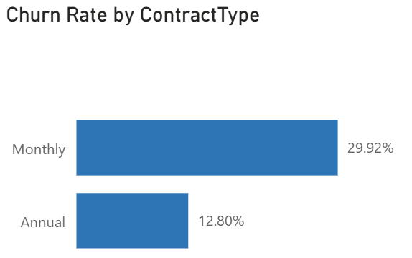
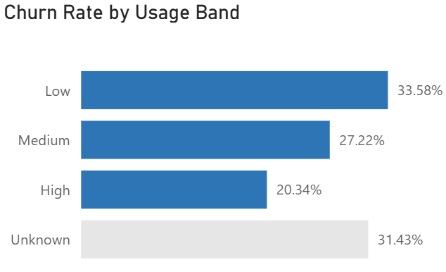
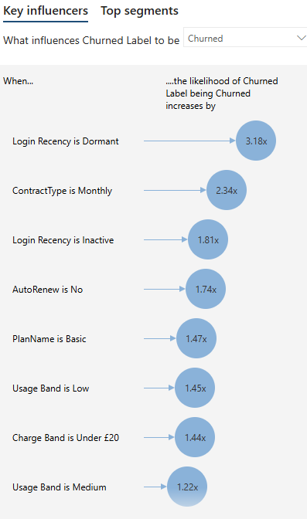
9
Visual Analysis
Three charts, three actions, and a ranked list of what actually drives churn.
KEY INFLUENCERS
Churn rate by login recency
Active 17.1%, Recent 22.2%, Inactive 37.7%, Dormant 75.0%.
ACT: win the customer back before they turn Inactive, where the rate jumps from 22.2% to 37.7%.
Churn rate by contract type
Monthly 29.9% vs Annual 12.8%, across 1,297 monthly customers.
ACT: fund up to two months of discount to move monthly customers onto annual terms at renewal.
Churn rate by usage band
Under 10 hours a month 33.6% vs 30+ hours 20.3%.
ACT: onboard Basic customers onto usage in the first 90 days, not onto feature tours.
Read together: churn tracks engagement and commitment, not price or demographics. The levers are reaching a customer before they go dormant, moving them onto annual terms, and building usage early.
Ranked drivers, each adjusted for the others.
Region, age, gender, payment method and support tickets do not appear at all.
Power BI PL-300 · Capstone Project
9 / 12
Notes:
Read the ACT line out loud for each of the three charts. Lead with login recency: 75% churn among dormant customers is the strongest single number in the analysis, on 12 customers, so say the number and the sample size in the same breath. Then use Key influencers on the right as the summary: it ranks the same drivers in the same order using a model that adjusts each factor for the others, and it independently confirms that region, age, gender, payment method and support tickets carry nothing. Its multipliers differ from a hand-calculated odds ratio because they are adjusted; the agreement that matters is the ranking.

Slide 10
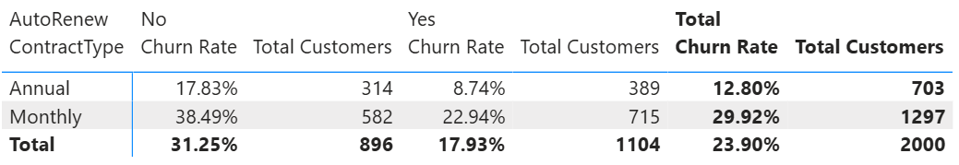
10
Insights & Findings
The five questions from slide 2, answered in order.
Question | Answer from the data
1. Overall churn rate | 23.9%: 478 of 2,000 customers have cancelled. Roughly one in four.
2. Contract type | Yes, strongly. Monthly 29.9% vs Annual 12.8%, a 17-point gap and the single largest commercial difference in the model.
3. Auto-renew, plan, price | Auto-renew: off 31.2% vs on 17.9%. Plan: Basic 29.1% → Standard 21.0% → Premium 17.4%. Price runs the "wrong" way, with the cheapest band churning most (29.2%), because price is a proxy for plan tier and commitment rather than a cause of leaving.
4. Engagement signals | Login recency is by far the strongest: 17.1% Active, 22.2% Recent, 37.7% Inactive, 75.0% Dormant. Usage second: 33.6% under 10 hours vs 20.3% at 30+ hours. Tenure is mild (27.3% under six months, 18.1% past three years). Support tickets are effectively flat.
5. What matters, and what doesn’t | Matters: login recency, usage, contract type, auto-renew, plan tier. Looks like it matters but doesn’t: support tickets (churned customers average 1.74 vs 1.61 for retained, and the eye-catching 45% at six tickets is eleven customers), age (42.6 vs 42.4 years), gender (24.4% vs 23.4%), region (21.9% to 25.0%) and payment method (23.1% to 24.2%).
CONTRACT TYPE BY AUTO-RENEW, FROM THE REPORT
Two independent risks that stack.
Contract and auto-renew act separately and their effects add. Carrying both: 38.5% on 582 customers. Carrying neither: 8.7% on 389. Either lever moves the number on its own.
Power BI PL-300 · Capstone Project
10 / 12
Notes:
Answer the five questions in the order you asked them on slide 2. That symmetry is what makes a deck feel finished. Question 5 is where the marks are: naming what does NOT matter shows you tested rather than assumed. End on the navy box and pause. If asked how you know the two risks add rather than multiply: the odds ratio for auto-renew is 2.27 among annual customers and 2.10 among monthly ones, which is the same effect in both groups, so there is no interaction.

Slide 11
11
Recommendations
Four actions, ranked by leverage rather than by ease.
Action | Evidence behind it | Expected impact | How to measure it
1. Default auto-renew to on, with an opt-out and a clear reminder before each charge | Auto-renew off 31.2% vs on 17.9%. The worst cell in the model, monthly with auto-renew off, is 582 customers at 38.5%. | Largest single lever. Halving the gap on that cell alone is roughly 35 customers a year retained. | Auto-renew adoption rate; churn of the monthly / off cohort, month on month.
2. Trigger a win-back before a customer tips into the Inactive band | Churn runs 17.1% Active, 22.2% Recent, then jumps to 37.7% Inactive and 75.0% Dormant. The step change happens on the way into Inactive. | 395 customers are Inactive or Dormant. Returning a fifth of them to active use is roughly 30 retained. | Churn rate of the Inactive and Dormant cohorts; share of base in each login band.
3. Move monthly customers to annual at renewal, funding up to two months’ discount | Monthly 29.9% vs Annual 12.8%, on 1,297 monthly customers, 65% of the base. | Shifting 20% of monthly customers to annual terms implies ~45 fewer churns a year. | Share of base on annual terms; churn by contract type.
4. Onboard Basic customers onto usage, not features, in the first 90 days | Basic 29.1% vs Premium 17.4%, and customers under 10 hours a month churn at 33.6% vs 20.3% at 30+ hours. | 891 Basic customers. Early usage is the leading indicator every other action depends on. | Average usage hours at day 30 / 60 / 90 by signup cohort.
Worth exploring further: whether low usage causes churn or simply marks a customer who has already decided. An A/B test on the 21-day nudge would separate the two, and it is cheap to run.
Power BI PL-300 · Capstone Project
11 / 12
Notes:
Rank by leverage, not by ease; that's why auto-renew is first. Each impact figure is arithmetic on the cohort sizes in the deck, so show your working if pushed; they are order-of-magnitude estimates, not forecasts, and say so if asked. The A/B line signals you know that two things moving together is not proof of cause, without labouring it.

Slide 12
12
Limitations of the Analysis
What this analysis can claim, and what it cannot.
CONSTRAINTS I WORKED UNDER
WHAT IT MEANS FOR THE FINDINGS
Synthetic data
A teaching dataset, not NovaStream’s real book. The method transfers; the effect sizes do not.
A snapshot, not a timeline
There is no cancellation date, only a Yes/No flag, so I can say who has churned but not when. No survival curve, no true cohort retention.
Association is not cause
Low usage and churn go together. Nothing in this dataset establishes which one comes first.
260 excluded values
Blanks were excluded rather than imputed. If usage is blank because the customer never used the product, the usage gap is understated, not overstated.
Missing context
No price history, discounts, competitor moves or macro conditions. A driver that sits outside the file cannot appear in the answer.
Thin cells
Some bars rest on very few customers: the Dormant login band is 12 people, six support tickets is 11, the Unknown plan is 5. Dormant still clears the base rate comfortably, but the others are shown rather than interpreted.
Direction of the price finding
Cheaper plans churning more almost certainly reflects who buys Basic, not the price itself. Cutting prices would be the wrong reading of this chart.
With more time
A logistic regression to rank drivers while holding the others constant, and a survival model once cancellation dates exist.
Power BI PL-300 · Capstone Project
12 / 12
Notes:
Do not rush this slide or apologise through it. Naming limits is what separates an analyst from a chart-maker. The price point in the right-hand column is the strongest thing you say all deck: the chart says cheap customers churn, and the obvious conclusion, to cut prices, is the wrong one. Say that you spotted it.

Slide 13
Thank you
Questions & discussion
January Sambrook · Power BI PL-300 Capstone
Notes:
Thank them, then offer the one question you'd most like: 'If you take one thing away, it's the 582 monthly customers with auto-renew switched off.' Have the cleaning slide ready to jump back to; it's the most likely question.

