Slide 1
West Yorkshire Bus Performance
Post-pandemic recovery, service provision and public support | 2010–2025
Portfolio analysis report
A Power BI analysis of passenger demand, bus mileage, public support and punctuality across West Yorkshire and peer combined authorities.
January Sambrook • September 2026
Key message
West Yorkshire’s passenger demand has not returned to pre-pandemic levels, while total bus mileage has contracted even further and a larger share of the network is publicly supported.
1

Slide 2
Executive summary
West Yorkshire buses
What the analysis shows
2025 passenger journeys
passenger recovery
mileage recovery
supported mileage share
on-time services
116.6m
81.1%
75.5%
16.1%
77%
Headline findings
Demand has not fully recovered
Service mileage has fallen further
Publicly supported mileage matters more
Passenger journeys in 2025 are around 81% of the 2019 baseline in West Yorkshire.
Total vehicle miles are around 75.5% of 2019, suggesting network contraction has outpaced passenger recovery.
Commercial mileage fell sharply, while supported mileage rose relative to 2019.
Overall conclusion
The analysis points to a smaller, more publicly supported network that is carrying fewer passengers than before the pandemic. West Yorkshire is mid-table against peers for 2025 passenger recovery and punctuality.
2

Slide 3
Project brief
West Yorkshire buses
Analytical question and objectives
Main question
Has West Yorkshire’s bus network recovered since the pandemic — and how have service provision, public support and reliability changed?
Objectives
Measure passenger and mileage recovery against a 2019 baseline.
Compare commercial, supported and publicly controlled mileage trends.
Assess public support per passenger journey and punctuality.
Benchmark West Yorkshire against peer combined authorities.
Create a portfolio-ready Power BI report and presentation narrative.
Why this matters
Bus recovery is not just a demand question. It also reflects service supply, funding structure and reliability — all of which affect access to work, education and services.
3

Slide 4
Dataset overview
West Yorkshire buses
Public transport tables used in the analysis
Dataset
What it contributed
Final query
BUS01e
Passenger journeys by local authority, 2010–2025
Fact_PassengerJourneys
BUS02d_mi
Vehicle miles by authority and service type
Fact_VehicleMiles
BUS05di
Estimated net government support, £000s
Fact_GovSupport
BUS09a
Percentage of non-frequent services running on time
Fact_Punctuality
Authority mapping
Peer combined authority lookup and clean grouping
Authority_Mapping
Relevance to the project
Unit handling
Together, the tables allow a joined analysis of outcomes, service provision, funding and reliability — rather than treating passenger journeys as the only measure of recovery.
Passenger journeys and vehicle miles are in millions. Government support was held in £000s and converted to £m / £ per journey using DAX measures.
4

Slide 5
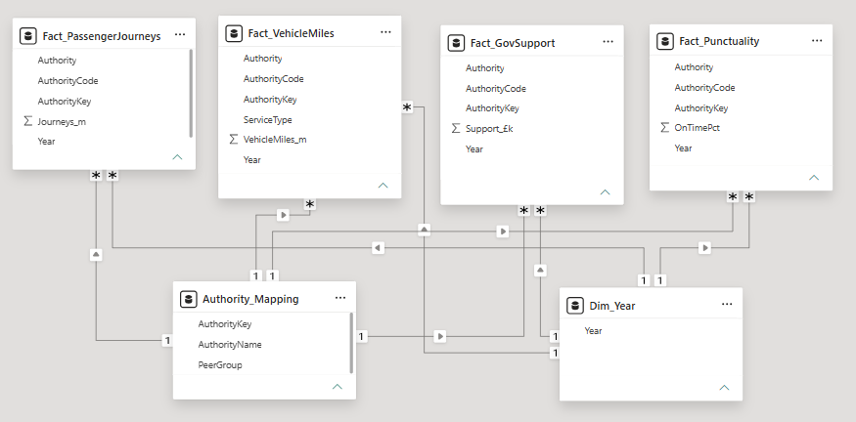
Data preparation and model
West Yorkshire buses
Cleaning, transformation and modelling decisions
Star schema
Power Query preparation
Removed non-data header rows from each DfT workbook.
Promoted true column headers and standardised names.
Unpivoted year columns into a consistent Year field.
Converted DfT shorthand markers such as [z] to null, not zero.
Kept raw support values as £000s, then used DAX for analysis units.
Filtered to the six peer combined authorities using a mapping table.
5

Slide 6
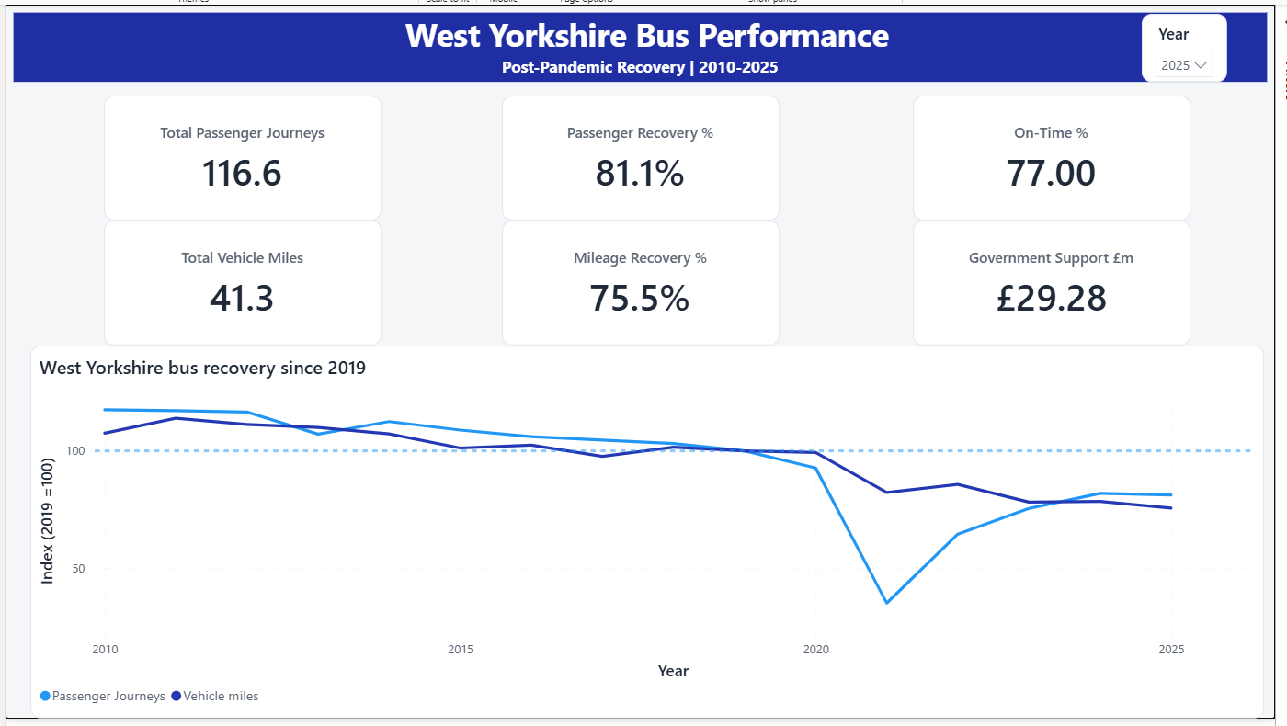
Power BI report overview
West Yorkshire buses
Three-page analytical report
Page 1: West Yorkshire overview
6

Slide 7
Finding 1: Recovery is incomplete
West Yorkshire buses
2019 baseline shows the scale of the gap
Passenger recovery
81.1%
Vehicle-mile recovery
75.5%
On-time services
77%
Interpretation
Passenger journeys have recovered more than service mileage, suggesting the network has contracted more than demand. Reliability remains below the stronger 2010s levels.
Dashboard view filtered to West Yorkshire and 2025; line chart indexes passenger journeys and vehicle miles to 2019 = 100.
7

Slide 8
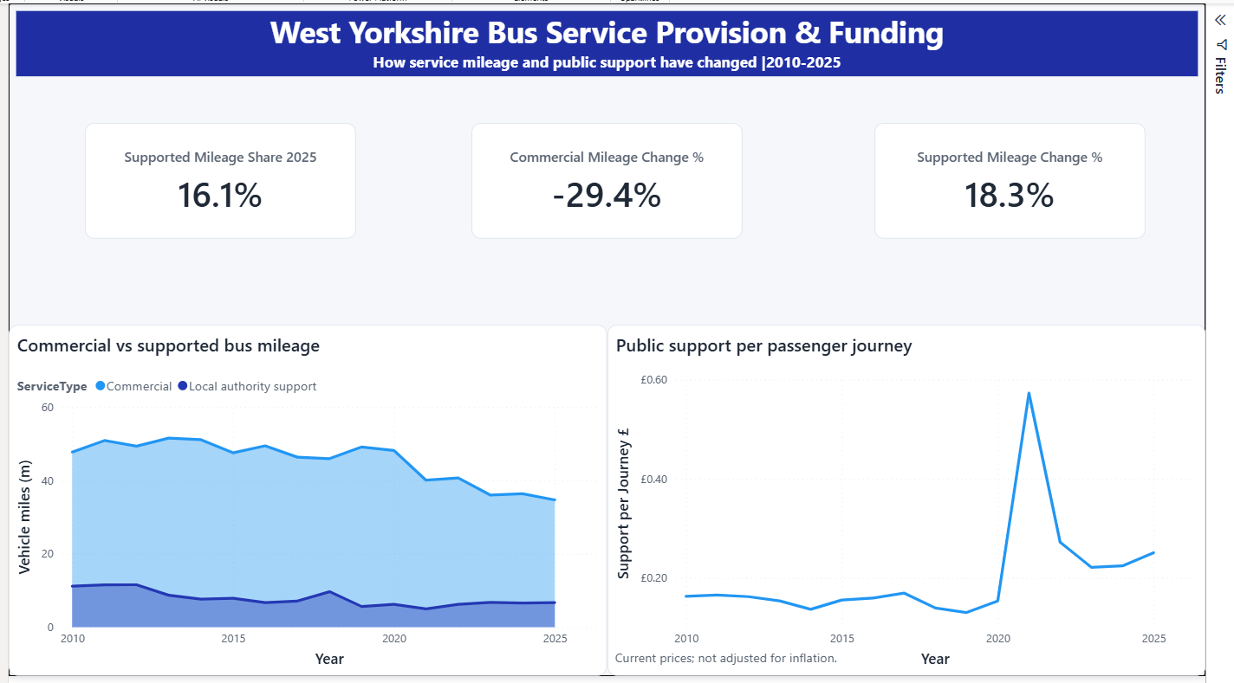
Finding 2: The mileage mix has shifted
West Yorkshire buses
Commercial mileage has contracted while supported mileage is more prominent
Supported mileage share
16.1%
Commercial mileage change
−29.4%
Supported mileage change
+18.3%
Interpretation
A larger share of West Yorkshire’s remaining bus mileage is now publicly supported. That makes funding and service-planning decisions increasingly important to network resilience.
8

Slide 9
Finding 3: Support per passenger remains elevated
West Yorkshire buses
Funding pressure rose sharply when passenger demand collapsed
Support per passenger journey
£0.25
in 2025
Pre-pandemic values were closer to £0.13 per journey. The 2021 spike reflects very low passenger volumes during the pandemic.
Caveat
Support figures are current prices and are not adjusted for inflation. They are also net revenue measures, so local authority values can be affected by offsets and accounting practices.
Why this is useful
This KPI connects public support to passenger outcomes, rather than reporting funding in isolation.
9

Slide 10
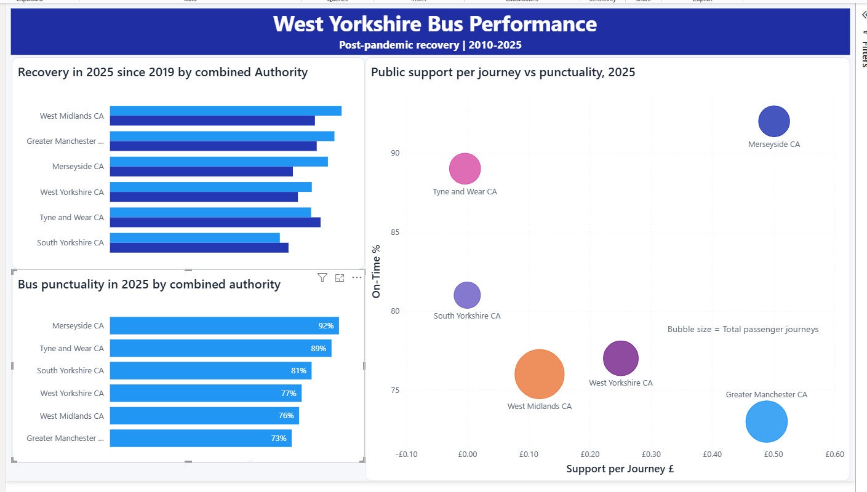
Peer comparison
West Yorkshire buses
Benchmarking recovery, punctuality and public support | 2025
Benchmark takeaway
Analytical caution
West Yorkshire is mid-table for passenger recovery and punctuality. It does not stand out as either the strongest or weakest performer across the peer group.
The scatter shows association, not causation. Higher recorded support per passenger does not translate neatly into better punctuality across this peer group.
10

Slide 11
Insights and recommendations
West Yorkshire buses
What the analysis suggests for decision-makers
1. Track demand and supply together
2. Monitor reliance on supported services
3. Treat punctuality as a separate performance lens
Passenger journeys alone understate the story. Mileage has contracted more sharply, so recovery should be monitored as both demand and service provision.
Supported mileage has become a larger share of West Yorkshire’s network. Funding risk should be assessed as part of service planning.
Passenger recovery and service mileage do not automatically imply reliability. Punctuality needs its own tracking and operational investigation.
Recommended next analysis
Add inflation-adjusted support measures to separate nominal and real-terms change.
Bring in route-level or operator-level data to identify where service contraction is concentrated.
Overlay population, employment and deprivation context to assess social impact.
Track punctuality alongside congestion or roadworks data where available.
11

Slide 12
Limitations and next steps
West Yorkshire buses
How to interpret the findings responsibly
Limitations
Portfolio skills demonstrated
Annual aggregated data masks route-level variation and local service changes.
Funding is at current prices, not inflation-adjusted.
Net support can be affected by offsets, accounting practices and inter-authority transfers.
Punctuality data does not explain causes such as congestion, staffing, roadworks or operational disruption.
The analysis uses peer combined authorities, not every possible comparator.
Power Query cleaning and unpivoting of inconsistent public datasets.
Dimensional modelling with shared Year and Authority dimensions.
DAX measures for baselines, recovery indices and per-journey metrics.
Dashboard layout, storytelling and visual interpretation.
Clear documentation of caveats and analytical assumptions.
Final takeaway: the report is strong because it explains how the network changed, not just what the latest numbers are.
12

