Slide 1
Q1 2024 Performance:
Where to Focus in Q2
National Bookstore Group · Genre, Region & Publisher Review
750 orders · $73,792.73 total sales · January – March 2024
January Sambrook | Junior Data Analyst | Tableau Final Project
August 2026

Slide 2
1
Project Brief
What management asked for, and how this analysis answers it
Overview
Key Questions
A national bookstore group selling across four U.S. regions requested a Q1 2024 performance review. The purpose is to direct marketing spend and purchasing decisions for Q2 2024.
Q1
Which genres generated the highest sales?
Q2
How does performance vary by region and state?
Objectives
Establish which genres drive revenue
Compare regional performance and identify underserved markets
Rank publisher partners by contribution
Track how sales accumulated week by week across the quarter
Q3
Which publishers are top and bottom performers?
Q4
Did sales grow, hold or decline across the quarter?
Q5
Do large orders or high-priced books drive revenue?

Slide 3
2
Dataset Overview
Source, scale and relevance of the data supplied
750
$73,792.73
749
60
records in the Q1 fact table
total Q1 2024 sales
distinct order IDs
publisher partners
Sources supplied
Relevance to the objectives
Bookstore_Monthly_Sales_2024_01/02/03.csv: 250 rows each, unioned into one Q1 fact table
Publisher_Info.csv: 60 rows, one per publisher (lookup / dimension table)
Bookstore_Sales.csv: 700 rows spanning 2020 to 2024, related on PublisherID
Covers the exact review window: 1 Jan – 28 Mar 2024
Carries genre, region, state and city, the four dimensions management asked about
Publisher lookup supplies readable partner names for the ranking view
Coverage note: 10 states and 48 cities across Central, East, South and West. Every order is United States only, so no international comparison is possible from this data.

Slide 4
3
Dataset Structure
Key variables in the unioned Q1 fact table and the publisher lookup
Field | Type | Role | Range / distinct values
OrderID | Categorical | Identifier | 749 distinct across 750 rows
OrderDate | Date | Dimension | 1 Jan – 28 Mar 2024
PublisherID | Categorical | Join key | 60 distinct
Genre | Categorical | Dimension | 8 values (Children → Self-Help)
Quantity | Numerical (discrete) | Measure | 1 – 7 (mean 3.96)
UnitPrice | Numerical (continuous) | Measure | $5.06 – $44.97 (mean $25.15)
Sales | Numerical (continuous) | Measure | $5.17 – $311.85 (median $82.84)
Region | Categorical | Dimension | 4 values
State / City | Geographic | Dimension | 10 states, 48 cities
PublisherName | Categorical | Dimension (lookup) | 60 distinct
HQ_State | Geographic | Dimension (lookup) | From Publisher_Info.csv
Sales is a derived field: Quantity × UnitPrice. This was verified on all 750 rows, with no mismatches.

Slide 5
4
Identified Problems & Challenges
What was checked, and what the checks found
Missing values
Duplicate rows
Duplicate OrderID
Outliers
None
None
1 found
4 flagged
All 10 fields across 750 rows are fully populated. Publisher_Info is also complete.
No duplicate order records were identified in the unioned table.
BM-03-493700 appears twice with different dates, publishers, genres and values, an ID collision, not a duplicated sale.
All are legitimate: 7 units at a high unit price. Retained, not removed.
The join that would have broken the analysis
The brief specifies joining the Q1 union to Bookstore_Sales.csv on PublisherID. That table holds ~12 rows per publisher and spans 2020–2024, a different grain and a different period.
Executed as a physical inner or left join, the 750-row union expands to 8,704 rows, inflating total sales from $73,792.73 to $875,069.56. That is an 11.86x overstatement.
Resolved by connecting it as a Tableau relationship on the logical layer rather than a physical join, so each table aggregates at its own level and Q1 totals stay correct.

Slide 6
5
Data Cleaning Process
Steps taken, and the justification for each decision
1
Union, not append
2
Left join for the lookup
The three monthly files share an identical 10-column schema, so a Tableau union produces one clean 750-row Q1 fact table with no field mismatches.
Publisher_Info.csv holds exactly one row per PublisherID, so it cannot fan out the fact table. A left join preserves every sales row even if a publisher were ever missing from the lookup. An inner join would silently delete those sales.
3
Relationship for Bookstore_Sales.csv
4
Duplicate OrderID retained
Used the logical layer rather than a physical join to satisfy the data model without corrupting the Q1 aggregates. No field from this table is used in any worksheet.
The two BM-03-493700 rows describe genuinely different transactions. Deleting either would remove real revenue. Retained, and noted as a caveat on any distinct-count measure.
5
Outliers retained
6
No fields invented
The four IQR outliers sit within the valid ranges of both Quantity (max 7) and UnitPrice (max $44.97). They are real high-value orders, and removing them would understate the top of the market.
Per the brief, no Customer, Discount, Category or Profit Ratio fields were created. All analysis uses supplied fields only.

Slide 7
6
Data Transformation
New variables created from existing fields only
Avg. Sales per Order
SUM([Sales]) / COUNTD([OrderID])
Normalises revenue by order count so regions of different size compare fairly. Q1 value: $98.52.
Aggregate · Measure
Avg. Unit Price (Weighted)
SUM([Sales]) / SUM([Quantity])
Weights price by units sold rather than averaging list prices, giving the true realised price. Q1 value: $24.86.
Aggregate · Measure
Order Size
IF [Quantity] >= 5 THEN "Large (5+)"
ELSEIF [Quantity] >= 3 THEN "Medium (3-4)"
ELSE "Small (1-2)" END
Bands each order by units so basket size can be used as a slicing dimension.
Row-level · Dimension
It’s worth noting that by using distinct count of orderID total sales was divided by 749 not 750 due to the duplicate order ID which is not a duplicate order

Slide 8
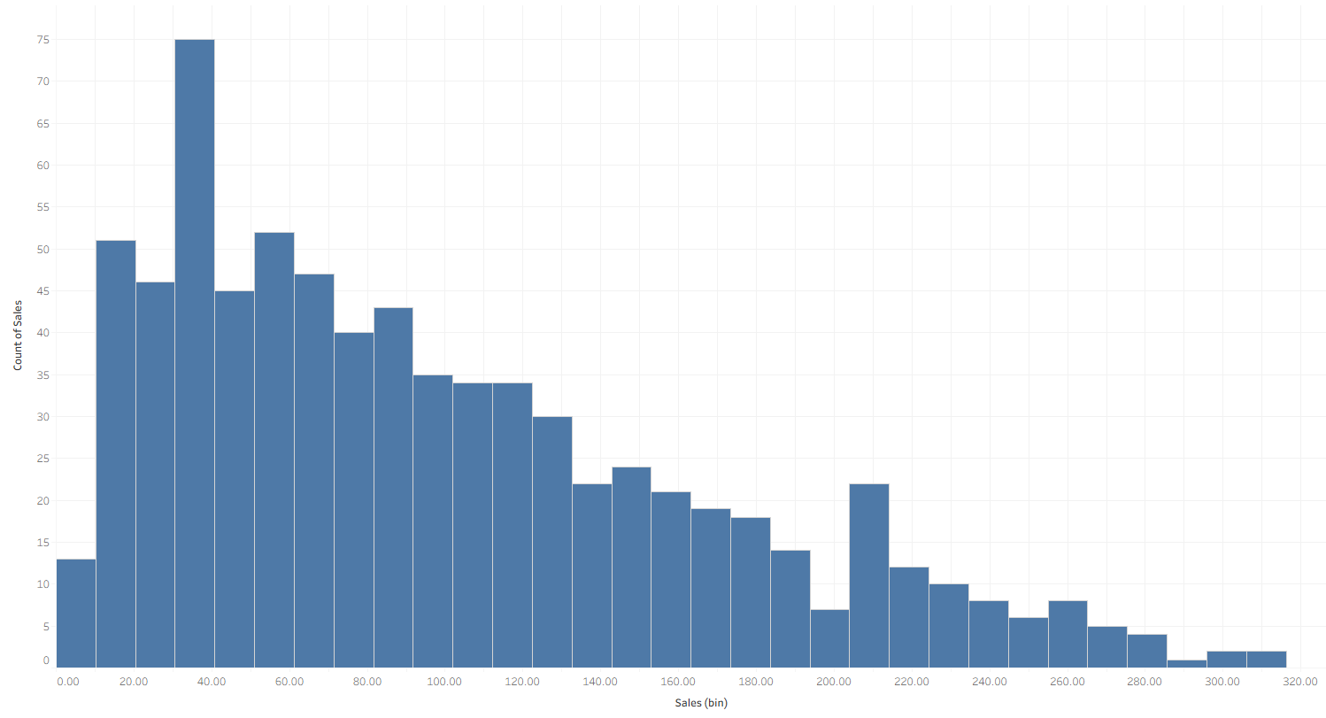
Key findings from initial analysis
7
Exploratory Data Analysis
Large orders of 5 or more units are 41% of rows but 61.7% of revenue, so basket size is the dominant lever.
Revenue is not concentrated: the top 10 of 60 publishers account for only 23.9% of sales.
Quantity ranges 1 to 7 with a median of 4. No single-item dominance in ordering behaviour.
Volume is stable month to month: January $24,387, February $23,414, March $25,991. No seasonal collapse.
Sales is right-skewed: mean $98.39 sits well above median $82.84, pulled up by large multi-unit orders.
Unit price spans $5.06 to $44.97 with a median of $25.76, sitting mid-range. There is no budget or premium split in the catalogue.
Descriptive statistics and first observations
Measure | Min | Median | Mean | Max | Std dev
Quantity (units) | 1 | 4 | 3.96 | 7 | 1.97
Unit Price | $5.06 | $25.76 | $25.15 | $44.97 | $11.34
Sales | $5.17 | $82.84 | $98.39 | $311.85 | $68.38

Slide 9
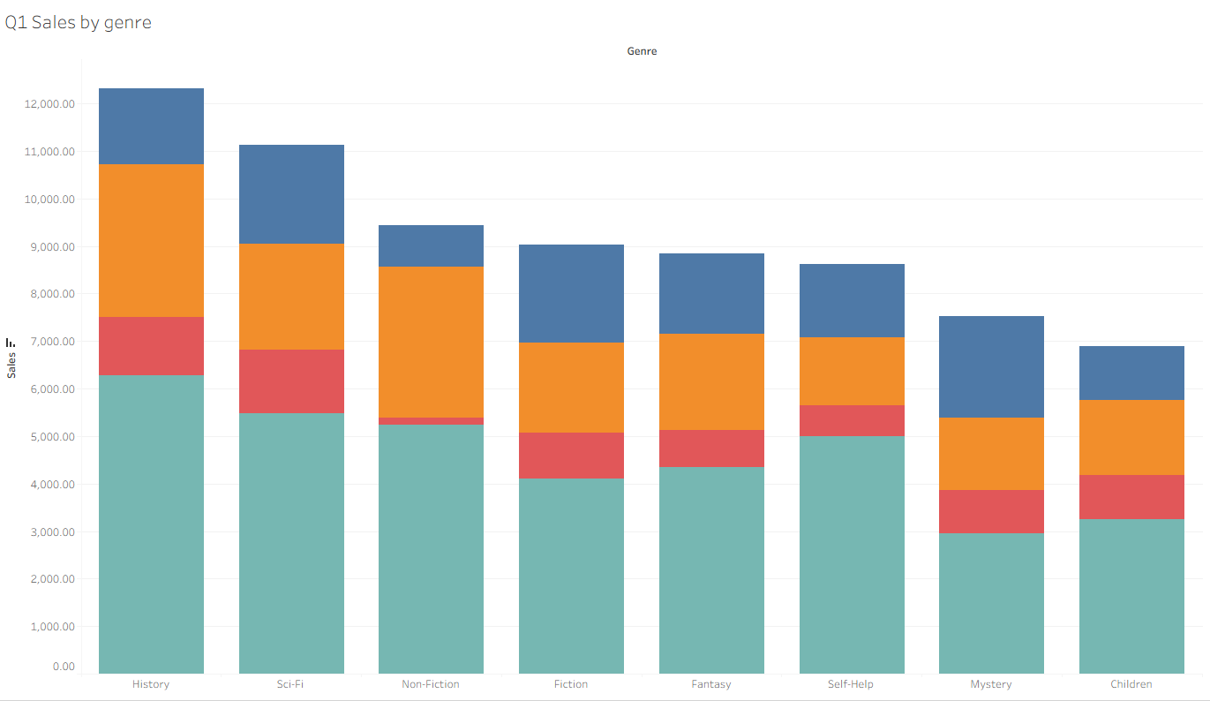

8
Visual Analysis: Sales by Genre
Task 2 · Bar chart, Genre on Columns, SUM(Sales) on Rows, Region on Colour
What it shows
History leads at $12,316.63 (16.7% of Q1 sales), followed by Sci-Fi at $11,121.71.
Children is weakest at $6,886.85 (9.3%).
The spread is narrow: only 7.4 percentage points separate best from worst. No genre is failing; none is dominant.
History also carries the highest average order value at $116.19, well above the $98.52 overall average. It sells fewer orders but bigger ones.
West colouring dominates every single bar, so regional skew rather than genre preference is the stronger signal.

Slide 10
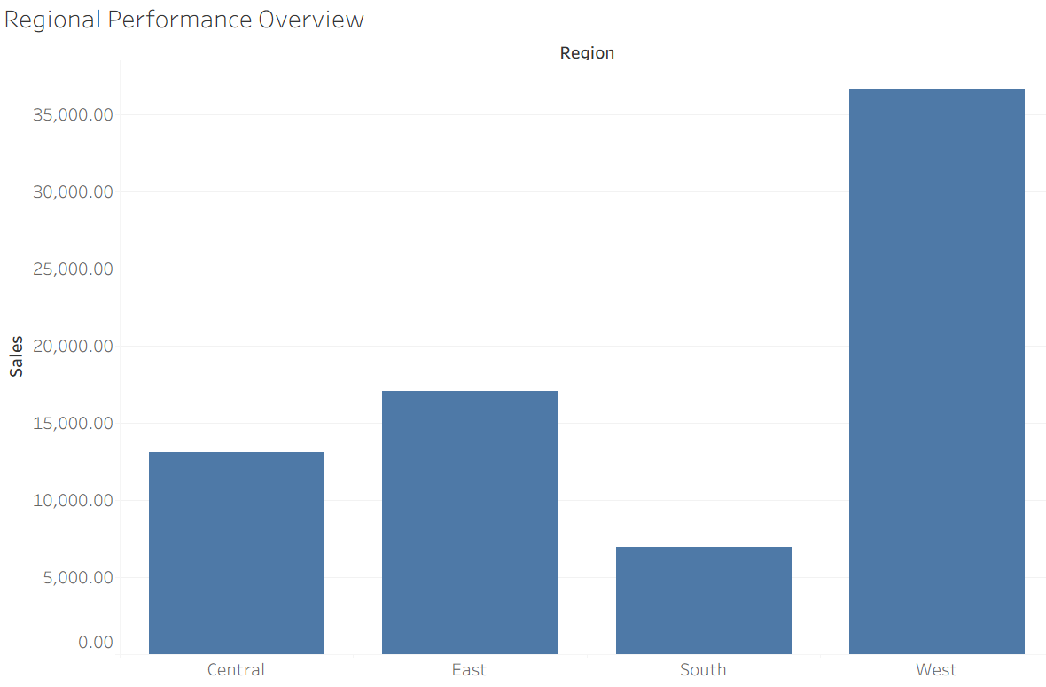
9
Visual Analysis: Regional Performance
Task 3 · Bar chart, Region on Columns, SUM(Sales) on Rows, Genre filter shown
What it shows
West alone is 49.7% of all Q1 revenue, more than the other three regions combined.
South is the clear laggard at $6,962.80 (9.4%), with only 80 orders.
The gap is driven by order volume, not order value: West took 360 orders to South's 80.
Average order value is far more even across regions, ranging only $87.04 to $101.85.
This means South's problem is reach, not pricing or product mix.
Region | Sales | Share | Orders | Avg per order
West | $36,666.66 | 49.7% | 360 | $101.85
East | $17,056.30 | 23.1% | 174 | $98.02
Central | $13,106.97 | 17.8% | 136 | $96.37
South | $6,962.80 | 9.4% | 80 | $87.04

Slide 11
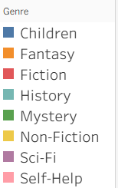
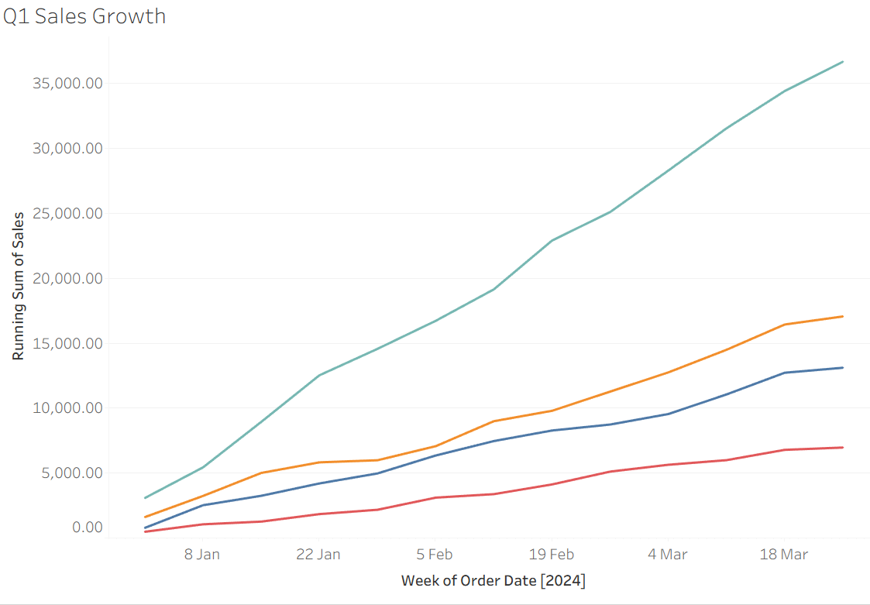
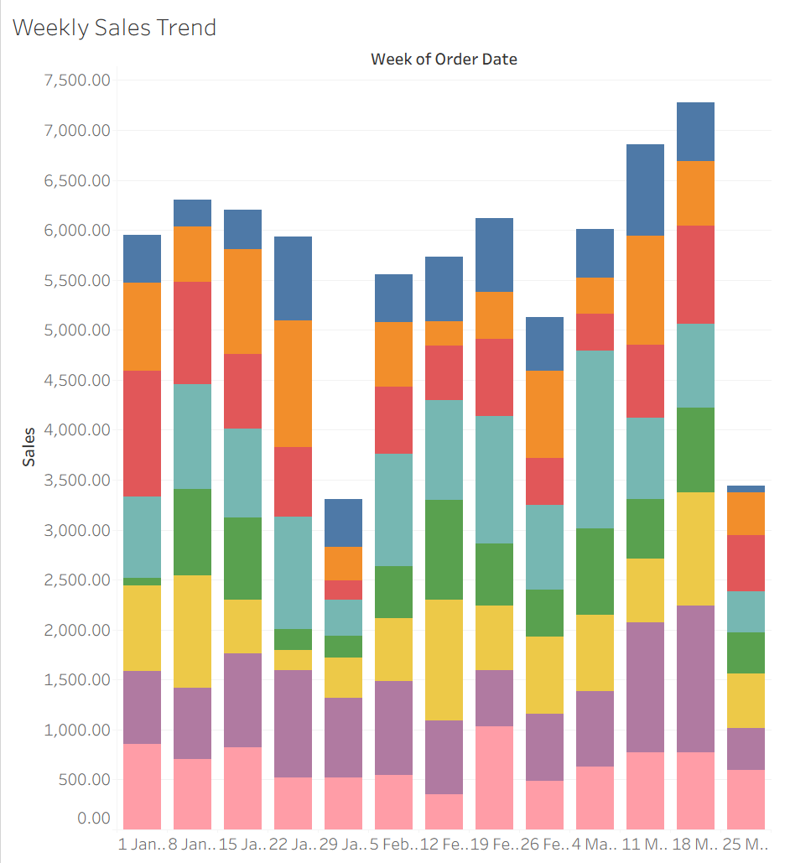
10
Visual Analysis: Sales Over Time
Task 4 · Weekly trend by Genre | Task 9 · Running total by Region
What it shows
Weekly sales are steady between $5,100 and $7,300 for the bulk of the quarter.
The strongest week was the one beginning 18 March at $7,274, so the quarter finished on an upward trend.
Two apparent troughs, the weeks beginning 29 January ($3,306) and 25 March ($3,438), are data artefacts: each monthly file stops on the 28th, so those weeks are partial. They are not real declines.
The running total shows West pulling away steadily from week one rather than spiking. This is a persistent structural advantage, not a one-off campaign.
Task 4 specifies a line chart with Genre on Colour. Eight genre lines across thirteen weeks produced an unreadable chart. A stacked bar was substituted: total weekly sales remain legible as bar height while genre composition is preserved as colour.

Slide 12
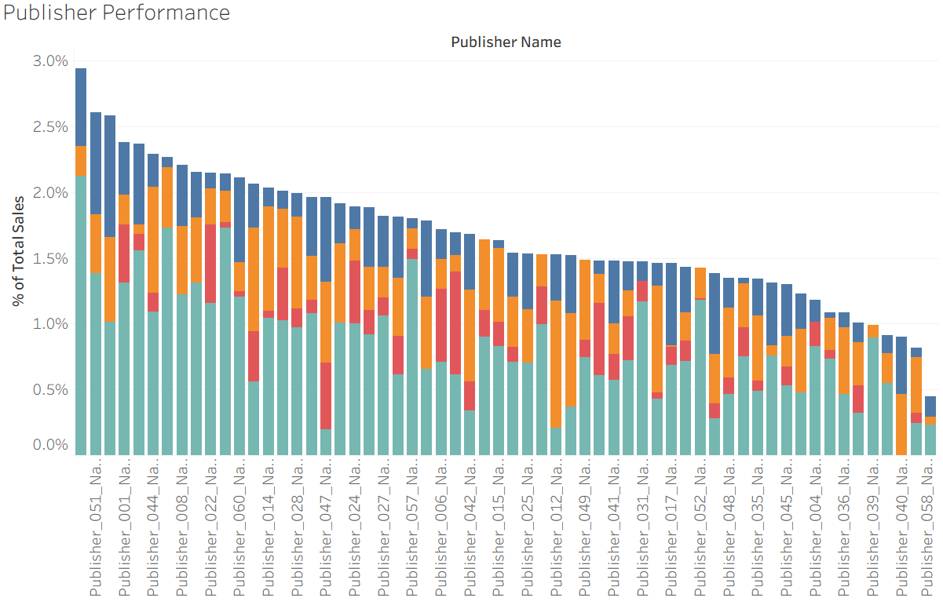
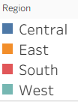
11
Visual Analysis: Publisher Performance
Task 5 · Bar chart, PublisherName on Columns, sorted descending, shown as percent of total sales
What it shows
Revenue is highly fragmented across 60 publishers. The top 10 account for approximately 24% of Q1 sales.
Publisher_013 leads at $2,171.33; Publisher_058 trails at $327.94, a 6.6x gap between best and worst.
No single partner is critical to the business, which lowers supplier risk but also means no publisher has meaningful negotiating leverage.
The top five publishers sit within 0.6 percentage points of each other, so the leaderboard is unstable and could reorder on a single large quarter.

Slide 13
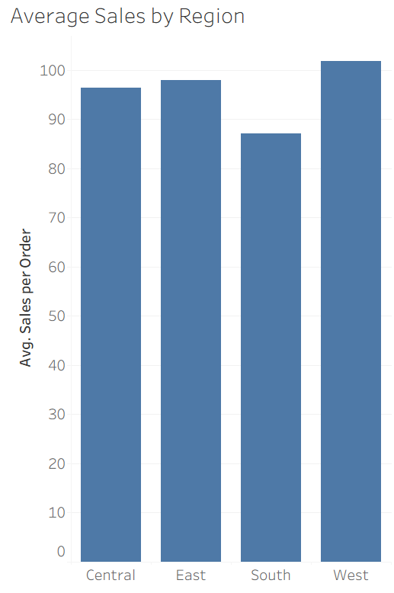
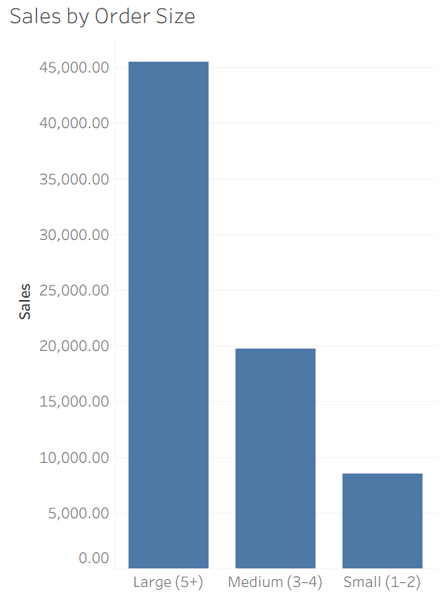
12
Visual Analysis: Order Value & Basket Size
Task 6 · Avg. Sales per Order by Region | SUM(Sales) by Order Size
What it shows
Average order value barely moves across regions: $101.85 in West down to $87.04 in South, so South sits just 15% below West.
Compare that with the 5.3x gap in total regional sales, confirming that volume rather than value drives the regional difference.
Basket size is where the real concentration sits. Large orders of 5+ units are $45,509 of revenue, or 61.7% of the quarter.
Small orders of 1–2 units are 29% of rows but only 11.6% of revenue.

Slide 14
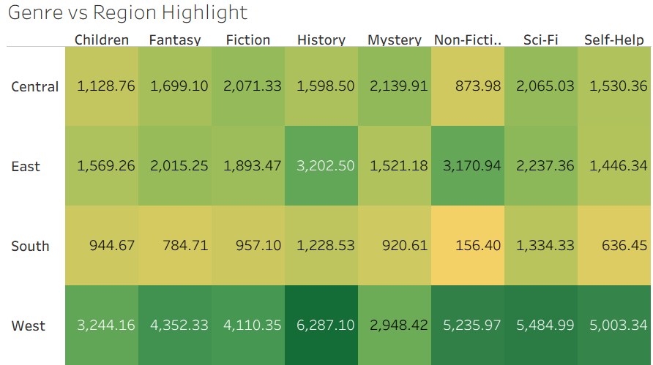

13
Visual Analysis: Genre vs Region Highlight Table
Task 7 · Highlight table, Region on Rows, Genre on Columns, Square marks coloured by SUM(Sales)
What it shows
The hot corner is West × History at $6,287, the single strongest genre-region cell in the business.
The cold corner is South × Non-Fiction at $156, which is effectively no trade at all.
That is a 40x spread between the best and worst cells.
West is strong across every genre without exception, which points to a distribution or store-footprint advantage rather than a merchandising one.
South shows no genre it performs well in. There is no niche to build on, so any Q2 action there starts from scratch.

Slide 15
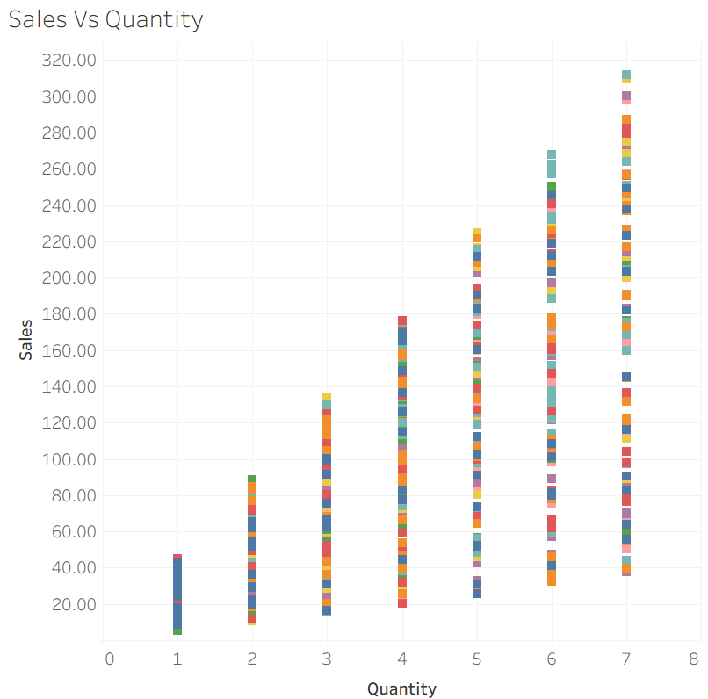
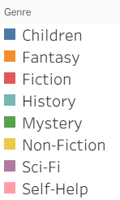
14
Visual Analysis: Sales vs Quantity
Task 8 · Scatter plot, Quantity on Columns, Sales on Rows, OrderID on Detail, Genre on Colour
What it shows
Points fan upward and outward from the origin: at each quantity step the possible sales range widens, because unit price varies independently.
The upper envelope is set by the 7-unit orders at premium prices: the largest single order is $311.85 (History, 7 units at $44.55).
No genre clusters in a distinct price band. Colour is scattered evenly throughout, meaning genre does not predict order value.
Four orders exceed the IQR outlier threshold. All are legitimate high-quantity, high-price purchases and were retained.

Slide 16
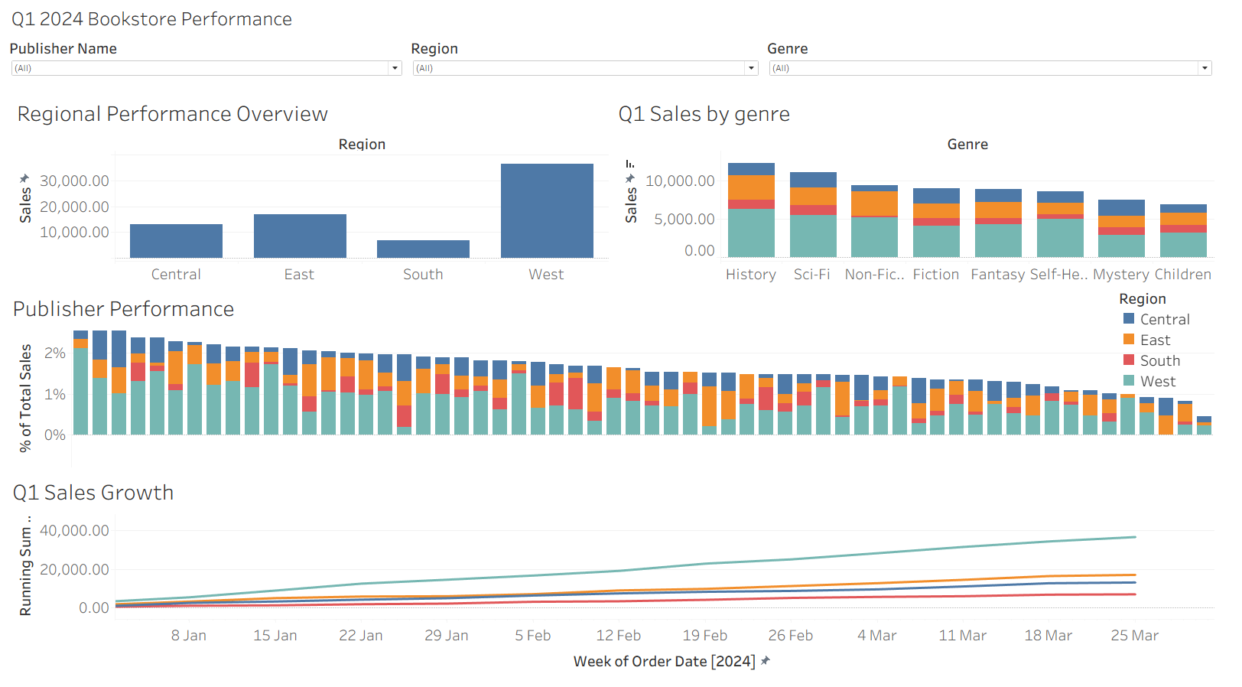
15
Executive Dashboard
Task 10 · Four views combined with interactive Region, Genre and PublisherName filters
Dashboard design decisions
Four views: Sales by Genre, Regional Performance, Running Total and Publisher Performance.
All three filters set to dropdown controls to keep the header compact.
Filters applied to all worksheets using the data source, so one selection moves every chart.
Publisher axis header hidden and the measure shown as percent of total, since 60 labels were illegible at dashboard scale.
All 60 publishers retained rather than filtered, so the fragmentation of revenue stays visible.

Slide 17
16
Insights & Findings
Answers to the five questions set at the start
Q1
Genre is not the problem
History leads at $12,317 and Children trails at $6,887, but only 7.4 points of share separate them. Every genre trades. There is no dead category to cut.
Q2
Region is the problem
West is 49.7% of revenue; South is 9.4%. A 5.3x gap driven almost entirely by order volume: 360 orders against 80.
Q3
No publisher is critical
60 partners, top 10 worth only 24%. Low supplier concentration risk, but also no leverage with any single publisher.
Q4
Sales held and finished strong
January $24,387, February $23,414, March $25,991. The best week of the quarter was the last full one, ending 24 March at $7,274.
Q5
Basket size drives revenue
Large orders of 5+ units are 61.7% of sales from 41% of transactions.

Slide 18
17
Recommendations for Q2 2024
Suggested actions, ordered by expected return
Grow order volume in South
South's average order value is only 15% below West, but it takes a fifth of the orders. The deficit is reach. Direct Q2 marketing spend at customer acquisition in South rather than at basket-size promotions.
1
Highest impact
Protect and extend West
West is half the business and contributed steadily across the quarter. Ensure Q2 stock allocation matches this, particularly History and Sci-Fi, which are strongest there.
2
Lowest risk
Incentivise larger baskets
Large orders already produce 61.7% of revenue from 41% of transactions. Multi-buy offers targeted at the 1–2 unit segment address the weakest 11.6% of revenue.
3
Quick win
Review the bottom publishers
The weakest partners contribute under $400 each for the quarter. Consolidating purchasing toward stronger performers could improve terms without meaningful revenue risk.
4
Medium term
Investigate West's advantage
West outperforms in every genre, which suggests a structural cause such as store footprint, distribution or local marketing. Identifying it would make it repeatable elsewhere.
5
Further analysis

Slide 19
18
Limitations of the Analysis
Constraints on the data, and how they affect the conclusions above
Revenue only, no profitability
Incomplete month-ends
The Q1 files carry Sales but no Cost or Profit. Those fields exist only in Bookstore_Sales.csv, which covers a different period and grain and cannot be safely joined. Every recommendation is therefore made on revenue, not margin. A genre with high sales could still be unprofitable.
Each monthly file stops on the 28th, so roughly 3 days per month are missing. Q1 totals are understated by an unknown amount and the final week of any trend line reads artificially low.
Single quarter, no baseline
No customer dimension
With only Q1 2024 and no prior-year comparison, it is impossible to say whether West's dominance is normal or new, or whether South is declining or has always been small.
There is no customer identifier, so repeat purchase rate, customer lifetime value and new-versus-returning splits cannot be measured. 'Grow order volume' cannot be separated into acquisition versus frequency.
Anonymised publishers
Duplicate order identifier
Publisher names are placeholders, so the ranking cannot be tied to real commercial terms, genre specialisms or contract status.
One OrderID appears twice on different transactions. Any distinct-count measure is understated by one, and Avg. Sales per Order is marginally overstated as a result.

Slide 20
The one thing to take away
Q1 is a distribution problem,
not a product problem.
Every genre sells, every publisher contributes, and the quarter finished on its strongest week. The single largest opportunity in Q2 is closing the 5.3x gap between West and South, and that is a question of reach, not of what is on the shelves.
$73,792.73
49.7%
61.7%
Q1 sales
from West
from large orders

