Slide 1
How marriage and having children affect the timings of waking up, leaving for work, returning home from work, and going to bed: Comparison of Japan and the United States
Minoru Yagishita
Tokyo Metropolitan University and JSPS research fellow
yagishita-minoru@ed.tmu.ac.jp
Acknowledgement: Based on the Statistics Act of Japan, National Statistics Center provided anonymized data of Survey on Time Use and Leisure Activities (Ministry of Internal Affairs and Communications). I am fully responsible for the statistics that I created. The results presented here are not identical to the statistics that the Ministry of Internal Affairs and Communications published. The research was supported by JSPS Grant-in-Aid for JSPS Research Fellow Grant Number JP18J11821.

Slide 2
Gender inequality in time use
Research on gender inequality from aggregate of durations
Duration: time spent on activities such as housework
Convergence of men’s and women’s housework across societies → Trend toward gender equality (Altintas and Sullivan 2016; Sullivan, Gershuny, and Robinson 2018)
Multidimensionality of time (Southerton 2006; van Tienoven 2019; Zerubavel 1976)
duration, timing, tempo, sequence, synchronization, and periodicity
Studying gender inequality across societies only from duration perspective limits full understanding of gender inequality in time use
I investigate how being married and being a parent influences men’s and women’s timings in Japan and the United States.

Slide 3
Why those four timings?
Four timings: waking up, leaving for work, returning home from work, and going to bed
These timings are reference points (deadlines or goals) when people organize their daily schedules.
Participation rates in those activity are high (most people wake up). Waking up and going to bed divide sleep, which is about a third of the day, and other activities.
Leaving for work and returning home from work divide market labor and related activities outside home, and other activities (such as unpaid labor and leisure) inside home.

Slide 4
Effects of marriage and being a parent on men’s and women’s timings
Gender specialization (Becker 1993)
Gender differences in the timings of activities arise from men’s (husbands and fathers) greater involvement in the labor market and women’s (wives and mothers) greater involvement in their families.
Gendered responsibilities for housework and childcare, which needs to be done in certain timings (DeVault 1994; Yates and Warde 2017).
Women rise from bed to meet familial obligations, and men are less likely to do so (Maume, Sebastian, and Bardo 2010).
Another study reported that, according to its interviewees, the person who comes home first does the food preparation for the family (Beagan et al. 2008).

Slide 5
Societal difference in the effects of marriage and a being parent on the timings
Are gender differences in the effects of marriage and having children on timings smaller in a more gender equal society in terms of duration of housework?
Male-breadwinner model: men are breadwinners for their families, and women are the caregivers (Lewis 1992) i.e., Japan
In a male-breadwinner model, greater responsibility for housework and childcare fall on women, the timing of those activities for women is affected by their responsibilities, but timing is less affected among men.
US: dual earner model, less gender differences (Lewis 2001)

Slide 6
Hypotheses
H1: The gender differences in the effect of marriage on four timings are larger in Japan than in the United States.
How to test?: Coefficients for marriage × gender are larger for Japan than for the United States.
H2: The gender differences in the effect of being a parent on four timings are larger in Japan than in the United States.
How to test?: Coefficients for parental status× gender are larger for Japan than for the United States.

Slide 7
Anonymized version of JTUS
Questionnaire A Time use: 1991, 1996, 2001, 2006
Questionnaire A Behavior: 1991, 1996, 2001, 2006
Questionnaire B Time use: 2001, 2006
Older & Recent datasets are not available
1976, 1981, 1986, 2011, 2016
Those are available on on-site facilities
Datasets are provided in csv format.
Researcher can use datasets in approved places.
Some procedures are taken to achieve anonymity.

Slide 8
What is anonymization of JTUS?
Resampling
80% of the original sample is resampled
Making identification of respondents difficult
Some identification variables are deleted
Observations are reordered
Observations with abnormal values are deleted
E.g., households with over 8 people
Some variables are Top- and bottom-coded & recoded
Age: over 85 years old, age 10-14 years old etc.

Slide 9
Pros and Cons for Anonymized JTUS
Pros
Researcher can use it any time
They do not have to wait for the results approval process
Cons
Anonymized JTUS is not the same as original data.
Older and recent datasets are not available.
Some variables are not provided.
Categories of some variables are coarse not fine (Especially age).

Slide 10
Data and variables
STULA(or JTUS) 2006 anonymized data & ATUS 2003-2018
Analytic samples are restricted to respondents age 20 or over.
Dependent variables (timings are calculated):
All population: waking up and going to bed
Working population: leaving for work and returning home from work
Independent variables:
Marriage (vs never married) × women
Four Parental statuses ×women
parent with youngest children age 0-4, 5-9, 10-14, 15-19 vs no child or children age 20 or over

Slide 11
Control variables
To account for gender specialization: length of sleep, work, commuting, housework, childcare
age, educational attainment, household income, respondents' occupation, day of the week
ATUS only: Race, Years, Months

Slide 12
Definition of waking up by SBJ
the time at which the activity of sleep ceases; it must have begun at midnight or after and before noon and its duration must exceed 60 minutes or more. If the duration a non-sleep activity between two sleep activities is 30 minutes or less, that activity is regarded as sleep (Statistics Bureau of Japan 2018a:6).

Slide 13
Definition of leaving for work by SBJ
activity start time of the commute that occurs before the first work activity that starts at 15 minutes after midnight or after and before midnight. If there is no commuting activity before the first work activity and there is a commuting activity before another work activities, the start time for the commuting activity for the later work activity is chosen. If there are no commuting activities before any work activities, the start time of the first work activity is chosen

Slide 14
Definition of returning home from work
the stop time of the commute that occurs after the last work activity which starts at 0:15 or after and before midnight. If there is no commuting activity following the last work activity and there is a commuting activity after another work activity, the stop time for last commuting activity is chosen. If there are no commuting activities after any work activity, the stop time of the last work activity is chosen. If the last work activity is not followed by commuting but there is commuting before its start, and there is another work activity before the last work activity that have commuting before the start of that work activity, returning home from work is coded as unknown

Slide 15
Definition of going to bed
the start time for sleep that begins 17:00 or after and before 36:00 (noon the next day) and has a duration that exceeds 60 minutes. If there are more than one sleep activity, the start time for the longest sleep is chosen (if the lengths are the same, the start time of the earlier sleep is chosen). Non-sleep activities between two sleep activities that continue 30 minutes or less are regarded as sleep

Slide 16
Calculation of timings from time use data
Statistics Bureau of Japan provides the definition of timings (Statistics Bureau of Japan 2017: 81-2) but it is incomplete
6 timings: waking up, going to bed, start of breakfast, start of dinner, leaving for work, returning home from work
Anonymized data do not contain those variables
Personal communication with Statistics Bureau of Japan allowed me to calculate these timings from anonymized data.
Similar procedures are used for ATUS to calculate timings
Differences: Start of the day(JTUS 0:00am; ATUS 4:00am), surveyed days (JTUS two days; ATUS a day), different coding of travels

Slide 17
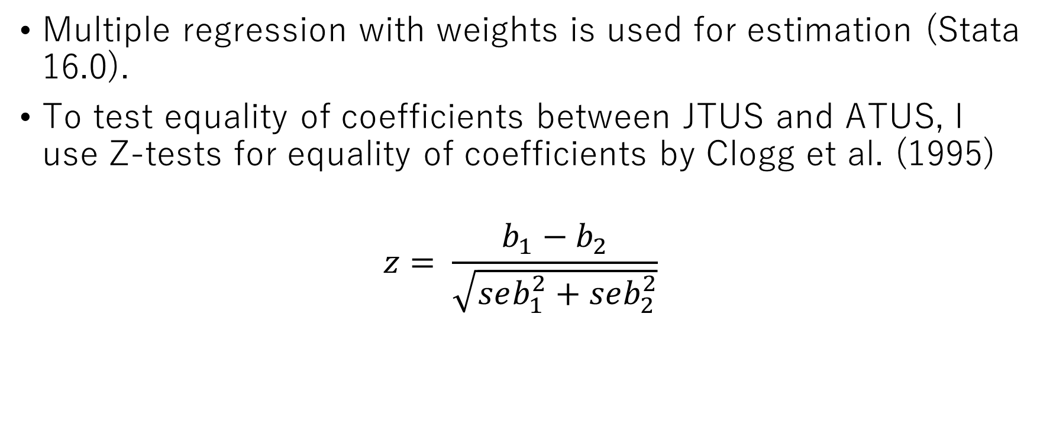
Methods
Multiple regression with weights is used for estimation (Stata 16.0).
To test equality of coefficients between JTUS and ATUS, I use Z-tests for equality of coefficients by Clogg et al. (1995)
$$z= \frac{b_{1}−b_{2}}{\sqrt{seb_{1}^{2}+seb_{2}^{2}}}$$

Slide 18
Comparison of published and calculated values of the timings (JTUS)
 | Published values |  | Calculated Values (Anonymized)
 | Participation Rate | Average | Participation Rate | Average
Waking up | 99.5 | 6:39 | 99.5 | 6:38
Breakfast | 85.1 | 7:12 | 85.4 | 7:12
Dinner | 90.9 | 19:09 | 91.4 | 19:10
Going to bed | 99.5 | 23:16 | 99.4 | 23:15
Leaving for work | 86.6 | 8:28 | 86.5 | 8:26
Returning home from work | 86.6 | 18:58 | 86.1 | 18:56
Note: No distributional difference is found (Kolmogorov–Smirnov tests; p > .99).

Slide 19
All differences between men and women are significant

Slide 20
All differences between men and women are significant except going to bed in ATUS

Slide 26
Table. Tests of equality of coefficients between ATUS and JTUS
 | Waking up |  | Leaving for work |  | Returning home from work |  | Going to bed
Women × Married
ATUS | .294 | *** | .123 |  | .176 | † | .214 | ***
JTUS | .125 | * | -.136 |  | -.208 |  | .147 | *
Difference JTUS - ATUS | -.169 | ** | -.259 | † | -.384 | * | -.067
Women × Age of youngest children in households 0-4
ATUS | -.168 | *** | -.017 |  | -.044 |  | -.145 | ***
JTUS | -.560 | *** | -.759 | *** | -.781 | *** | -.565 | ***
Difference JTUS - ATUS | -.392 | *** | -.742 | *** | -.737 | ** | -.420 | ***
Women × Age of youngest children in households 5-9
ATUS | -.303 | *** | -.109 |  | -.249 | * | -.183 | ***
JTUS | -.556 | *** | -.592 | *** | -.641 | *** | -.493 | ***
Difference JTUS - ATUS | -.253 | *** | -.483 | ** | -.392 | * | -.310 | ***
Women × Age of youngest children in households 10-14
ATUS | -.226 | *** | -.193 | † | -.324 | ** | -.146 | ***
JTUS | -.440 | *** | -.380 | ** | -.373 | * | -.376 | ***
Difference JTUS - ATUS | -.214 | ** | -.187 |  | -.049 |  | -.230 | **
Women × Age of youngest children in households 15-19
ATUS | -.187 | ** | .002 |  | -.068 |  | -.117 | *
JTUS | -.251 | *** | -.080 |  | -.201 |  | -.132 | *
Difference JTUS - ATUS | -.064 |  | -.082 |  | -.133 |  | -.015
Note: Z-tests are derived from Clogg et al. (1995) .*** p < .001; ** p < .01; * p < .05; † p < .1 (two-tailed tests).

Slide 27
Tests of Hypotheses
H1: The gender differences in the effect of marriage on four timings are larger in Japan than in the United States.
Not supported. (Coefficients for ATUS > Coefficients for JTUS)
H2: The gender differences in the effect of being a parent on four timings are larger in Japan than in the United States.
Supported. (Coefficients for ATUS < Coefficients for JTUS)
Differences in effects of being parents with youngest children 0-4, 5-9 between Japan and the US are significant on all timings
Differences between JTUS and ATUS decrease as youngest children are older (10-14: significant on two timings, 15-19: no significance is found)

Slide 28
Is there yearly trend in ATUS ? (17 significant in 300 = 4 variables by 5 category by 15 years)
Married × women × Year (Leaving home for work & Going to bed: No difference)
Waking up: 2016 + (positive coefficient)
Returning home from work: 2003, 2010, 2018 +
Parent of 0-4× women × Year: No difference
Parent of 5-9× women × Year
Waking up: 2008 +
Leaving for work: 2003+
Going to bed: 2003, 2004, 2008, 2009, 2014 +
Other:
Waking: 10-14 2016 －, 15-19 2014－/ Going: 10-14 2012, 2016 －/ Return 10-14 2014, 2016 － (negative coefficient)

Slide 29
Discussion and Conclusions
Marriage shows similar effects for women in US and Japan, but quite different for men.
Being a parent affects Japanese men and women’s daily schedules in a different direction but not among men and women in the US (0-4, 5-9 years old).
US parents seems to organize their daily schedules to meet the needs of housework and childcare which should be done in certain timings, but only women in Japan?

Slide 30
Discussion and Conclusions
Comparability might be questioned because not the same procedures are used to create timing variables in JTUS and ATUS.
Adding estimates from Nordic countries? However, sequence data are not available esp., Sweden
Organizing daily schedules to meet the demands of the household seems to take a toll on Japanese women when they are parents of young children.
Next step: What are they doing after returning home?
By focusing only on duration, gender inequality in timings is overlooked. Expanding duration perspective to time use perspectives with duration, timings, tempo, and sequence might be fruitful.

