Slide 1
YOUTUBE TRANSCRIPT SUMMARIZER

Slide 2

TEAM MEMBERS
N190375 - K.JYOTHISAI
N190370 - B.VEMESH
N190245 - A.V.VAMSI
N191035 - S.SRAVANI
N190495 - SK.JASMIN

Slide 3

Table Of Contents
Abstract
Introduction
Theoretical Framework for Transcript Summarizer
Proposed Methodology
Technologies and Libraries used
API Key Generation
NLP Technologies used
Hardware and software requirements
Results
Observation
Conclusion and Future Scope
References

Slide 4
Abstract
This project involves creating a YouTube transcript summarizer using Google Gemini Pro and Streamlit. The application extracts transcripts from YouTube videos and generates concise summaries using the Google Gemini Pro model. Users can input a YouTube video URL, and the app displays the video's thumbnail. The summary can be translated into multiple languages using the Google Translate API, catering to a diverse audience. The summarized content is available for download in the chosen language, making it convenient for users to save and share the information. This tool provides an efficient way to obtain and disseminate key points from YouTube videos.

Slide 5
Introduction
This project aims to simplify the process of extracting and summarizing YouTube video content, making it accessible and comprehensible for diverse audiences. By integrating advanced AI models for summarization and translation, users can quickly obtain key insights from videos in their preferred language and complexity level. This tool is particularly useful for students, researchers, and professionals who need to efficiently digest large amounts of video content.

Slide 6
Real World Applications
Education:Helps students and educators quickly grasp key concepts from educational videos.
Content Creation:Aids content creators in generating concise summaries for video descriptions or social media posts.
Research: Facilitates researchers in extracting relevant information from academic or instructional videos efficiently.

Slide 7
Theoretical Framework for
Transcript Summarizer
The YouTube transcript summarizer framework combines NLP techniques for text extraction with YouTubeTranscriptApi and utilizes Google Gemini Pro for advanced content generation. Streamlit enhances accessibility through its intuitive user interface, facilitating user interaction and summarization process clarity. Integration with Google Translate API enables multilingual accessibility, accommodating diverse language preferences. This framework demonstrate modern advancements in AI-driven summarization, supporting efficient information retrieval and dissemination across global audiences.

Slide 8
Proposed Methodology
This project allows users to input a YouTube video link in a Streamlit interface. Using YouTubeTranscriptApi, it extracts the video's transcript. Google's Gemini Pro model then generates a brief summary based on a predefined prompt. Users can view the summary in its original language or translate it using Google Translate API, with an option to download the summarized content for offline use, ensuring convenient access to distilled information from YouTube videos.

Slide 9
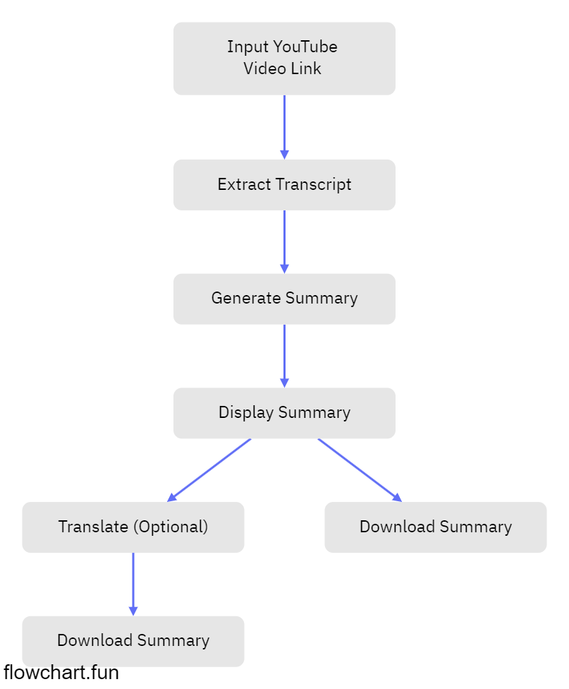
FlowChart:

Slide 10
Explaination
Input YouTube Video Link:
The user inputs the URL of the YouTube video they want to process.
Extract Transcript:
The system extracts the transcript of the YouTube video using an API like YouTubeTranscriptApi. This transcript is the text spoken in the video.

Slide 11
Generate Summary:
The extracted transcript is fed into a generative AI model (like Google's Gemini model) which processes the transcript and generates a summarized version of the video content.
Display Summary:
The generated summary is displayed to the user on the interface. At this point, the user can review the summary.
Translate (Optional):
If the user wants the summary in a different language, they can choose to translate the summary using a translation service (like Google Translate). This step is optional.
Download Summary:
The user can download the generated summary. If the translation step was performed, the translated summary can also be downloaded.

Slide 12
Algoithm: 1. Initialize:
- Import necessary libraries: streamlit, dotenv, googletrans, youtube_transcript_api, os, google.generativeai.
- Load environment variables using dotenv (load_dotenv).
2. Define constants and variables:
- Define prompt for Gemini Pro model.
- Define languages array for language dropdown.
3. Define functions:
function extract_transcript_details(youtube_video_url):
try: extract video_id from youtube_video_url fetch transcript using YouTubeTranscriptApi based on video_id concatenate all transcript text into a single string return transcript

Slide 13
except Exception as e: raise e
function generate_gemini_content(transcript_text, prompt):
initialize GenerativeModel with "gemini-pro"
generate content by providing prompt + transcript_text
return generated content text
function translate_text(text, target_language):
initialize Translator
translate text to target_language using Translator
return translated text

Slide 14
4. Create Streamlit web application:
function main():
display title using st.title()
prompt user to enter YouTube video link using st.text_input()
if video link is provided:
extract video_id from video link
display video thumbnail using st.image()
display language dropdown using st.selectbox() to select target language
if st.button("Get summary") is clicked:
extract transcript_text using extract_transcript_details(youtube_video_url)

Slide 15
if transcript_text is not empty:
generate summary using generate_gemini_content(transcript_text, prompt)
if selected_language is not 'English':
translate summary to selected_language using translate_text(summary, selected_language)
display translated summary using st.write() or st.markdown() else: display original summary using st.write() or st.markdown()
provide download button using st.download_button() to download summary as "summary.txt"
Run main function to start the Streamlit application.

Slide 16
5. Handle exceptions:
- Use try-except blocks in extract_transcript_details function to catch and raise exceptions.
6. Run the Streamlit web application:
- Execute the main() function to run the Streamlit application.

Slide 17
Technologies and Libraries used
Python: The primary programming language used for the entire application.
Streamlit: Streamlit is used to create the web application interface for interacting with the user. It simplifies the process of building interactive web apps for data science and machine learning.
dotenv: The dotenv library is used to load environment variables from a .env file. This is typically used to store sensitive information like API keys securely.

Slide 18
Technologies and Libraries used
googletrans: This library provides a Python wrapper around Google Translate API. It allows for language translation, which in this case, is used to translate the summary text into different languages based on user selection.
youtube_transcript_api: This library allows fetching transcripts of YouTube videos. It's used to extract the transcript text from a YouTube video URL provided by the user.
google.generativeai (presumably GenAI): This library seems to be part of a service (possibly GenAI) that provides access to generative models like Gemini Pro. It is used for generating summaries or content based on given prompts and input text.

Slide 19
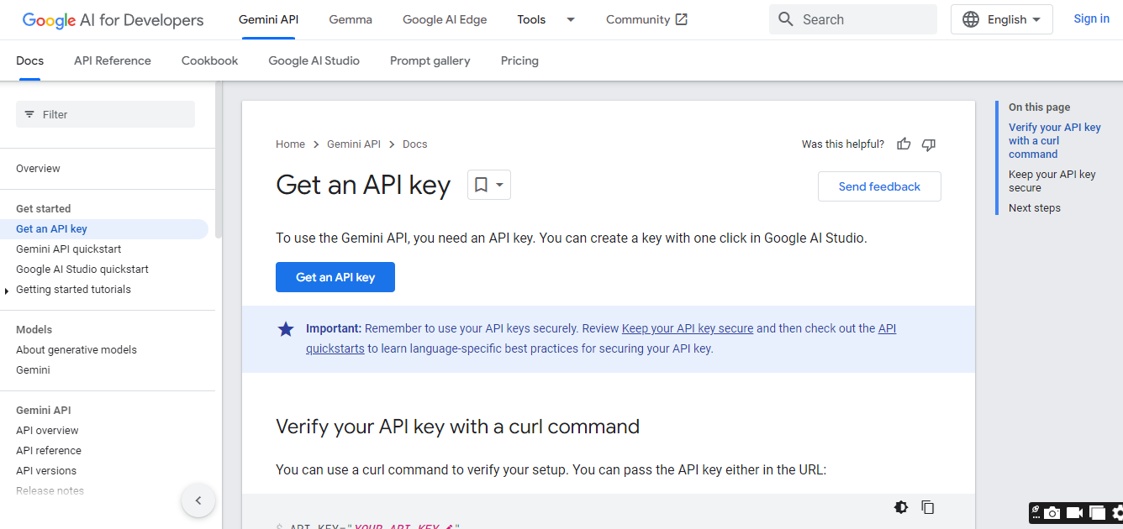
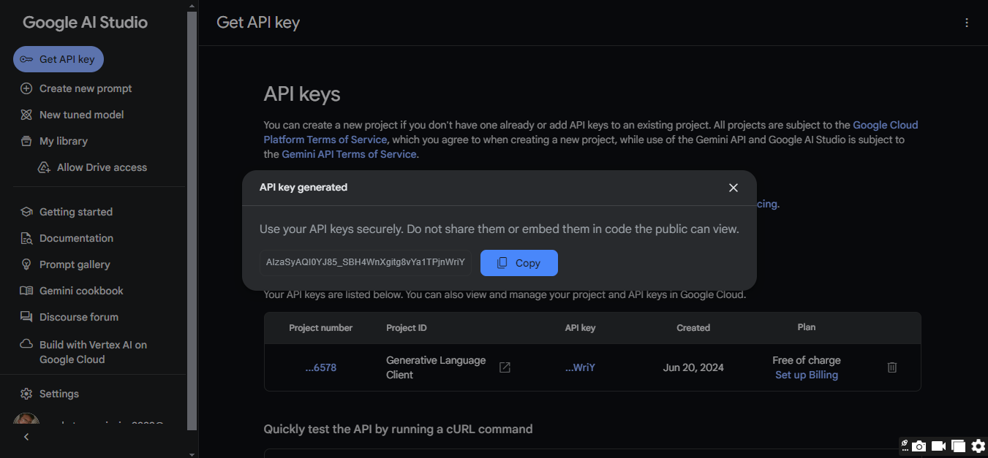
API Key Generation

Slide 20
NLP Techniques Used:
Text Summarization: Using a generative model (Gemini Pro) to summarize video transcripts.
Machine Translation: Translating the summary into different languages using Google Translate API.
Text Extraction: Extracting textual data (transcripts) from YouTube videos.
Content Generation: Generating textual content based on a prompt using a deep learning model.
Environment Management: Securely managing and accessing API keys and other sensitive information.

Slide 21
Hardware and software requirements
Minimum Hardware Requirements:
RAM: 4GB
Storage: HDD or SSD with adequate storage capacity
System Type: 64-bit architecture
Minimum Software Requirements:
Operating System: Windows 8 and above
Python Version: 3.9 or higher
IDE: VS Code, Anaconda

Slide 22
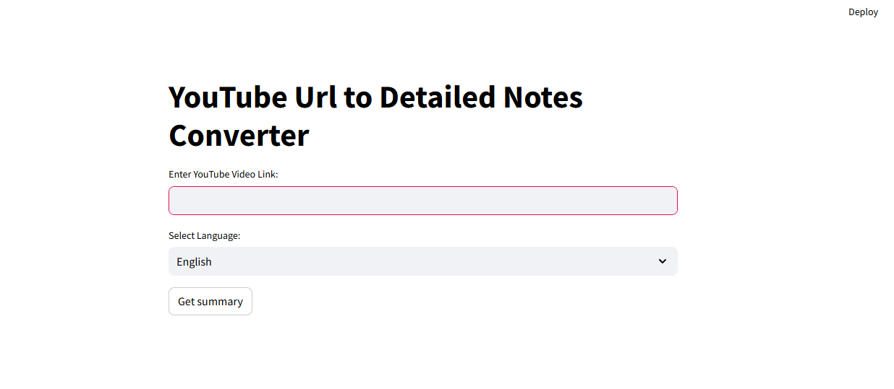
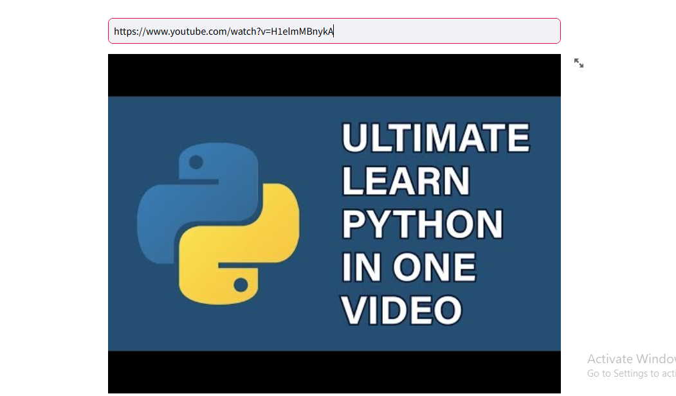
Results

Slide 23
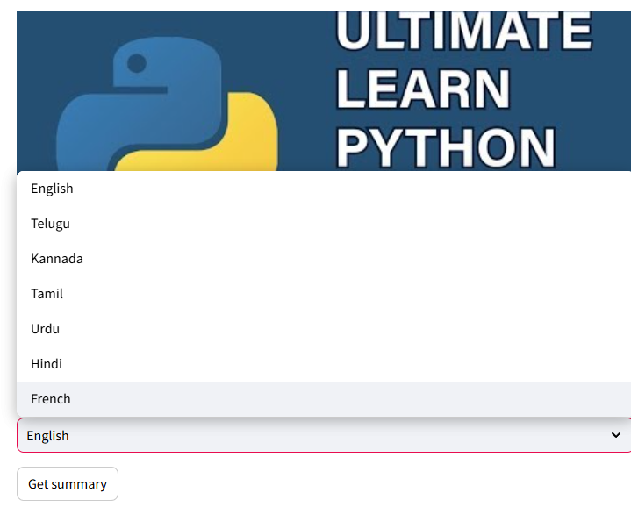
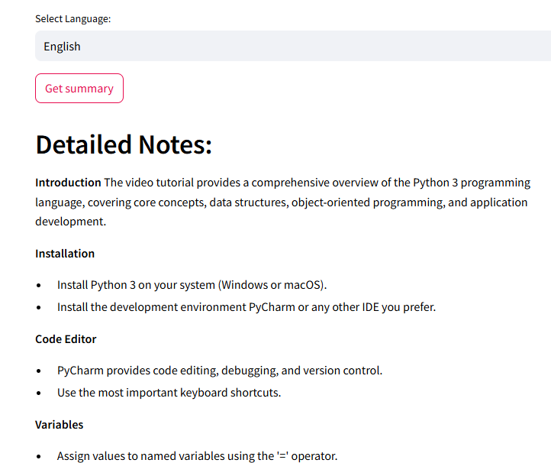
Results

Slide 24
Observation
This Streamlit application efficiently integrates YouTube video transcript extraction and summarization using Google's Gemini Pro API, with added functionality for language translation via Google Translate. The use of environment variables for API keys ensures security, while error handling around transcript extraction could be more robust to handle diverse scenarios. Enhancing user experience through clearer feedback mechanisms during processing and optimizing UI layout for intuitive navigation would further improve usability.
Incorporating caching mechanisms for repeated API calls and ensuring compatibility across different browsers and platforms for the download button functionality would enhance overall reliability. Testing with varied YouTube videos and accent types is crucial to validate the accuracy of transcript extraction and summary generation. Keeping dependencies updated ensures access to the latest features and bug fixes, contributing to the application's stability and performance.

Slide 25
Conclusion
In conclusion, This Streamlit application efficiently integrates APIs to offer users a streamlined experience for summarizing and translating YouTube video transcripts. It combines YouTubeTranscriptApi for fetching transcripts, Google's Gemini Pro for generating summaries, and Google Translate for translating summaries into multiple languages. With a user-friendly interface and a downloadable summary feature, the app simplifies the process of accessing concise video summaries tailored to user preferences.

Slide 26
Future Scope
Implement speech-to-text for video summarization instead of using transcribers.
Develop it as a website accessible to all users.
Add a feature that allows users to find videos by searching keywords or video titles.
Enable customization of our user interface by allowing users to define their preferred languages.

Slide 27
References
GitHub Repository YTtranscriber (GitHub)​
Video summarization: A conceptual framework and survey of the state of the art. Journal of Visual Communication and Image Representation. Volume 19, Issue 2,2008. Pages 12 l Arthur G. Money. Harry Agios. 143. ISSN 1047-3203.
Youtube Video :End To End Youtube Video Transcribe Summarizer LLM App With Google Gemini Pro

Slide 28
THANK YOU

