Slide 1
A study of reinforcement learning algorithms in simulated robotics scenarios
Alejandro Pajares Chirre
Event, date

Slide 2
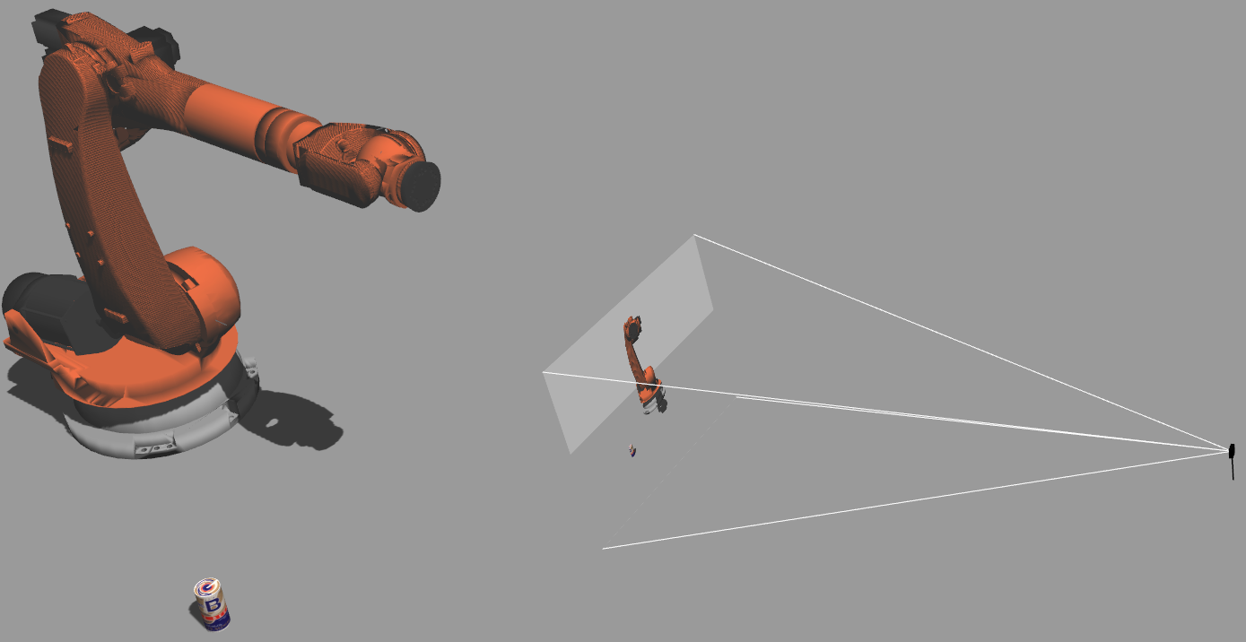
Contents
17.05.2023
<number>

Slide 3
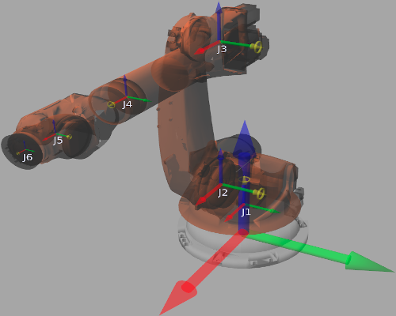
Contents
16.05.2023
4

Slide 4
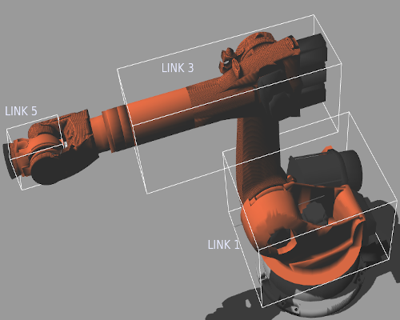
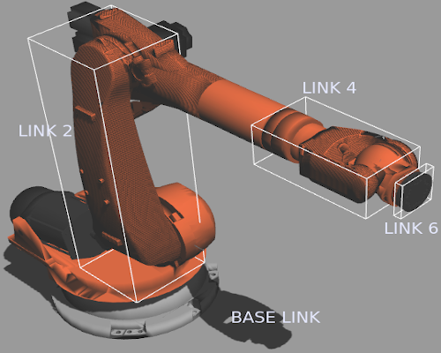
Contents
16.05.2023
4

Slide 5
Contents
17.05.2023
<number>

Slide 6
Contents
17.05.2023
<number>

Slide 7
Contents
17.05.2023
<number>

Slide 8
Contents
17.05.2023
<number>

Slide 9
Contents
17.05.2023
<number>

Slide 10
Contents
Motivation
Topic
Summary
Sources
17.05.2023
<number>

Slide 11
Motivation
<Motivation: Describe in a dotted list what is new and which problem is behind your academic work >
<For the whole presentation:
Avoid whole sentences whereever possible
Use figures, tables or diagrams whereever possible>
<Be careful with colors>
<Citation rules must be followed>
17.05.2023
<number>

Slide 12
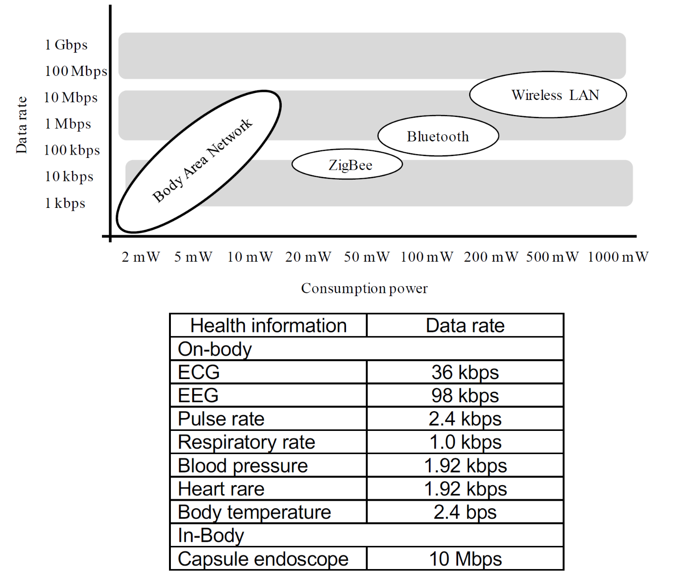
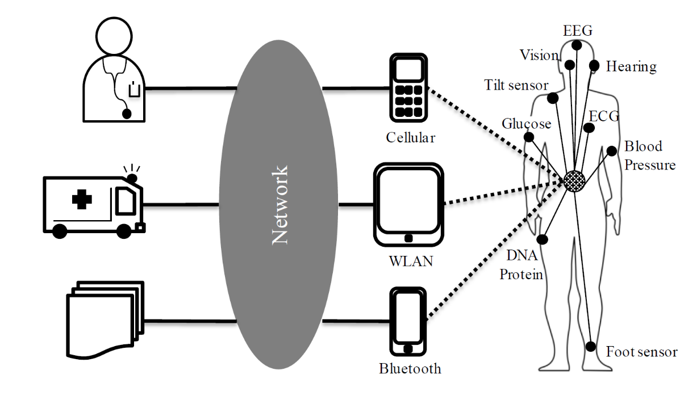
System Architecture
Describe the topic with overview diagrams and tables
17.05.2023
<number>

Slide 13
Summary
Benefits/drawbacks
Next steps
17.05.2023
<number>

Slide 14
Sources
Figures on page 3: lecture Body Area Networks, Prof. Dr. D. Anzei, Nagoya University, Japan, 2017
17.05.2023
<number>

