Slide 1
Snake Game
A Django Project by
Name : Janvi Parekh
Enrollment Number: 2402031030044
Class - 4 IT - B

Slide 2
Introduction
This presentation outlines the Snake Game developed using Django, covering its concept, implementation structure, challenges, and future improvements.

Slide 3

01
Game Concept

Slide 4
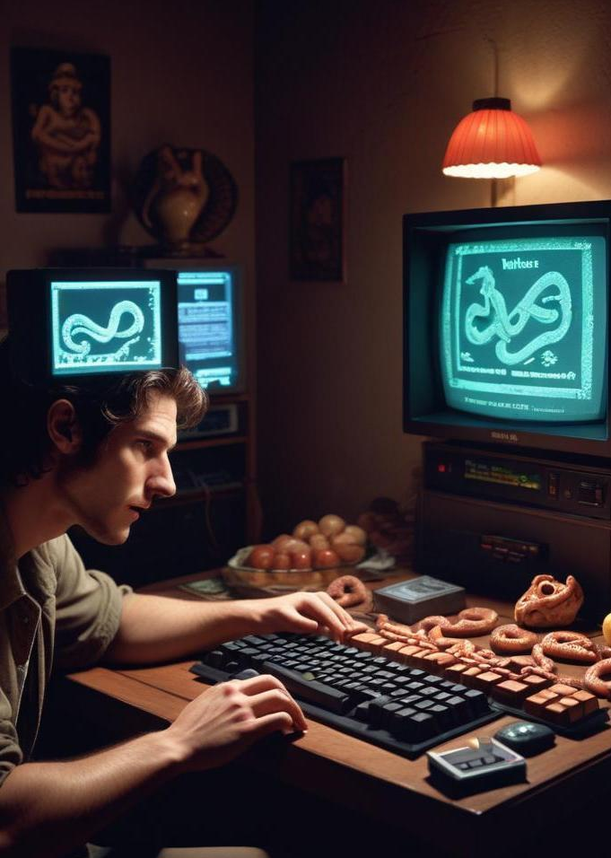
Gameplay Mechanics
The Snake Game features classic gameplay where the player controls a snake, navigating to collect food while avoiding collisions with the walls and its own tail. The snake grows longer with each item collected, increasing the game's difficulty as the player progresses.

Slide 5
Objectives
The primary objective is to score as many points as possible by collecting food items. Players aim to survive for as long as they can while navigating the game area, which becomes increasingly challenging as the snake grows.

Slide 6
User Experience
The game is designed to provide a seamless and engaging user experience. Players can easily navigate using keyboard controls, with intuitive mechanics that enhance playability. The game's design focuses on clarity and responsiveness, ensuring that actions feel immediate, which is critical in fast-paced gameplay.

Slide 7
02
Django Implementation

Slide 8
Project Structure
The project follows a standard Django structure, comprising apps for game logic, user management, and frontend presentation. Key directories include 'models' for data handling, 'views' for game logic, and 'templates' for rendering HTML. This modular approach allows for easy maintenance and scalability.

Slide 9
Key Code Snippets
Significant code snippets include the game loop management within the views, handling player inputs, and updating the game state. Models define the snake's characteristics along with scoring mechanisms and persistent leaderboard functionalities, which enhance competitive play.

Slide 10

Framework Utilization
Django's robust features include ORM for database management, templating engines for dynamic content rendering, and built-in admin functionality for easy management of game data. This framework streamlines development processes while offering scalability for future enhancements.

Slide 11
Conclusions
The Snake Game developed with Django showcases a well-structured implementation focusing on a smooth user experience. With modular design principles and key functionalities effectively executed, future improvements may include additional game modes, enhanced graphics, and broader deployment options.

Slide 12
GIT Hub URL:
https://github.com/janvi2101/python-assignment

Slide 13
Thank you!
Do you have any questions?

