Slide 1

Front End Engineering-I Project
PetHaven
(Pet Adoption Website)
Submitted By :
Jasjeet Kaur (2210990442)
Kamaljeet Kaur(2210990470)
Kanchan Yadav(2210990471)
Submitted To :
Mrs.Baljit Kaur
Mr.Vikas Patel

Slide 2
Table of content
Introduction
Problem Statement
Technical Details
Key Features
Project Highlights
References/Links used

Slide 3
Introduction
We are excited to present our project on a Pet Adoption Website developed by our dedicated team using HTML, CSS, Bootstrap and JavaScript.
Our website is a haven (i.e a home) for those looking to expand their family with a new furry, feathered, or fluffy friend.
At PetHaven, we believe that:
“Every pet deserves a loving home, and every home deserves the joy only a pet can bring.”

Slide 4
Problem and Solution Statement
In an era where thousands of pets are in need of loving homes, prospective pet owners face challenges in finding the right animal companion due to a lack of accessible, user-friendly, and informative platforms.
PetHaven aims to address this gap by offering an easy to understand and engaging online environment designed with HTML, CSS, Bootstrap and JavaScript, facilitating the adoption process pets and ensuring these pets find suitable homes efficiently and effectively

Slide 5
Technical Details
PetHaven is built using simple web tools:
HTML makes up the basic structure, like the skeleton of the website
CSS adds style and makes it look nice, like choosing the outfit for the website
Bootstrap is used to make few parts of the website, it helps in making the layout of the element and to make that element responsive
JavaScript makes everything on the site work smoothly, like making sure all parts can move and interact properly.
This combination helps people facilitate with user-friendly environment , easily search for pets, find pets to adopt and store user data in local storage.

Slide 6
Key Features
Pet Search Functionality: Users can easily search for pets by type, age, size, and other criteria to find the perfect match.
Detailed Pet Profiles: Each pet has its own profile with photos, descriptions, and important information like health status and temperament.
User Registration and Login: Allows users to create accounts, and submit adoption applications.
PetCare Section: Tips and guides on pet care, training, and health to help adopters.
Responsive Design: The website is designed to work smoothly on desktops, tablets, and smartphones.

Slide 7
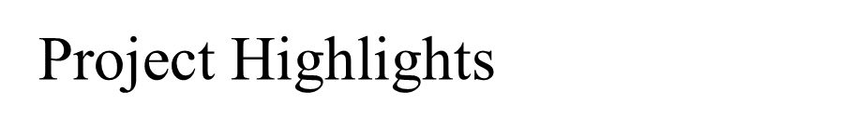
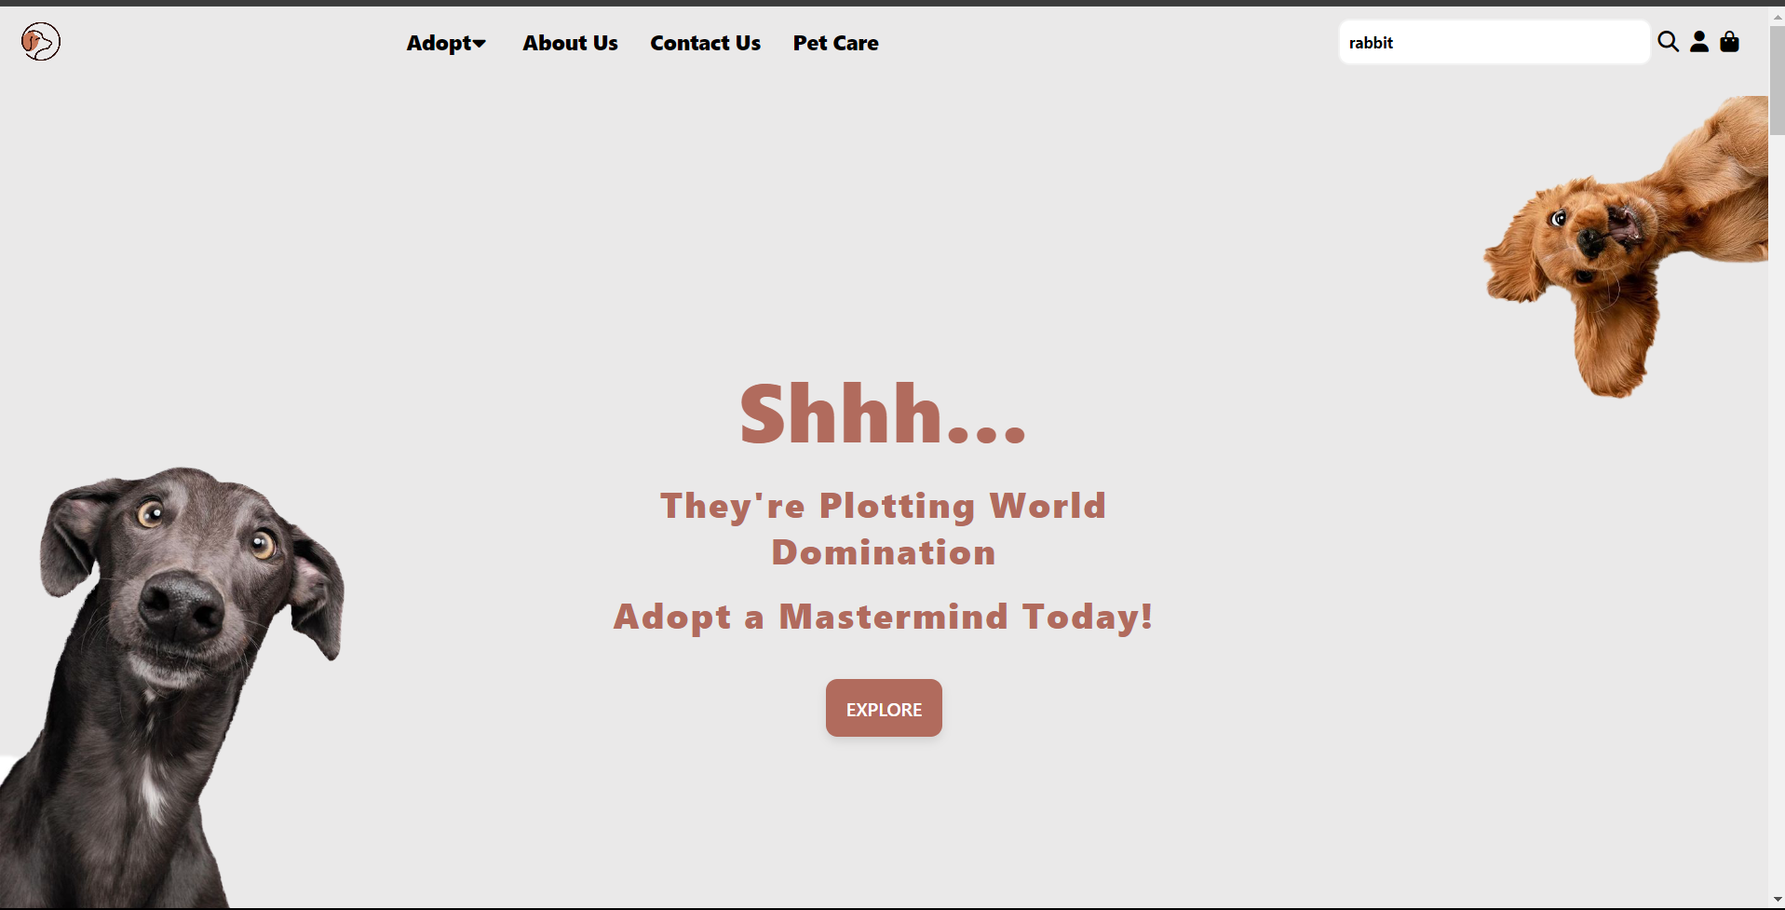
Here are few Project snapshots for preview:
Main page:

Slide 8
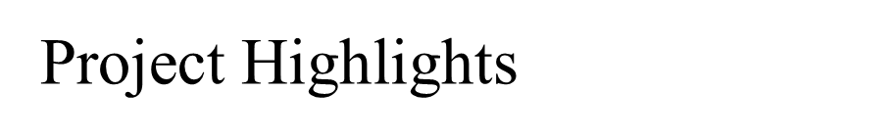
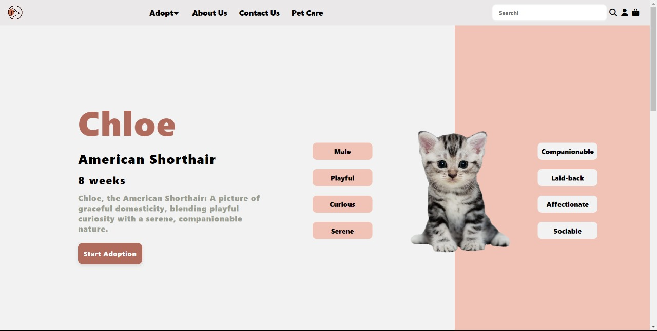
Detailed Profile:

Slide 9
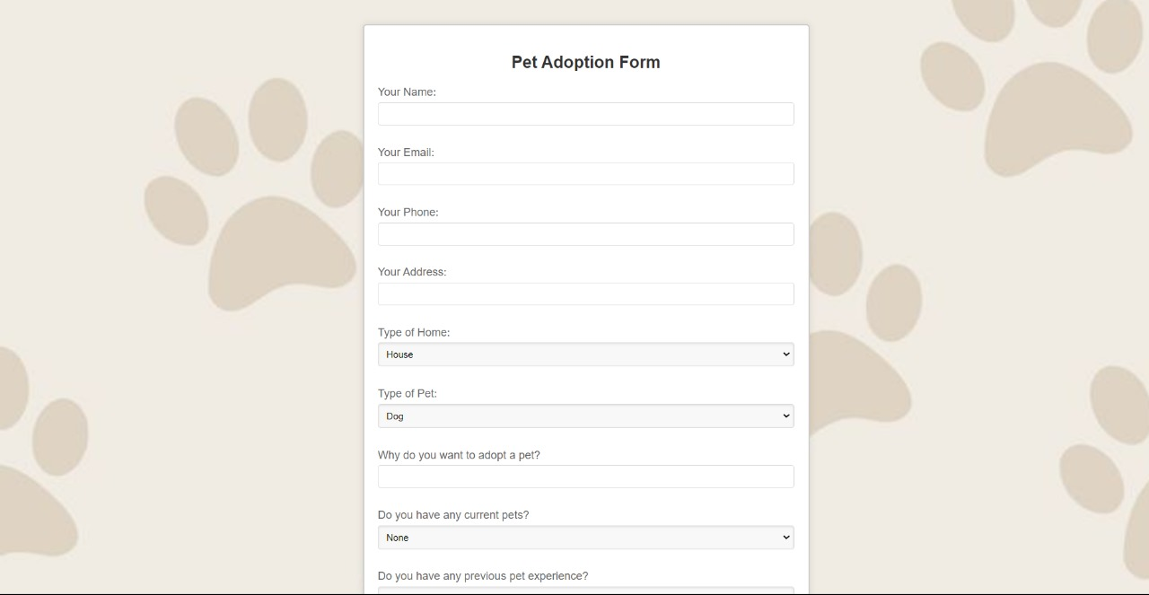
Project Highlights
Pet Adoption Form:

Slide 10
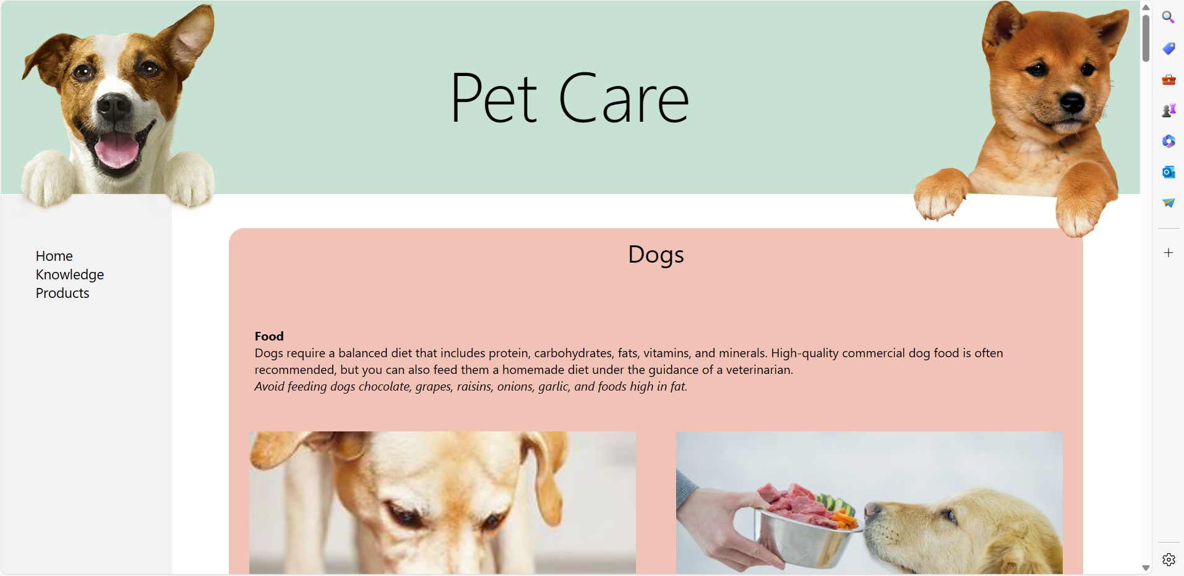
Project Highlights
Pet Care section :

Slide 11
Repository & Netlify link
Repository link:
https://github.com/ydv-kanchan/Pet_Haven-Pet_Adoption_Website
Netlify deployment link:
https://stunning-churros-8a08b1.netlify.app/

Slide 12
References/Links used
MDN Web Docs - https://developer.mozilla.org/en-US/docs/Web
W3Schools - https://www.w3schools.com/
Bootstrap- Introduction · Bootstrap v5.0 (getbootstrap.com)
Pinterest - Pinterest – India
FreeCodeCamp - freecodecamp.org

Slide 13


