Slide 1

Home Insurance Prediction
Project Guide:
Dr. Shantanu Pathak
Akanksha Rebhankar - 239505
Janvi Borkar - 239520

Slide 2
Introduction
In this rapidly evolving digital landscape, accurate prediction models are essential for mitigating risks and ensuring homeowners' peace of mind. Today, we'll explore how cutting-edge data analytics and machine learning algorithms can revolutionize the insurance industry, enabling us to anticipate and prevent potential losses. By harnessing the power of data, we aim to provide a comprehensive overview of the factors influencing home insurance claims, ultimately enhancing decision-making processes for insurers and policyholders alike.

Slide 3
DATA SET
The dataset had 66 features in total, representing Home Insurance Attributes Details
Details
Attributes | 25
Instances | 665249
Data set Characteristics | Multivariate

Slide 4
Objectives of Home Insurance Prediction
The primary objectives of home insurance prediction include:
Enhancing risk assessment: Identifying factors contributing to potential claims and assessing their impact.
Improving underwriting decisions: Setting premiums based on accurate risk evaluation.
Enhancing customer satisfaction: Tailoring insurance coverage to individual needs and providing proactive risk management solutions.

Slide 5
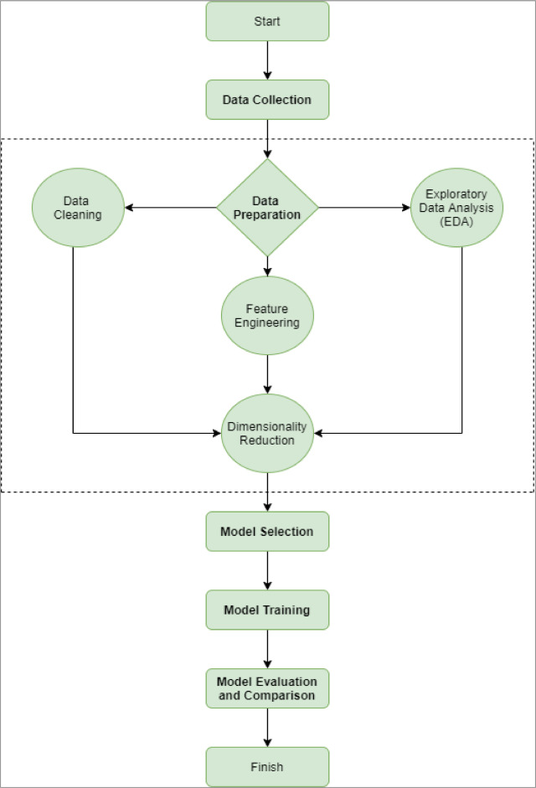
Workflow of Project:

Slide 6
Data Preprocessing
Data Collection
Handling Missing Values
Outlier Detection and Treatment
Feature Engineering
Data Encoding
Data Splitting
Exploratory Data Analysis

Slide 7
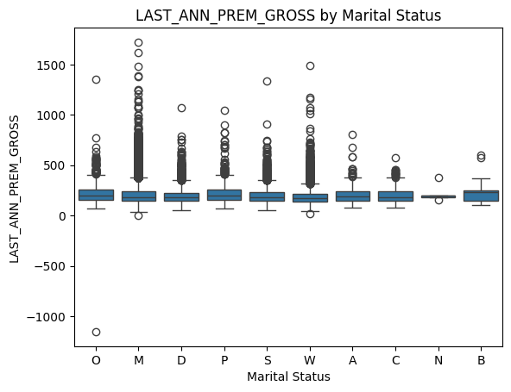
For outliers Detection use Boxplot:

Slide 8
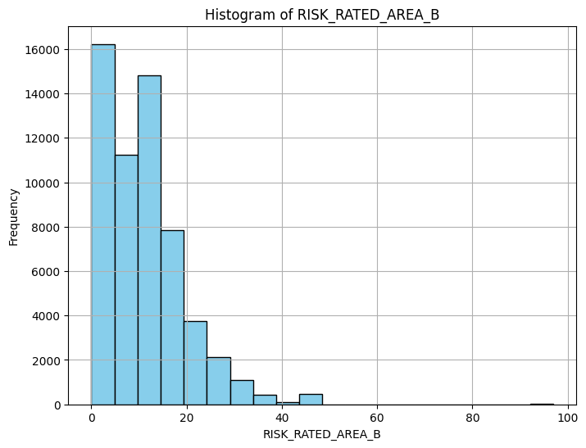
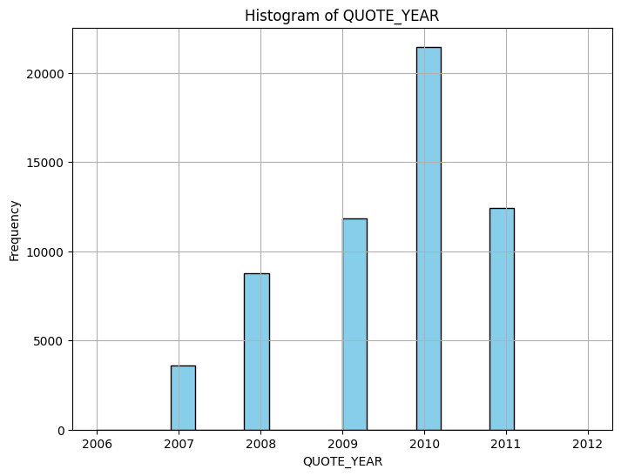
For showing distribution use histogram :

Slide 9
Model Selection:
We use different types of Regression model for predict home insurance:
Linear Regression
Ridge Regression
Lasso Regression
ElasticNet Regression

Slide 10
Linear Regression:
Linear regression is a statistical method used to model the relationship between one or more independent variables (features) and a dependent variable (target) by fitting a linear equation to observed data. It is one of the simplest and most commonly used regression techniques
y=β0+β1⋅x+ε
Where β0 - the y-intercept
Β1 - slope of the line
Ε - represents the random error term

Slide 11
2. Ridge Regression
In ridge regression, the standard least squares objective function of linear regression is augmented with a penalty term that penalizes large coefficients. The goal is to shrink the coefficients towards zero without eliminating them entirely. This helps to reduce the model's sensitivity to the training data and produces more stable and reliable estimates.

Slide 12
Lasso Regression:
Lasso regression, short for Least Absolute Shrinkage and Selection Operator, is a linear regression technique that performs both variable selection and regularization to improve the model's performance.instead of penalizing the squared values of the coefficients (as in ridge regression), lasso penalizes the absolute values of the coefficients.

Slide 13
4. ElasticNet Regression:
ElasticNet regression is a linear regression technique that combines both L1 (Lasso) and L2 (Ridge) regularization penalties to overcome their individual limitations. It is particularly useful when dealing with high-dimensional datasets with multicollinearity among the predictor variables.

Slide 14
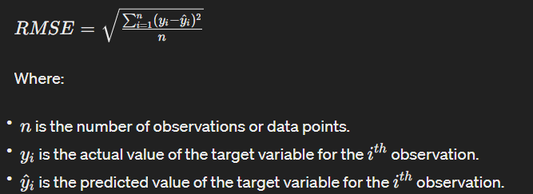
Evaluated Best Model:
Root Mean Squared Error (RMSE):
RMSE value represents the standard deviation of the residuals. A lower RMSE indicates better performance, as it means that the model's predictions are closer to the actua

Slide 15
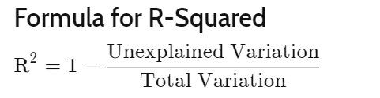
R-squared:
It also known as the coefficient of determination, indicates the proportion of the variance in the dependent variable that is predictable from the independent variables in a regression model.
​
​

Slide 16
RMSE and R - Squared value:
MODEL | RMSE | R - squared value
Linear Regression | 57.765 | 0,5442
Ridge Regression | 57.763 | 0.5443
Lasso Regression | 57.731 | 0.5448
ElasticNet Regression | 60.346 | 0.5026

Slide 17
conclusion
In conclusion, our analysis of home insurance prediction revealed several important insights. We found that variables such as property type, coverage options, and policyholder insurance premiums.
While Lasso Regression models achieved relatively good performance with low RMSE and high R-squared values, there are still areas for improvement, particularly in feature engineering and data quality.
Overall, this project highlights the importance of data-driven approaches in insurance pricing and provides valuable insights for insurers seeking to optimize their pricing strategies and enhance customer satisfaction.

Slide 18
References:
https://www.kaggle.com/datasets/ycanario/home-insurance/data
https://www.scribd.com/doc/88469262/Project-on-Home-Insurance
https://www.researchgate.net/publication/228227047_Homeowners_Insurance_Market_Trends_Issues_and_Problems

