Slide 1
E-commerce Sales Data Visualization
By : Janvi Chaudhary
Roll No. : 2367035009
Date : 10 June 2025

Slide 2
Dataset Overview
This dataset includes:
- Transaction date
- Product and category details
- Region-wise revenue
- Quantity sold
Objective: To analyze sales trends, product performance, and regional contributions.

Slide 3
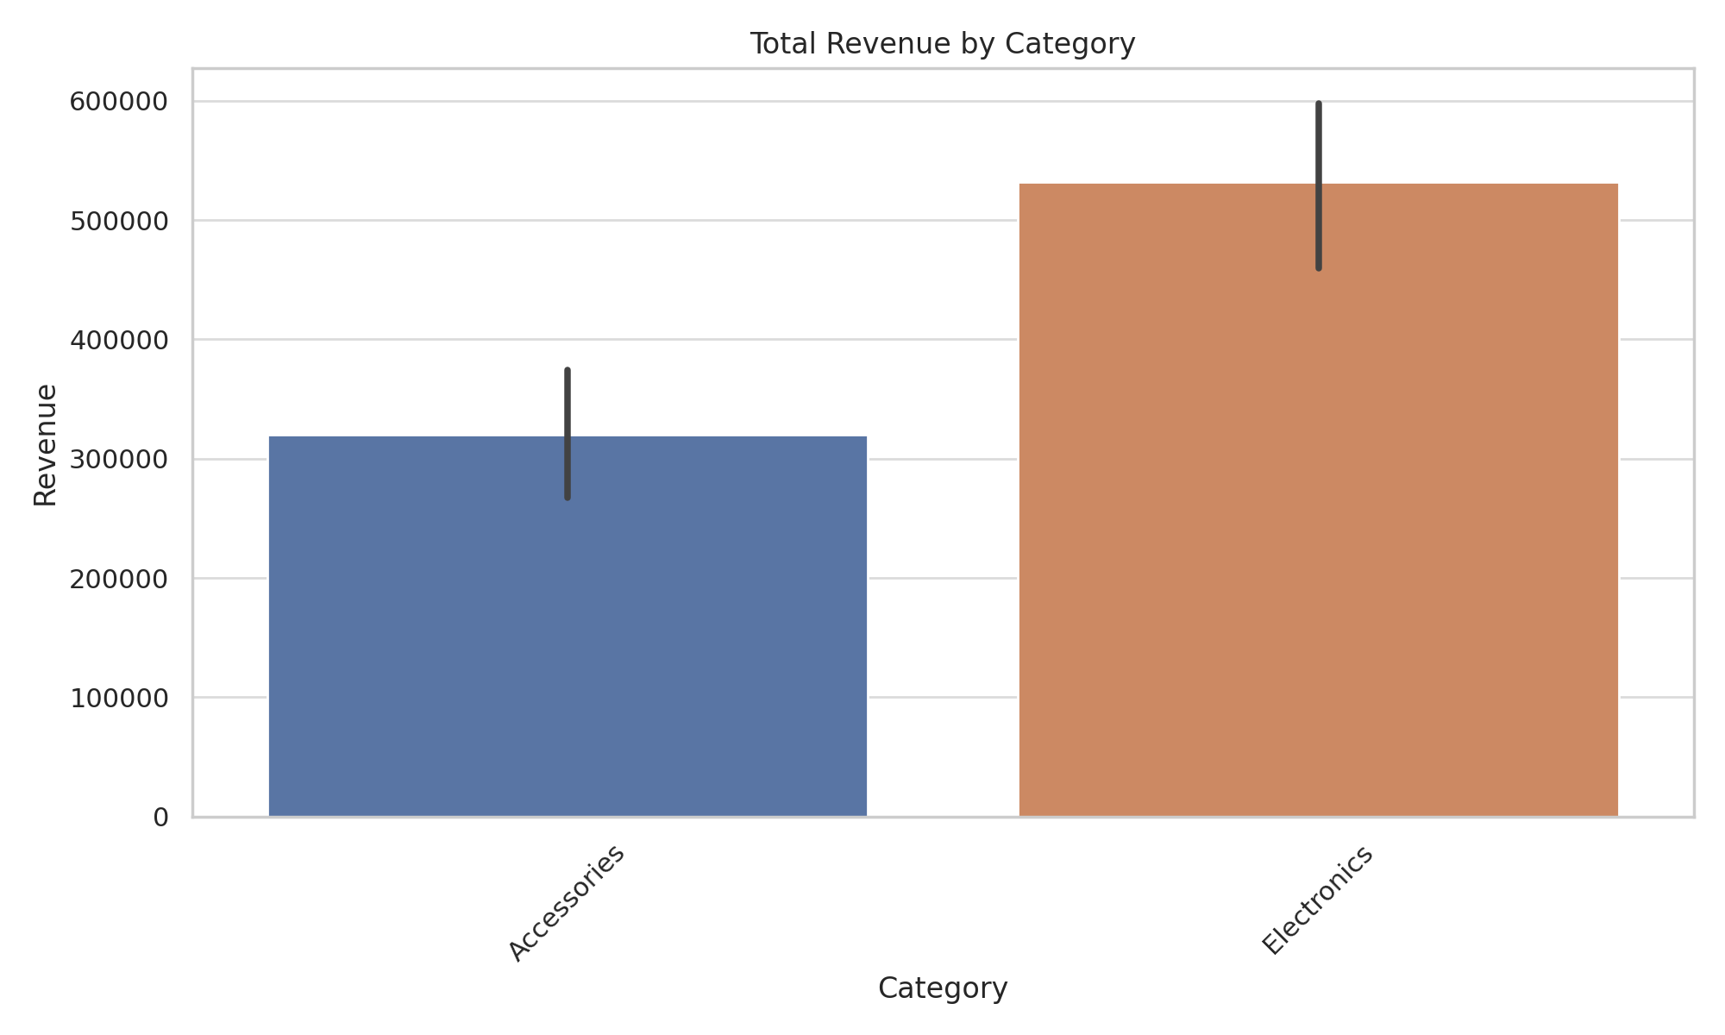
Total Revenue by Category
Visualizes which categories drive the most revenue.

Slide 4
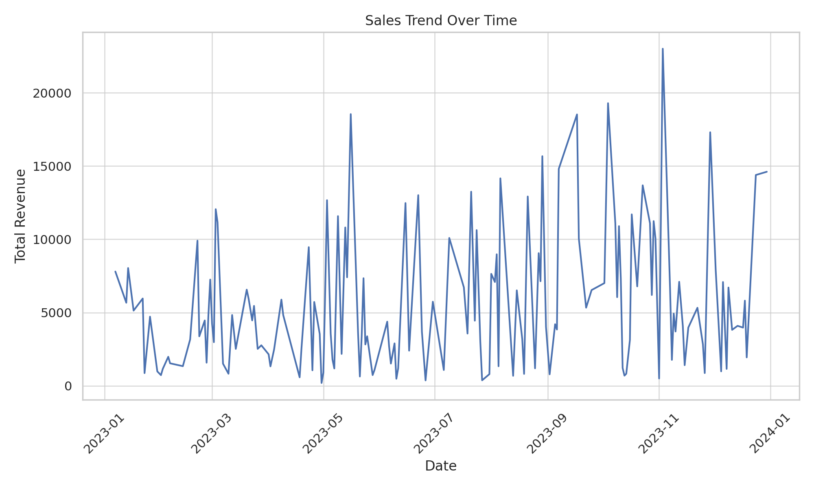
Sales Trend Over Time
Shows how revenue fluctuates over the timeline.

Slide 5
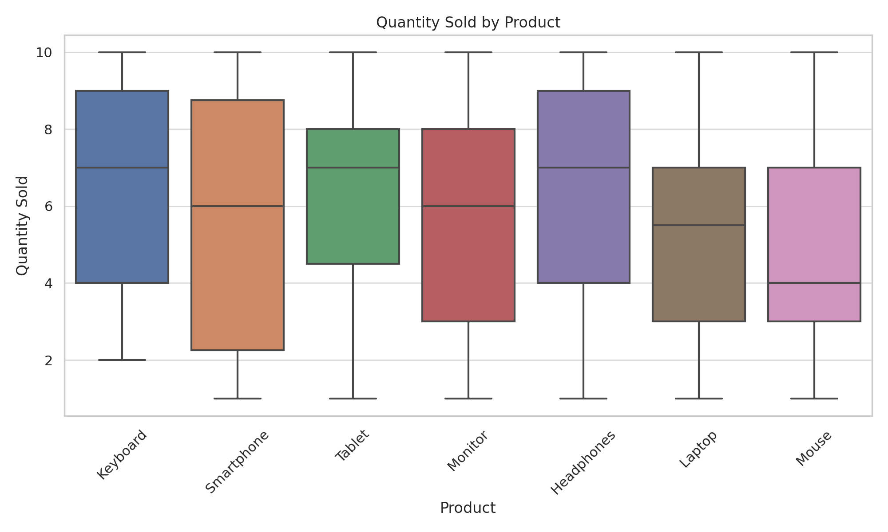
Quantity Sold by Product
Distribution of quantity sold for each product.

Slide 6
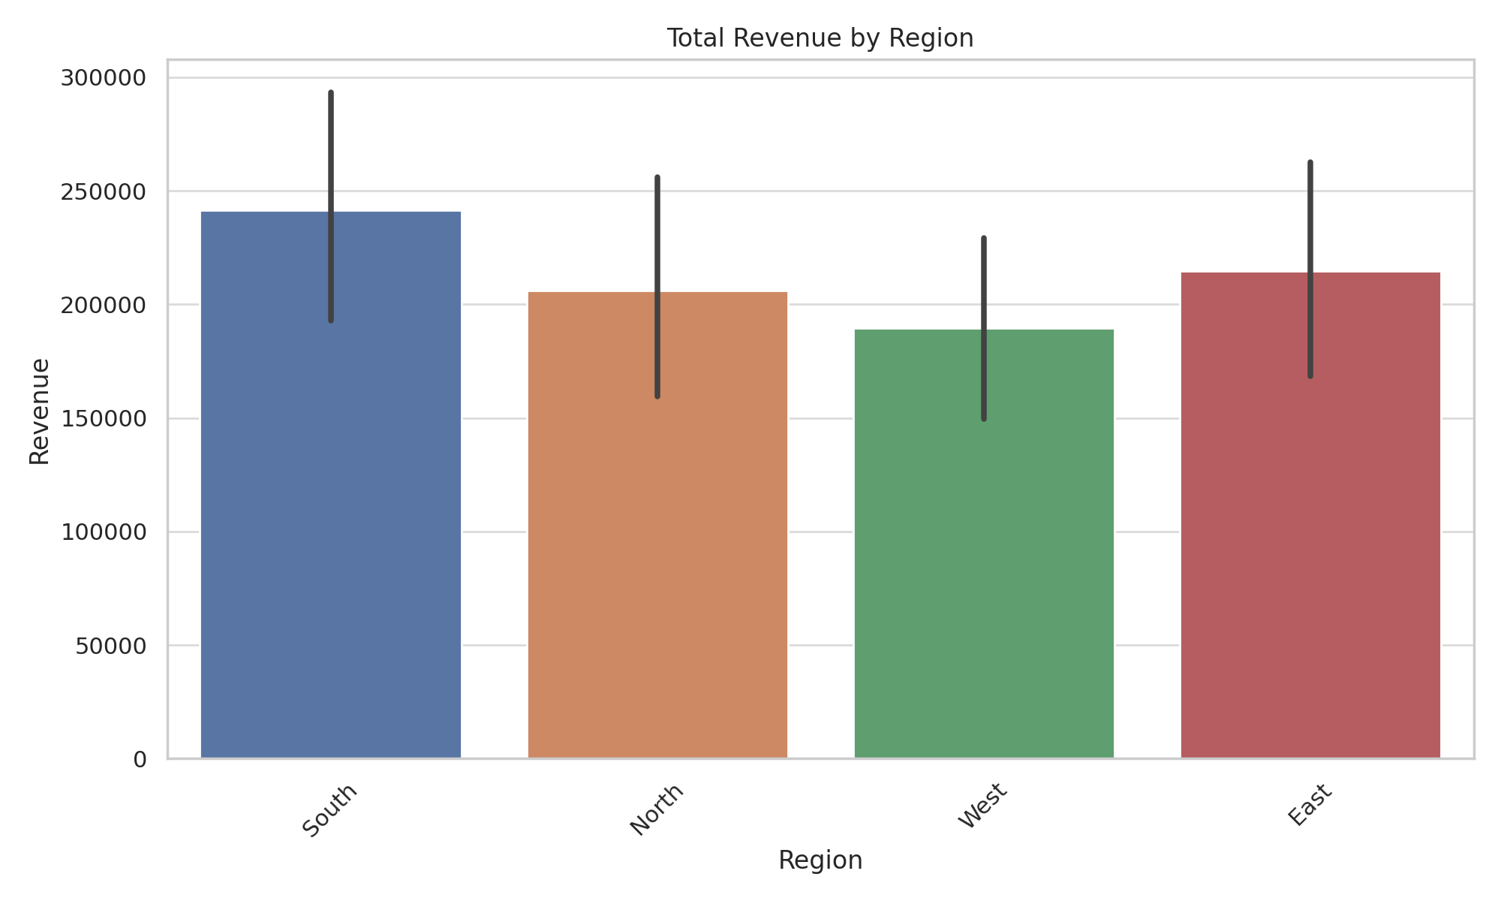
Total Revenue by Region
Highlights the regional contributions to total revenue.

Slide 7
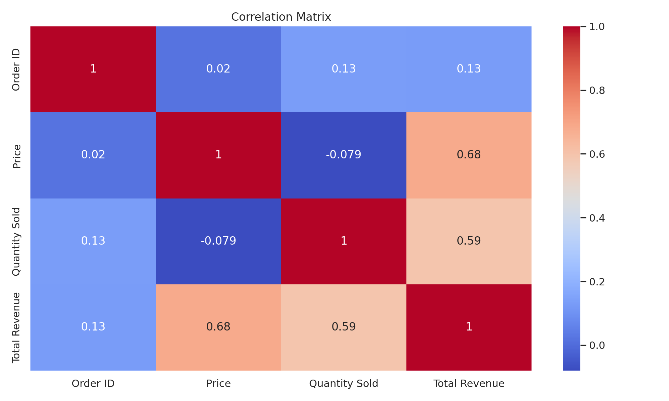
Correlation Heatmap
Displays correlation between numeric variables.

Slide 8
Conclusion
Key Insights:
- Top-performing categories significantly influence revenue.
- Sales trends show seasonal or periodic patterns.
- Product performance varies widely in quantity sold.
- Some regions are more profitable than others.
- Strong correlations can help in predictive modeling.

