Slide 1
ETL Pipeline Project
By : JANVI CHAUDHARY AND ANSH TOMAR
Date : 11 JUNE 2025

Slide 2
Introduction
ETL stands for Extract, Transform, Load.

Slide 3
Project Aim
Build an ETL pipeline using Python to process student grades.

Slide 4
Tools Used
Python
Pandas
SQLite3

Slide 5
Extract Phase
Reading student grades from a CSV file using pandas.

Slide 6
Transform Phase
Removing missing data
Calculating average grades

Slide 7
Load Phase
Loading final data into SQLite database.

Slide 8
Results
Data stored in 'grades.db' with average scores.

Slide 9
Conclusion
This project demonstrates an academic use of ETL.

Slide 10
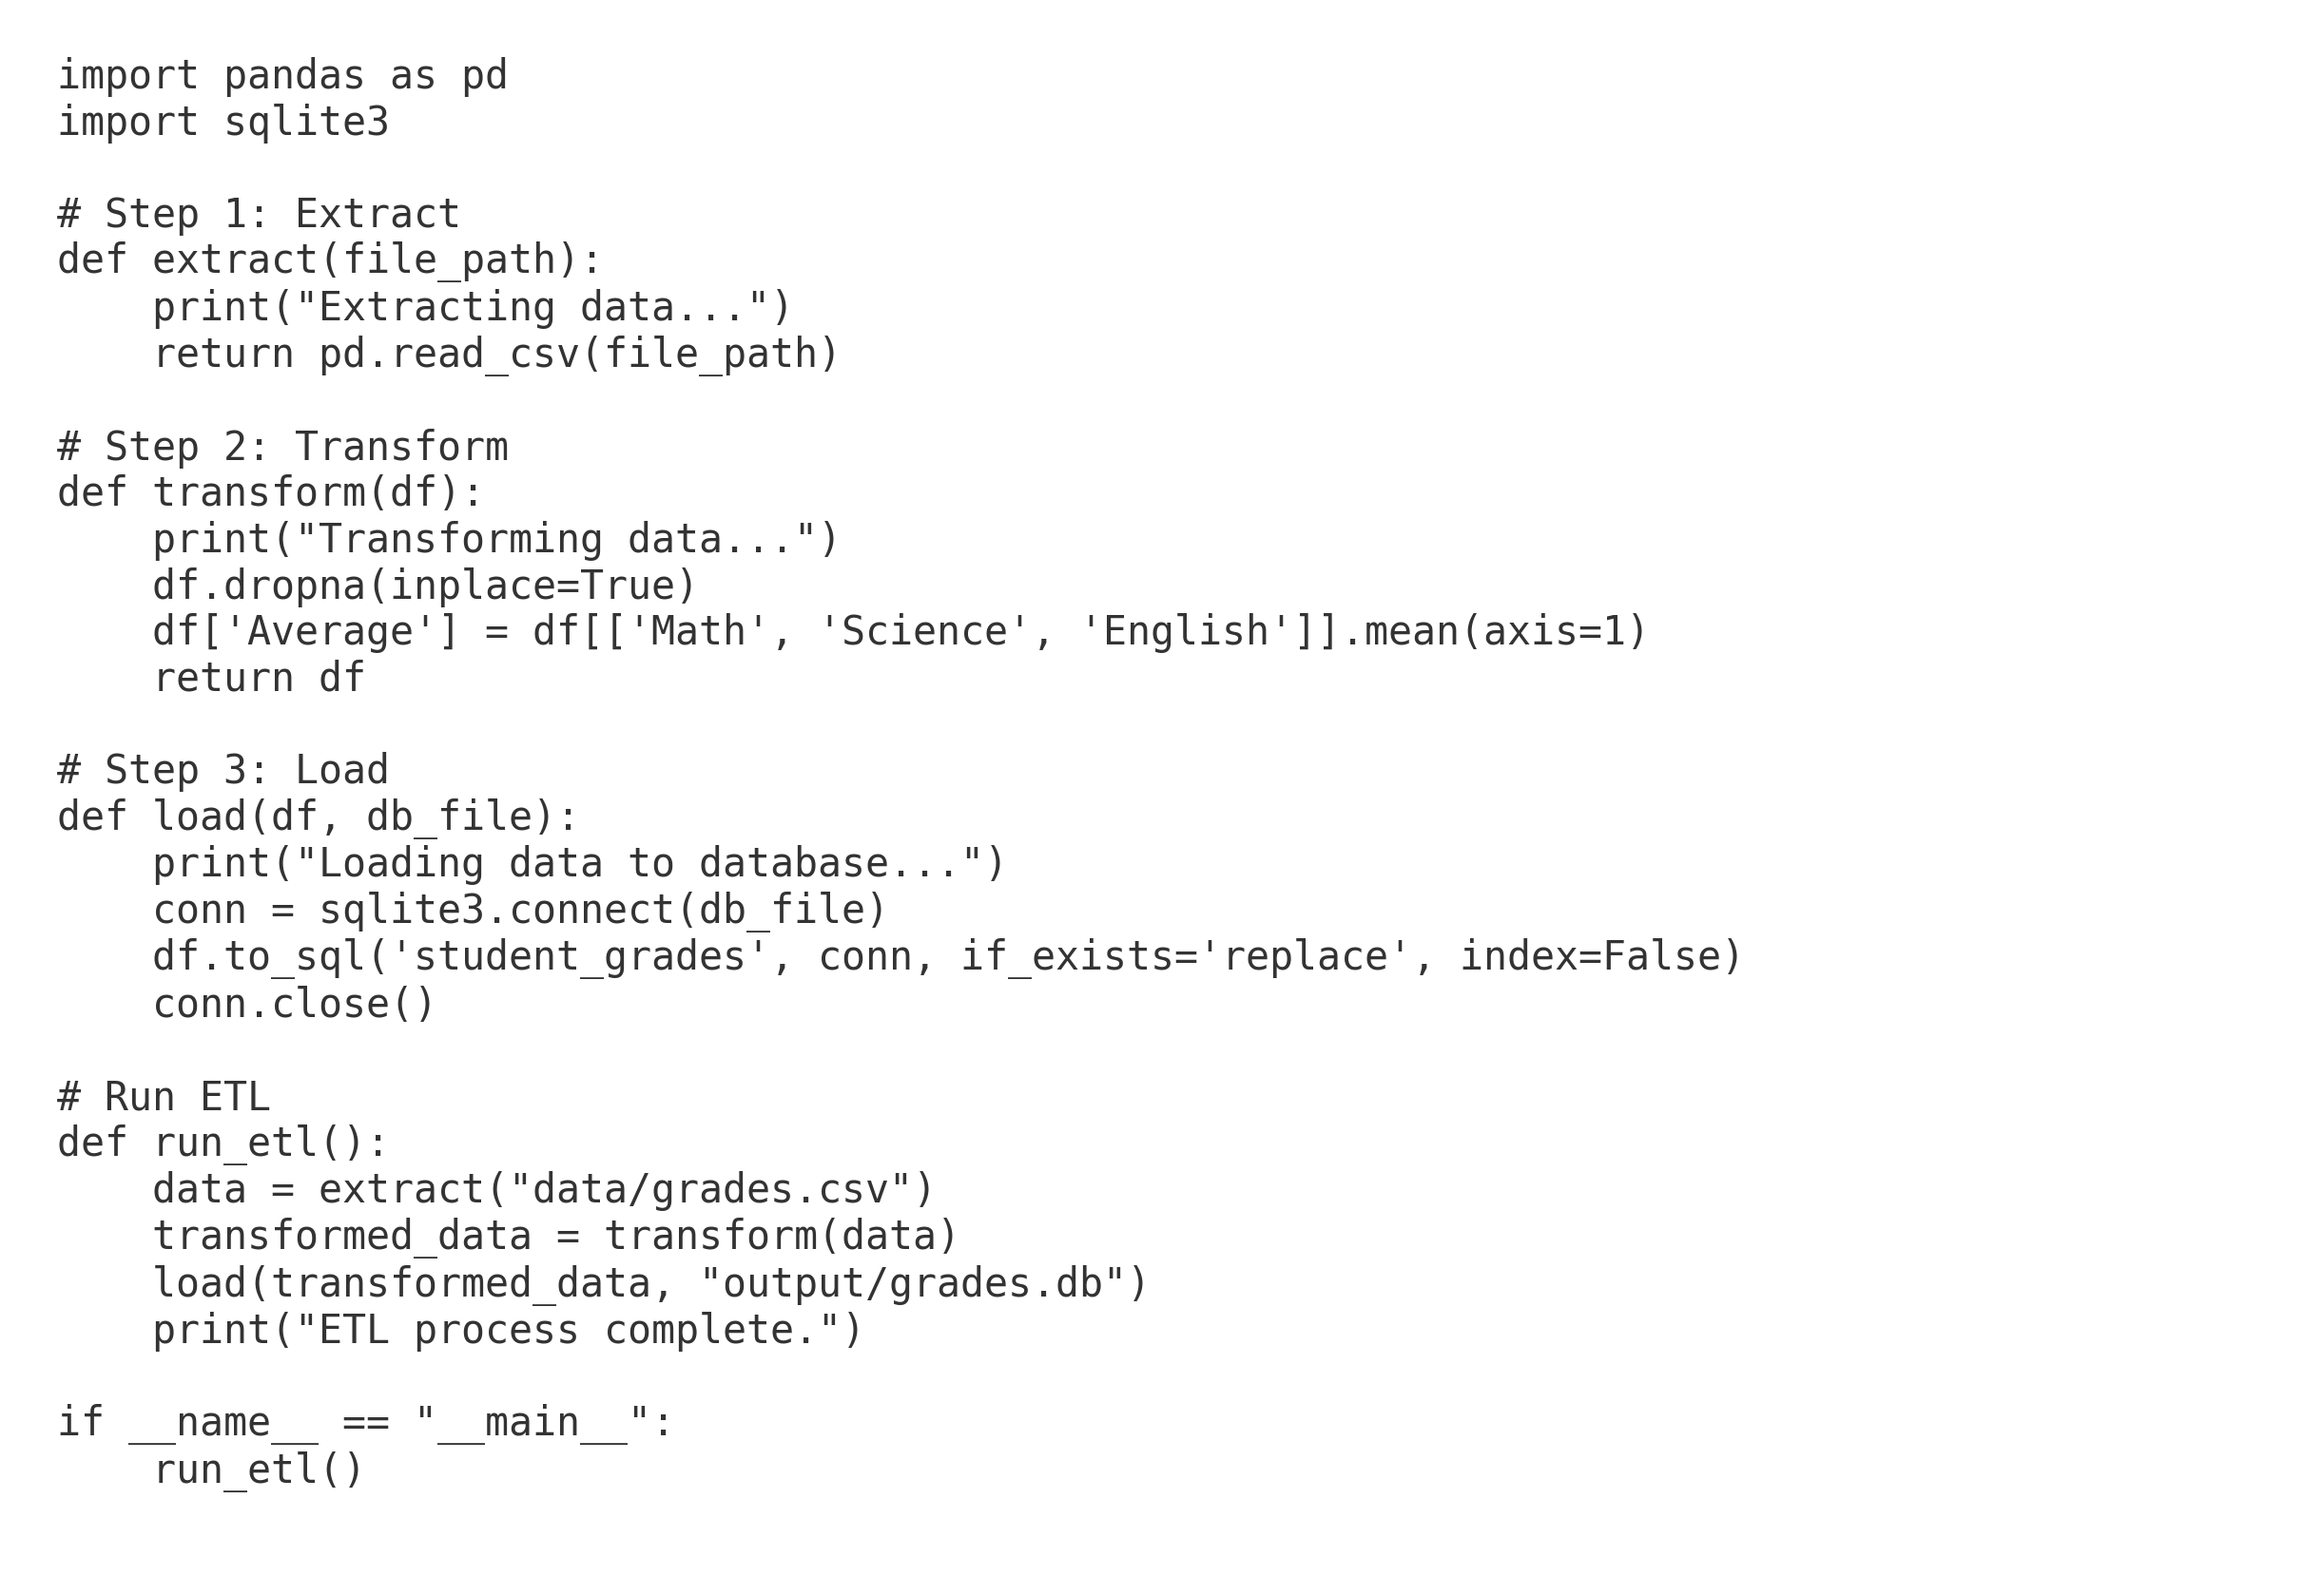
ETL Python Code Screenshot

