Slide 1
IBM University Engagement Project Submission
“Exploring the Power of Agentic AI with IBM Granite and IBM Bob”

Slide 2

Project Tile – Social Media Agent
Domain of Project – Lifestyle
Student Name | Recent Passport Photo | Email ID | Mobile number [WhatsApp]
Janvi Sanjaykumar Gavit |  | Janvi.g1602@gmail.com | 9764984760

Slide 3
Problem Statement -
Problem Statement : Social Media Agent
The Challenge
Managing social media across multiple platforms is challenging for brands, businesses, influencers, and organizations. Creating engaging content consistently, tracking audience sentiment, analyzing competitors, identifying trending topics, and responding to users in real time require significant effort and expertise. Existing tools are often fragmented, making it difficult to gain actionable insights and improve overall social media performance.
The Objective
Build an AI-powered Social Media Agent using IBM Bob and IBM Granite models that helps users create, analyze, and optimize social media content. The solution should:
Generate platform-specific content for Instagram, LinkedIn, X, Facebook, and YouTube.
Suggest relevant hashtags and trending topics.
Analyze audience sentiment and engagement.
Monitor competitor strategies and market trends.
Recommend the best posting time and content improvements.
Provide AI-powered marketing insights through a multi-agent system.

Slide 4
Proposed Solution -
Proposed Solution: AI-powered Social Media Agent
The proposed solution is an AI-powered Social Media Agent developed using IBM Bob, IBM Granite Models, and the Groq API to assist businesses, influencers, marketers, and content creators in managing their social media presence efficiently.
The system provides intelligent assistance for content creation, trend analysis, audience engagement, and marketing strategy. Users can simply enter their requirements through an interactive web interface, and the AI generates optimized social media content tailored to different platforms.
The system consists of four specialized agents:
Content Generation Agent creates captions, posts, marketing copies, and promotional content.
Trend Analysis Agent analyzes current trends, hashtags, and viral topics.
Sentiment Analysis Agent evaluates audience sentiment to understand customer feedback and engagement.
Strategy Recommendation Agent provides actionable recommendations to improve reach, engagement, and posting schedules.
The application features a clean HTML-based interface integrated with the Groq API for fast AI responses. IBM Bob orchestrates the agent workflow, while IBM Granite models enhance reasoning, content generation, and intelligent decision-making.
Overall, the solution serves as an intelligent digital social media assistant that simplifies content creation, improves audience engagement, and helps users make data-driven marketing decisions.

Slide 5
Technology Used
IBM Bob platform - Used for designing and orchestrating the multi-agent workflow.
IBM Grainte model - Provides reasoning, intelligent content generation, summarization, and recommendation capabilities.
IBM Cloud – Provides a scalable and secure environment for deploying AI services.
RAG– Can be integrated to retrieve real-time social media trends and marketing insights.
Groq API – Enables high-speed AI inference for real-time content generation and user interaction.
HTML, CSS & JavaScript – Used to build a responsive and interactive web interface.

Slide 6
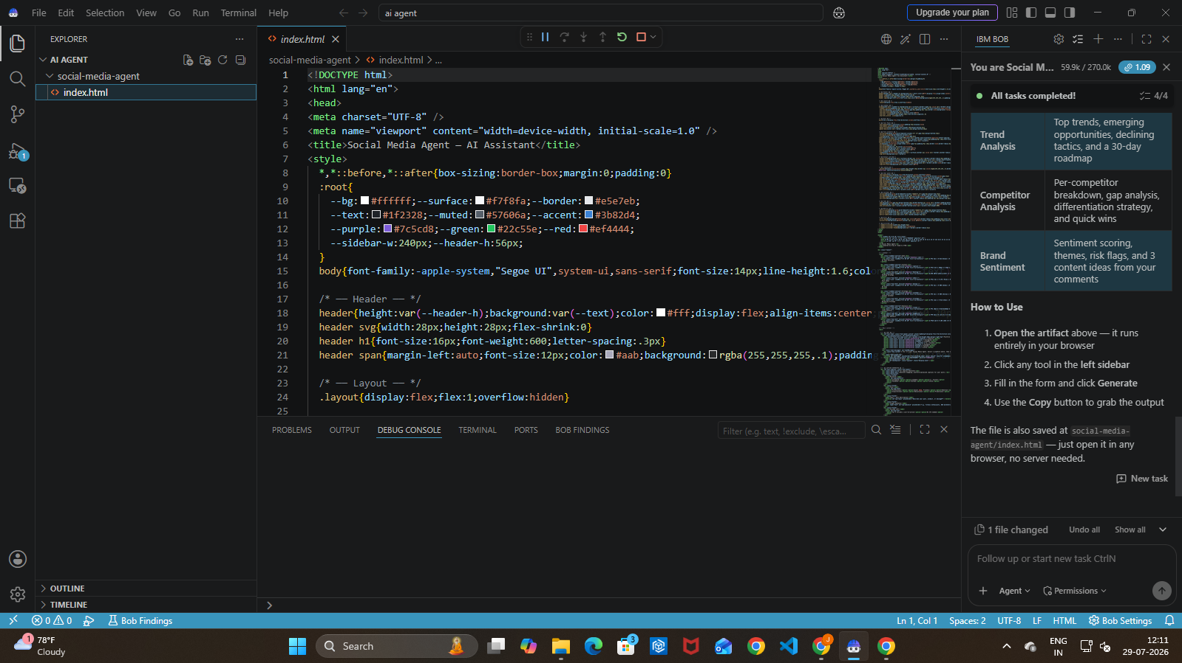
Required Files created using IBM bob -
Index.html

Slide 7
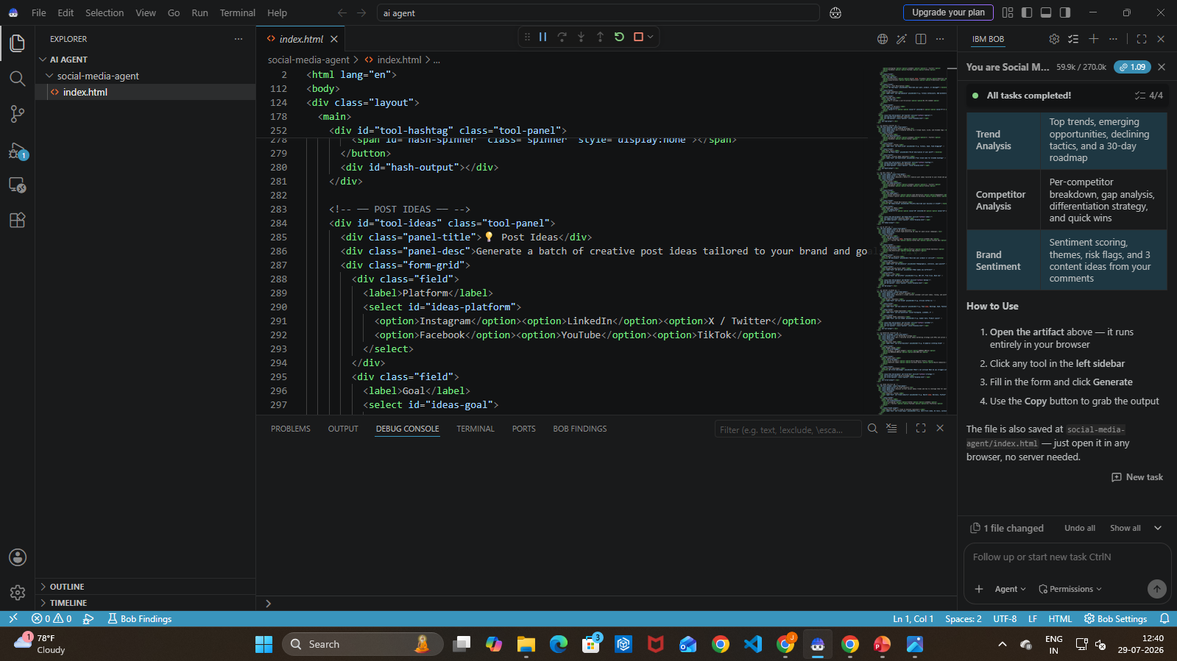
IBM Bob Screenshots:

Slide 8

Role of Agentic AI in the solution
Agentic AI enables the Social Media Agent to operate as an intelligent assistant by coordinating multiple specialized AI agents. Instead of relying on a single chatbot, the system assigns different responsibilities to dedicated agents responsible for content creation, trend monitoring, sentiment analysis, and marketing strategy.
Each agent collaborates with others to deliver accurate, personalized, and context-aware responses. The AI understands user goals, platform requirements, and audience preferences before generating recommendations.
This multi-agent architecture improves response quality, enhances decision-making, and delivers actionable social media insights that help users grow their online presence effectively.
.

Slide 9
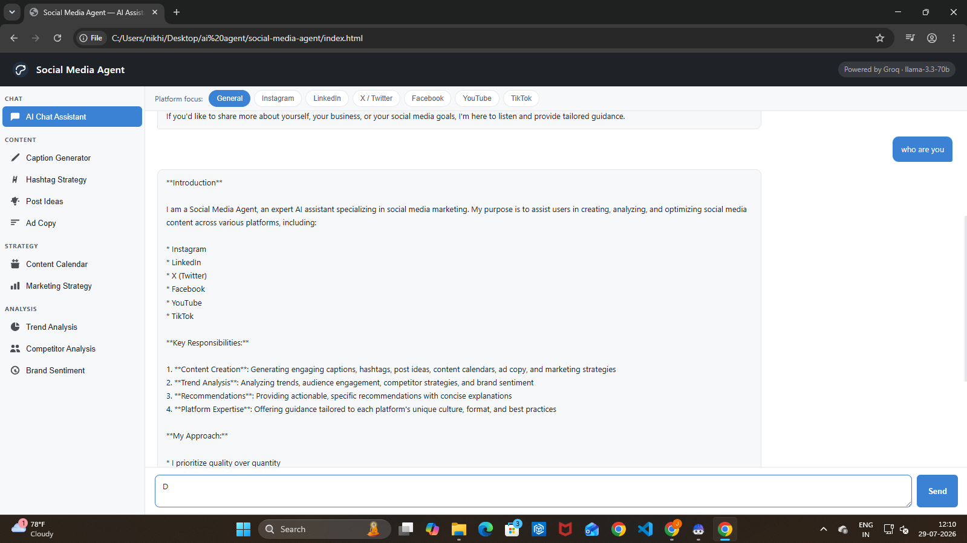
Project Output Screenshot
·
·
·

Slide 10
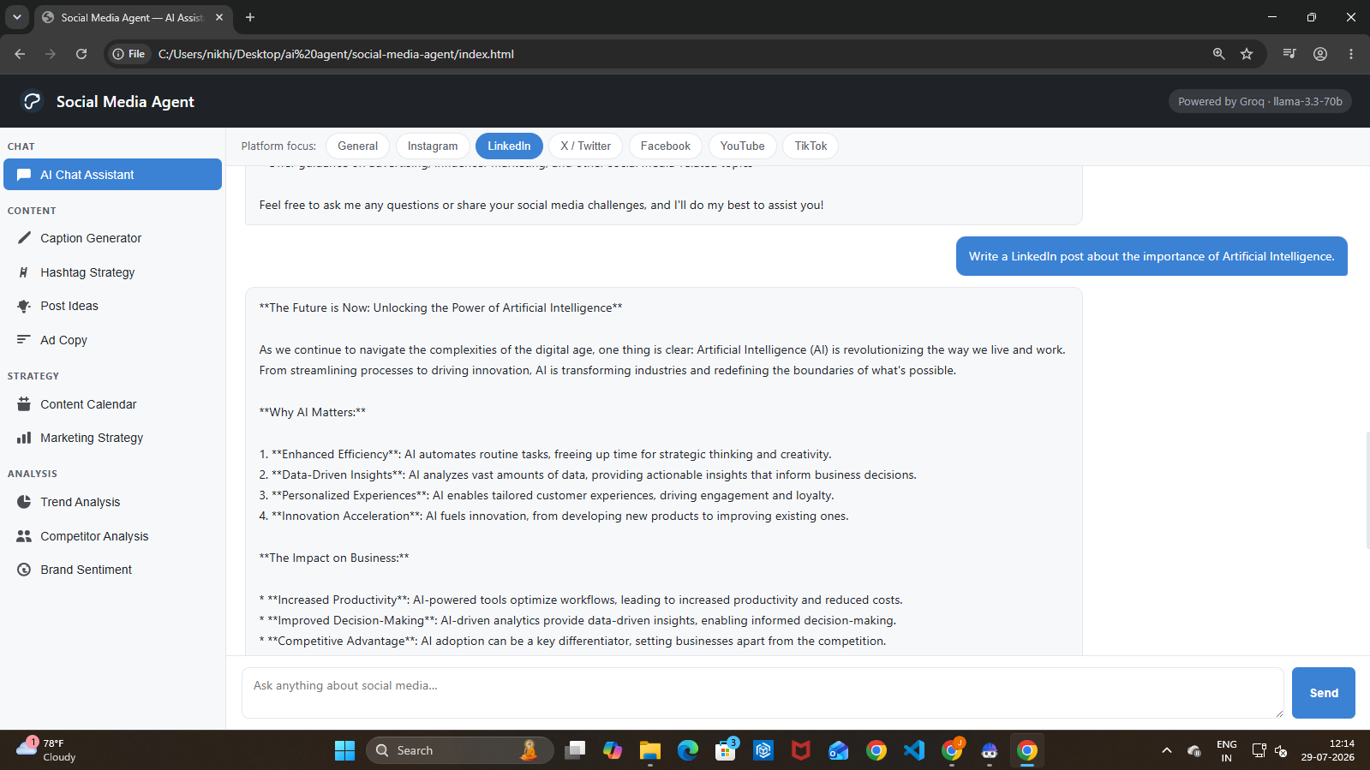
Project Output Screenshot
·
·
·

Slide 11
Novelty and Uniqueness
Multi-Agent AI architecture instead of a traditional chatbot.
AI-powered content generation for multiple social media platforms.
Intelligent trend and hashtag recommendations.
Audience sentiment analysis for better engagement.
Personalized marketing strategy recommendations.
Fast response generation using Groq API.
User-friendly single-page web interface.
Scalable architecture using IBM Bob and IBM Granite.
This solution acts as an intelligent social media assistant capable of assisting creators, businesses, and marketers in making informed content decisions.

Slide 12
Future Scope
Integration with live social media APIs (Instagram, LinkedIn, X, Facebook) for real-time analytics and automated posting.
AI-powered image and video generation for creating complete social media campaigns.
Real-time competitor analysis and campaign performance tracking.
Personalized content recommendations based on audience behavior and engagement history.
Multi-language support for global content creation and marketing.
·
·
·

Slide 13
Git Hub Link
github.com/janvigavit/social-media-agent

Slide 14
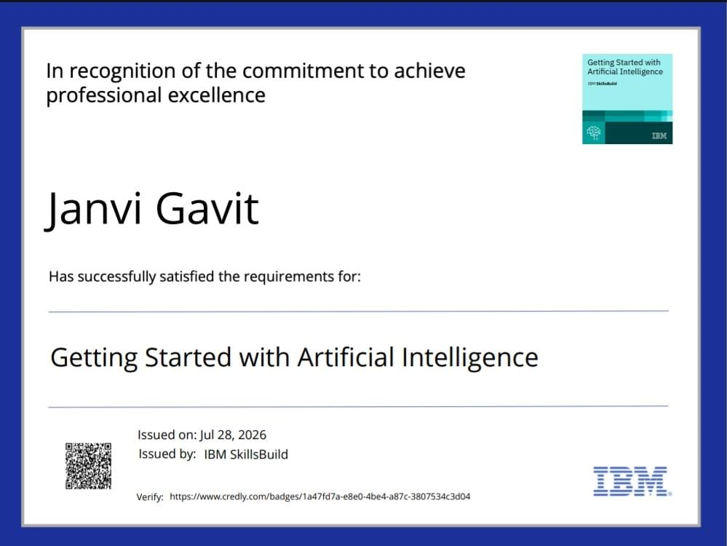
Certificates Earned:

Slide 15

Certificates Earned:​

Slide 16
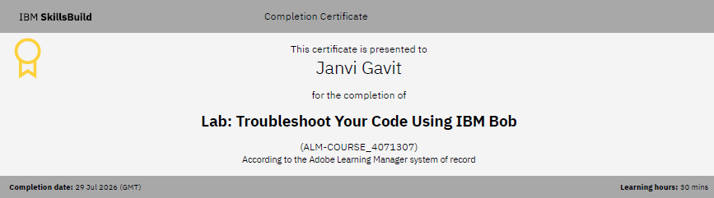
Certificates Earned:​

Slide 17
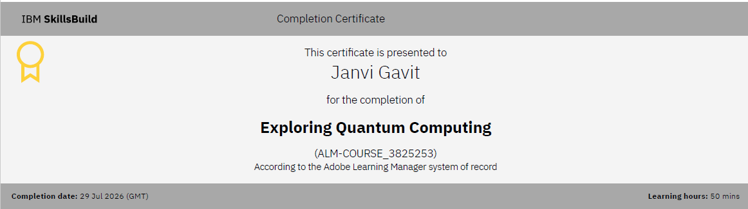
Certificates Earned:​

Slide 18


