Slide 1
Abstraction

Slide 2
What is Abstraction
Abstraction is the process of hiding certain details and showing only essential information to the user.
Abstraction can be achieved with either abstract classes or interfaces.

Slide 3
Abstract Classes and Method
Abstract class: is a restricted class that cannot be used to create objects (to access it, it must be inherited from another class).
Abstract method: can only be used in an abstract class, and it does not have a body. The body is provided by the subclass (inherited from).

Slide 4
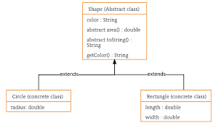
Flow chart of the Example

Slide 5
Important Points
An abstract class is a class that is declared with an abstract keyword.
An abstract method is a method that is declared without implementation.
An abstract class may or may not have all abstract methods. Some of them can be concrete methods
A method-defined abstract must always be redefined in the subclass, thus making overriding compulsory or making the subclass itself abstract.
Any class that contains one or more abstract methods must also be declared with an abstract keyword.
There can be no object of an abstract class. That is, an abstract class cannot be directly instantiated with the new operator.
An abstract class can have parameterized constructors and the default constructor is always present in an abstract class.

Slide 6
What are Interfaces
An abstract type used to define the behaviour of a class or is a blueprint of the class. There can be only abstract methods in the Java interface, not method body.

Slide 7
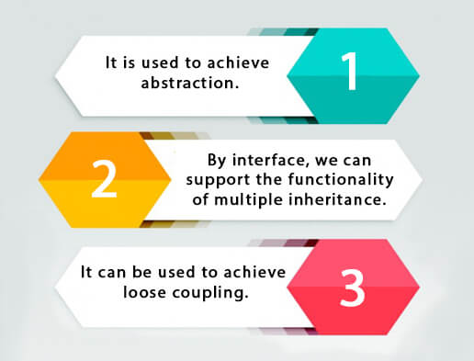
Why we use Interfaces

Slide 8
Important Points
Like abstract classes, interfaces cannot be used to create Interface .methods do not have a body - the body is provided by the "implement" class.
On implementation of an interface, you must override all of its methods.
Interface methods are by default abstract and public.
Interface attributes are by default public, static and final.
An interface cannot contain a constructor.

Slide 9
Difference
Parameter | Abstract Classes | Interfaces
Keyword | abstract keyword is used. | interface keyword is used.
Type of variables | Can handle final, non-final, static, and non-static variables. | Can only have static and final variables defined by default.
Final variables | May or may not have final variables declared within it. | Variables by default are declared as final
Access modifiers | Can have all any of the modifiers – private, public, static, etc. | Can only have the public access modifier.
Types of methods | Can have both abstract and non-abstract methods. | Can only have abstract methods.
Speed | Fast | Slow, as it requires extra indirection.

Slide 10
Problem of Multiple Inheritance
Multiple inheritance is a special type of inheritance in which a class can inherit properties of more than one parent class.
Java doesn't support multiple inheritance of classes due to the diamond problem ambiguity.
Diamond problem ambiguity arises when the same signature exists in both the super classes and the compiler cannot determine which signature to call in the subclass.
The solution to the diamond problem is default methods and interfaces.
We can override the default methods explicitly with its interface name.
Multiple inheritance by interface occurs if a class implements multiple interfaces or also if an interface itself extends multiple interfaces.

