Slide 1



SafetySentinel
Drug Safety Signal Detection & Regulatory Submission Readiness
From millions of safety reports and thousands of dossier sections to a prioritized, explainable review queue.
Team members-
Patel Janvi Dirgeshkumar (23bph050)
Thakkar Priyanshi Sanjivkumar(23bph098)
Pandit Devanshi Krushnakumar(23bph035)
Dabhi Divyaraje Vijaysinh (23bph008)
Team SafetySentinel
Notes:
1

Slide 2
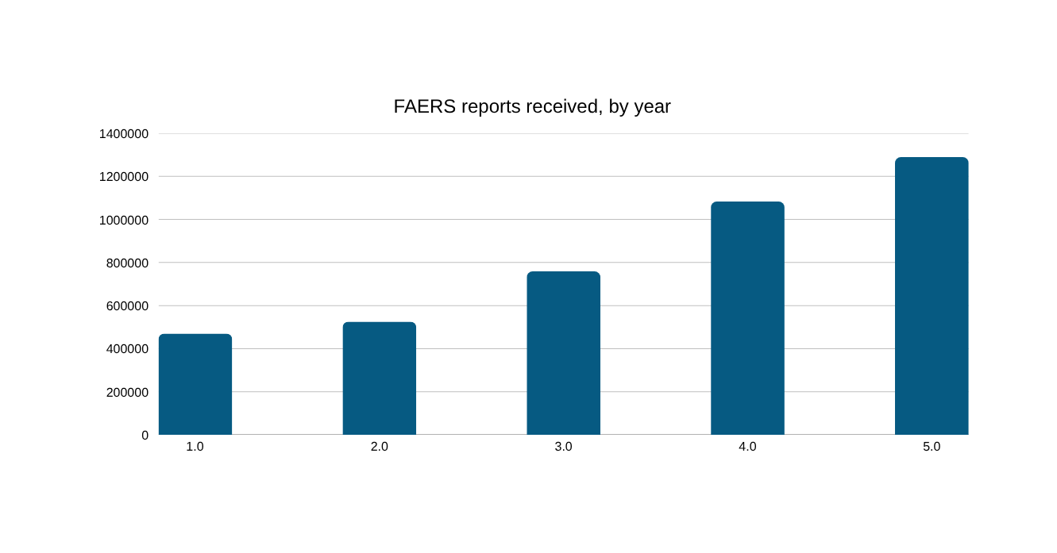
1
Problem — Pharmacovigilance: Drowning in Reports
The evidence for an emerging safety signal usually already exists — buried in volume.
32.8M+
Adverse-event reports now held in FDA's FAERS database
2.1M+
New reports logged into FAERS every year at current volumes
1.7x
FDA's own caution:
  A report does not establish that a drug caused an event
  Reports can be incomplete or duplicated
  FAERS data cannot directly calculate incidence, since the exposed population is usually unknown
Growth in annual reports received, 2014 → 2025 alone
Notes:
2

Slide 3
2
Problem — Regulatory Dossiers: One Gap, Months of Delay
The Common Technical Document spans five modules — and hides its gaps in scale, not complexity.
Module 1
Region-specific administrative information
If a gap isn't caught before submission:
  A missing or weak section commonly triggers a deficiency letter or information request
  Review clocks reset — turning a fixable gap into months of delay
  Because Modules 2–5 are reused across regions, one missed gap multiplies across every region's copy of the dossier
  Regulatory operations time shifts from new submissions to rework
Module 2
CTD summaries (quality, nonclinical, clinical)
Module 3
Quality (CMC)
Module 4
Nonclinical study reports
The common failure mode: both workflows need to turn high-volume evidence into a short, defensible review list. That's a triage problem, not a knowledge problem.
Module 5
Clinical study reports
Modules 2–5 are meant to be common in content and format across ICH regions — the entire point of the CTD.
Notes:
3

Slide 4
3
Our Solution — Two Workflows, One Evidence-First Platform
SafetySentinel is a screening and readiness assistant — not a certification system.
SafetySentinel
SIGNAL DETECTION
SUBMISSION READINESS
Accept adverse-event records
Accept a CTD outline
1
1
Build PRR + chi-square disproportionality screen
Score Modules 1–5 against ICH-M4 checklist
2
2
Rank candidate signals with full evidence
Produce a prioritized, exportable gap report
3
3
Notes:
4

Slide 5
4
Mode 1 — Safety Signal Detector
We don't just say “risk detected.” We show the evidence behind every flag.
Evidence table (per drug–event pair)
How it works
 | Target event | Other events
Target drug | a | b
Other drugs | c | d
1
Normalize drug names and reaction terms
2
Aggregate reports into drug–event pairs
3
Build a 2×2 contingency table for each pair
PRR = [ a / (a+b) ] ÷ [ c / (c+d) ]
4
Compute PRR (proportional reporting ratio)
5
Compute chi-square for statistical strength
Framing that matters:
PRR and chi-square are disproportionality-screening statistics, not proof of causation. They mirror FDA's own caution that a report does not establish that a drug caused an event.
6
Rank and flag candidates (e.g. PRR ≥ 2, χ² ≥ 4, ≥ 3 cases)
Notes:
5

Slide 6
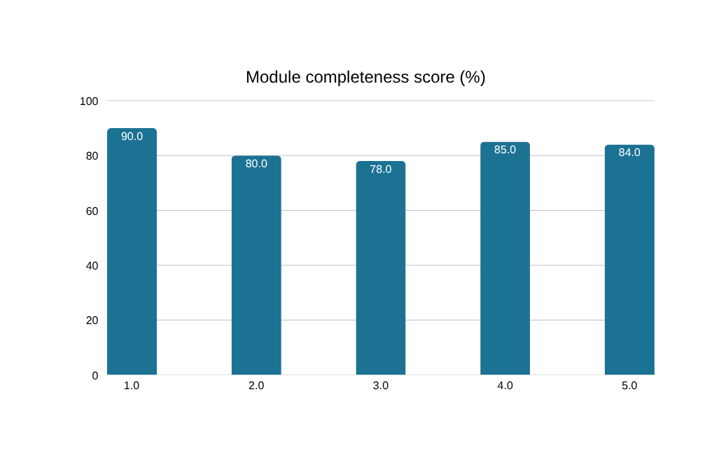
5
Mode 2 — Submission Readiness Checker
From “submission = incomplete” to an exact, section-level fix list.
How it works
1
Accept a CTD outline / section manifest
2
Match submitted sections against an ICH-M4-inspired checklist
3
Score completeness per module (present / missing / weak)
4
Aggregate into an overall readiness score
5
Produce a prioritized, exportable gap report
Example gap output:
  Module 3 → missing 3.2.P.5.6 Container Closure
  Module 5 → weak / incomplete cross-references
Framing that matters: this is a structural completeness check against a checklist — not a certification that a dossier is scientifically sound or “regulatory-ready.”
Notes:
6

Slide 7
6
Demo & Architecture — Evidence-First Pipeline
Deterministic statistics and checklist logic, with AI used for build speed — not for the math.
USER
Streamlit Dashboard (Signal / Readiness tabs)
Signal Engine — normalize · aggregate · PRR · χ²
CTD Engine — match · score modules · detect gaps
Ranked Signal Report (evidence-linked)
Exportable Module Gap Report
Tech stack
Layer | Technology
Frontend | Streamlit
Data processing | Python, pandas
Statistics | scipy — deterministic PRR / χ²
Regulatory structure | ICH M4-inspired checklist
AI layer | IBM Bob (dev) · watsonx.ai (future explain layer)
Dev tooling | GitHub, GitHub Actions
Notes:
7

Slide 8
7
Live Demo Results (Synthetic Prototype Data)
What the prototype actually produced — not real-world safety conclusions.
306
25
2
8%
synthetic reports
drug–event pairs screened
candidate signals flagged
flag rate — a sharply narrowed queue
Signal Detection — flagged pairs
Submission Readiness — example gaps found
Drug – Event | PRR | χ²
DrugB + Arrhythmia | 7.52 | 47.58
DrugA + Hepatotoxicity | 6.08 | 55.21
  Module 3 → missing 3.2.P.5.6 Container Closure
  Module 4 → incomplete batch analysis data
  Module 5 → weak / incomplete cross-references
These are synthetic, prototype-stage screening results — shown to demonstrate mechanism and output format, not real pharmacovigilance conclusions or a real submission's actual readiness.
Notes:
8

Slide 9
8
Where IBM Bob Fits
Bob was part of the development lifecycle — not just a logo on the slide.
Ask
Plan
Agent
Understand concepts or analyze existing code without making changes
Think through architecture and produce a technical plan before implementation
Take an approved plan and implement it end-to-end across the codebase
Our actual build workflow
Problem
statement
Bob —
PLAN
Bob —
AGENT
Local
testing
Bug
found
Bob —
debug
GitHub
Actions
Concrete example from our build:
The CTD tab threw a StreamlitWidgetAlreadyInstantiatedError. Instead of hand-tracing the session-state logic, we gave Bob the real error trace and asked it to inspect widget-key handling — Bob fixed it, and the workflow ran correctly. Plan → implement → hit a real error → debug with Bob → verify → commit.
Notes:
9

Slide 10
9
Implemented Today vs. Future IBM Integration
This distinction is what keeps the pitch credible instead of overclaiming.
IMPLEMENTED TODAY
FUTURE ROADMAP
  IBM Bob for planning, code generation, debugging, and iterative improvement
  GitHub + GitHub Actions for version control and CI validation
  All PRR / χ² / checklist logic is deterministic, auditable Python — Bob helped build it but doesn't run inside live scoring
  watsonx.ai foundation models as an explanation layer — turning outputs into plain-English, regulator-style summaries
  watsonx embeddings to group related adverse-event terms and CTD sections for smarter triage
  Retrieval-augmented querying over regulatory guidance documents
  Agentic, governed multi-step review workflows on watsonx Orchestrate
“We used IBM Bob to build SafetySentinel — we're not claiming a live Bob/watsonx API powers today's running app.”
Notes:
10

Slide 11
10
Beyond the Hackathon
From prototype to a pharmacovigilance & regulatory intelligence platform.
Phase 1
Phase 2
Phase 3
Real Data, Governed Access
Smarter Signal Triage
Submission Copilot
  Connect to governed FAERS/AEMS extracts
  Internal case-processing systems
  Structured regulatory datasets
  Add ROR, IC, EBGM alongside PRR
  Temporal trend + duplicate detection
  MedDRA-aware clustering, severity weighting
  Cross-document consistency checks
  Catch conflicting values across modules
  Flag stale cross-references automatically
Goal: turn thousands of raw statistical candidates and hundreds of dossier sections into a small, ranked, explainable human-review queue — better-triaged, not just fewer, numbers.
Notes:
11

Slide 12
SafetySentinel
Detect earlier. Review smarter. Submit with confidence.
DRUG SAFETY — detect signals, investigate
REGULATORY — check readiness, fix gaps
HUMAN EXPERT REVIEW
BETTER, FASTER DECISIONS
BETTER, FASTER DECISIONS
Make high-volume pharmacovigilance and regulatory review more proactive, explainable, and efficient — without ever removing the human expert who makes the final call.
Team SafetySentinel
Notes:
12

