Slide 1

InsurAI Corporate Policy Automation and Intelligence System

Slide 2
Problem Statement
Corporate insurance policy management is often dependent on fragmented systems and manual administrative workflows.
Limited end-to-end visibility across policy lifecycle, claims, renewals, and compliance tracking.
High administrative dependency on HR teams for documentation, eligibility validation, and query resolution.
Complex policy documentation creates ambiguity for employees regarding coverage, benefits, and claim procedures.
Absence of centralized intelligence for monitoring risk exposure, utilization trends, and policy performance.

Slide 3
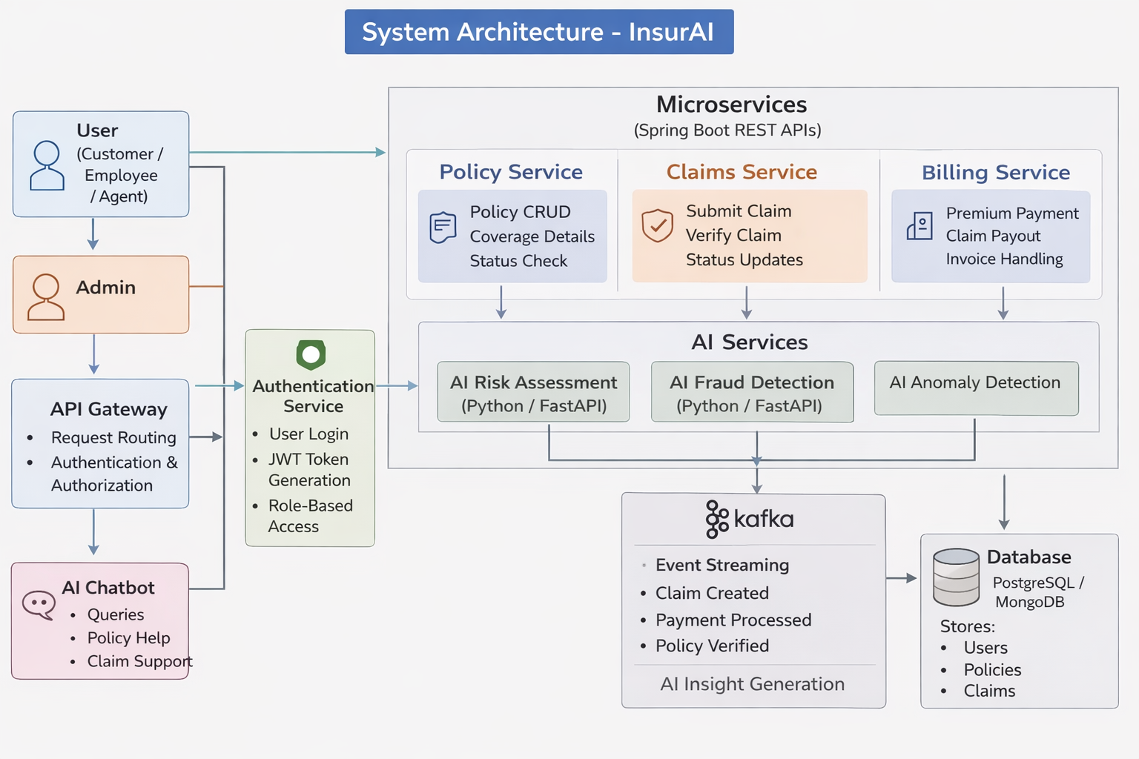
System Architecture
USER LAYER
Admin | HR Manager | Employee
USER LAYER
Admin | HR Manager | Employee
PRESENTATION LAYER
Web Dashboard | Forms | Reports | Alerts
PRESENTATION LAYER
Web Dashboard | Forms | Reports | Alerts
APPLICATION SERVICES LAYER
Policy Management | OCR | Claims | Risk Assessment | Recommendation Engine
APPLICATION SERVICES LAYER
Policy Management | OCR | Claims | Risk Assessment | Recommendation Engine
AI & ANALYTICS LAYER
NLP Processing | Rule-Based Decision Engine | Risk Prediction
AI & ANALYTICS LAYER
NLP Processing | Rule-Based Decision Engine | Risk Prediction
DATA MANAGEMENT LAYER
Policy DB | User DB | Claims DB | Audit Logs | Secure Storage
DATA MANAGEMENT LAYER
Policy DB | User DB | Claims DB | Audit Logs | Secure Storage
INTEGRATION LAYER
Insurance APIs | Email/SMS Gateway | Payment Gateway
INTEGRATION LAYER
Insurance APIs | Email/SMS Gateway | Payment Gateway

Slide 4
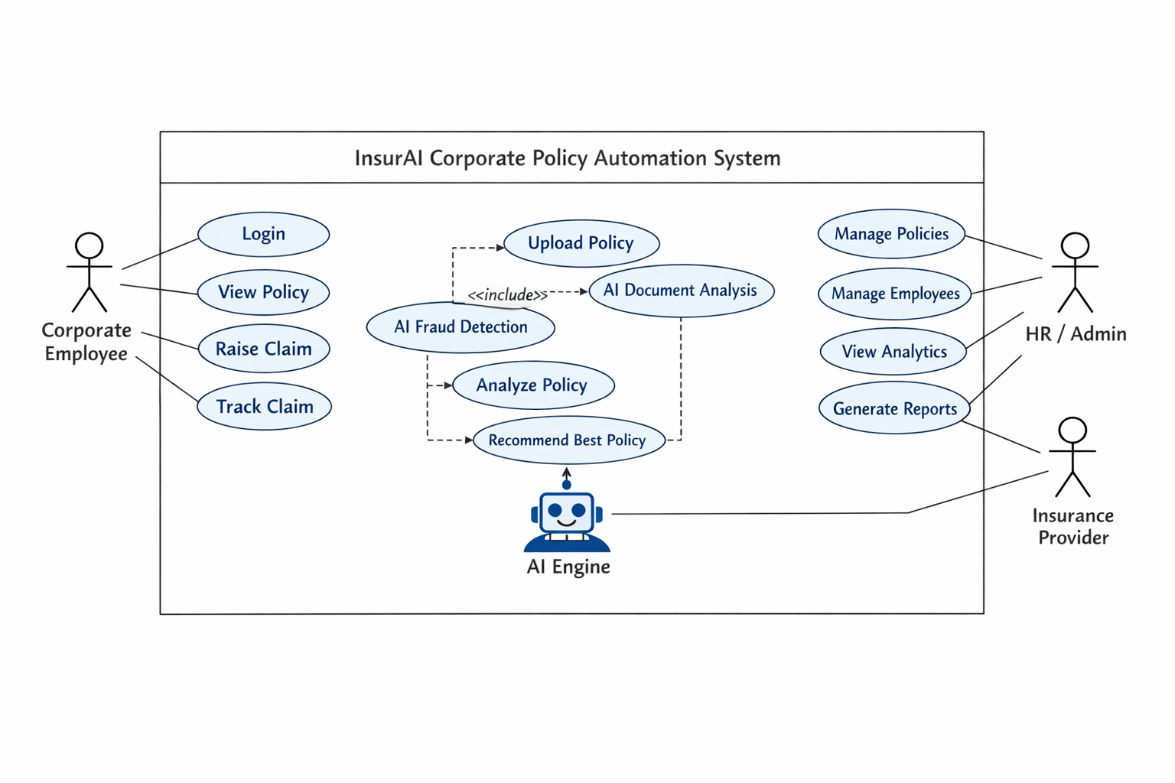
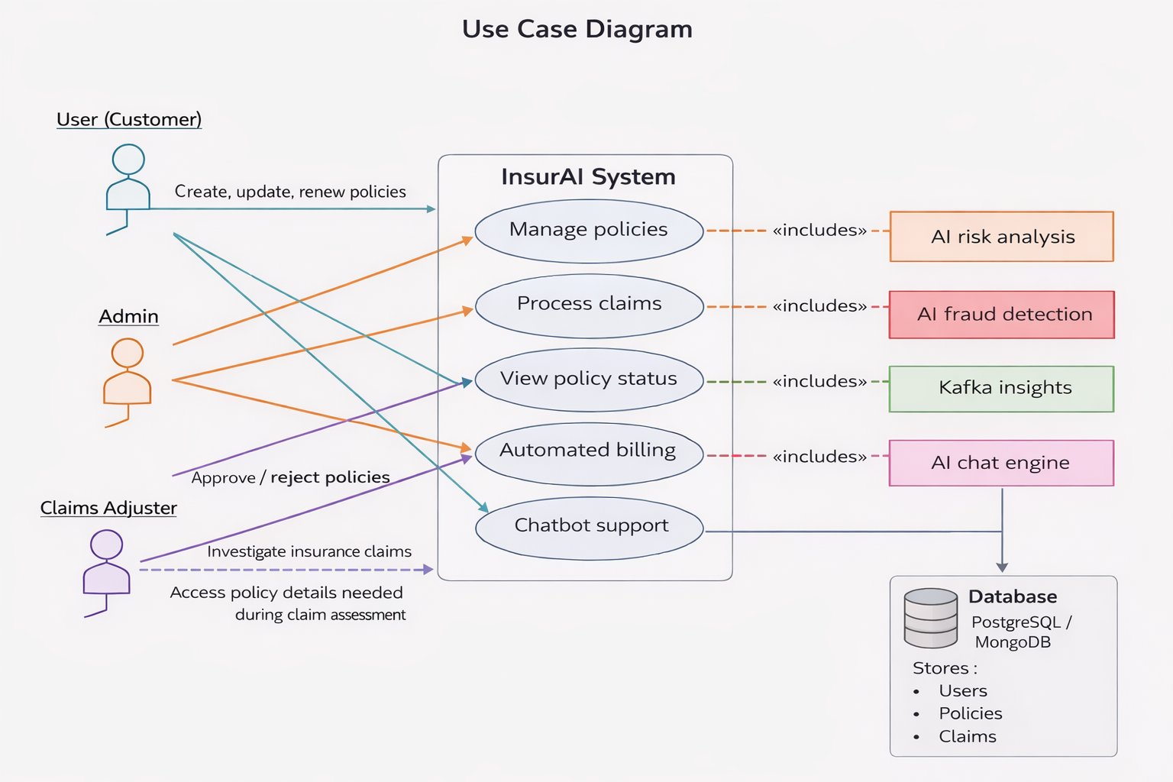
System Architecture
Layer 1: User Interface Layer
Actors:
Employees
HR / Admin Teams
Insurance Providers
Access Through:
Web Portal
Mobile Application
Layer 2: Application Services Layer
Policy Management Module
Claims Processing Engine
Compliance Tracking System
Query & Support Interface
Notification Management
Layer 3: AI & Intelligence Layer
NLP-Based Policy Interpretation
Automated Document Processing
Claim Validation Logic
Risk & Utilization Analytics
Insight Generation Engine
Layer 5: Integration Layer
HRMS Integration
ERP Systems
Insurance Provider APIs
Email / SMS Gateway
Layer 4: Data Management Layer
Employee Database
Policy Repository
Claims Database
Compliance Logs
Analytics Data Store

Slide 5
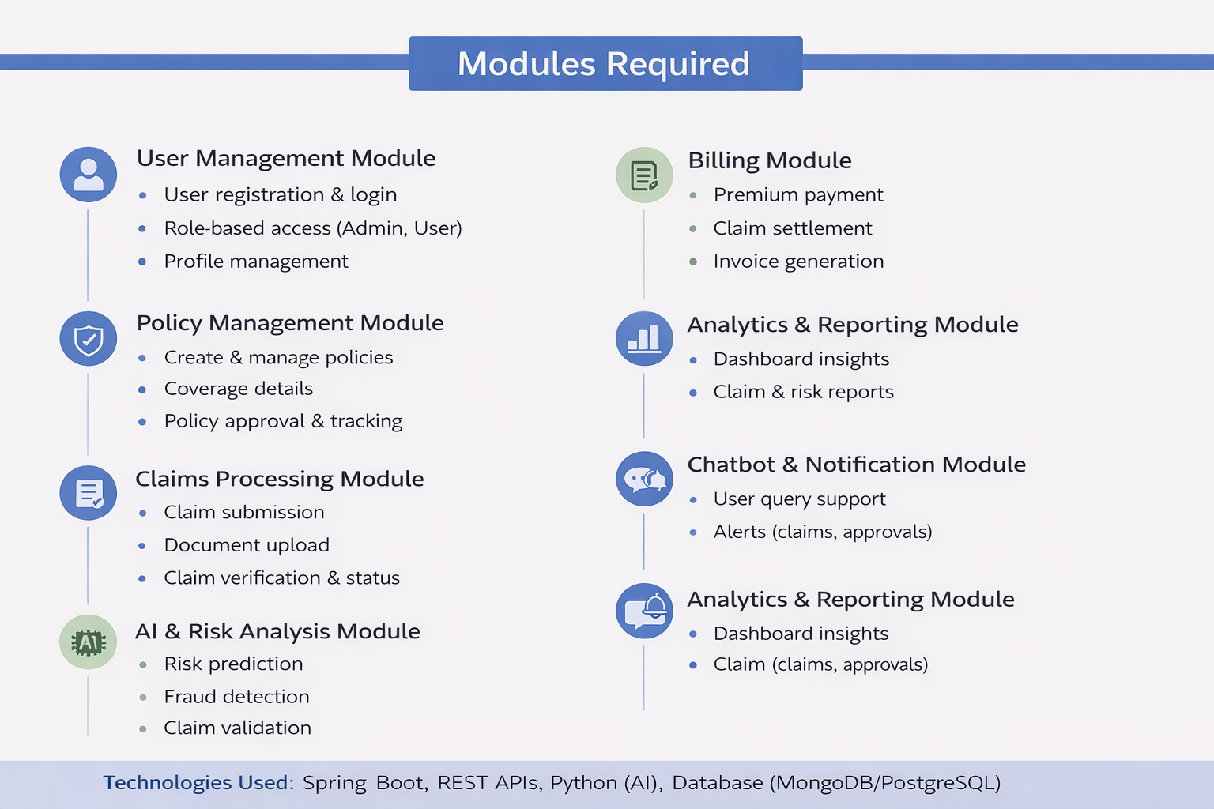
Modules Required
1. User Management Module
User Registration & Authentication
Role-Based Access Control (Admin / HR / Employee)
Secure Login & Profile Management
2. Document Processing Module
Policy Document Upload
OCR-Based Text Extraction
Data Cleaning & Structuring
3. AI & Intelligence Module
NLP-Based Clause Analysis
Policy Classification
Risk & Compliance Detection
4. Policy Management Module
Policy Creation & Editing
Version Control
Policy Search & Retrieval
5. Workflow & Automation Module
Automated Approval Process
Task Assignment
Email / System Notifications
6. Analytics & Reporting Module
Policy Insights Dashboard
Compliance Reports
Usage Statistics
7. Data & Storage Module
Secure Database Management
Cloud Document Storage
Backup & Recovery System

Slide 6
THANKS

