Slide 1
Food Delivery Time Predictor
AI-Powered Logistics Solution

Slide 2
The Problem
1. Customer Frustration ("Where is my food?")
Vague Estimates: Standard apps provide broad time windows (e.g., "30-50 mins") rather than precise ETAs.
Anxiety & Churn: Lack of transparency leads to anxious customers and cancelled orders.
2. Operational Inefficiency
Blind Logistics: Restaurants and delivery partners operate reactively without predictive data.
Resource Waste: Inefficient routing and staffing during peak hours burns fuel and time.
3. Static Models in a Dynamic World
One-Size-Fits-All: Current algorithms often ignore critical real-time variables like traffic, weather, and vehicle type.
Result: Delivery promises that fail when reality hits.

Slide 3
The Solution: Intelligent Delivery Prediction & Analytics
1. Precision Engine (The Brain)
Problem Solved: Vague time windows -> Precise ETAs
Core Technology: Random Forest Regressor trained on 45,273 real-world records.
Key Inputs: Dynamic analysis of Distance, Ratings, Driver Age, Vehicle Type, & Traffic.
Result: ~5.67 minutes MAE (Mean Absolute Error), significantly outperforming standard estimates.
2. Operational Clarity (The Eyes)
Problem Solved: Blind logistics -> Data-Driven Decisions
Interactive Dashboard: 6+ Real-Time Visualizations (Heatmaps, Distributions, Trends).
Actionable Insights: Identify bottlenecks like specific vehicle inefficiencies or peak-hour delays instantly.
3. Seamless Accessibility (The Interface)
Problem Solved: Static tools -> Anytime, Anywhere Access
Universal Design: Fully responsive web app optimized for Mobile, Tablet, and Desktop.
Zero Friction: <100ms prediction latency for instant decision-making in the field.

Slide 4
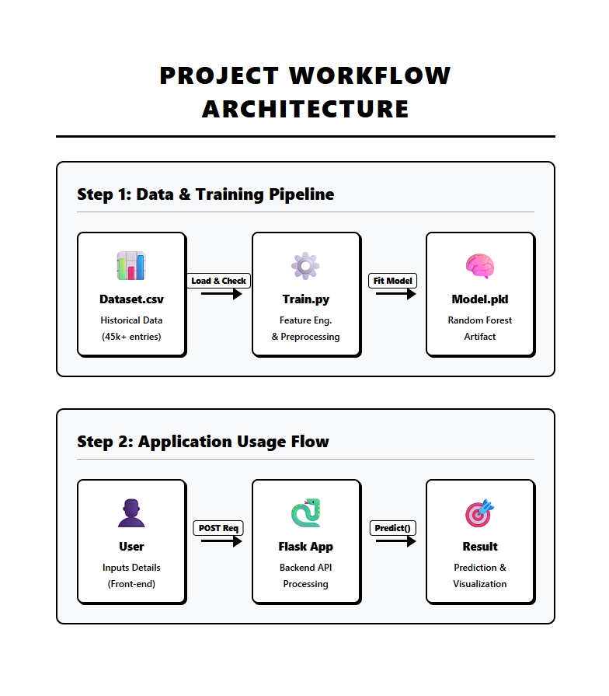

Slide 5
Data Cleaning Workflow
Data Cleaning for Delivery Time Prediction
To improve prediction accuracy, the dataset was cleaned and validated before model training.
Key Cleaning Steps:
Duplicate Removal:
Removed repeated delivery records to avoid model bias.
Invalid Value Handling:
Filtered unrealistic delivery partner ages (<18 years).
Ensured ratings were within the valid range (1–5).
Target Validation:
Checked delivery time values to remove incorrect or extreme entries.
Categorical Text Cleaning:
Trimmed extra spaces in order and vehicle type categories to prevent incorrect grouping.
Outcome:
A reliable, consistent dataset suitable for machine learning regression models.

Slide 6
Data Cleaning Workflow
Preprocessing & Feature Engineering
After cleaning, preprocessing was applied to make the dataset model-ready.
Major Enhancements:
Distance Feature Creation:
Restaurant and delivery latitude/longitude were transformed into a meaningful feature:
Distance_km using the Haversine formula.
(Distance is one of the strongest factors affecting delivery time.)
Categorical Encoding (Digit Assignment):
Since ML models cannot process text categories directly, categorical features were converted into numeric labels:
  Vehicle Type: Bicycle → 0, Electric Scooter → 1, Motorcycle → 2, Scooter → 3
  Order Type: Snack → 0, Meal → 1, Drinks → 2, Buffet → 3
Noise Reduction:
Dropped unnecessary identifier columns that do not contribute to prediction.
Final Result:
A clean and optimized dataset enabling accurate delivery time prediction using models like XGBoost.

Slide 7
Technology Stack: Building for Performance
1. Frontend (User Interface)
HTML5 & CSS3: Custom responsive design with modern gradients and animations.
JavaScript (Vanilla): Lightweight interactivity for forms and dynamic content.
Font Awesome: Professional iconography system.
2. Backend (Server & Logic)
Python 3.x: Core programming language for robust logic.
Flask: Lightweight web framework for handling API requests and routing.
3. Machine Learning (Intelligence)
Scikit-Learn: Random Forest Regressor implementation for prediction.
Pandas & NumPy: High-performance data manipulation and cleaning.
Joblib: Efficient model serialization for fast loading.
4. Visualization (Analytics)
Plotly: Interactive, responsive charts for the analytics dashboard.

Slide 8
Model Performance
The model accuracy (R² ≈ 40%) is low because the dataset contains only one independent variable: Distance_km.
In real-world scenarios, delivery time does not depend only on distance,Delivery time is influenced by many hidden factors such as:
Traffic conditions
Weather conditions
Road type
Delivery person speed
Restaurant preparation delay
Time of day (peak vs non-peak hours)

Slide 9
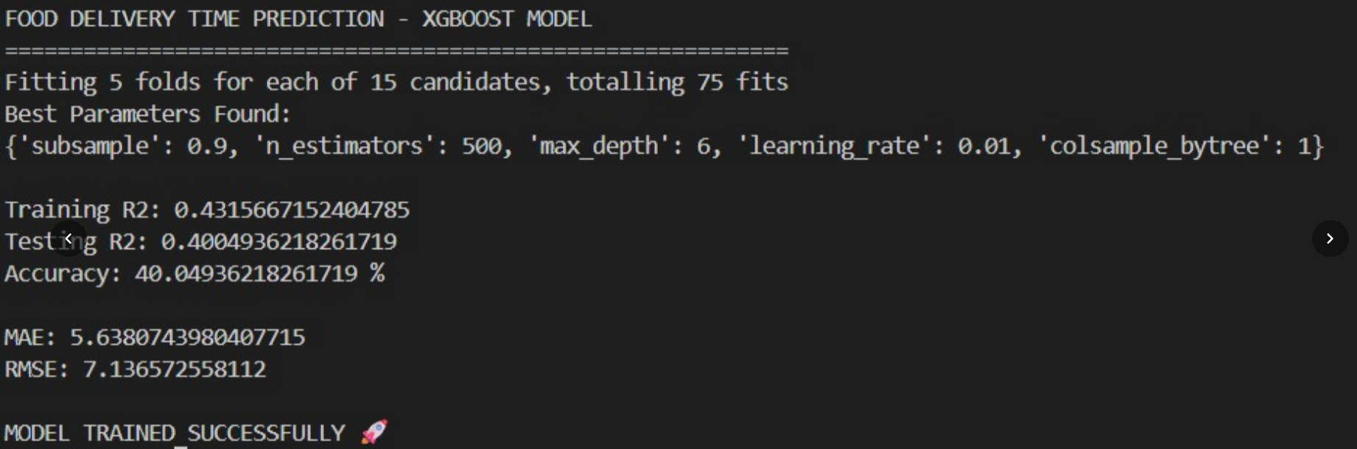
Model Performance
The absence of these key variables limits the model’s ability to accurately explain and capture real-world variations in delivery time.

Slide 10
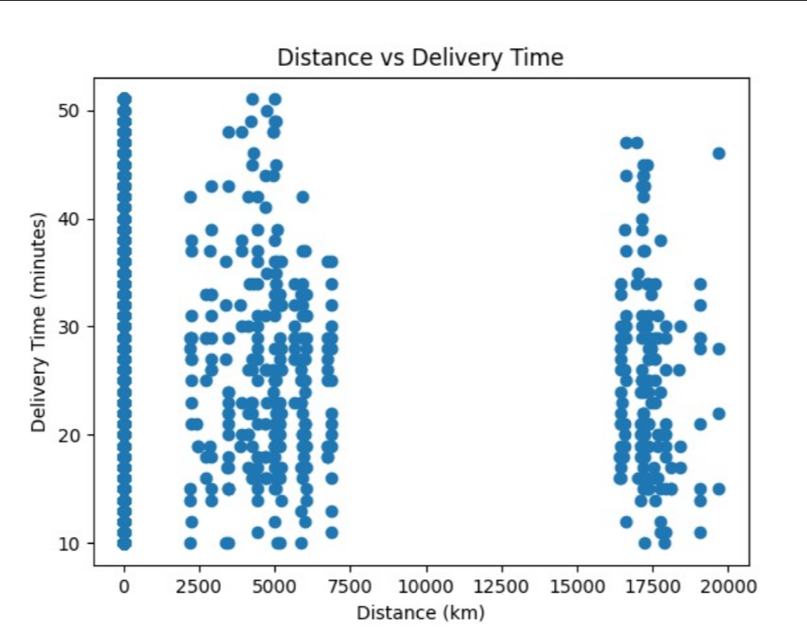
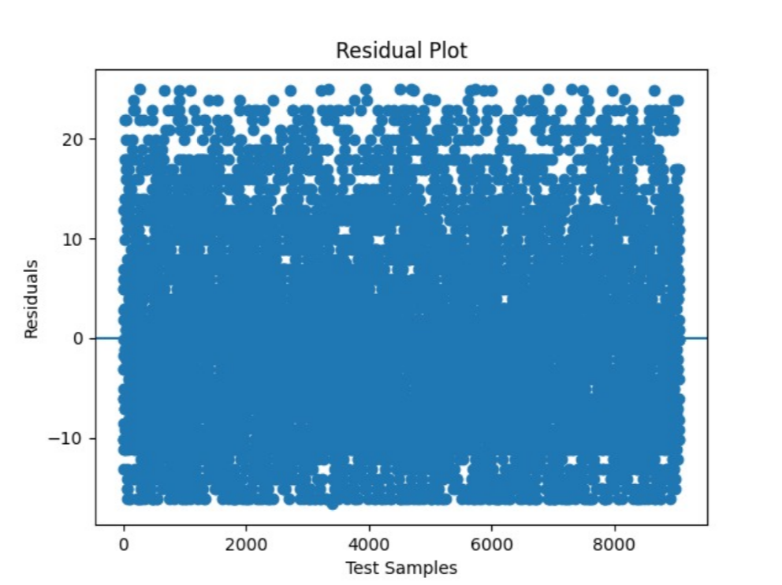
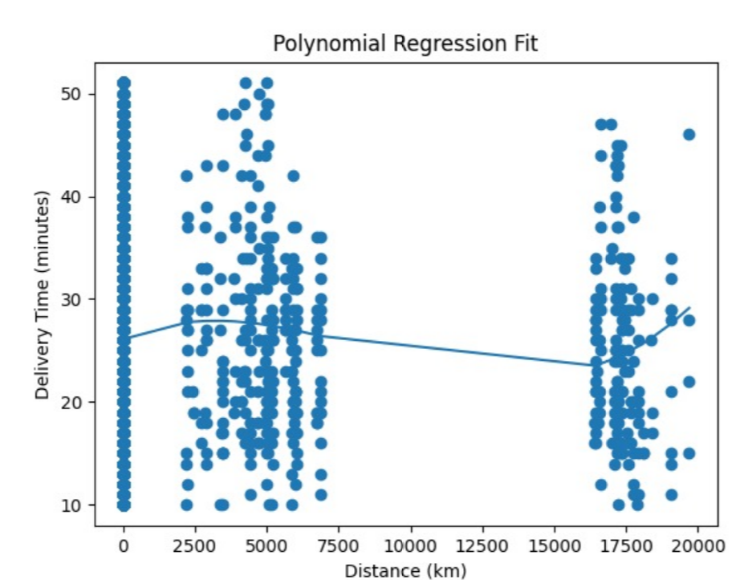
Model Performance

Slide 11
Analytics & Insights
• Distance vs Time: Strong correlation.
• Ratings Impact: Better ratings = faster delivery.
• Age Factor: Experienced partners are consistent.
• Vehicle Type: Motorcycles faster in traffic.

Slide 12
Future Roadmap: Scaling Intelligence
1. Real-Time Data Integration
Live Traffic API: Integrate Google Maps/TomTom API to account for real-time congestion and road closures.
Weather API: Factor in rain, snow, or heatwaves which significantly impact delivery speed.
2. Advanced AI/ML
Deep Learning: transition to LSTM/Neural Networks for time-series forecasting.
Driver Profiling: Personalized efficiency scores for each driver to optimize assignments.
Demand Forecasting: Predict order surges before they happen to pre-position fleets.
3. Ecosystem Expansion
Mobile App: Native iOS/Android app for drivers with GPS tracking and push notifications.
Customer App: Real-time order tracking map for end-users.
4. Sustainability
Green Routing: ALgorithms to prioritize fuel-efficient routes to reduce carbon footprint.
EV Fleet Optimization: specialized management for electric vehicle range and charging.

Slide 13
Conclusion
End-to-End Solution: Raw data to web app.
User-Centric: Solves real-world problems.
Scalable: Built on robust tech.
Thank You!

