Slide 1






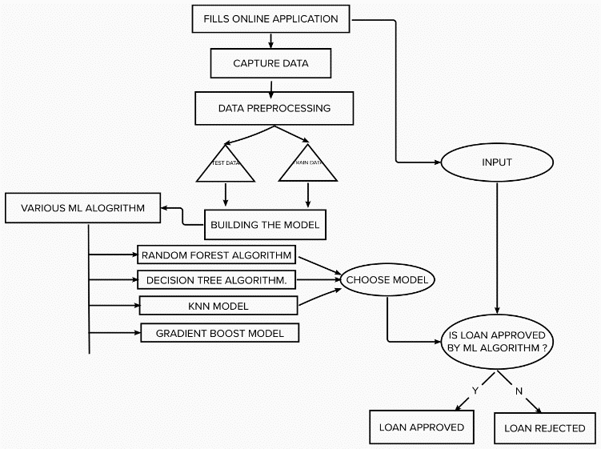
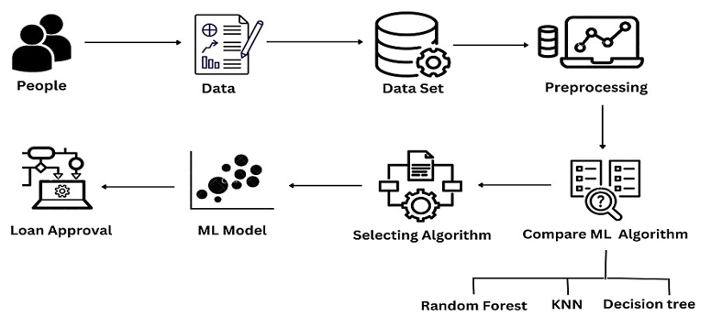
HOUSING LOAN PROGNOSIS USING VARIOUS MACHINE LEARNING TECHNIQUES
Jashwanthi S 312319104053
Jane Sanjeevini R 312319104053
ABSTRACT
Over the last decade, digital credit has been the fastest growing financial innovation. credit risk models based on machine Learning algorithms provide a higher level of accuracy. This project takes data of previous customers to whom on a set of parameters loans were approved. The machine learning model is then trained on that record to get accurate results. The performance of the machine learning models are then compared and the best machine learning algorithm is selected to predict the loan default.
INTRODUCTION
MATERIALS AND METHODOLOGY
RESULT
Loans are the major requirement of the modern world. By this only, Banks get a major part of the total profit. It is beneficial for students to manage their education and living expenses, and for people to buy any kind of luxury like houses, cars, etc.
But when it comes to deciding whether the applicant’s profile is relevant to be granted with loan or not. Banks have to look after many aspects. So, here we will be using Machine Learning with python to ease their work and predict whether the candidate’s profile is relevant or not using key features.
Data collection : The dataset gathered for forecasting loan default customers includes 13 features. The response variable is loan status and remaining data is used to check whether the loan can be approved or not.
Data preprocessing : To ensure optimal performance of the model, the following techniques were deployed; Normalization, Handling missing data, Handling categorial data and outliers.
Building model : Once the data is in usable shape after splitting, then its time to train the model using various Machine Learning Techniques like random forest , decision tree, KNN model and gradient boost classifier and compare which has high accuracy.
Prediction: After integrating model with the website , user can predict the output by filling out the inputs
Random forest Algorithm: An approach to characterization involves constructing an enormous number of Decision trees over the duration and obtaining the class that would be the mode of the classes produced by the independent tree. Random Forest has the highest accuracy compared to all models , hence it is deployed.
This research utilized state-of-the-art machine learning methods to build credible and accurate prediction model. Our models achieved high performance accuracy based on the precision and recall metrics, with the R.F. model achieving a 93% score.
CONCLUSION
From the proper view of analysis this system can be used perfect for detection of clients who are eligible for approval of loan. The software is working perfect and can be used for all banking requirements. This system is more secure and reliable.
Department of Computer Science and Engineering, St. Joseph’s College of Engineering, OMR, Chennai – 119.
- Dr. P.Naveen, M.E, Ph.D

