Slide 1
Is Transactional Memory an Oxymoron?
Mark D. Hill
Computer Sciences Department
University of Wisconsin—Madison
http://www.cs.wisc.edu/~markhill
August 2008 @ VLDB in Auckland, NZ
Aren’t transactions about durability?
Memory is not durable!

Slide 2



My Connection to VLDB
DeWitt
Ailamaki
Hill
VLDB 1999: Ailamaki, DeWitt, Hill, & Wood, VLDB 1999
DBMSs on a Modern Processor: Where Does Time Go?
VLDB 2001 Best Paper: Ailamaki, DeWitt, Hill, & Skounakis Weaving Relations for Cache Performance

Slide 3
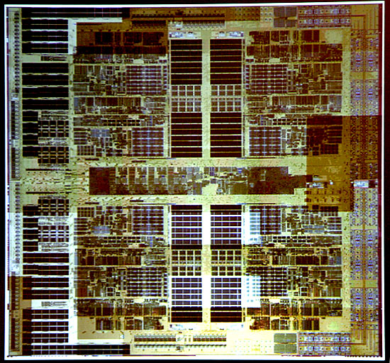
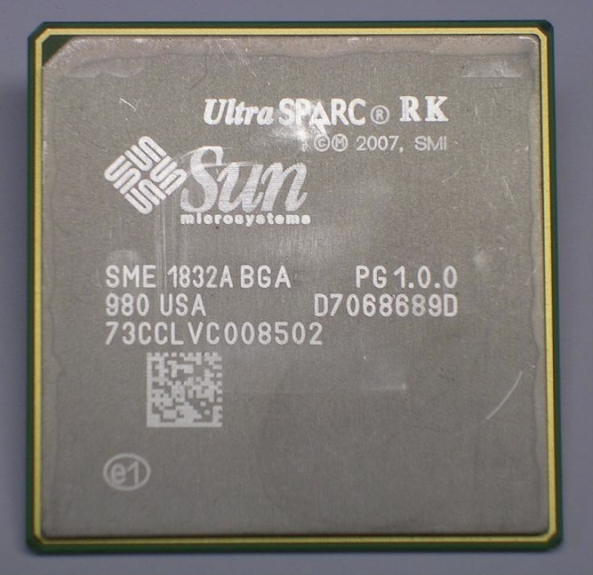
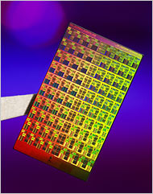
Why this Keynote?
Multicore chips here & cores multiplying fast
Hardware Transactional Memory soon
Is Transactional Memory relevant to DB community?
4 cores now
16 cores 2009
80 cores in 20??
AMD Quad Core
Sun Rock
Intel TeraFLOP

Slide 4
Goals of this Keynote
Teaching
1. Introduce Transactional Memory (TM)
  Programmers specifies instruction sequences as atomic
  Motivated & facilitated by emerging multicore HW
2. Show TM Transactions != DBMS Transactions
  Different Purpose, State, & Implementation
3. Explore Impact to DB-like Applications
  E.g., Transactional Latch Elision
Bottom Line: Multicore HW impacts SW; TM may help

Slide 5
Outline
Multicore & Implications
  Moore’s Law(s), Multicore HW, & SW Implications
Transactional Memory
Best-Effort Hardware Transactional Memory
Best-Effort HTM Example
Impact to DB-like Applications
Unbounded Hardware Transactional Memory

Slide 6
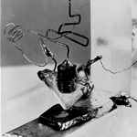

Technology & Moore’s Law
Transistor
1947
Integrated Circuit 1958 (a.k.a. Chip)
Moore’s Law 1964:
# Transistors per Chip doubles every two years (or 18 months)

Slide 7
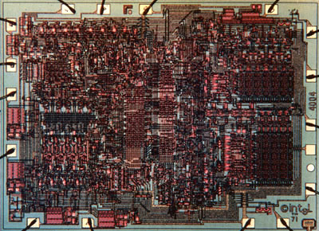
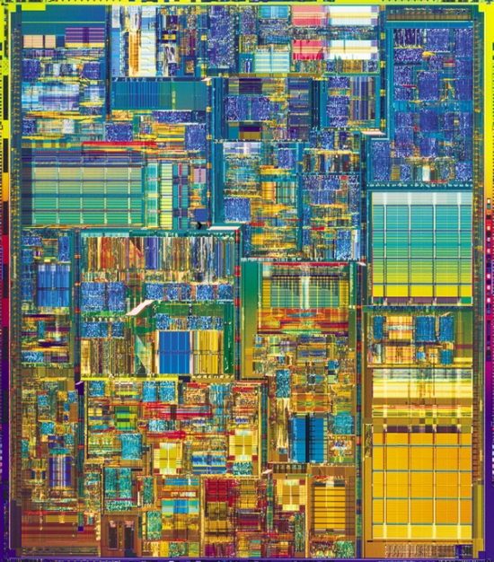
Architects & Another Moore’s Law
2300 transistors 1971
50M transistors ~2000 →
Popular Moore’s Law:
Processor (core) performance doubles every two years

Slide 8
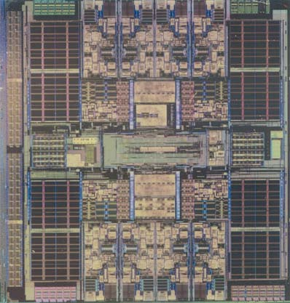
Multicore Chip (a.k.a. Chip Multiprocesors)
Why Multicore?
Power
→ slow clock scaling
→ simpler structures
Memory
→ concurrent accesses
to tolerate off-chip latency
Wires
→ intra-core wires shorter
Complexity
→ divide & conquer
L2$
d
a
t
a
4
4
4
4
L2$
d
a
t
a
4
4
4
4
2006 Sun Niagara

Slide 9
SW Implications: Why Multicore Matters
Need More Performance?
OLD: HW Core Performance Repeatedly Doubles
NEW: Need SW Parallelism to Repeatedly Double
Retarget Existing Relational DBMS
Author New DB-like Apps for Concurrency Scaling
Amdahl’s Law in the Multicore Era [Computer, 7/08]

Slide 10
More Implications: Follow the Parallelism
Where is Workload Parallelism?
  Servers have it: DBMS, web/app, 2nd Life
  Clients? Graphics, Recognition/Mining/Synthesis?
  Market disruption is client SW parallelism not found
How Program to Exploit Parallelism?
  Most: Very High Level (SQL, DirectX, LINQ, ...)
  Experts: Target HW w/ threads & shared memory

Slide 11
Parallelism Brokered via Locks is Hard
Latch or Spinlocks != DBMS Locks
// WITH LOCKS
void move(T s, T d, Obj key){
LOCK(s);
LOCK(d);
tmp = s.remove(key);
d.insert(key, tmp);
UNLOCK(d);
UNLOCK(s);
}
Locking Granular
Too coarse limits parallelism
Fine can be difficult
Optimal granularity depends
Maintenance Hard
Global knowledge
Partial order on acquires
Thread 0
move(a, b, key1);
Thread 1
move(b, a, key2);
DEADLOCK!
(& can’t abort)

Slide 12
Outline
Multicore & Implications
Transactional Memory
  Definition, != DBMS Transactions, & Implementations
Best-Effort Hardware Transactional Memory
Best-Effort HTM Example
Impact to DB-like Applications
Unbounded Hardware Transactional Memory

Slide 13
Transactional Memory (TM)
void move(T s, T d, Obj key){
atomic {
tmp = s.remove(key);
d.insert(key, tmp);
}
}
Programmer says
  “I want this atomic”
TM system
  “Makes it so”
Pioneering reference [Herlihy & Moss, ISCA 1993]
TM transactions appear to execute in serial order
TM system seeks concurrent transaction execution
Sound familiar?

Slide 14
Some Transaction Terminology
Transaction: State transformation that is:
Atomic (all or nothing)
Consistent
Isolated (serializable)
Durable (permanent)
Commit: Transaction successfully completes
Abort: Transaction fails & must restore initial state
Read (Write) Set: Items read (written) by a transaction
Conflict: Two concurrent transactions conflict if either’s write set overlaps with the other’s read or write set
NOT DB contents: Memory words, cache blocks, or objects

Slide 15
Goals for DBMS & TM Transactions
DBMS Transactions Target Failures (then Concurrency)
  *!@&$% Happens, so let’s make it predictable
  Durable ALL or NOTHING
TM Transactions Target Concurrency Only
  Let’s make parallel programming easier
  Programmer says where mutual exclusion is needed
  TM system seeks to make it so
➔ DBMS & TM Fundamentally Different Goals

Slide 16
State for DBMS & TM Transactions
DBMS Transactions
  Durable storage (Disk)
  Real world (ATM cash dispenser)
  Memory = non-durable cache
TM Transactions
  User-level memory
  Open research regarding extensions
DBMS & TM Fundamentally Different State
TM NOT an Oxymoron
  For concurrency w/o reliability, non-durable memory sensible

Slide 17
Implementation for DBMS & TM Transactions
Different Purpose
  DBMS: Reliability
  TM: Concurrency
Different State
  DBMS: Durable Storage
  TM: User Memory
➔ DBMS/TM Fundamentally Different Implementations
  DBMS: TPC-C/minute/system ~ Million
  TM: transactions/minute/core ~ Billion
So How Does One Implement TM?

Slide 18
Alternatives Classes for Implementing TM
Software TM (STM)
  + All SW implementation works on current HW
  Currently slower than locks (by integer factors)
Best-Effort Hardware TM (HTM)
  + Faster than using locks & coming soon
  No forward-progress guarantees & transactions bounded
Unbounded HTM
  + Faster than using locks & unbounded transactions
  But many research issues extant
Hybrids & HW-assisted STMs
  +/- Best (or Worst) of Both Worlds
Too slow
(for DBMSs)
Beyond
talk scope

Slide 19
Outline
Multicore & Implications
Transactional Memory
Best-Effort Hardware Transactional Memory
  Goals, Base/Enhanced HW, Example set up
Best-Effort HTM Example
Impact to DB-like Applications
Unbounded Hardware Transactional Memory

Slide 20
Why Do Hardware & Detailed TM Example?
Give Intuition on State of Multicore HW
Show How TM Adds Little HW (Thus, Viable)
Set Up How TM Can Aid Concurrency in DB-like Apps
Avoid Keynote of Vacuous Platitudes
Quiz: HW Optimistic or Conservative Concurrency Ctrl?

Slide 21
Goal of Ideal Hardware Transactional Memory
Thread 1
atomic {
a++;
c = a + b;
}
Thread 1
LOCK(L)
a++;
c = a + b;
UNLOCK(L)
Thread 2
atomic {
d++;
e = d + b;
}
Thread 2
LOCK(L)
d++;
f = d + b;
UNLOCK(L)
Thread 2
atomic {
d++;
e = d + b;
}
No access (cache miss) to Lock
Seek critical sections parallelism

Slide 22
Lesser Goal of Best-Effort HTM
Seek Ideal HTM Goal, But
  No forward progress guarantees
  Transactions bounded by HW structures
  No system interactions
Why? Keep HW Changes Simple (Viable)
E.g. 2009 Sun Rock (for which I consult)
  chkpt failPC
  <critical section>
  commit
Either <critical section> executes atomically
Or chkpt aborts & branches to failPC
One-instruction
commit ➔
TM != DBMS

Slide 23
Best-Effort HTM Execution Example Set Up
atomic {
a++;
c = a + b;
}
retry: chkpt retry // Naïve repeated retry
r0 = a // Read a into register
r0 = r0 + 1 // Arithmetic
a = r0 // Write new value of a
r1 = a // Read new value of a
r2 = b // Read b
r3 = r1 + r2 // Arithmetic
c = r3 // Write c
commit // Commit if appears atomic

Slide 24
Toward Implementation of Best-Effort HTM
retry: chkpt retry // Checkpoint registers
r0 = a // Add a to read-set
r0 = r0 + 1 //
a = r0 // Add a to write-set
// Buffer old/new values of a
r1 = a // Read new value of a
r2 = b // Add b to read-set
r3 = r1 + r2 //
c = r3 // Add c to write-set
// Buffer old/new values of c
commit // commit if appears atomic
Q & A :
  Represent Read/Write Sets?
  Buffer Old/New Values?
  Detect Conflicts?
  Cache Bits & Writebuffer Addresses
  Register Chkpt & Writebuffer Values
  Use Cache Coherence

Slide 25
Multicore Chip: Base System
Core0
Core2
Core13
Core14
Core15
…
L1 $
L1$
L1$
L1$
L1$
Interconnect
L2 $
Memory Controller
I/O
Controller
DRAM
I/O (Disks)

Slide 26
Multicore Chip: Base Core
registers
writebuffer
addr data
Register State
  Recall Machine Language?
Cache(s)
  Buffer Recent Memory Blocks
  Reduce Memory Latency/BW
Cache Coherence Protocol
  (Next Slide)
8-32 words
+ FP
r0
10
r1
20
--
---
r2
30
--
---
r3
40
--
---
8-16 words
addr data
CACHE(S)
a
42
?
??
8-64KB L1
c
12
?
??
Core 0
?
??

Slide 27
Multicore Chip: Base Cache Coherence
a = 43
Core0
Core2
Core13
Core14
Core15
…
a | 42
a | 43
a | 42
-- | --
a | 42
a | 42
-- | --
Interconnect
get2write(core0, a)
Problem if Cores/Threads see “a” as BOTH 42 & 43
Solution: Protocol that Invalidates Old Copies
Invariant: one writable or multiple read-only copies

Slide 28
Enhance Each Core for Best-Effort HTM
Represent Read/Write Sets
  Read: R-bit in (L1) Cache
  Write: Writebuffer Addresses
Buffer Old/New Values
  Checkpoint Old Register Values
  New Memory Values in Writebuffer
Detect Conflicts
  Use Coherence Protocol
➔ Not much new HW!
chkpt
registers
writebuffer
addr data
writebuffer
addr data
writebuffer
addr data
r0
--
r0
10
r1
r1
20
---
--
--
---
--
---
--
---
r2
--
r2
30
--
---
--
---
r3
--
r3
40
--
addr data
read-set addr data
CACHE(S)
--
a
42
--
?
??
--
c
12
--
?
??
Core 0
--
?
??

Slide 29
Outline
Multicore & Implications
Transactional Memory
Best-Effort Hardware Transactional Memory
Best-Effort HTM Example
  Take-away: Light-weight w/ (mostly) existing HW
Impact to DB-like Applications
Unbounded Hardware Transactional Memory

Slide 30
Example of Best-Effort HTM
retry: chkpt retry
r0 = a
r0 = r0 + 1
a = r0
r1 = a
r2 = b
r3 = r1 + r2
c = r3
commit
chkpt
registers
writebuffer
addr data
r0
--
r0
10
r1
--
r1
20
--
---
r2
--
r2
30
--
---
r3
--
r3
40
--
---
read-set addr data
CACHE(S)
--
a
42
--
?
??
KEY:
BLUE: Represent Read/Write Sets
RED: Buffer Old/New Values
GREEN: Detect Conflicts
--
c
12
--
?
??
Core 0
--
?
??

Slide 31
Example of Best-Effort HTM
retry: chkpt retry
r0 = a
r0 = r0 + 1
a = r0
r1 = a
r2 = b
r3 = r1 + r2
c = r3
commit
chkpt
registers
writebuffer
addr data
r0
10
r0
10
r1
20
r1
20
--
---
r2
30
r2
30
--
---
r3
40
r3
40
--
---
read-set addr data
CACHE(S)
--
a
42
--
?
??
KEY:
BLUE: Represent Read/Write Sets
RED: Buffer Old/New Values
GREEN: Detect Conflicts
--
c
12
--
?
??
Core 0
--
?
??

Slide 32
Example of Best-Effort HTM
Note: Added to read set as side-effect of memory read!
retry: chkpt retry
r0 = a
r0 = r0 + 1
a = r0
r1 = a
r2 = b
r3 = r1 + r2
c = r3
commit
chkpt
registers
writebuffer
addr data
r0
10
r0
42
r1
20
r1
20
--
---
r2
30
r2
30
--
---
r3
40
r3
40
--
---
read-set addr data
CACHE(S)
R
a
42
--
?
??
KEY:
BLUE: Represent Read/Write Sets
RED: Buffer Old/New Values
GREEN: Detect Conflicts
--
c
12
--
?
??
Core 0
--
?
??

Slide 33
Example of Best-Effort HTM
retry: chkpt retry
r0 = a
r0 = r0 + 1
a = r0
r1 = a
r2 = b
r3 = r1 + r2
c = r3
commit
chkpt
registers
writebuffer
addr data
r0
10
r0
43
r1
20
r1
20
--
---
r2
30
r2
30
--
---
r3
40
r3
40
--
---
read-set addr data
CACHE(S)
R
a
42
--
?
??
KEY:
BLUE: Represent Read/Write Sets
RED: Buffer Old/New Values
GREEN: Detect Conflicts
--
c
12
--
?
??
Core 0
--
?
??

Slide 34
Example of Best-Effort HTM
retry: chkpt retry
r0 = a
r0 = r0 + 1
a = r0
r1 = a
r2 = b
r3 = r1 + r2
c = r3
commit
chkpt
registers
writebuffer
addr data
r0
10
r0
43
r1
20
r1
20
--
---
r2
30
r2
30
--
---
r3
40
r3
40
a
43
read-set addr data
CACHE(S)
R
a
42
old/new
values
of a
--
?
??
KEY:
BLUE: Represent Read/Write Sets
RED: Buffer Old/New Values
GREEN: Detect Conflicts
--
c
12
--
?
??
Core 0
--
?
??

Slide 35
Example of Best-Effort HTM
retry: chkpt retry
r0 = a
r0 = r0 + 1
a = r0
r1 = a
r2 = b
r3 = r1 + r2
c = r3
commit
chkpt
registers
writebuffer
addr data
r0
10
r0
43
r1
20
r1
43
--
---
r2
30
r2
30
--
---
r3
40
r3
40
a
43
read-set addr data
CACHE(S)
R
a
42
--
?
??
KEY:
BLUE: Represent Read/Write Sets
RED: Buffer Old/New Values
GREEN: Detect Conflicts
--
c
12
--
?
??
Core 0
--
?
??
get2read(core0, b)
data(b, 26)

Slide 36
Example of Best-Effort HTM
retry: chkpt retry
r0 = a
r0 = r0 + 1
a = r0
r1 = a
r2 = b
r3 = r1 + r2
c = r3
commit
chkpt
registers
writebuffer
addr data
r0
10
r0
43
r1
20
r1
43
--
---
r2
30
r2
26
--
---
r3
40
r3
40
a
43
read-set addr data
CACHE(S)
R
a
42
R
b
26
KEY:
BLUE: Represent Read/Write Sets
RED: Buffer Old/New Values
GREEN: Detect Conflicts
--
c
12
--
?
??
Core 0
--
?
??

Slide 37
Example of Best-Effort HTM
retry: chkpt retry
r0 = a
r0 = r0 + 1
a = r0
r1 = a
r2 = b
r3 = r1 + r2
c = r3
commit
chkpt
registers
writebuffer
addr data
r0
10
r0
43
r1
20
r1
43
--
---
r2
30
r2
26
--
---
r3
40
r3
69
a
43
read-set addr data
CACHE(S)
R
a
42
R
b
26
KEY:
BLUE: Represent Read/Write Sets
RED: Buffer Old/New Values
GREEN: Detect Conflicts
--
c
12
--
?
??
Core 0
--
?
??

Slide 38
Example of Best-Effort HTM
retry: chkpt retry
r0 = a
r0 = r0 + 1
a = r0
r1 = a
r2 = b
r3 = r1 + r2
c = r3
commit
chkpt
registers
writebuffer
addr data
r0
10
r0
43
r1
20
r1
43
--
---
r2
30
r2
26
c
69
r3
40
r3
69
a
43
read-set addr data
CACHE(S)
R
a
42
R
b
26
KEY:
BLUE: Represent Read/Write Sets
RED: Buffer Old/New Values
GREEN: Detect Conflicts
--
c
12
--
?
??
Core 0
--
?
??

Slide 39
Example of Best-Effort HTM
retry: chkpt retry
r0 = a
r0 = r0 + 1
a = r0
r1 = a
r2 = b
r3 = r1 + r2
c = r3
commit
chkpt
registers
writebuffer
addr data
r0
10
r0
43
r1
20
r1
43
--
---
r2
30
r2
26
--
---
r3
40
r3
69
--
---
read-set addr data
CACHE(S)
--
a
43
--
b
26
KEY:
BLUE: Represent Read/Write Sets
RED: Buffer Old/New Values
GREEN: Detect Conflicts
--
c
69
--
?
??
Core 0
--
?
??

Slide 40
Other Core’s Coherence Requests Detect Conflicts
retry: chkpt retry
r0 = a
r0 = r0 + 1
a = r0
r1 = a
r2 = b
r3 = r1 + r2
c = r3
commit
chkpt
registers
writebuffer
addr data
r0
10
r0
43
r1
20
r1
43
--
---
r2
30
r2
26
--
---
r3
40
r3
69
a
43
read-set addr data
CACHE(S)
Conflict!
get2write(other-core, a)
R
a
42
R
b
26
Abort!
--
c
12
External write request checks
writebuffer & read-set bits
External read checks
writebuffer
--
?
??
--
?
??

Slide 41
Coherence Requests from Other Cores Detect Conflicts
retry: chkpt retry
r0 = a
r0 = r0 + 1
a = r0
r1 = a
r2 = b
r3 = r1 + r2
c = r3
commit
chkpt
registers
writebuffer
addr data
r0
10
r0
10
r1
20
r1
20
--
---
r2
30
r2
30
--
---
r3
40
r3
40
--
---
read-set addr data
CACHE(S)
--
a
42
--
b
26
--
c
12
Abort done
Resume at retry
Forward-progress issues
--
?
??
--
?
??

Slide 42
Concurrency Control Quiz
Q: HTM Example Use Optimistic or Conservative CC?
A: Conservative CC with Two-Phase Locking
  Cache R-bits are read locks
  Writebuffer addresses are write locks
  1st phase: Get read/write locks before read/write (no release)
  2nd phase: Commit releases all locks

Slide 43
Whither Best-Effort HTM
Easier Parallel Programming & Maintenance
  Program with coarser-grained locks
  Get parallelism of fine-grain locks
  Critical Section Parallelism
Uncontended Critical Sections Faster
  atomic { } fast & avoid cache miss on Lock
But No Forward-Progress Guarantees
  Can abort due to HW sizes (e.g., writebuffer )
  Too fragile for general-purpose HLL programmers
But can we use it to implement a DB-like apps?

Slide 44
Outline
Multicore & Implications
Transactional Memory
Best-Effort Hardware Transactional Memory
Best-Effort HTM Example
Impact to DB-like Applications
  Latches, Transactional Latch Elision, & Benefits.
Unbounded Hardware Transactional Memory

Slide 45
Applying TM to DBMS: Acks & Disclaimer
You are DBMS experts
I am NOT
Read [Gray & Reuter] (at some level)
Discussed With
  Natassa Aliamaki, AnHai Doan, David DeWitt,
  Cristian Diaconu, Goetz Graefe, Jeff Naughton,
  Jignesh Patel, David Wood, & Mike Zwilling
But comments & mistakes are mine alone

Slide 46
DBMS Locks & Latches
(What I Mean By)
A.k.a.
Spinlock
RWlock
Semaphore
Feature
Purpose
Protects
Duration
Separates
Implementation
Lock
Trans. Serializability
DB Contents
User Transaction
User Transactions
Hash table & links
(no storage if unlocked)
Latch
Thread Concurrency
In-Memory Data Structures
Short (~100 instrns)
Threads
Memory word
(+ optional waiters, etc.)

Slide 47
Lock Manager [Gray/Reuter ~Fig. 8.8]
Transaction
Table
Lock Hash Table
1st Lock & List
Free List(s)
2nd Lock & List
Transaction Lock List
Do DBMS locks or latches remind you of TM?
LATCHES!

Slide 48
Big Picture: Best-Effort HTM for DBMS
Thread 1
atomic {
update linked-list
to add reader FOO
}
Thread 1
LATCH(L)
update linked-list
to add reader FOO
UNLATCH(L)
Thread 2
atomic {
update linked-list
to remove reader BAR
}
Thread 2
LATCH(L)
update linked-list
to remove reader BAR
UNLATCH(L)
Thread 2
atomic {
update linked-list
to remove reader BAR
}
But Best-Effort HTM does NOT guarantee forward progress
Therefore, augment code to fall back on Latch

Slide 49
Transactional Lock Elision (TLE)
Latch
Ack: Mark Moir, TLE [Dice et al. Transact08] & non-TM
Speculative Lock Elision [Rajwar/Goodman Micro01]
1. Target Latches
  Commonly executed
  (Usually) obey best-effort HTM constraints
  Lock, Memory, & Log Managers, etc.
2. Replace Latch w/ TM
3. But fall back on original Latch for forward progress
4. Insure TM & Latch code “play together”

Slide 50
Example of TLE with Best-Effort HTM
while test-and-set(Latch) {} // spin for Latch
a++; c = a + b; // Do critical section
Latch = 0; // Unlock Latch
But must make TM & Latch “play together”
count = 0
tryTM: chkpt backup // Try TM
if (Latch!=0) abort // Abort if Latch not free
a++; c = a + b // Do critical section w/ TM
commit // Commit if atomic
goto next
backup: count++ // Retry TM “count” times
if (count <= THRESHOLD) goto tryTM
while test-and-set(Latch) {} // Spin for Latch
a++; c = a + b // Critical section w/ Latch
Latch = 0 // Unlock Latch
next:

Slide 51
Benefits of Transactional Latch Elision
Easier Parallel Programming & Maintenance
  Program with coarser-grained Latches
  Get parallelism of fine-grain Latches
  Critical Section Parallelism ➔ Latch Parallelism
Scale DB Apps to More Cores w/o Refining Latches
Easier to Author New, Parallel DB Apps
  More “Future-proof” as #cores keep doubling
Will TLE help DBMS? Experiments needed!
  + TLE works outside of DBMSs (>5 critical section parallelism)
  Little consensus of DBMS Latch characteristics

Slide 52
Outline
Multicore & Implications
Transactional Memory
Best-Effort Hardware Transactional Memory
Best-Effort HTM Example
Impact to DB-like Applications
Unbounded Hardware Transactional Memory
  Motivation, Challenges, & Wisconsin LogTM

Slide 53
Why Research Beyond Best-Effort HTMs?
Limits of Best-Effort HTMs
  Forward progress NOT guaranteed
  SW must provide backup (e.g., latch code)
If TM System Guaranteed Forward Progress
  No need for SW backup
  Maintenance w/o latches easier
  Write future code w/o latches?
  So impact greater for new, emerging apps
Requires That Transactions Eventually Succeed
  Even if large & long-running
  Even if conflicts recur

Slide 54
Best-Effort ➔ Unbounded HTM?
Best-Effort
Represent Read/Write Sets
  Read: R-bit in (L1) Cache
  Write: Writebuffer Addresses
Buffer Old/New Values
  Checkpoint Old Register Values
  New Memory Values in Writebuffer
Detect Conflicts
  Use Coherence Protocol
Unbounded Challenges
Unbound R/W Sets; Finite HW?
  L1 victimization forget read-set?
  Small writebuffer limits write-set
Unbounded Values; Finite HW?
  OK
  Small writebuffer limits writes
Detect Conflicts
  After cache victimization?
  After context switch or paging?

Slide 55
Unbounded Wisconsin LogTM Signature Edition
Buffer Unbounded Old/New Values
  Learn from DBMS:
  Write old values in per-thread LOG (~ Pthreads mem. stack)
  Write new values in place (in memory)
Represent Unbounded Read/Write Sets
  Finite HW
Detect Conflicts on Unbounded R/W Sets
  Cache coherence + sticky coherence + summary signatures
  Forward progress guaranteed!!!
See http://www.cs.wisc.edu/multifacet/logtm/
BEFORE-IMAGE LOGGING
SIGNATURES: Over-approximate → false conflicts

Slide 56
Unbounded Wisconsin LogTM Signature Edition
Core0
Core1
Core13
Core14
Core15
Registers
Register Checkpoint
…
L1 $
L1$
L1$
L1$
L1$
TMCount
Read
Interconnect
Write
LogFrame
SummaryRead
L2 $
LogPtr
SummaryWrite
Core 15
TM HW ~ 1KB/core
Memory Controller
I/O
Controller
DRAM
I/O (Disks)

Slide 57
HTM Related Work
 | How Buffer Old/New Values
 | Lazy: buffer updates & move on commit | Eager: update “in place” after saving old values
When Detect Conflicts
Eager: check
before read/write
Lazy: check
on commit
Talk’s best-effort HTM Sun Rock
Herlihy/Moss TM, MIT LTM, Rajwar+ VTM
Wisconsin LogTM
MIT UTM
Like Databases with
Conservative C. Ctrl.
Stanford TCC
Illinois Bulk
No HTMs (yet)
“ semantic issues”
Like Databases with
Optimistic Conc. Ctrl.

Slide 58
Goals of this Keynote
Teaching
1. Introduce Transactional Memory (TM)
  Programmers specifies instruction sequences as atomic
  Motivated & facilitated by emerging multicore HW
2. Show TM Transactions != DBMS Transactions
  Different Purpose, State, & Implementation
3. Explore Impact to DB-like Applications
  E.g., Transactional Latch Elision
Bottom Line: Multicore HW impacts SW; TM may help

Slide 59
Backup Slides

Slide 60
Whither 2018 Hardware?
Most systems to have one multicore chip (or few)
  Multicore replaces microprocessor
  Cores to get modestly faster (10-20%/year)
  Can double cores per chip (every 2 years)
Whither SW?
  Should work for servers (limited by economics)
  For clients? TBD
  If we build it (HW), will they come (SW)?
Serious market disruption if clients stagnate
  Server sales 1/10x of client & will be lower margins
  Impact to whole chain: SW, HW, …, fab machines
Nevertheless computing will: Follow the Parallelism

Slide 61
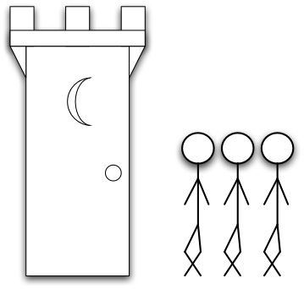


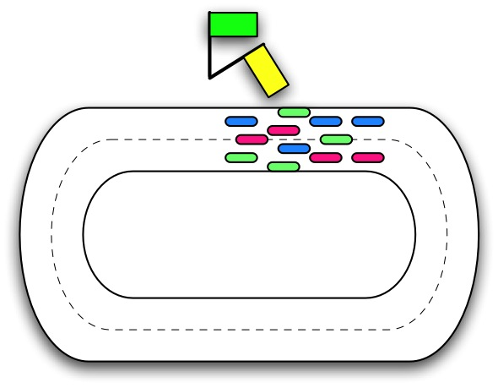



FutileStall
DuelingUpgrades
FriendlyFire
HTM Performance Pathologies
[ISCA 2007 & Top Picks]
RestartConvoy
StarvingWriter
SerializedCommit
StarvingElder

Slide 62
Transactional Latch Elision References
All HW Speculative Lock Elision (no TM)
  [Rajwar & Goodman, Micro 2001]
  TLR [Rajwar & Goodman, ASPLOS 2002]
  Rajwar [Wisconsin Ph.D. 2002]
TLE with Best-Effort HTM
  [Dice et al.TRANSACT 2008]
  Actual Rock TLE Macros in backup slides
  More general locking & critical section code written ONCE

Slide 63
TLE Acquire Macro
// ACQUIRE_ST: A *statement* -- acquire latch.
// LOCK_EXP: A boolean *expression* -- latch free or mine
#define TXLOCK_REGION_BEGIN(ACQUIRE_ST, LOCK_EXP){\
UINT64 __HTfailures = 0; \
bool __IhaveLock = false; \
while (!beginHT()) { \
__HTfailures++; \
if (__HTfailures >= MaxHTFailures) { \
__IhaveLock = true; \
ACQUIRE_ST; \
break; } \
while (!(LOCK_EXP)) ; } \
if (!(LOCK_EXP)) abortHT() ;
Source:
Dice et al.
Transact’08

Slide 64
TLE Release Macro
// RELEASE_ST: A *statement* -- release Latch.
#define TXLOCK_REGION_END(RELEASE_ST) \
if (!__IhaveLock) { \
commitHT(); \
} else { \
RELEASE_ST; \
} \
}
Source:
Dice et al.
Transact’08

