Slide 1
Lowering the Overhead of Nonblocking Software Transactional Memory
Virendra J. Marathe
Michael F. Spear
Christopher Heriot
Athul Acharya
David Eisenstat
William N. Scherer III
Michael L. Scott

Slide 2
Background
Hardware support for managed code STMs is a daunting task
C/C++ users need a fast nonblocking STM library
The larger community needs STM libraries that are free and unencumbered by license restrictions
RSTM: a fast, free, pthreads STM library

Slide 3
Outline
Reducing indirection
Limiting heap use
Fast, flexible conflict detection
Performance
Future work
Conclusions

Slide 4
Indirection Costs
Owner
State
Data
(old)
TMObject
Old
Descriptor
New
Data
(new)
Locator
Basic DSTM / ASTM / SXM organization
  Adds 2 levels of indirection
  Adds 3 pointer dereferences to access data
    Up to 4 cache misses to determine valid version

Slide 5
Reducing Indirection
Owner
State
Transaction Descriptor
readers
Old
Owner
Header
Data
(new)
never accessed
Old
Clean Bit
Data
(old)
Adds up to 2 levels of indirection
Adds up to 3 dereferences
  Unacquired objects: 1 dereference
  Committed owner: 2 dereferences
  Aborted owner: 3 dereferences
4 cache misses
only on dirty, aborted
owner

Slide 6
Reusing Heap Objects
Reference counting descriptors risks a cache miss on every decrement
At transaction end, RSTM cleans up all pointers to the descriptor
  If abort, install clean header pointing to old object
  If commit, install clean header pointing to new object
  Most headers will be in cache
  Appropriate data objects marked for lazy
  reclamation
Owner
State
readers
Old
Owner
Data
(new)
Old
Data
(old)

Slide 7
Preallocation
Initial read/write sets are fields in descriptor
  Dynamic allocation only if set > 64 items
Sets optimized for iteration
  Every method that may do a lookup also does a full validation
  Predict result of lookup, then verify it during the validation
  High locality during iteration
  Similar to McRT’s Sequential Store Buffers [PPoPP 06]
size
64 element array

Slide 8
Conflict Detection
“Eager” and “Lazy” acquire are straightforward
What about “Visible” readers?
  Saves validation overhead, allows writer-reader arbitration
  Typical implementation is as field in locator; visible reader list is modified atomically as part of header
    Increases heap use and takes time to get memory, construct locator, and CAS it in
Simpler solution via bitmap
  Limits # visible readers
  Allows (rare) spurious aborts
  No memory management required

Slide 9
RSTM Visible Readers
CAS
Read IDs
Get ReaderID
On open_RO(),
set bit
On commit/abort,
clear read bits
2n CAS instrs to
read n objects
T₁
COMMITTED
ACTIVE
?
2: avail
2: T₁
2
CAS
0
Owner
00000100
Old
00000000
Data
CAS
0
Owner
00100100
Old
00100000
Data
CAS
0
Owner
11000100
Old
11000000
Data

Slide 10
RSTM Performance
Tests conducted on 16-processor SunFire 6800
Always outperforms Java ASTM
C++ ASTM implementation shows that language is less important than metadata and conflict detection policy
No single conflict detection policy is best

Slide 11

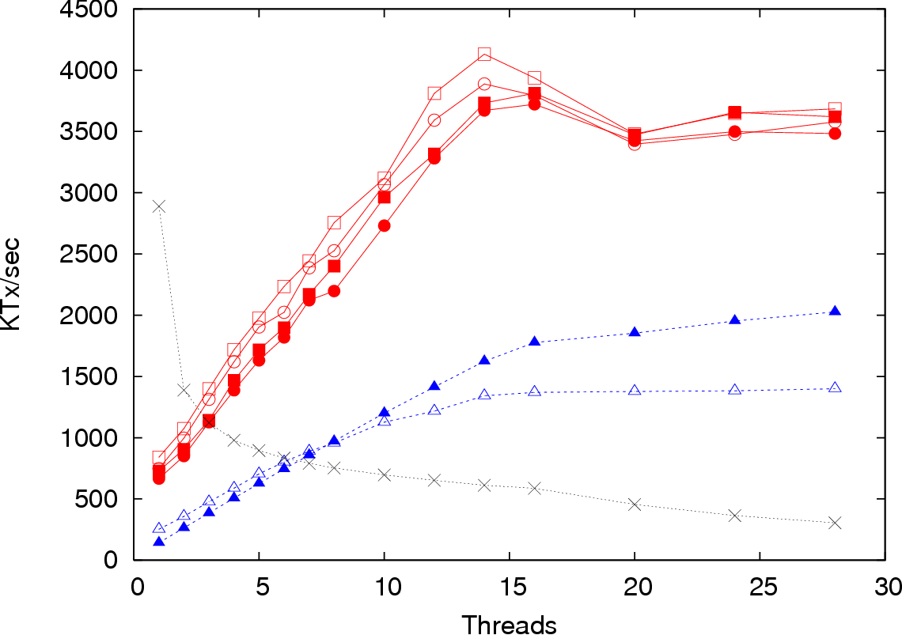
HashTable (embarrassingly parallel)
Java ASTM
C++ ASTM
RSTM VE
RSTM IE
RSTM IL
RSTM VL
CGL
Few conflicts == strategy doesn’t matter much
Metadata is the only difference between C++ ASTM and RSTM
Eager has slightly
less overhead

Slide 12
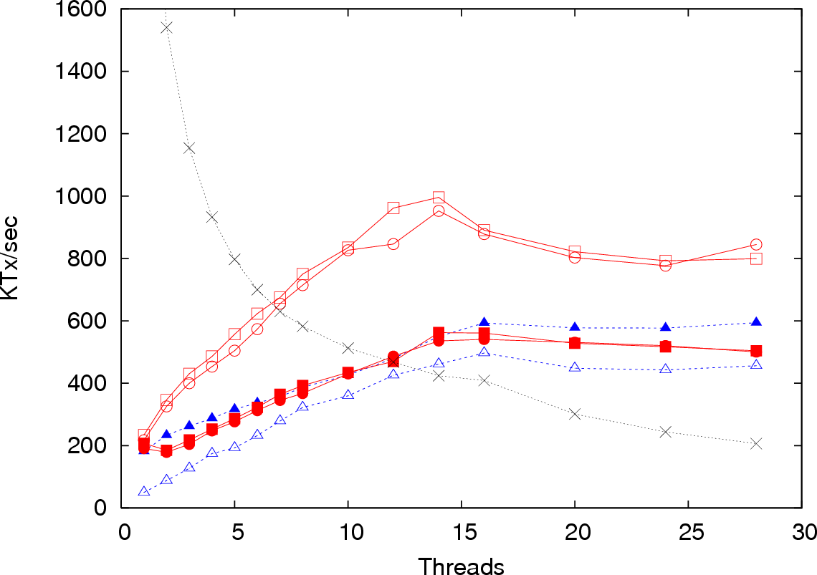
RBTree (some conflicts)
2500 @ 1 thread
Java ASTM
C++ ASTM
RSTM VE
RSTM IE
RSTM IL
RSTM VL
CGL
Visible reads force tree head to
bounce between cache lines

Slide 13
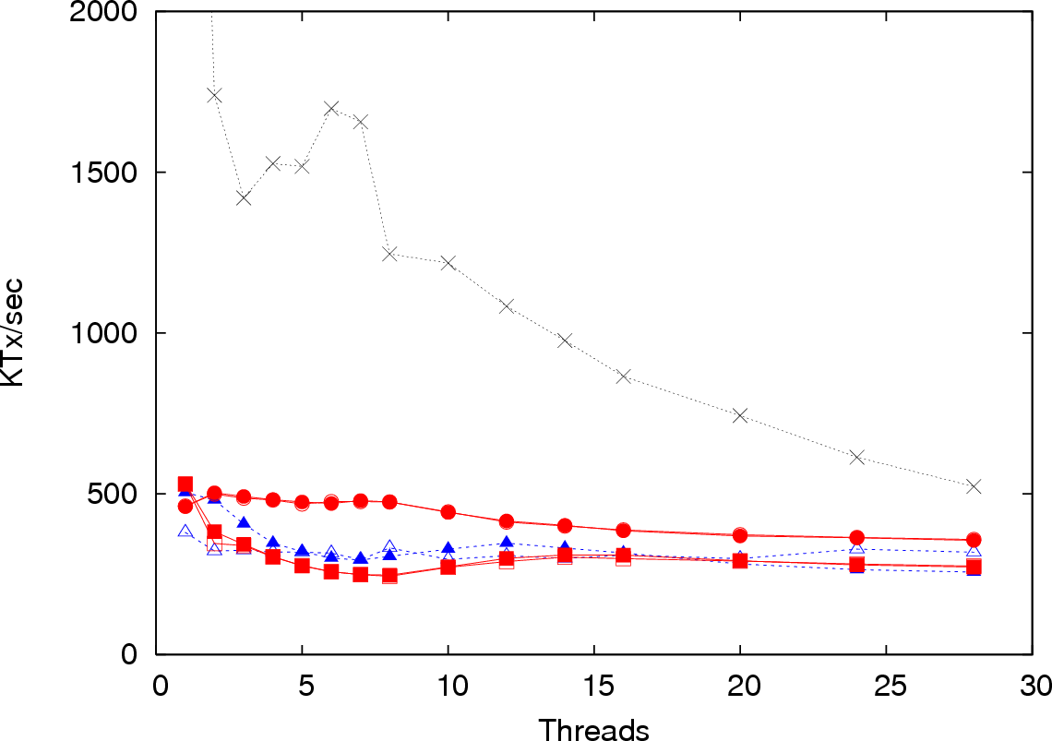
LFUCache (no parallelism)
4500 @ 1 thread
Java ASTM
C++ ASTM
RSTM VE
RSTM IE
RSTM IL
RSTM VL
CGL
No natural parallelism; Lazy
conflicts don’t impede progress

Slide 14
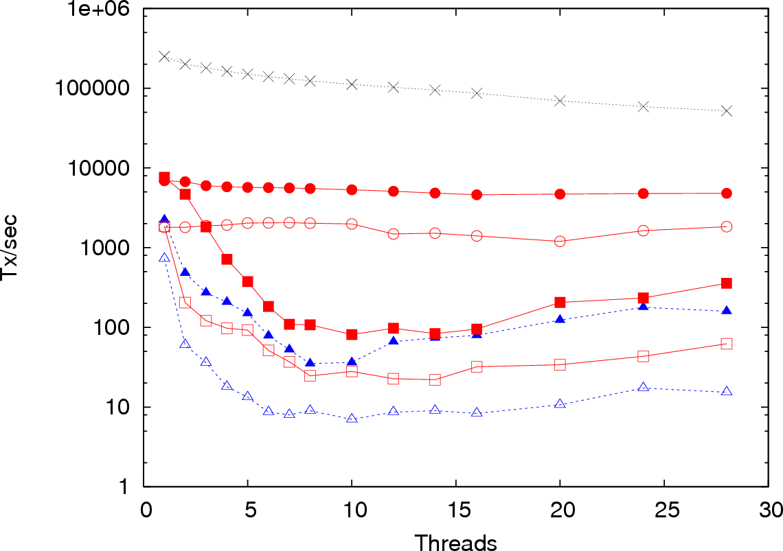
RandomGraph (torture test)
Java ASTM
C++ ASTM
RSTM VE
RSTM IE
RSTM IL
RSTM VL
CGL
Visible reads dramatically
reduce validation
Log scale, Tx/sec
Eager acquire
leads to livelock

Slide 15
Future Work
Adaptation between lazy and eager, visible and invisible
  Architectural implications…Intel Xeon, Sun Niagara have very different CAS overheads
Avoiding validation with heuristics
Mixed invalidation
Hardware assistance

Slide 16
Summary
Better metadata organization reduces cache misses
Limiting dynamic memory management helps
Conflict detection is workload dependent
Download RSTM for SPARC/Solaris at http://www.cs.rochester.edu/research/synchronization/rstm/
  (check back soon for x86/Linux version)

Slide 17
Supplemental Material

Slide 18
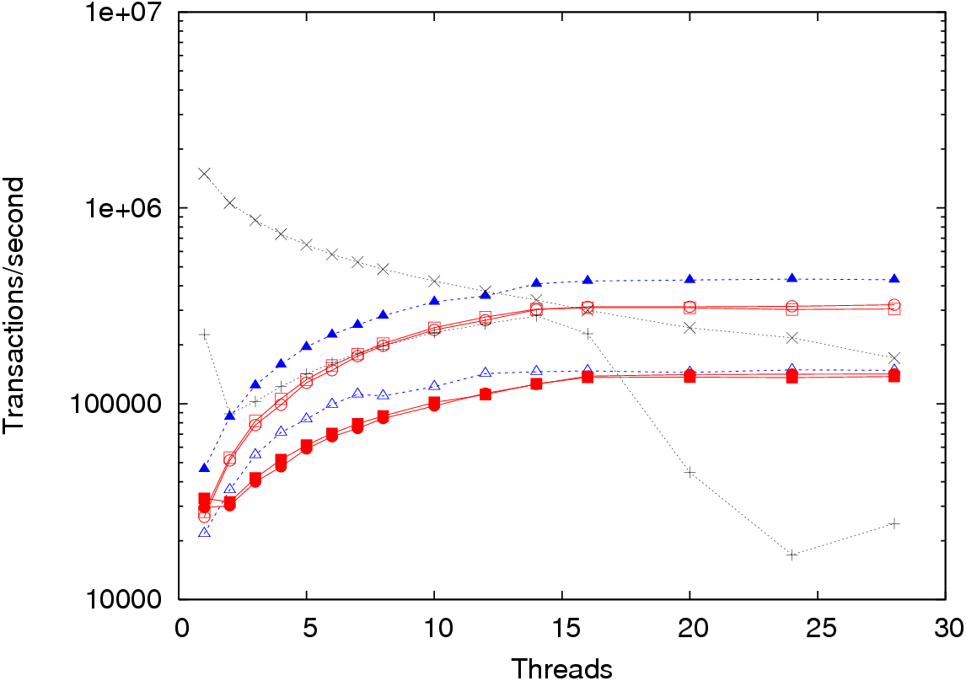
Linked List with Early Release
Java ASTM
C++ ASTM
RSTM VE
RSTM IE
RSTM IL
RSTM VL
CGL
FGL
FGL cache & preemption effects
C++ ASTM is best
(no writer cleanup)
Visible reads: 2 CASes
in rapid succession

