Slide 1
Transactional Locking II
Nir Shavit, Dave Dice and Ori Shalev
Scalable Synchronization Group
Sun Labs
Notes:
This is not the case of worm expert invited to talk about elephants…

Slide 2
Transactional Memory
[HerlihyMoss93]

Slide 3
The Brief History of STM
Soft Trans (Ananian, Rinard)
Meta Trans (Herlihy, Shavit)
T-Monitor (Jagannathan…)
Trans Support TM (Moir)
AtomJava (Hindman…)
WSTM (Fraser, Harris)
OSTM (Fraser, Harris)
Lock-OSTM (Ennals)
STM (Shavit,Touitou)
ASTM (Marathe et al)
DSTM (Herlihy et al)
McTM (Saha et al)
HybridTM (Moir)
TL (Dice, Shavit))
2005
1993
2005
2005
2006
1997
2003
2003
2003
2004
2004
2004
2004
2004
Lock-free
Obstruction-free
Lock-based

Slide 4
As Good As Fine Grained
Postulate (i.e. take it or leave it):
If we could implement fine-grained locking with the same simplicity of course grained, we would never think of building a transactional memory.
Implication:
Lets try to provide TMs that get as close as possible to hand-crafted fine-grained locking.
Notes:
We have a long way top go but in some cases are starting to do well…

Slide 5
Premise of Lock-based STMs
Performance: ballpark fine grained
Memory Lifecycle: work with GC or any malloc/free
Hardware➔Software: support voluptuous transactions
Safety: need to work on coherent state
Unfortunately: OSTM, HyTM, Ennals, Saha, AtomJava deliver only 1 and 3 (in some cases)…

Slide 6

Transactional Locking
TL2 Delivers all four
properties
How? use what we learned…
- Unlike all prior algs: use
  Commit time locking instead
  of Encounter order locking
  - Introduce a Global Version Clock
  mechanism for validation

Slide 7
Locking STM Design Choices
Map
Array of Versioned-
Write-Locks
Application
Memory
V#
PS = Lock per Stripe (separate array of locks)
PO = Lock per Object
(embedded in object)

Slide 8
Encounter Order Locking (Undo Log)
[Ennals,Saha,Harris,…]
Mem Locks
V# 0
V# 0
V# 0
V# 0
To Read: load lock + location
Check unlocked add to Read-Set
To Write: lock location, store value
Add old value to undo-set
Validate read-set v#’s unchanged
Release each lock with v#+1
V#+1 0
X
V#+1 0
V# 0
X
V# 1
V# 0
V# 0
Y
V#+1 0
V#+1 0
V# 0
Y
V# 1
V# 0
V# 0
V# 0
V# 0
V# 0
V# 0
V# 0
V# 0
V# 0
V# 0
Quick read of values freshly
written by the reading transaction

Slide 9
Commit Time Locking (Write Buff)
Mem Locks
[TL,TL2]
V# 0
V# 0
V# 0
V# 0
To Read: load lock + location
Location in write-set? (Bloom Filter)
Check unlocked add to Read-Set
To Write: add value to write set
Acquire Locks
Validate read/write v#’s unchanged
Release each lock with v#+1
X
V#+1 0
X
V# 1
V# 1
V#+1 0
V# 0
V# 0
V# 0
V# 0
Y
V#+1 0
Y
V# 0
V#+1 0
V# 1
V# 1
V#+1 0
V# 0
V# 0
V# 0
V# 0
V# 0
V# 0
V# 0
V# 0
V# 0
V# 0
V# 0
Hold locks for very short duration

Slide 10
Why COM and not ENC?
Under low load they perform pretty much the same.
COM withstands high loads (small structures or high write %). ENC does not withstand high loads.
COM works seamlessly with Malloc/Free. ENC does not work with Malloc/Free.

Slide 11
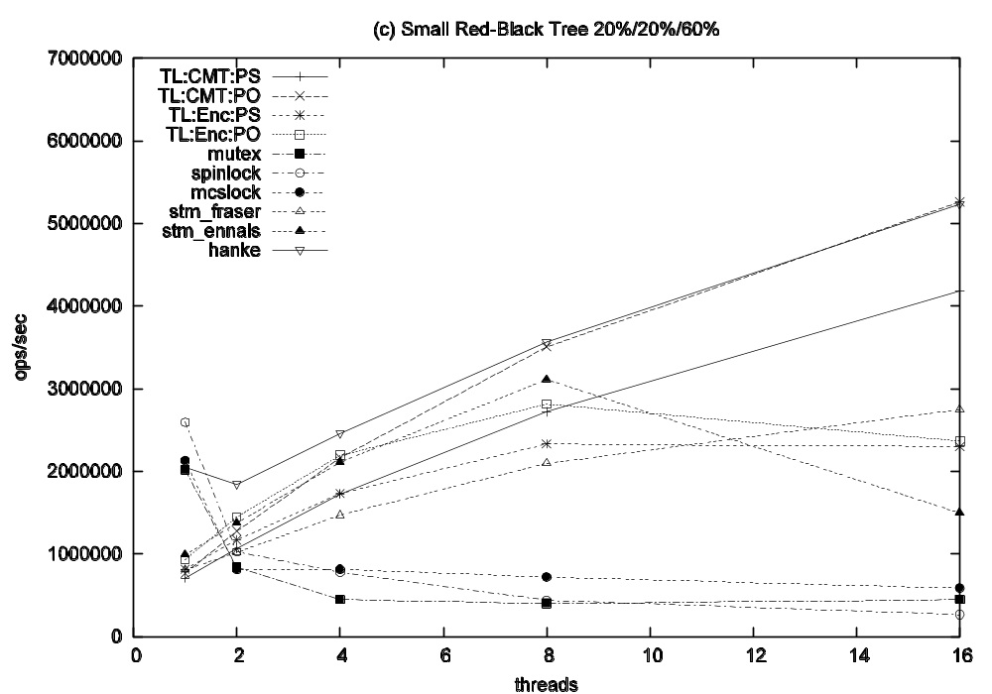
COM vs. ENC High Load
Red-Black Tree 20% Delete 20% Update 60% Lookup
Hand
COM
ENC
MCS
Notes:
Holding locks long exposes COM to contention. Order of magnitude faster than MCS lock

Slide 12
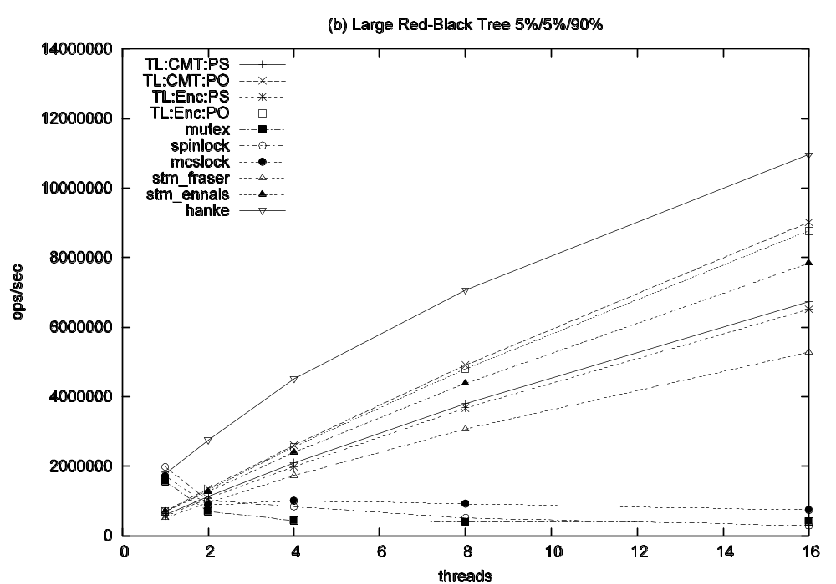
COM vs. ENC Low Load
Red-Black Tree 5% Delete 5% Update 90% Lookup
Hand
COM
ENC
MCS
Notes:
Hanke 10-12 times faster than lock

Slide 13
COM: Works with Malloc/Free
A
PS Lock Array
B
X
V#
FAILS
IF INCONSISTENT
VALIDATE
To free B from transactional space:
Wait till its lock is free.
Free(B)
B is never written inconsistently because any write is preceded by a validation while holding lock

Slide 14
ENC: Fails with Malloc/Free
A
PS Lock Array
B
X
V#
VALIDATE
Cannot free B from transactional space because undo-log means locations are written after every lock acquisition and before validation.
Possible solution: validate after every lock acquisition (yuck)

Slide 15
Problem: Application Safety
All current lock based STMs work on inconsistent states.
They must introduce validation into user code at fixed intervals or loops, use traps, OS support,…
And still there are cases, however rare, where an error could occur in user code…

Slide 16
Solution: TL2’s “Version Clock”
Have one shared global version clock
Incremented by (small subset of) writing transactions
Read by all transactions
Used to validate that state worked on is always consistent
Later: how we learned not to worry
about contention and love the clock

Slide 17
Version Clock: Read-Only COM Trans
Mem Locks
100
VClock
87 0
87 0
87 0
87 0
RV ← VClock
On Read: read lock, read mem, read lock: check unlocked, unchanged, and v# <= RV
Commit.
34 0
34 0
34 0
34 0
88 0
88 0
99 0
99 0
99 0
99 0
V# 0
V# 0
44 0
44 0
Reads form a snapshot of memory.
No read set!
50 0
50 0
50 0
50 0
V# 0
V# 0
100
RV

Slide 18
Version Clock: Writing COM Trans
100
120
121
100
VClock
Mem Locks
87 0
87 0
87 0
87 0
87 0
RV ← VClock
On Read/Write: check unlocked and v# <= RV then add to Read/Write-Set
Acquire Locks
WV = F&I(VClock)
Validate each v# <= RV
Release locks with v# ← WV
X
121 0
X
34 0
34 0
34 1
121 0
34 0
88 0
88 0
121 0
Y
V# 0
Y
99 0
99 0
99 0
99 1
121 0
44 0
44 0
50 0
V# 0
50 0
V# 0
50 0
50 0
50 0
Reads+Inc+Writes
=Linearizable
100
Commit
RV

Slide 19
Version Clock Implementation
On sys-on-chip like Sun T2000™ Niagara: almost no contention, just CAS and be happy
On others: add TID to VClock, if VClock has changed since last write can use new value +TID. Reduces contention by a factor of N.
Future: Coherent Hardware VClock that guarantees unique tick per access.

Slide 20
Performance Benchmarks
Mechanically Transformed Sequential Red-Black Tree using TL2
Compare to STMs and hand-crafted fine-grained Red-Black implementation
On a 16–way Sun Fire™ running Solaris™ 10

Slide 21
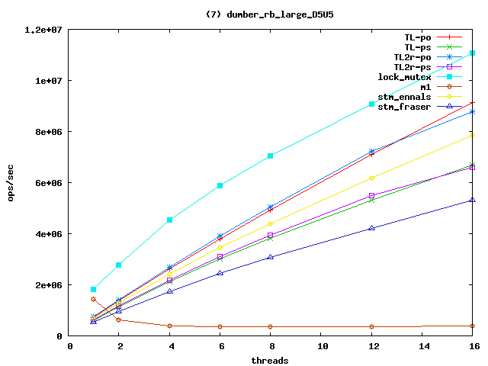
Uncontended Large Red-Black Tree
Hand-crafted
5% Delete 5% Update 90% Lookup
TL/PO TL2/P0
Ennals
TL/PS
TL2/PS
FarserHarris
Lock-free

Slide 22
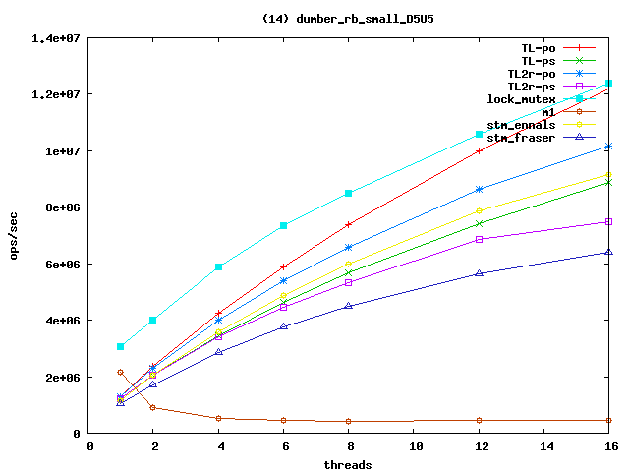
Uncontended Small RB-Tree
5% Delete 5% Update 90% Lookup
TL/P0
TL2/P0

Slide 23
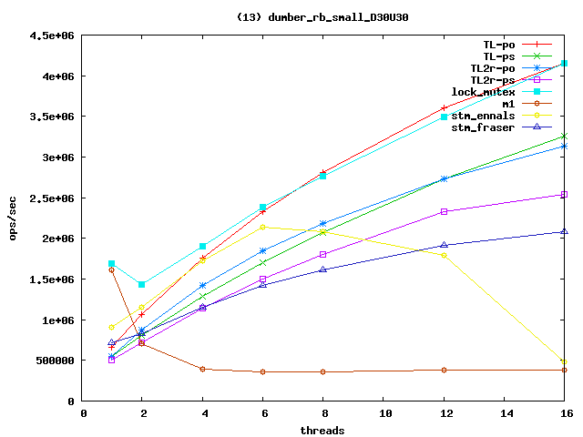
Contended Small RB-Tree
30% Delete 30% Update 40% Lookup
TL/P0
TL2/P0
Ennals

Slide 24
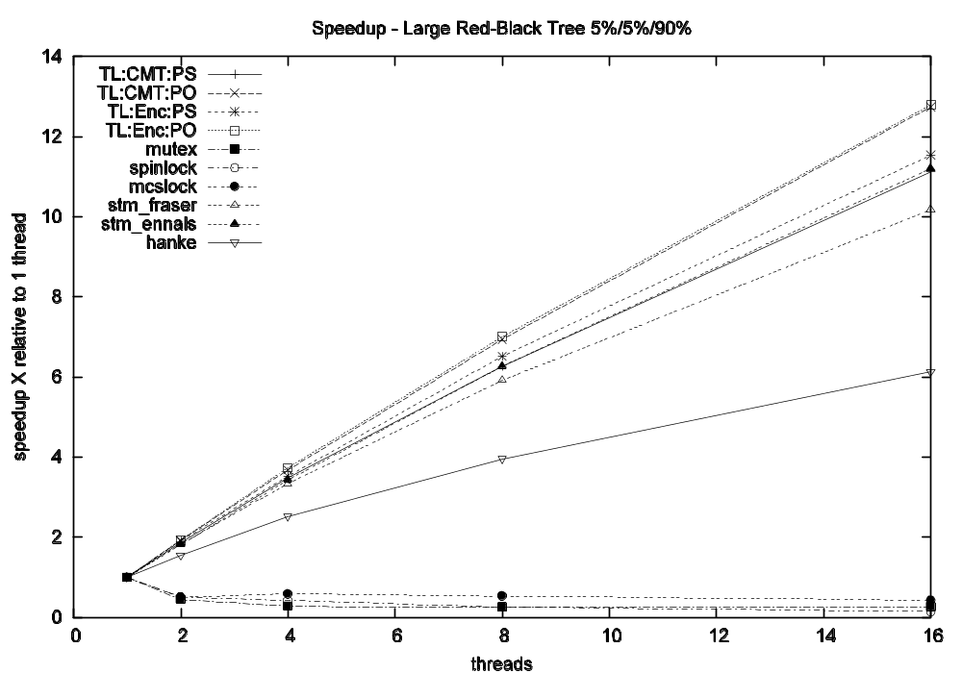
Speedup: Normalized Throughput
Large RB-Tree 5% Delete 5% Update 90% Lookup
TL/PO
Hand-
Crafted

Slide 25
Overhead Overhead Overhead
STM scalability is as good if not better than hand-crafted, but overheads are much higher
Overhead is the dominant performance factor – bodes well for HTM
Read set and validation cost (not locking cost) dominates performance

Slide 26
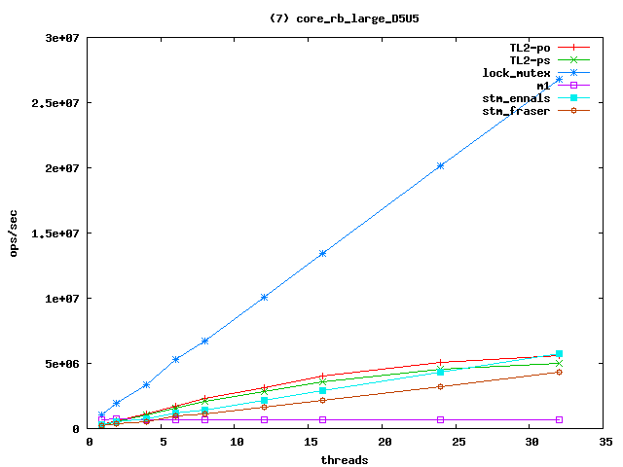
On Sun T2000™ (Niagara): maybe a long way to go…
Hand-crafted
RB-tree 5% Delete 5% Update 90% Lookup
STMs
Notes:
Niagara delivers 3 times the throughput of SunFire with half the processors and cost a factor of 10 less.
This is only a 1st generation machine, so the number of instructions on cvomputation path is dominant and

Slide 27
Conclusions
COM time locking, implemented efficiently, has clear advantages over ENC order locking:
  No meltdown under contention
  Seamless operation with malloc/free
VCounter can guarantee safety so we
  don’t need to embed repeated validation in user code

Slide 28
What Next?
Further improve performance
TL2 library available shortly
Mechanical code transformation tool…
Cut read-set and validation overhead, maybe with hardware support?
Add hardware VClock to Sys-on-chip.

Slide 29
Thank You

