Slide 1

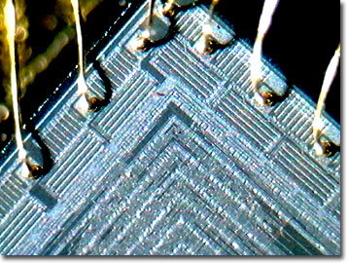
Higher Order Combinators for Join Patterns using STM
Satnam Singh, Microsoft
TRANSACT 2006

Slide 2

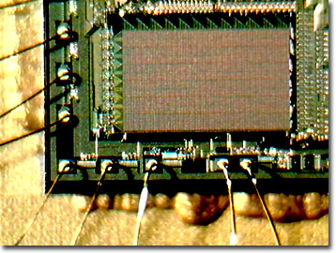
Overview
Specifically: encoding an existing concurrency idiom with STM
    very straightforward
    nothing clever
More generally: what kind of existing idioms can we sensibly encode with STM?
  Or should we not bother?
Notes:
We want to try and understand how to write applications for future processing architectures which comprise of multiple processing elements on one die. How can Word or Excel run better or faster by taking advantage of the available computing resource? How can XML serialization or decryption happen faster by trying to map any inherent concurrency in algorithms to available computing resources?
We de not propose to design new multiprocessing architectures with a view to turning them into products: that is a research project and we should be incubating. We shall take existing architectural elements and software techniques and combine them together to help us build and instrument and analyze complete systems for which we will try and flesh out the philosophy of loosely coupled systems to the point where we can show how a product team could follow such an approach.
Any hardware we do build will be as a test platform to help us imagine and simulate future platforms made by hardware vendors like Intel.

Slide 3
Cω Concurrency
Objects have both synchronous and asynchronous methods
Values are passed by ordinary method calls:
  If the method is synchronous, the caller blocks until the method returns some result (as usual)
  If the method is async, the call completes at once and returns void
A class defines a collection of chords (synchronization patterns), which define what happens once a particular set of methods have been invoked. One method may appear in several chords.
  When pending method calls match a pattern, its body runs.
  If there is no match, the invocations are queued up.
  If there are several matches, an unspecified pattern is selected.
  If a pattern containing only async methods fires, the body runs in a new thread.

Slide 4
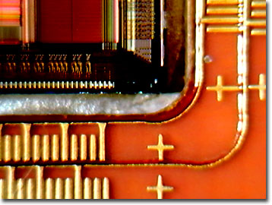
Cω asynchronous methods
using System ;
public class MainProgram
{ public class ArraySummer
{ public async sumArray (int[] intArray)
{ int sum = 0 ;
foreach (int value in intArray)
sum += value ;
Console.WriteLine ("Sum = " + sum) ;
}
}
static void Main()
{ Summer = new ArraySummer () ;
Summer.sumArray (new int[] {1, 0, 6, 6, 1, 9, 6, 6}) ;
Summer.sumArray (new int[] {3, 1, 4, 1, 5, 9, 2, 6}) ;
Console.WriteLine ("Main method done.") ;
}
}

Slide 5
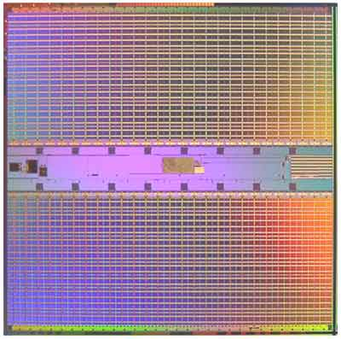
Cω chords
using System ;
public class MainProgram
{ public class Buffer
{ public async Put (int value) ;
public int Get () & Put(int value)
{ return value ; }
}
static void Main()
{ buf = new Buffer () ;
buf.Put (42) ;
buf.Put (66) ;
Console.WriteLine (buf.Get() + " " + buf.Get()) ;
}
}

Slide 6
Reader/Writer Locks
public class ReaderWriter {
private async idle();
private async s(int n);
public ReaderWriter() {idle();}
public void Exclusive() & idle() {}
public void ReleaseExclusive() { idle(); }
public void Shared() & idle() { s(1);}
& s(int n) { s(n+1);}
public void ReleaseShared() & s(int n) {
if (n == 1) idle(); else s(n-1);
}
}

Slide 7
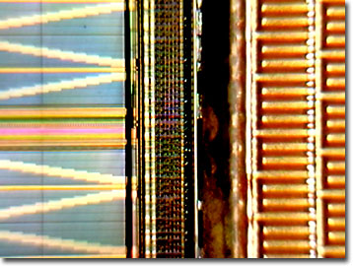
“STM”s in Haskell
-- Running STM computations
atomically :: STM a -> IO a
retry :: STM a
orElse :: STM a -> STM a -> STM a
-- Transactional variables
data TVar a
newTVar :: a -> STM (TVar a)
readTVar :: TVar a -> STM a
writeTVar :: TVar a -> a -> STM ()
newTChan :: STM (TChan a)
writeTChan :: a -> TChan a -> STM ()
readTChan :: TChan a -> STM a

Slide 8
Haskell Crash Course
add :: Int -> Int -> Int
add a b = a + b
add 2 4 = 6
2 `add` 4 = 6
(&) a b = a + b
2 & 4 = 6

Slide 9
Haskell Crash Course
inc :: Int -> Int
inc x = x + 1
twice :: (Int -> Int) -> Int -> Int
twice f v = f (f v)
twice (inc) 6
twice (\ x -> x + 1) 6

Slide 10
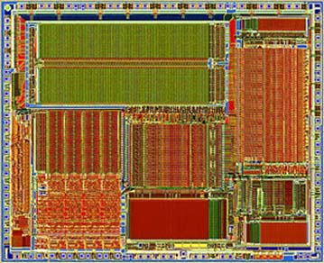
One-Shot Synchronous Join
(&) :: TChan a -> TChan b -> STM (a, b)
(&) chan1 chan2
= do a <- readTChan chan1
b <- readTChan chan2
return (a, b)
(>>>) :: STM a -> (a -> IO b) -> IO b
(>>>) joinPattern handler
= do results <- atomically joinPattern
handler results
example chan1 chan2
= chan1 & chan2 >>>
\ (a, b) -> putStrLn (show (a, b))

Slide 11
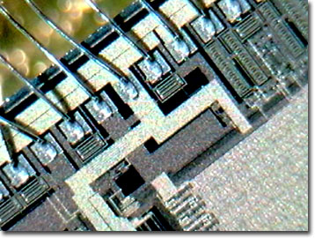
Repeating Asynchronous Join
(>!>) :: STM a -> (a -> IO ()) -> IO ()
(>!>) joins cont
= do forkIO (asyncJoinLoop joins cont)
return () -- discard thread ID
asyncJoinLoop :: (STM a) -> (a -> IO ()) -> IO ()
asyncJoinLoop joinPattern handler
= do joinPattern >>> forkIO . handler
asyncJoinLoop joinPattern handler
example chan1 chan2
= chan1 & chan2 >!>
\ (a, b) -> putStrLn (show ((a, b)))

Slide 12
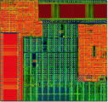
Exploiting Overloading
class Joinable t1 t2 where
(&) :: t1 a -> t2 b -> STM (a, b)
instance Joinable TChan TChan where
(&) = join2
instance Joinable TChan STM where
(&) = join2b
instance Joinable STM TChan where
(&) a b = do (x,y) <- join2b b a
return (y, x)
chan1 & chan2 & chan3 >>>
\ ((a, b), c) -> putStrLn (show (a,b,c))

Slide 13
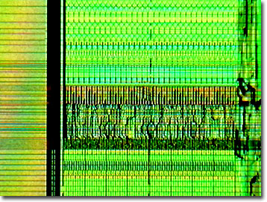
Biased Synchronous Choice
(|+|) :: (STM a, a -> IO c) ->
(STM b, b -> IO c) ->
IO c
(|+|) (joina, action1) (joinb, action2)
= do io <- atomically
(do a <- joina
return (action1 a)
`orElse`
do b <- joinb
return (action2 b))
io
(chan1 & chan2 & chan3,
\ ((a,b),c) -> putStrLn (show (a,b,c)))
|+|
(chan1 & chan2,
\ (a,b) -> putStrLn (show (a,b)))

Slide 14
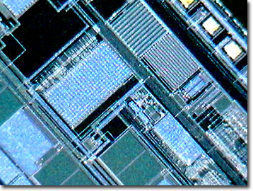
Conditional Joins
(??) :: TChan a -> (a -> Bool) -> STM a
(??) chan predicate
= do value <- readTChan chan
if predicate value then
return value
else
retry
(chan1 ?? \x -> x > 3) & chan2 >>>
\ (a, b) -> putStrLn (show (a, b))

Slide 15
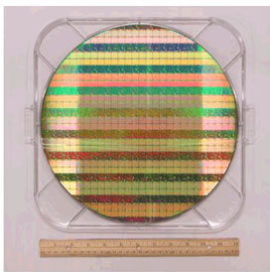
Dynamic Joins
example numSensors numSensors chan1 chan2 chan3
= if numSensors = 2 then
chan1 & chan2 >!> \ (a, b) ->
putStrLn (show ((a, b)))
else
chan1 & chan2 & chan3 >!> \ (a, (b, c))
-> putStrLn (show ((a, b, c)))

Slide 16
Transacted Handlers
(>%>) :: STM a -> (a -> STM b) -> IO b
(>%>) joinPattern handler
= atomically (do results <- joinPattern
handler results)

Slide 17
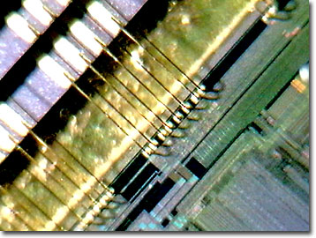
Non-Blocking Variants
nonBlockingJoin :: STM a ->
STM (Maybe a)
nonBlockingJoin pattern
= (do result <- pattern
return (Just result))
`orElse`
(return Nothing)

Slide 18
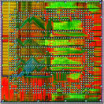
Summary and Questions
Straightforward encoding of Cω join patterns using STM.
Higher order combinators in Haskell act as powerful “glue”.
Model for understanding join patterns in terms of STMs.
A good literal implementation (?)
  Parallel execution?
Joins as statements instead of declarations.
Q: What other concurrency idioms can be nicely modeled by STM with retry and orElse?

Slide 19

Puzzle
main :: IO ()
main
= do chan1 <- atomically $ newTChan
atomically $ writeTChan chan1 42
atomically $ writeTChan chan1 74
chan1 & chan1 >>>
\ (a, b) -> putStrLn (show (a,b))
Notes:
Benchmarks
The empirical basis for comparison is provided by six benchmark programs described below. TAM-level dynamic instruction distributions are collected by running an instrumented version of the program on the CM-5. The translator inserts in-line code to record roughly a hundred specific statistics on each processor, which are combined at the end of the program. These are grouped into the basic instruction categories. ALU includes integer and floating-point arithmetic, messages includes instructions executed to handle messages, heap includes global I-structure and M-structure accesses, and control represents all control-flow instructions including moves to initialize synchronization counters.
Six benchmark programs ranging from 50 to 1,100 lines are used. QS is a simple quick-sort using accumulation lists. The input is a list of random numbers. Gamteb is a Monte Carlo neutron transport code [6]. It is highly recursive with many conditionals. Paraffins [3] enumerates the distinct isomers of paraffins. Simple is a hydrodynamics and heat conduction code widely used as an application benchmark rewritten in Id90 [7, 2]. Speech determines cepstral coefficients for speech processing. MMT is a simple matrix operation test using 4x4 blocks; two double precision identity matrices are created, multiplied, and subtracted from a third.

Slide 20
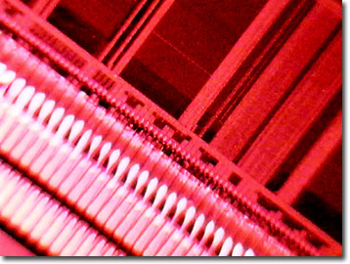
Conditional Joins
(?) :: TChan a -> Bool -> STM a
(?) chan predicate
= if predicate then
readTChan chan
else
retry
(chan1 ? cond) & chan2 >>>
\ (a, b) -> putStrLn (show (a, b))

Slide 21
Conditional Joins
(?) :: TChan a -> STM Bool -> STM a
(?) chan predicate
= do cond <- predicate
if cond then
readTChan chan
else
retry

Slide 22
The Buffer Over Time
Producer
Thread
Buffer b
Consumer
Thread
b.get();
b.put(“a”);
put(“a”)
Time
b.get()& put(“a”){
return “a”;
}
b.put(“b”);
b.put(“c”);
put(“b”)
put(“b”),put(“c”)
put(“b”),put(“c)
b.get()& put(“b”){
return “b”;
}
put(“c”)

Slide 23

Backup

Slide 24
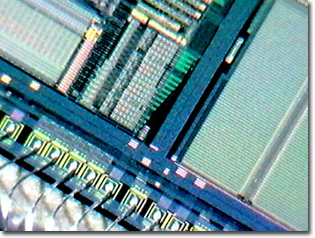
Backup

