Slide 1
X10: Computing at scale
Vijay Saraswat
July 24, 2006
IBM Research

Slide 2
What?
Context and overview
The X10 Programming Model
Programming in X10
Research topics

Slide 3
Acknowledgments
X10 Core Team
  Rajkishore Barik
  Chris Donawa
  Allan Kielstra
  Igor Peshansky
  Christoph von Praun
  Vijay Saraswat
  Vivek Sarkar
  Tong Wen
X10 Tools
  Philippe Charles
  Julian Dolby
  Robert Fuhrer
  Frank Tip
  Mandana Vaziri
Emeritus
  Kemal Ebcioglu
  Christian Grothoff
Research colleagues
  R. Bodik, G. Gao, R. Jagadeesan, J. Palsberg, R. Rabbah, J. Vitek
  Several others at IBM
Recent Publications
"X10: An Object-Oriented Approach to Non-Uniform Cluster Computing", P. Charles, C. Donawa, K. Ebcioglu, C. Grothoff, A. Kielstra, C. von Praun, V. Saraswat, V. Sarkar. OOPSLA conference, October 2005.
"Concurrent Clustered Programming", V. Saraswat, R. Jagadeesan. CONCUR conference, August 2005.
"An Experiment in Measuring the Productivity of Three Parallel Programming Languages”, K. Ebcioglu, V. Sarkar, T. El-Ghazawi, J. Urbanic. P-PHEC workshop, February 2006.
"X10: an Experimental Language for High Productivity Programming of Scalable Systems", K. Ebcioglu, V. Sarkar, V. Saraswat. P-PHEC workshop, February 2005.
Upcoming tutorials
PACT 2006, OOPSLA 2006

Slide 4
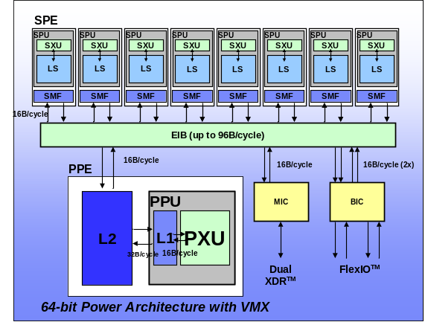
A new Era of Mainstream Parallel Processing
The Challenge:
Parallelism scaling replaces frequency scaling as foundation for
increased performance ➔ Profound impact on future software
Multi-core chips
Heterogeneous Parallelism
Cluster Parallelism
SMP Node
SMP Node
. . .
. . .
. . .
PEs,
L1 $
PEs,
L1 $
. . .
. . .
PEs,
PEs,
PEs,
PEs,
L2 Cache
. . .
. . .
PEs,
L1 $
PEs,
L1 $
Memory
Memory
L2 Cache
Interconnect
Our response:
Use X10 as a new language for parallel hardware that builds on
existing tools, compilers, runtimes, virtual machines and libraries
Notes:
Contacts: Vivek Sarkar/Watson/IBM, Vijay Saraswat/Watson/IBM
Parallelism scaling replaces frequency scaling as the foundation for increased performance. Parallelism scaling can be observed at three important levels of the hardware stack:
Multi-core parallelism
Hetreogeneous parallelism (as in the Cell processor)
Cluster parallelism as in Blue Gene or in commodity scale-out clusters
The move towards parallelism as the primary driver for system performance will have a profound software impact on software, because all software will need to be enabled to exploit parallelism. Some areas of commercial software (e.g. transaction systems) are already prepared for this trend from past investments in SMP-enablement. However, a lot of other software is predominantly single-threaded has been riding the frequency scaling curve predicted by Moore’s Law for the last two decades. The goal of the X10 project in IBM Research is to respond to this future software crisis by establishing new foundations for programming models, languages, tools, compilers, runtimes, virtual machines, and libraries for parallel hardware.

Slide 5
The X10 Programming Model
Support for productivity
  Axiom: Exploit proven OO benefits (productivity, maintenance, portability benefits).
  Axiom: Rule out large classes of errors by design (Type safe, Memory safe, Pointer safe, Lock safe, Clock safe …)
  Axiom: Support incremental introduction of explicit place types/remote operations.
  Axiom: Itegrate with static tools (Eclipse) -- flag performance problems, refactor code, detect races.
  Axiom: Support automatic static and dynamic optimization (CPO).
Support for scalability
  Axiom: Provide constructs to deal with non-uniformity of access.
  Axiom: Build on asynchrony. (To support efficient overlap of computation and communication.)
  Axiom: Use scalable synchronization constructs.
  Axiom: Permit programmer to specify aggregate operations.

Slide 6
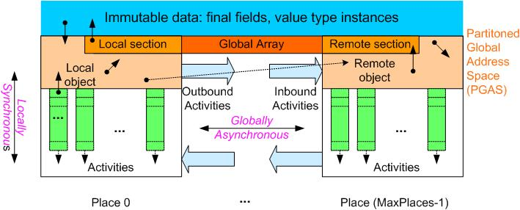
The X10 Programming Model
Place = collection of resident
activities & objects
Storage classes
Immutable Data
PGAS
  Local Heap
  Remote Heap
Activity Local
Locality Rule
Any access to a mutable
datum must be performed by a
local activity ➔ remote data
accesses can be performed by
creating remote activities
Ordering Constraints (Memory Model)
Locally Synchronous:
Guaranteed coherence for local heap ➔
Sequential consistency
Globally Asynchronous:
No ordering of inter-place activities ➔
use explicit synchronization for coherence
Few concepts, done right.

Slide 7
Sequential X10
Classes and interfaces
  Fields, Methods, Constructors
  Encapsulated state
  Single inheritance
  Multiple interfaces
  Nested/Inner/Anon classes
Static typing
Objects, GC
Statements
  Conditionals, assignment,…
  Exceptions (but relaxed)
Not included
  Dynamic linking
  User-definable class loaders
Changes
  Value types
  Aggregate data/operations
  Space: Distribution
  Time: Concurrency
Changes planned
  Generics
  FP support
Shared underlying philosophy: shared syntactic and semantic tradition, simple, small, easy to use, efficient to implement, machine independent

Slide 8
X10 v0.41 Cheat Sheet
Stm:
async [ ( Place ) ] [clocked ClockList ] Stm
when ( SimpleExpr ) Stm
finish Stm
next; c.resume() c.drop()
for( i : Region ) Stm
foreach ( i : Region ) Stm
ateach ( I : Distribution ) Stm
Expr:
ArrayExpr
ClassModifier : Kind
MethodModifier: atomic
DataType:
ClassName | InterfaceName | ArrayType
nullable DataType
future DataType
Kind :
value | reference
x10.lang has the following classes (among others)
point, range, region, distribution, clock, array
Some of these are supported by special syntax.
Forthcoming support: closures, generics, dependent types.

Slide 9
X10 v0.41 Cheat Sheet: Array support
ArrayExpr:
new ArrayType ( Formal ) { Stm }
Distribution Expr -- Lifting
ArrayExpr [ Region ] -- Section
ArrayExpr | Distribution -- Restriction
ArrayExpr || ArrayExpr -- Union
ArrayExpr.overlay(ArrayExpr) -- Update
ArrayExpr. scan( [fun [, ArgList] )
ArrayExpr. reduce( [fun [, ArgList] )
ArrayExpr.lift( [fun [, ArgList] )
ArrayType:
Type [Kind] [ ]
Type [Kind] [ region(N) ]
Type [Kind] [ Region ]
Type [Kind] [ Distribution ]
Region:
Expr : Expr -- 1-D region
[ Range, …, Range ] -- Multidimensional Region
Region && Region -- Intersection
Region || Region -- Union
Region – Region -- Set difference
BuiltinRegion
Dist:
Region -> Place -- Constant Distribution
Distribution | Place -- Restriction
Distribution | Region -- Restriction
Distribution || Distribution -- Union
Distribution – Distribution -- Set difference
Distribution.overlay ( Distribution )
BuiltinDistribution
Language supports type safety, memory safety, place safety, clock safety.

Slide 10
Hello, World!
public class HelloWorld {
public static void main(String[] args) {
System.out.println("Hello, world!");
}
}
public class HelloWorld2 {
public static void main(String[] args) {
finish foreach(point [p] : [1:10])
System.out.println("Hello, world from async " + p + "!");
}
}

Slide 11
Value types : immutable instances
Value class
  Can only extend value class or x10.lang.Object.
  Have only final fields
  Can only be extended by value classes.
  May contain fields at reference type.
  May be implemented by reference or copy.
Two values are equal if their corresponding fields are equal.
nullable _ provided as a type constructor.
public value complex {
double im, re;
public complex(double im,
double re) {
this.im = im; this.re = re;
}
public complex add(complex a) {
return new complex(im+a.im,
re+a.re);
} … }

Slide 12
async, finish
async PlaceExpressionSingleListopt Statement
Statement ::= finish Statement
async (P) S
  Parent activity creates a new child activity at place P, to execute statement S; returns immediately.
  S may reference final variables in enclosing blocks.
finish S
  Execute S, but wait until all (transitively) spawned async’s have terminated.
  Trap all exceptions thrown by spawned activities, throw aggregate exception when all activities terminate.
  double[D] A =…; // Global dist. array
  final int k = …;
  async ( A.distribution[99] ) {
  // Executed at A[99]’s place
  atomic A[99] = k;
  }
finish ateach (point [i]:A) A[i] = i;
finish async (A.distribution[j]) A[j] = 2;
// All A[i]=I will complete before A[j]=2
cf Cilk’s spawn, sync

Slide 13
atomic, when
Statement ::= atomic Statement
MethodModifier ::= atomic
Statement ::= WhenStatement
WhenStatement ::= when ( Expression ) Statement
Atomic blocks are
  Executed in a single step, conceptually, while other activities are suspended.
An atomic block may not
  Block
  Access remote data.
  Create activities.
  Contain a conditional block.
Essentially, body is a bounded, sequential, non-blocking activity
  Hence executing in a single place.
Conditional atomic blocks
  Activity suspends until a state in which guard is true; in that state it executes body atomically.
Body has same restructions as unconditional atomic block.
await(e)=def=when(e);
X10 does not assume retry semantics for atomics.
X10 has only one synchronization construct: conditional atomic block.

Slide 14
Atomic blocks simplify parallel programming
No explicit locking
  No need to worry about lock management details: What to lock, in what order to lock.
No underlocking/overlocking issues.
No need for explicit consistency management
  No need to carry mapping between locks and data in your head.
System can manage locks and consistency better than user
Enhanced performance scalability
  X10 distinguishes intra-place atomics from inter-place atomics.
  Appropriate hardware design (e.g. conflict detection) can improve performance.
Enhanced analyzability
  First class programming construct
Enhanced debuggability
  Easier to understand data races with atomic blocks than with critical sections/synchronization blocks

Slide 15
Aside: Memory Model
X10 v 0.41 specifies sequential consistency per place.
We are considering a weaker memory model.
Built on the notion of atomic: identify a step as the basic building block.
A process is a pomset of steps closed under certain transformations:
  Composition
  Decomposition
  Augmentation
  Linking
There may be opportunity for a weak notion of atomic: decouple atomicity from ordering.

Slide 16
Bounded buffer
class OneBuffer {
nulable Object datum = null;
public void send( Object v) {
when (datum == null) {
datum = v;
}
}
public Object receive() {
when (datum != null) {
Object v = (Object) datum;
datum = null;
return v;
}
}
}

Slide 17
Atomic examples: future
class Latch implements future {
boolean forced = false;
nullable boxed result = null;
nullable exception z = null;
atomic boolean set( nullable Object val ) {
return set( val, null); }
atomic boolean set( nullable Exception z ) {
return set( null, z); }
atomic boolean set( nullable Object val,
nullable Exception z ) {
if ( forced ) return false;
// these assignment happens only once.
this.result = val;
this.z = z;
this.forced = true;
return true; }
atomic boolean forced() {
return forced;
}
Object force() {
when ( forced ) {
if (z != null)
throw z;
return result;
}
}
}

Slide 18
Atomic examples: future
new RunnableLatch() {
public Latch run() {
Latch L = new Latch();
async ( P ) {
Object X;
try {
finish X = e;
async ( L ) L.setValue( X );
} catch ( exception Z ) {
async ( L ) L.setValue( Z );
}
}
return l;
}
}.run()
future (P) { e}

Slide 19
Atomic Blocks: SPECjbb Example #2
X10:
public class Stock extends Entity {…
private float ytd;
private short orderCount; …
public atomic void
incrementYTD(short ol_quantity) { …
ytd += ol_quantity; …}…
public atomic void
incrementOrderCount() { …
++orderCount; …} …
}
Java:
public class Stock extends Entity {…
private float ytd;
private short orderCount; …
public synchronized void
incrementYTD(short ol_quantity) { …
ytd += ol_quantity; …}…
public synchronized void
incrementOrderCount() { …
++orderCount; …} …
}
Layout of a “Stock” object
lock
NOTE: these two methods cannot be executed simultaneously because they use the same lock
NOTE: with atomic blocks, these two methods can be executed simultaneously
ytd
lock1
orderCount
ytd
orderCount
lock2

Slide 20
Atomic blocks: Barrier synchronization
ORIGINAL JAVA CODE
Main thread (see spec.jbb.Company): …
// Wait for all threads to start.
synchronized (company.initThreadsStateChange) {
while ( initThreadsCount != threadCount ) {
try {
initThreadsStateChange.wait();
} catch (InterruptedException e) {…}
}
}
// Tell everybody it’s time for warmups.
mode = RAMP_UP;
synchronized (initThreadsCountMonitor) {
initThreadsCountMonitor.notifyAll();
} …
Worker thread (see spec.jbb.TransactionManager): …
synchronized (company.initThreadsCountMonitor) {
synchronized (company.initThreadsStateChange) {
company.initThreadsCount++;
company.initThreadsStateChange.notify();
}
try {
company.initThreadsCountMonitor.wait();
} catch (InterruptedException e) {…}
} …
EQUIVALENT CODE WITH ATOMIC SECTIONS
Main thread: …
// Wait for all threads to start.
when(company.initThreadsCount==threadCount) {
mode = RAMP_UP;
initThreadsCountReached = true;
} …
Worker thread: …
atomic {
company.initThreadsCount++;
}
await ( initThreadsCountReached ); //barrier synch.
…

Slide 21
Determinate, dynamic barriers: clocks
Operations
  clock c = new clock();
  c.resume();
    Signals completion of work by activity in this clock phase.
  next;
    Blocks until all clocks it is registered on can advance. Implicitly resumes all clocks.
  c.drop();
    Unregister activity with c.
  async(P)clocked(c₁,…,c_{n})S
    (Clocked async): activity is registered on the clocks (c₁,…,c_{n})
Static Semantics
  An activity may operate only on those clocks for which it is live.
  In finish S,S may not contain any (top-level) clocked asyncs.
Dynamic Semantics
  A clock c can advance only when all its registered activities have executed c.resume().
No explicit operation to register a clock.
Supports over-sampling, hierarchical nesting.

Slide 22
Deadlock freedom
Central theorem of X10:
  Arbitrary programs with async, atomic, finish (and clocks) are deadlock-free.
Key intuition:
  atomic is deadlock-free.
  finish has a tree-like structure.
  clocks are made to satisfy conditions which ensure tree-like structure.
  Hence no cycles in wait-for graph.
Where is this useful?
  Whenever synchronization pattern of a program is independent of the data read by the program
  True for a large majority of HPC codes.
  (Usually not true of reactive programs.)

Slide 23
Clocked final
Clocks permit an elegant form of determinate, synchronous programming.
Introduce a data annotation on variables.
  clocked(c) T f = …;
  f is thought of as being “clocked final” – it takes on a single value in each phase of the clock,
Introduce a new statement:
  next f = e;
Statically checked properties:
  Variable read and written only by activities clocked on c.
  For each activity registered on c, there are no assignments to f.
  next f = e; is executed by evaluating e and assigning value to shadow variable for f.
When c advances, each variable clocked on c is given the value of its shadow variable before activities advance.
If activities communicate only via (clocked) final variables, program is determinate.

Slide 24
Synchronous Kahn networks are CF (and DD-free)
This idea may be generalized to arbitrary mutable variables.
  Determinate imperative programming.
Each variable has an implicit clock.
Each variable has a stream of values.
Each activity maintains its own index into stream.
An activity performs reads/writes per its index (and advances index).
Reads block.
clock c = new clock();
clocked(c) int x = 1, y=1;
async while (true) {
next x = y; next;
}
async while (true) {
next y = x+y; next;
}
Guaranteed determinate, though programs may deadlock (cf asynchronous Kahn networks.)

Slide 25
Current Status

Slide 26
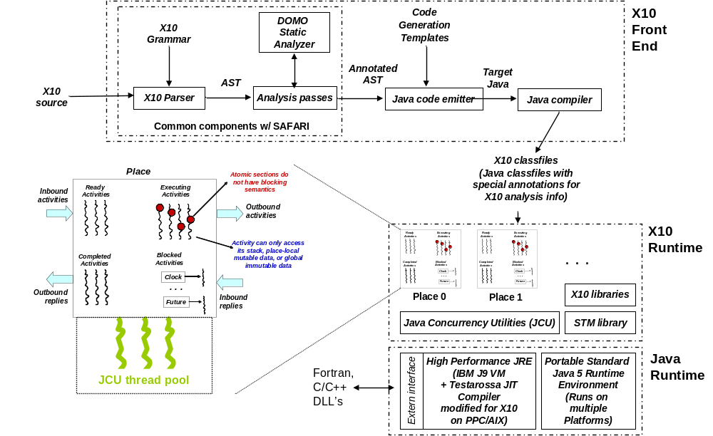
Single Node SMP X10 Implementation

Slide 27
Current Status 07/2006
09/03
Operational X10 implementation (since 02/2005)
PERCS Kickoff
02/04
X10 Kickoff
07/04
Code Templates
X10 Multithreaded RTS
X10 Grammar
X10 0.32 Spec Draft
Annotated AST
Target Java
Native code
AST
Parser
Analysis passes
Code emitter
JVM
X10 source
02/05
X10 Prototype #1
Structure
  Translator based on Polyglot (Java compiler framework)
  X10 extensions are modular.
  Uses Jikes parser generator.
Code metrics
  Parser: ~45/14K*
  Translator: ~112/9K
  RTS: ~190/10K – revised for JUC
  Polyglot base: ~517/80K
  Approx 280 test cases.
  (* classes+interfaces/LOC)
Program output
07/05
New features
  Dependent types (places, arrays)
  Better codegen.
  Implicit syntax support.
  More functionality for points, arrays.
X10 ProductivityStudy
12/05
X10 Prototype #2
09/06
Open Source Release

Slide 28
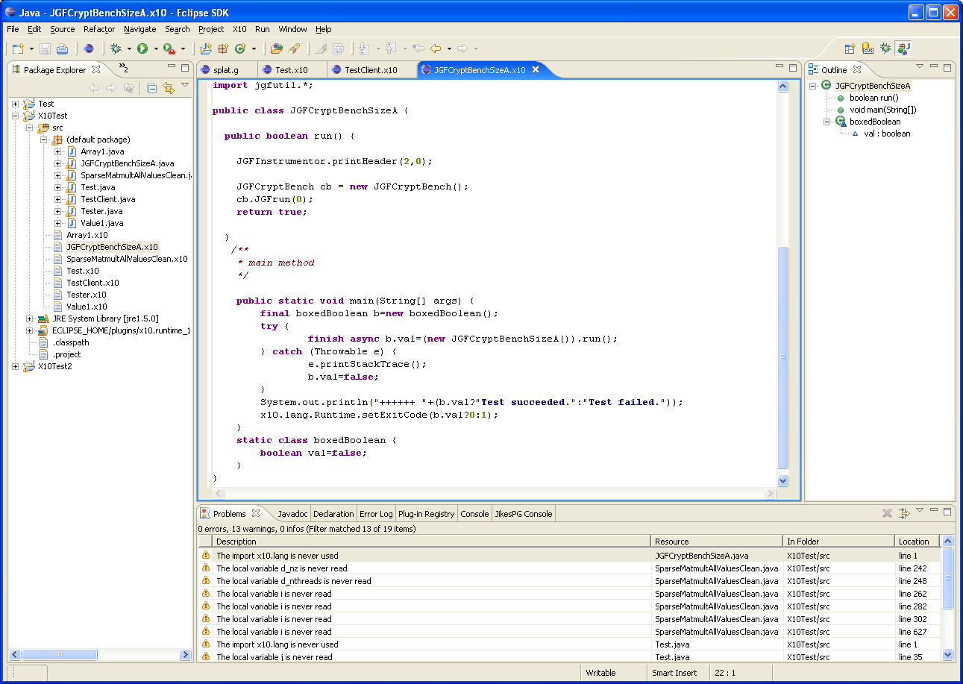
X10DT: Enhancing productivity
X10 Launch Configuration
Source editor w/ syntax
highlighting, auto indenting,
some content assist
Outline View populated w/
X10 types, members, loops
X10 Incremental Builder;
Problems View populated
w/ X10 compiler messages
Code editing
Refactoring
Code visualization
Data visualization
Debugging
Static performance analysis
Vision: State-of-the-art IDE for a modern OO language for HPC

Slide 29
X10 Applications/Benchmarks
Java Grande Forum
  OOPSLA Onwards! 2005 (IBM)
  Showed substantial (SLOC) benefit in serial -> parallel -> distributed transition for X10 vs Java (qua C-like language).
SSCA
  SSCA#1 (PSC study)
  SSCA#2 (Bader et al, UNM/GT)
  SSCA#3 (Rabbah, MIT)
Sweep3d
  Jim Browne (UT Austin)
NAS PB
  CG, MG (IBM)
  CG, FT, EP (Padua et al, UIUC)
  Cannon, LU variant (UIUC)
AMR (port from Titanium)
  In progress, IBM
SpecJBB
  In progress, Purdue
Measures: SLOC as a “stand in” + process measures.

Slide 30
Arrays

Slide 31
regions, distributions
Region
  a (multi-dimensional) set of indices
Distribution
  A mapping from indices to places
High level algebraic operations are provided on regions and distributions
region R = 0:100;
region R1 = [0:100, 0:200];
region RInner = [1:99, 1:199];
// a local distribution
dist D1=R-> here;
// a blocked distribution
dist D = block(R);
// union of two distributions
dist D = (0:1) -> P0 || (2:N) -> P1;
dist DBoundary = D – RInner;
Based on ZPL

Slide 32
arrays
Arrays may be
  Multidimensional
  Distributed
  Value types
  Initialized in parallel:
  int [D] A= new int[D]
  (point [i,j]) {return N*i+j;};
Array section
  A[RInner]
High level parallel array, reduction and span operators
  Highly parallel library implementation
  A-B (array subtraction)
  A.reduce(intArray.add,0)
  A.sum()

Slide 33
Ateach, foreach
ateach (point p : A) S
  Creates |region(A)| async statements
  Instance p of statement S is executed at the place where A[p] is located
foreach (point p : R) S
  Creates |R| async statements in parallel at current place
Termination of all activities can be ensured using finish.
public boolean run() {
dist D = dist.factory.block(TABLE_SIZE);
long[.] table = new long[D] (point [i]) { return i; }
long[.] RanStarts = new long[distribution.factory.unique()]
(point [i]) { return starts(i);};
long[.] SmallTable = new long value[TABLE_SIZE]
(point [i]){return i*S_TABLE_INIT;};
finish ateach (point [i] : RanStarts ) {
long ran = nextRandom(RanStarts[i]);
for (int count: 1:N_UPDATES_PER_PLACE) {
int J = f(ran);
long K = SmallTable[g(ran)];
async atomic table[J] ^= K;
ran = nextRandom(ran);
}}
return table.sum() == EXPECTED_RESULT;
}
ateach ( FormalParam: Expression ) Statement
foreach ( FormalParam: Expression ) Statement
Notes:
Allocate and initialize RanStarts with one random number seed for each place.
Allocate and initialize table as a block-distributed array.
Everywhere in parallel, repeatedly generate random table indices and atomically read/modify/write table element.
Allocate a small immutable table that can be copied to all places.

Slide 34
JGF Monte Carlo benchmark -- Sequential
double[] expectedReturnRate =
new double[nRunsMC];
//….
final ToInitAllTasks t = (ToInitAllTasks) initAllTasks;
for (point [i] : expectedReturnRate) {
PriceStock ps = new PriceStock();
ps.setInitAllTasks(t);
ps.setTask(tasks[i]);
ps.run();
ToResult r = (ToResult) ps.getResult();
expectedReturnRate[i] =
r.get_expectedReturnRate();
volatility[i] = r.get_volatility();
}
A tasks array (of size nRunsMC) is initialized withToTask instances at each index.
Task:
  Simulate stock trajectory,
  Compute expected rate of return and volatility,
  Report average expected rate of return and volatility.
Notes:
Problem
--------
Perform a MonteCarlo simulation nRunsMC time. A tasks array (of size nRunsMC) is initialized with
ToTask instances at each index. The task is to simulate the trajectory of a stock, and compute
its expected rate of return and volatility. The overall simulation reports the average
of the expected rate of return and volatility.
Parallelization
-----------------
Each task instance can be run in parallel, with the values of expected rate of
return and volatility placed in an array. The sequential version executes these
tasks (and computes the required metrics) in sequence. The parallel version
distributes the array into a single place and uses a finish/ateach to compute
each task in parallel. It uses a collective operation (sum) to compute the
average. The distributed version differs only in that the array is block distributed
across the given number of places.
Thus the change in code from sequential to parallel, and from parallel to distributed
is minimal (one line).

Slide 35
JGF Monte Carlo benchmark -- Parallel
dist D = [0:(nRunsMC-1)] -> here;
double[.] expectedReturnRate = new double[D];
//….
final ToInitAllTasks t = (ToInitAllTasks) initAllTasks;
finish foreach (point [i] : expectedReturnRate) {
PriceStock ps = new PriceStock();
ps.setInitAllTasks(t);
ps.setTask(tasks[i]);
ps.run();
ToResult r = (ToResult) ps.getResult();
expectedReturnRate[i] =
r.get_expectedReturnRate();
volatility[i] = r.get_volatility();
}
A tasks array (of size nRunsMC) is initialized withToTask instances at each index.
Task:
  Simulate stock trajectory,
  Compute expected rate of return and volatility,
  Report average expected rate of return and volatility.
Notes:
Problem
--------
Perform a MonteCarlo simulation nRunsMC time. A tasks array (of size nRunsMC) is initialized with
ToTask instances at each index. The task is to simulate the trajectory of a stock, and compute
its expected rate of return and volatility. The overall simulation reports the average
of the expected rate of return and volatility.
Parallelization
-----------------
Each task instance can be run in parallel, with the values of expected rate of
return and volatility placed in an array. The sequential version executes these
tasks (and computes the required metrics) in sequence. The parallel version
distributes the array into a single place and uses a finish/ateach to compute
each task in parallel. It uses a collective operation (sum) to compute the
average. The distributed version differs only in that the array is block distributed
across the given number of places.
Thus the change in code from sequential to parallel, and from parallel to distributed
is minimal (one line).

Slide 36
JGF Monte Carlo benchmark -- Distributed
dist D = dist.factory.block([0:(nRunsMC-1)]);
double[.] expectedReturnRate = new double[D];
//….
final ToInitAllTasks t = (ToInitAllTasks) initAllTasks;
finish ateach (point [i] : expectedReturnRate) {
PriceStock ps = new PriceStock();
ps.setInitAllTasks(t);
ps.setTask(tasks[i]);
ps.run();
ToResult r = (ToResult) ps.getResult();
expectedReturnRate[i] =
r.get_expectedReturnRate();
volatility[i] = r.get_volatility();
}
A tasks array (of size nRunsMC) is initialized withToTask instances at each index.
Task:
  Simulate stock trajectory,
  Compute expected rate of return and volatility,
  Report average expected rate of return and volatility.
Notes:
Problem
--------
Perform a MonteCarlo simulation nRunsMC time. A tasks array (of size nRunsMC) is initialized with
ToTask instances at each index. The task is to simulate the trajectory of a stock, and compute
its expected rate of return and volatility. The overall simulation reports the average
of the expected rate of return and volatility.
Parallelization
-----------------
Each task instance can be run in parallel, with the values of expected rate of
return and volatility placed in an array. The sequential version executes these
tasks (and computes the required metrics) in sequence. The parallel version
distributes the array into a single place and uses a finish/ateach to compute
each task in parallel. It uses a collective operation (sum) to compute the
average. The distributed version differs only in that the array is block distributed
across the given number of places.
Thus the change in code from sequential to parallel, and from parallel to distributed
is minimal (one line).

Slide 37
RandomAccess
public boolean run() {
dist D = dist.factory.block(TABLE_SIZE);
long[.] table = new long[D] (point [i]) { return i; }
long[.] RanStarts = new long[dist.factory.unique()]
(point [i]) { return starts(i);};
long[.] SmallTable = new long value[TABLE_SIZE]
(point [i]) {return i*S_TABLE_INIT;};
finish ateach (point [i] : RanStarts ) {
long ran = nextRandom(RanStarts[i]);
for (int count: 1:N_UPDATES_PER_PLACE) {
int J = f(ran);
long K = SmallTable[g(ran)];
async atomic table[J] ^= K;
ran = nextRandom(ran);
}
}
return table.sum() == EXPECTED_RESULT;
}
Allocate and initialize table as a block-distributed array.
Allocate and initialize RanStarts with one random number seed for each place.
Allocate a small immutable table that can be copied to all places.
Everywhere in parallel, repeatedly generate random table indices and atomically read/modify/write table element.

Slide 38
Jacobi

Slide 39
Advanced topics

Slide 40
Dependent types
Class or interface that is a function of values.
Programmer specifies properties of a type – public final instance fields.
Programmer may specify refinement types as predicates on properties
  T(v₁,…,v_{n} : c)
  all instances of t with the values f_{i}==v_{i} satisfying c.
  c is a boolean expression over predefined predicates.
public class List( int(: n >=0) n) {
this(:n>0) Object value;
this(:n>0) List(n-1) tail;
List(t.n+1) (Object o, List t) {
n=t.n+1; tail=t;value=o;}
List(0) () { n = 0; }
this(0) List(l.n) a(List l) {
return l; }
this(:n>0) List(n+l.n) a(List l) {
return new List(value, tail.append(l));
}
List(n+l.n) append(List l) {
return n==0?
this(0).a(l) : this(:n>0) .a(l);
}
….

Slide 41
Place types
Every X10 reference inherits the property (place loc) from X10RefClass.
The following types are permitted:
  Foo@? ➔ Foo
  Foo ➔ Foo(: loc == here)
  Foo@x ➔ Foo(: loc == x.loc)
Place types are checked by place-shifting operators (async, future).
class Tree (boolean ll) {
nullable<Tree>(:this.ll =>
(ll& loc==here))@? left;
nullable<Tree> right;
int node;
Tree(l) (final boolean l,
nullable<Tree>(:l =>
(ll&loc==here))@? left,
nullable<Tree> right,
int s) {
ll=l; this.left=left; this.right=right;
node=s;
}
…
}

Slide 42
Region and distribution types
abstract value class point (nat rank) {
type nat = int(: self >= 0) ;
abstract static value class factory {
abstract point(val.length) point(final int[] val);
abstract point(1) point(int v1);
abstract point(2) point(int v1, int v2);
… }
…
point(rank) (nat rank) { this.rank = rank; }
abstract int get( nat(: i <= n) n);
abstract boolean onUpperBoundary(region r,
nat(:i <= r.rank) i);
abstract public boolean onLowerBoundary(region r,
nat(:i <= r.rank) i);
abstract boolean gt( point(rank) p);
abstract boolean lt( point(rank) p);
abstract point(rank) mul( point(rank) p);
…
class point( nat rank ) { ...}
class region( nat rank, boolean rect,
boolean lowZero ) { … }
class dist(nat rank, boolean rect,
boolean lowZero,
region(rank,rect,lowZero) region,
boolean local, boolean safe ) { … }
class Array<T>( nat rank, boolean rect,
boolean lowZero,
region(rank,rect,lowZero) region,
boolean local, boolean safe,
boolean(:self==(this.rank==1)&rect&lowZero&local)
rail,
dist(rank, rect, lowZero, region,local,safe) dist
) { ...}
…
Dependent types statically express many important relationships between data.

Slide 43
Implicit syntax
Use conventional syntax for operations on values of remote type:
x.f = e //write x.f of type T
➔ final T v = e;
finish async(x.loc) {
x.f=v;
}
… = …x.f …//read x.f of type T
➔ future<T>(x.loc){x.f}.force()
Similarly for array reads and writes.
Invoke a method synchronously on values of remote type
e.m(e1,…,en);
➔
final T v = e;
final T1 v1 = e1;
…
final Tn vn = en;
finish async (v.loc) {
v.m(v1,…,vn);
}
Similarly for methods returning values.

Slide 44
Tiled regions
Tiled region (TR) is a region or an array (indexed by a region) of tiled regions.
Tiled region is a tree with leaves labeled with regions.
  TR depth = depth of tree
  TR uniform = all leaves at same depth
  Tile = region labeling a leaf
  Orthogonal TR = tiles do not overlap
  Convex TR = each tile is convex.
A tiled region provides natural structure for distribution.
region(2) R = [1:N*K];
region(1:rect)[] S =
new region[[1:K]]
(point [i]){[(i-1)*N+1:I*N]};
region[] S1 = new region[]
{[1:N],[N+1:2*N]};
Examples:
  Blocked, cyclic, block cyclic
  Arbitrary, irregular cutsets
User defined distributions

Slide 45
Future Plans
X10 API in C, Java
  X10 Core Library
    asyncs, future, finish, atomic, clocks, remote references
  X10 Global Structures Library
    Arrays, points, regions, distributions
Optimized SMP imp
  Locality-aware
  Good single-thread perf.
  Efficient inter-language calls
Annotations
  Externalized AST representation for source to source transformations.
  Meta-language for programmers to specify their own annotations and transformations
SAFARI
  Support for annotations.
  Support for refactorings
Application development

Slide 46
HPC Landscape: 20K view
Our view!
 | MPI + C/Fortran | C.OMP | ZPL | CAF | UPC | Ti | X10 | HPL 2010?
Convenient? | X+ | √ | √? | √− | √− | √− | √? | √+
Global view? | X | X | √ | √ | √ | √ | √ | √+
Object-oriented? | X | X | X | X | X | √ | √ | √+
Strong-typing? | √? | X | √? | √? | X | √ | √+ | √+
Exceptions? | X | X | X | X | X | √ | √+ | √+
Managed Runtime? | X | X | X | X | X | √− | √+ | √+
Productivity
Perf Transparency | √ | √ | √ | √ | √ | √ | √? | √+
Perf Portability | √ | X | √ | √ | √? | √ | √? | √+
Perf Scalability | √ | X | √ | √ | √ | √? | √? | √+
Perf
Data-structures? | X | √ | X | X | √ | √ | √+ | √+
Explicit parallelism? | √ | √ | X | √ | √ | √ | √+ | √+
Task parallelism? | X | √ |  | X | X | X | √+ | √+
Fork-join parallelism? |  | √ |  |  |  |  | √+ | √+
Expr.

