Slide 1
Design and Implementation of the
J-SEAL2 Mobile Agent System
Walter Binder
CoCo Software Engineering GmbH
E-mail: w.binder@coco.co.at

Slide 2
Mobile Agent Systems
requirements for commercial applications
  security
  portability
  good performance and scalability
system structure: core ~ OS kernel
  protection domains (cp. OS processes)
  communication (cp. OS IPC)
  domain termination, resource reclamation
  resource control (e.g., memory, CPU time)

Slide 3
Java for Mobile Agent Systems
portable code
language safety
  byte-code verification
  type safety
  garbage collector
  memory protection
multithreading
serialization
namespaces
availability
no protection domains
uncontrolled aliasing
no ownership information in objects
covert channels in the JDK (public static variables)
no resource control, single heap

Slide 4
J-SEAL2 Features
secure mobile agent platform
based on formal model (SEAL Calculus)
redesign of JavaSeal (OSG)
micro-kernel design
portable (pure Java)
small kernel (~100KB)
flexible and extensible
good performance

Slide 5
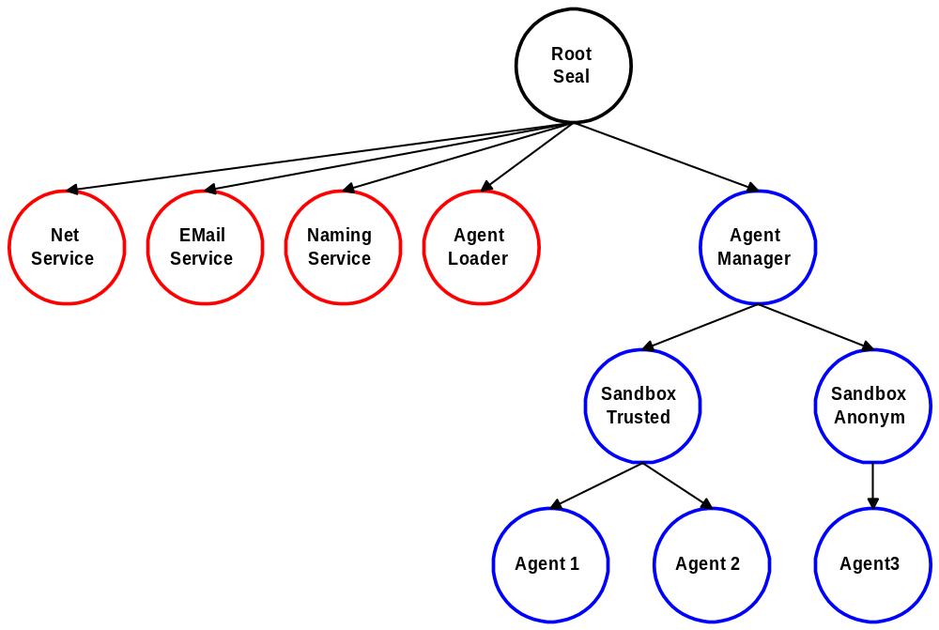
J-SEAL2 System Structure

Slide 6
Protection
hierarchical protection domains
  separate class-loader
  classes
  threads
  objects
  kernel state (e.g., communication queues)
domain isolation: no direct sharing
extended byte-code verification restricts access to shared JDK classes
startup performance ~ 125 agents / sec. (400MHz PII, JDK 1.3 Hotspot Client VM)

Slide 7
Communication
channels
  deep copy
  only between neighbors
  synchronous send/receive (SEAL Calculus)
  timeouts
  asynchronous send
external references
  indirect sharing
  cross-domain method invocation
  basis for efficient high-level protocols

Slide 8
Domain Termination
immediate resource reclamation
  termination of all threads in domain
  invalidation of external references
consistency of JVM and kernel
  atomic kernel operations
  VM operations only in kernel (class-loading!)
code restrictions
  no finalizers
  no catching of ThreadDeath (byte-code rewriting)

Slide 9
Kernel Mode
atomic operations
multiple reader / single writer lock
  domain termination: write lock
  other kernel primitives: read lock
asynchronous class-loading
  requires read lock
  avoid deadlocks
  keep track of threads in kernel-mode

Slide 10
Structure of Kernel Operations
boolean excl = …; // true or false
Kernel.lock(excl);
// now executing in kernel mode
try {
// allocate all objects (worst case)
…
// update kernel state
…
}
finally {
Kernel.unlock(excl);
}
// now back in user mode

Slide 11
Resource Control
prevent denial of service attacks
physical resources
  memory
  CPU time
  network bandwidth
logical resources
  threads
  seals

Slide 12
Model (1)
reflects seal hierarchy
generalization of CPU Inheritance Scheduling (Fluke)
startup - root domain owns all resources
  100% CPU time
  no memory limit
subdomain creation
  parent may donate resources to child
  parent may share resources with child

Slide 13
Model (2)
CPU
80%
share
MEM
∞
20%
10MB
20MB
CPU
5%
MEM
10MB
5%
MEM
12MB
10%
CPU
5%
share
8MB
CPU
10%
MEM
8MB

Slide 14
Implementation
accountability (every object belongs to exactly 1 domain; no direct sharing)
byte-code rewriting
  memory: check before allocation
  CPU: count byte-code instructions
compensate for native code
  class-loading
  deserialization (message opening)
  object cloning

Slide 15
Future Implementations
fixed J-SEAL2 API
different implementations
  portable, byte-code rewriting
  on top of RTJ
  optimized SEAL-VM
    optimized resource control
    thread segments for external reference method invocation (cp. Spring Nucleus)
    avoid unnecessary verification
    remove Java security architecture (stack introspection)

Slide 16
Summary
mobile agent systems require OS structure
  protection domains
  mediated communication
  safe domain termination (resource reclamation)
  resource control
J-SEAL2
  strong security model
  OS structure
  portability
  good performance

