Slide 1
Mobile Code Protection with Smartcards
Sergio Loureiro, Refik Molva
Institut Eurecom, Sophia Antipolis, France
ECOOP Workshop on Mobile Object Systems
June 2000

Slide 2
Outline
Privacy of execution
Computing with encrypted functions (prior work)
Solution using smartcards
Analysis

Slide 3
Computing with Encrypted Functions
Sander & Tschudin ‘98
Solution for polynomials and rational functions
Source
Host
T
r
a
n
s
f
o
r
m
f
E(f)
E(f)
x
key
f(x)
D
[E(f)](x)
[E(f)](x)

Slide 4
Solution based on Error Correcting Codes
Loureiro & Molva ‘99
Solution for matrices and combinational circuits
Source
Host
T
r
a
n
s
f
o
r
m
F
FGP+E
F’
x
Keys:
Code G
Permutation P
y=x.F
Decoder
y’=x.F’

Slide 5
Computing with Encrypted Functions
Limitations
  Rudimentary models
  One step execution
  No integrity of execution
Tamper Proof Hardware (TPH)

Slide 6
Smartcard Aided Protection
Source
delegation
T
r
a
n
s
f
o
r
m
TPH
V
f
f(x)
E(f)
E(f)
Host
key
x
f(x)
D
[E(f)](x)
[E(f)](x)

Slide 7
Smartcard Aided Protection
Multi-step execution requirements
  Retrieval of cleartext result must be less complex than f
  Disclosure of cleartext result should not weaken the privacy of E(f)
Integrity verification must not be complex

Slide 8
Function f
Set of sequential circuits
Execution on different processors / processes / threads
c1
c5
c8
c9
c2
c3
c6
c10
c4
c7

Slide 9
Smartcard Aided Protection - Solution
Code
Source
delegation
T
r
a
n
s
f
o
r
m
TPH
e
c
(c’(x),x)
c(x)
c’
c’
Host
key
x
c(x)
D
c’(x)
c’(x)

Slide 10
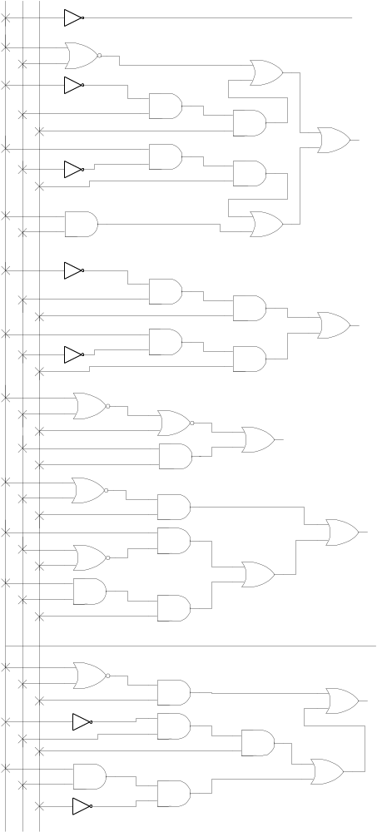
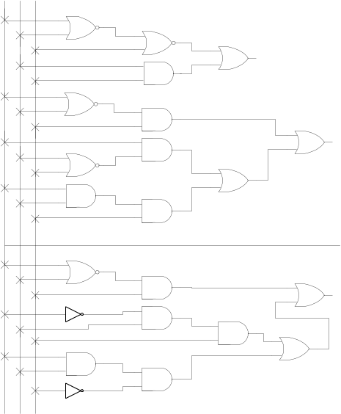
Example: combinational boolean circuits
linear code [7,4]
3 inputs / 4 outputs 3 inputs / 7 outputs

Slide 11
Smartcard Aided Protection - Solution
New features
  Multi-step
  Cleartext output at the remote host
  Integrity
Characteristics
  Linear circuit expansion from c to c’
    Same number of inputs
  Circuit e small compared with c
  Efficient decoding in the smartcard
  Efficient integrity verification in the smartcard

Slide 12
Security Evaluation
Privacy of execution
  Relies on composition of functions - many possible combinations
Integrity of execution
  Hard to find valid pairs (c’(x),x)
Giving result back
  Interpolation of c is possible with enough pairs
  Circuit e protects secrets stored in the TPH

Slide 13
Comparison with Related Work
vs obfuscation
  Pros
    Possible to quantify security
    Encrypted result
    Even if it is not possible to understand the code, encrypted result prevents:
    - re-execution and selection of the best result attacks
    - interpolation attacks aiming at reverse-engineering
  Cons
    Model - Powerful but not as flexible as a full fledged programming language
vs other smartcard based solutions
  The ‘bulk’ of the protected function is executed on the untrusted host

Slide 14
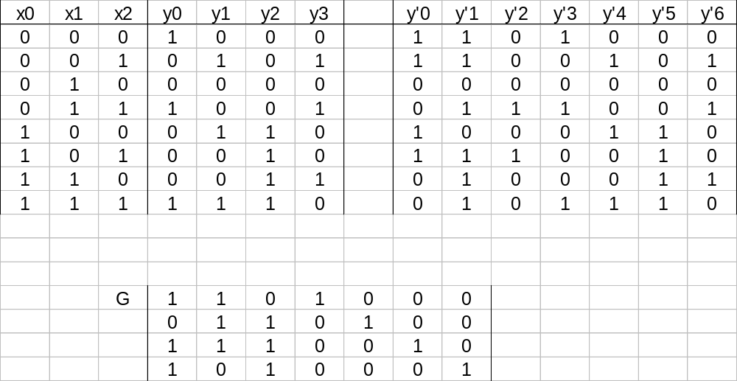
Example: combinational boolean circuits

