Slide 1
Scalable and Secure Name Services for Mobile Agents
Volker Roth
Fraunhofer IGD

Slide 2
Name services, what for?
Cooperation among agents requires coordination, and coordination requires communication.
Transparency of location requires transparent message passing between agents.
Controlling agents requires locating agents.
Analysis of travel patterns requires traces.

Slide 3
Scalability Issues
Name service updates must be fast. Huge update rates are to be expected.
Load must be distributed among a sufficient number of name servers.
The number of name servers must be increased gradually with rising demand.
An unambiguous mapping from agents to name servers must be established
Heavyweight cryptographic protocols should be avoided for the sake of efficiency.

Slide 4
Layered Services
Communication,
Control, Trace, Debug
Message
passing
Name Services

Slide 5
Established Name Services
DNS (Domain Name System)
  Tree must be traversed from root node.
  Scalability comes by replication and caching.
NIS, NIS+ (Network Information System)
  Central repository, does not scale.
Directory Services (NetInfo, LDAP,...)
  Distributed Databases, address different application domain.

Slide 6
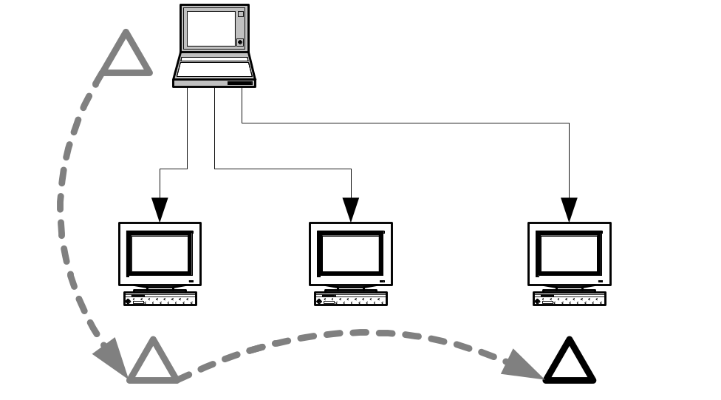
Searching
Inquirer probes potential hosts for a specific agent.
Heuristics can improve success rate.
All inquirers need to have advance knowledge on the agent’s itinerary.
Limited applicability

Slide 7
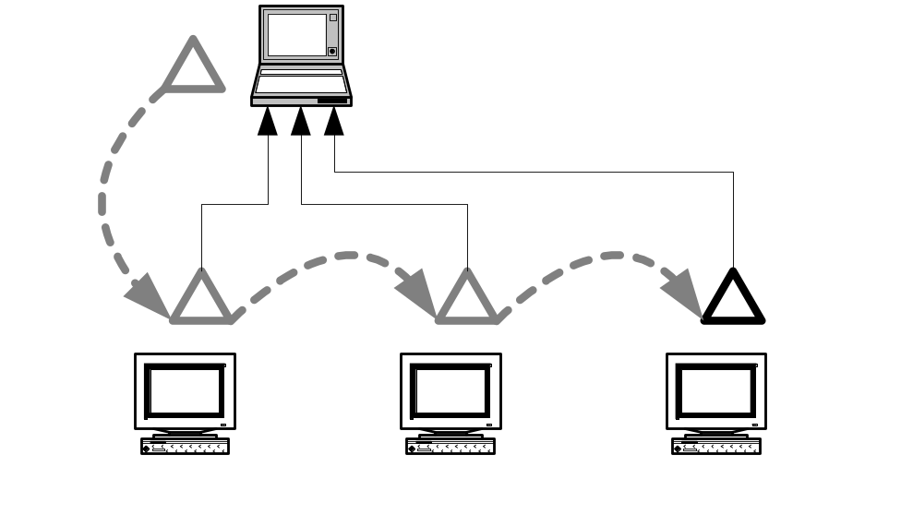
Direct Response
Agents report new locations back to their origin (base).
Base must be online.
Base implicitly reveals information on the agent owner.

Slide 8
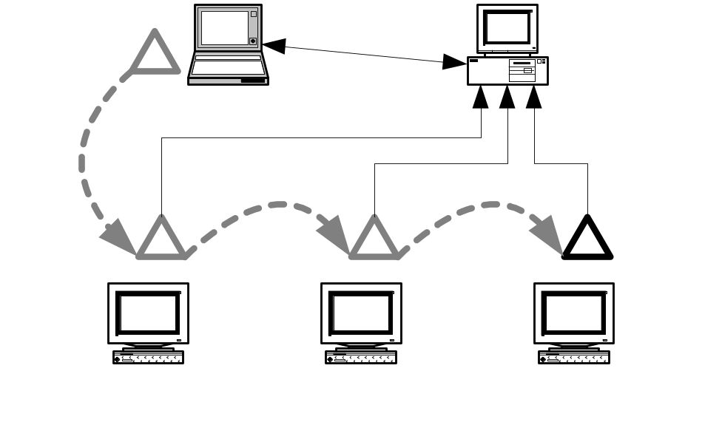
Buffered Response
“Name Server” per se.
Base must not be online.
Name server is omnipotent.
Trust in name server is required.

Slide 9
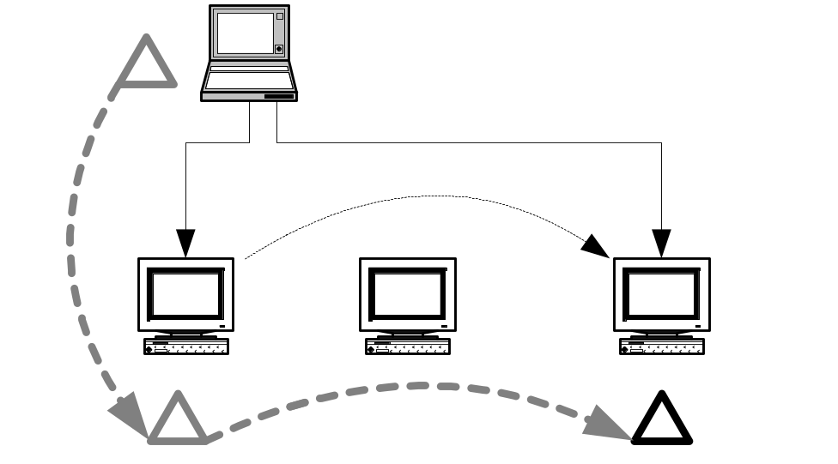
Forward References
Chain of references pointing from one hop to the next.
Local knowledge.
Validity period of chain links is uncertain.
Chain is broken easily.
Cycles must be avoided.

Slide 10
Principal Name Servers
Model
Active
Name server
Forward references
Requester
Agent origin
Direct response
Agent
Agent origin
Buffered response
Agent, requester
Dedicated server
Searching
Requester
None

Slide 11
Buffered Response vs. Forward References
Advantages depend on number of agents vs. number of inquirers.
Progressive collapsing of reference chains eliminates advantages compared to buffered response.
Model
updates
lookup
storage
Buffered response
a⋅n
c
a
Forward references
0
c⋅n
a⋅n
a - agents, n - |itinerary|, c - inquirers

Slide 12
Name service threats
Distributed co-ordinated attacks.
Impersonation, re-routing, and eavesdropping.
Name grabbing and DoS.
Tracking single agents.
Profile generation.

Slide 13
(1) Distributed Co-ordinated Attack
Mallet registers a huge number of chosen agent names with Nick which all point to the agent server of Bob. Mallet uses names likely to be used also by Alice and her friends. Therefor Carol and her friends all over the world all innocently send messages to Bob’s server which chokes under the sudden load.

Slide 14
(2) Impersonation and re-routing
Mallet asks Nick to make an entry with the name of Alice’s agent. When Carol asks for the location of Alice’s agent, Nick points to Mallet’s server. So Carol sends her message to Mallet who reads it.
Illicit updates of name server entries must be prevented.

Slide 15
(3) Name grabbing and DoS
When Alice tries to register her agent with Nick, he tells her that the name is already allocated to Mallet’s agent. Alice has to choose another name.
Mallet must not be able to guess or forge agent names.

Slide 16
(4) Tracking single agents
Mallot finds out the name of Alice’s agent. He constantly asks Nick for the new location of that agent and learns where it goes. From this information, Mallet infers Alice’s preferences.
Problem: perfectly legal use can hardly be distinguished from illicit use.

Slide 17
(5) Profile Generation
Mallet opens up a name service; over time he finds out lots of interesting things about Alice and her friends. He sells this information to others.
Alice should not reveal which agents are hers.

Slide 18
Explicit agent names
Sig_{A}(“Alice”, name_{X}, “Nick”)
Explicit names must be authenticated.
A PKI is required which causes considerable overhead.
Agent owners can be tracked across agents.
Anonymity is hard to achieve, pseudonyms must be changed frequently.
This incurs costs (buy new certificates)

Slide 19
Implicit agent names
Static part of agent:
signed by its owner,
contains owner’s ID,
contains random seed.
H
1
0
0
1
0
1
0
1
...
0
1
0
Name server ID
Agent unique ID
Agent names cannot be guessed nor forged.
(depends on seed and strength of hash function)
Agents cannot impersonate other agents.

Slide 20
Agent hand-over
Nick
(name_{x}, r_{i+2}), r_{i+1}
(name_{x}, r_{i+1}), r_{i}
Host_{i}
x
Host_{i+1}

Slide 21
Agent hand-over
Mallet
y
(name_{x}, r_{i+1}), r_{i}
(name_{x}, 0), r_{i+1}
Host_{i}
x
Alice
Final updates and name server entry removal should be
anonymized by means of relaying the message through
a proxy agent.

Slide 22
Choice of name servers
Chances to find one of k “good” servers among m servers after s tries are:
1-((m-k)/m)^{s}
1% acceptable, 230 tries, probability 0.9, 4 seconds, Pentium II, 400MHz, 10K

Slide 23
Conclusions
Application-level DoS attack possible
Simple and efficient protocol
No complicated cryptographic operations
Easy to implement
Scales well
Preserves anonymity of agent owners
Prevents linking of an owner’s agents

