Slide 1
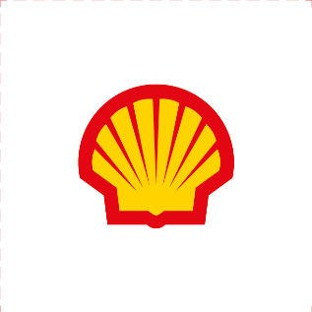

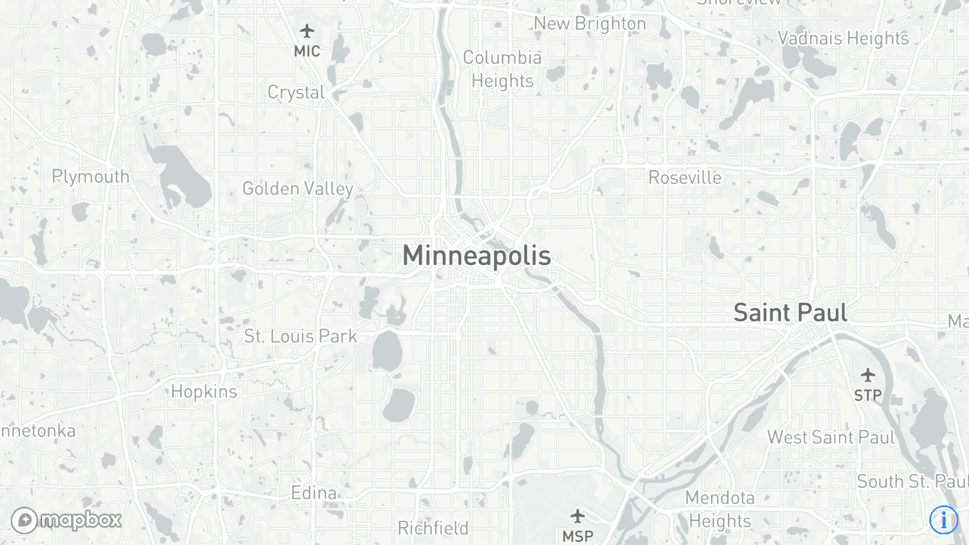




CO2 Footprint Tool
123
tons CO2 emission / month
12
€ energy cost / month
123
m3 / month
796
employees
Popup explanation
Energy
2315
kWh/ month
13
kW of installed solar PV
Option Select

