Slide 1
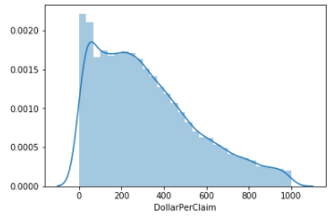
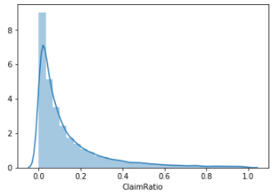
Claims AI Scoring Analytics
Input Variables
DollarPerClaim ($/claim)
DollarPerSale ($/sale)
#Sales
#Claims
ClaimRatio = $Claim/$Sale
Modeling
Output
Claim Score per customer
1
Score
Heuristic
Rank ordering
Mathematical models
Adaptive (Neural Nets, Genetic Algorithms, Fuzzy…)
0
Claim

Slide 2
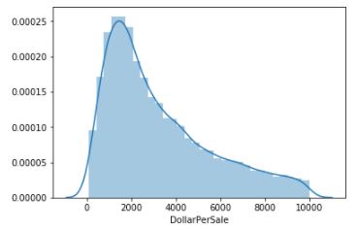
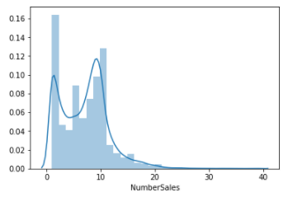
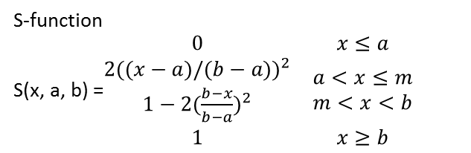
S-shaped function for sales
S-function
S(x, a, b) =$\begin{matrix}0 & x≤a \\ \begin{aligned}2{((x−a)/(b−a))}^{2} \\ 1−2{(\frac{b−x}{b−a})}^{2}\end{aligned} & \begin{aligned}a<x≤m \\ m<x<b\end{aligned} \\ 1 & x≥b\end{matrix}$
High
1
Definitely a desirable customer,
e.g., µ > 0.95
$/Sale
Continuous membership function for SALE
Or sign function
f(x) = 1/(1+exp(-x))
Degree of membership, µ
Lower bound
Upper bound
Definitely a blacklist customer,
e.g., µ < 0.3
#Sale
0
Low
a =Lower bound
m = (a+b)/2
b=Upper bound
Variables:
$/Sale
#Sale
Lower bound
Upper bound

Slide 3

Z-shaped function for claims
$/Claim
High
1
Definitely a desirable customer,
e.g., µ > 0.95
Lower bound
Upper bound
Z-function
Z(x, a, b) =$\begin{matrix}1 & x≤a \\ \begin{aligned}1−2{(\frac{x−a}{b−a})}^{2} \\ 2{(\frac{b−x}{b−a})}^{2}\end{aligned} & \begin{aligned}a<x≤m \\ m<x<b\end{aligned} \\ 0 & x≥b\end{matrix}$
#Claims
Or sign function
f(x) = 1-1/(1+exp(-x))
Degree of membership, µ
Lower bound
Upper bound
Definitely a blacklist customer,
e.g., µ < 0.3
0
$Claims/$Sale
Low
Variables:
$/Claim
#Claim
$Claim/$Sale
Upper bound
a=Lower bound
m = (a+b)/2
b = Upper bound
Lower bound

Slide 4
Aggregate Membership functions for claims scoring
High
High
1
Definitely a desirable customer,
e.g., µ > 0.95
Continuous membership function for each input
Membership functions of different input variables are aggregated by using the minimum operator to yield a total claim score (output)
Degree of membership, µ
Definitely a blacklist customer,
e.g., µ < 0.3
0
Low
Low
Lower bound
Upper bound
All variables

Slide 5
Example: Aggregate for claims scoring
1
Input 1
0.65
Degree of membership, µ
1
0
Min(0.65, 0.72)
0.65
Claim
1
Input 2
0.72
0
Degree of membership, µ
0
Claim

